Slide 1

Watson
Discovery

Slide 2
Discovery Hands On
1.) Create instance of the service
Login to IBM Cloud. Go to Catalog. Select Watson under Platform. Then Select Discovery.
Give a service name, select region, org and space. Then click Create.
2.) Copy the credentials to authenticate your service instance.
From your project in the Developer Console, add a new credential, give a credential name then click on Add. Copy the username, password, and url values from the credential you created.

Slide 3
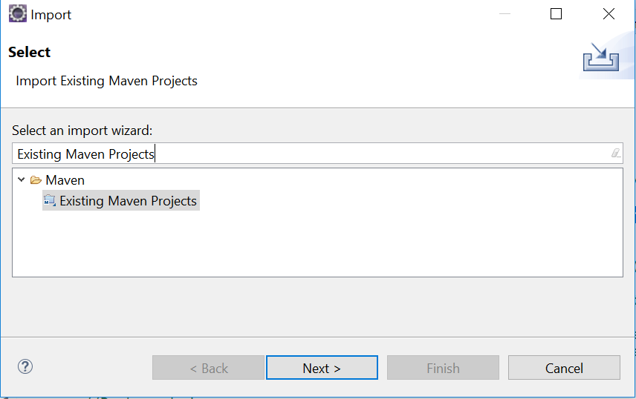
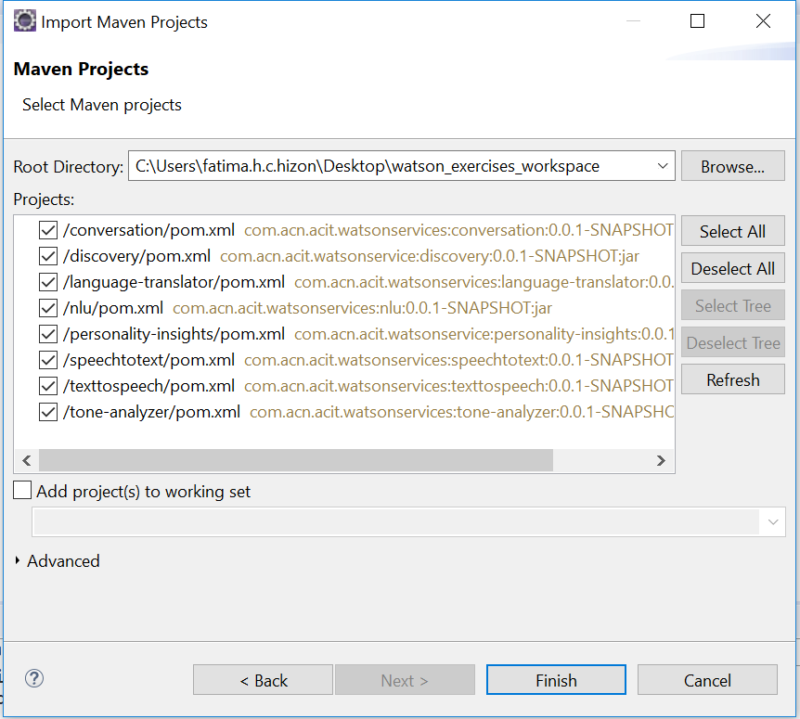
Discovery Hands On
3.) Clone and open project in eclipse the project: git clone https://github.com/pdcacit/discovery
Open project in eclipse: File > Import > Type in search box: Existing Maven Projects
Browse on your project directory / workspace > Select all projects > Click on finish

Slide 4

Discovery Hands On
4.) Configure Watson Discovery using the launch tool
From the Dashboard, Select your discovery service > Manage > Launch tool
Create environment: Click icon and choose create environment.
Create collection: Click on create data collection > Enter collection name > Default Configuration > Select language: English
Download sample documents (test-doc1.html, test-doc2.html, test-doc3.html, test-doc4.html) and put it in your project folder
Upload your documents.

Slide 5
Discovery Hands On - https://console.bluemix.net/docs/services/discovery/getting-started-tool.html#getting-started-with-the-tooling
QUERY USING THE TOOL:
Click on build queries > Choose a collection to query > Select your collection > Get Started. Filter which document to query > Enter field, operation and value > Run the query.
To search for results with entities named "IBM": Click Field and select enriched_text.entities.text. Select contains for Operator and IBM for Value. The query enriched_text.entities.text:IBM is displayed in Visual Query Builder. Click Run Query. The query returns 4 results.
To search for results with entities named "Watson": Click Field and select enriched_text.entities.text. Select contains for Operator and watson for Value. The query enriched_text.entities.text:watson is displayed in Visual Query Builder. Click Run Query. The query returns 2 results.
To search for results with both entities named "Watson" and "Slack": Click Field and select enriched_text.entities.text. Select contains for Operator and watson for Value. Click Add rule, then repeat your selections, but choose the Value of Slack. The query enriched_text.entities.text:watson,enriched_text.entities.text:Slack is displayed in Visual Query Builder. Click Run Query. The query returns 1 result.

Slide 6
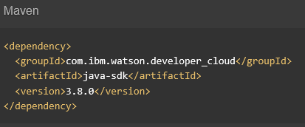

Discovery Hands On
QUERY USING API
5.) Go to the API Reference: https://www.ibm.com/watson/developercloud/discovery/api/v1/
6.) Copy Maven dependency in pom.xml, Then update the pom dependency: Right click on project > Maven > Update Project
7.) On the api website > Click Query your collection profile under Queries

Slide 7
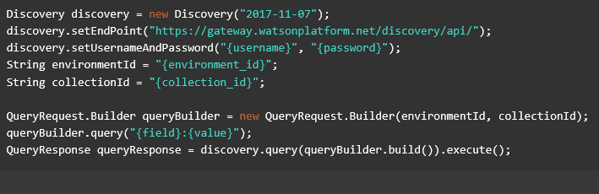
Discovery Hands On
8.) Copy the code in the main method:

Slide 8
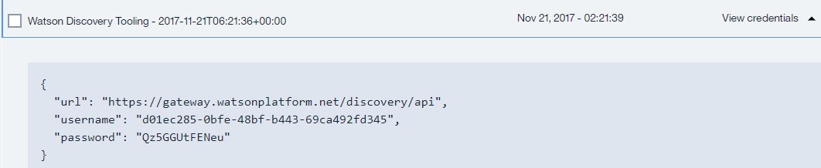
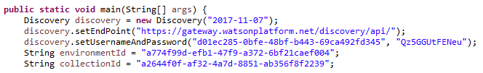
Discovery Hands On
9.) Import all necessary libraries
10.) Copy and change the username, password based on the discovery service credentials.
Sample credentials:
11.) Right click on your project then run as java application.

Slide 9
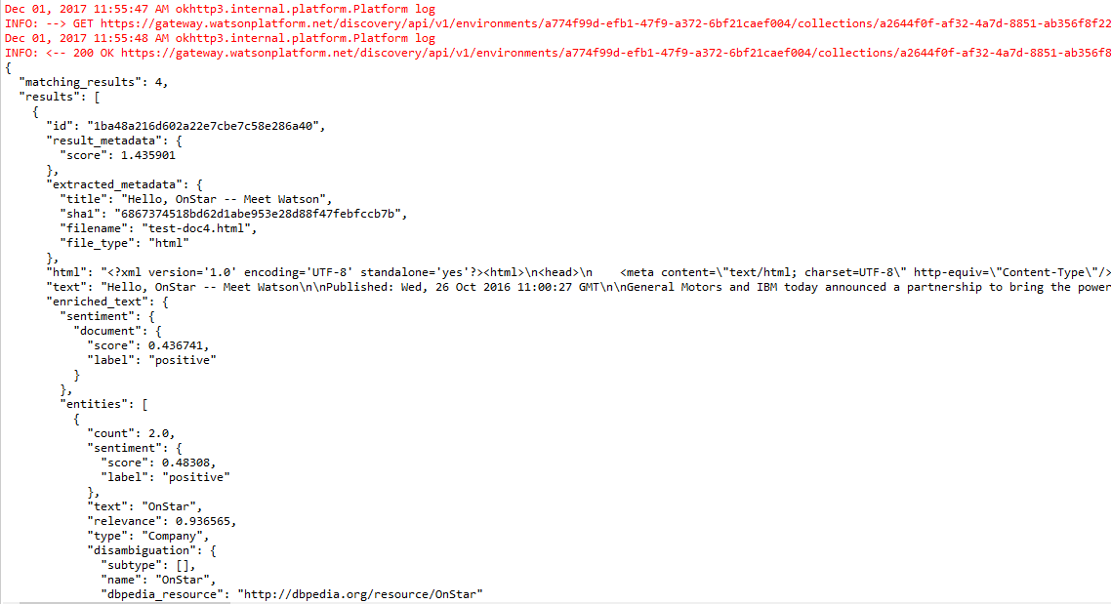
Discovery Hands On
Sample result:
Console:

Slide 10
Discovery References
About Discovery:
https://console.bluemix.net/docs/services/discovery/index.html#about
Getting Started Tutorial:
https://console.bluemix.net/docs/services/discovery/getting-started-tool.html#getting-started-with-the-tooling
API:
https://www.ibm.com/watson/developercloud/discovery/api/v1/

