Slide 1

Watson
Language
Translator

Slide 2
Language Translator Hands On
1.) Create instance of the service
Login to IBM Cloud. Go to Catalog. Select Watson under Platform. Then Select Language Translator.
Give a service name, select region, org and space. Then click Create.
2.) Copy the credentials to authenticate your service instance.
From your project in the Developer Console, add a new credential, give a credential name then click on Add. Copy the username, password, and url values from the credential you created.

Slide 3
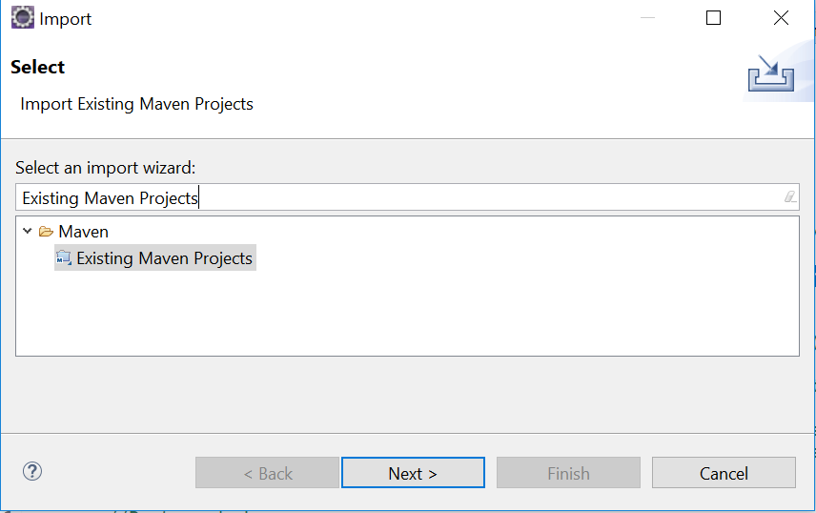
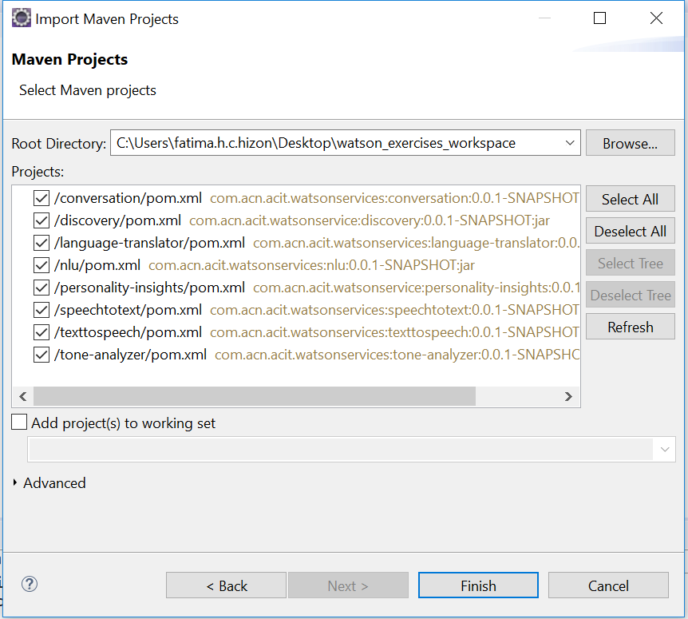
Language Translator Hands On
3.) Clone and open project in eclipse the project: git clone https://github.com/pdcacit/language-translator
Open project in eclipse: File > Import > Type in search box: Existing Maven Projects
Browse on your project directory / workspace > Select all projects > Click on finish

Slide 4
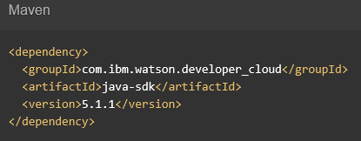

Language Translator Hands On
4.) Go to the API Reference: https://www.ibm.com/watson/developercloud/language-translator/api/v2/
5.) Copy Maven dependency in pom.xml, Then update the pom dependency: Right click on project > Maven > Update Project
6.) On the api website > Click Translate audio under Methods

Slide 5
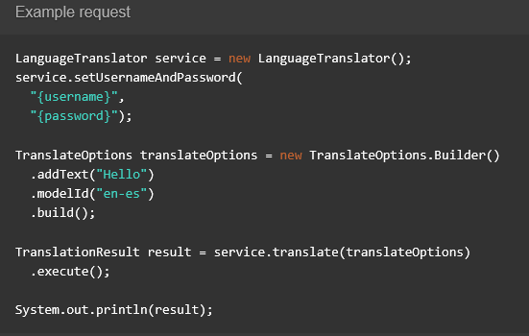
Language Translator Hands On
7.) Copy the code in the main method:

Slide 6
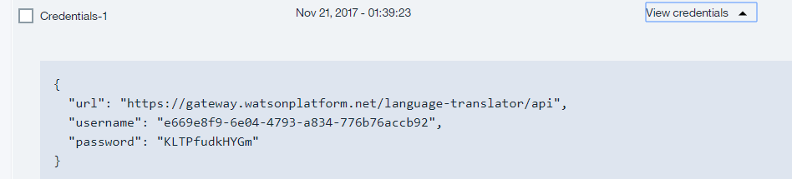

Language Translator Hands On
8.) Import all necessary libraries
9.) Copy and change the username, password based on your language translator service credentials.
Sample credentials:
10,) Right click on your project then run as java application.

Slide 7
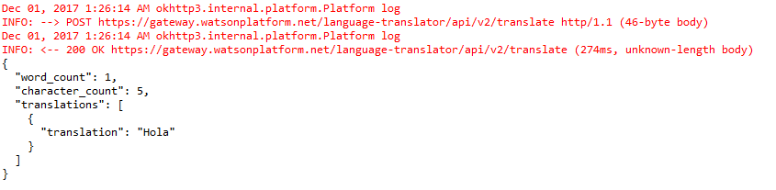
Language Translator Hands On
Sample result:
Console:

Slide 8
Language Translator References
About Language Translator:
https://console.bluemix.net/docs/services/language-translator/index.html#about
Getting Started Tutorial:
https://console.bluemix.net/docs/services/language-translator/getting-started.html#gettingstarted
API:
https://www.ibm.com/watson/developercloud/language-translator/api/v2/

