Slide 1

Watson
NLU

Slide 2
NLU Hands On
1.) Create instance of the service
Login to IBM Cloud. Go to Catalog. Select Watson under Platform. Then Select Tone Analyzer.
Give a service name, select region, org and space. Then click Create.
2.) Copy the credentials to authenticate your service instance.
From your project in the Developer Console, add a new credential, give a credential name then click on Add. Copy the username, password, and url values from the credential you created.

Slide 3
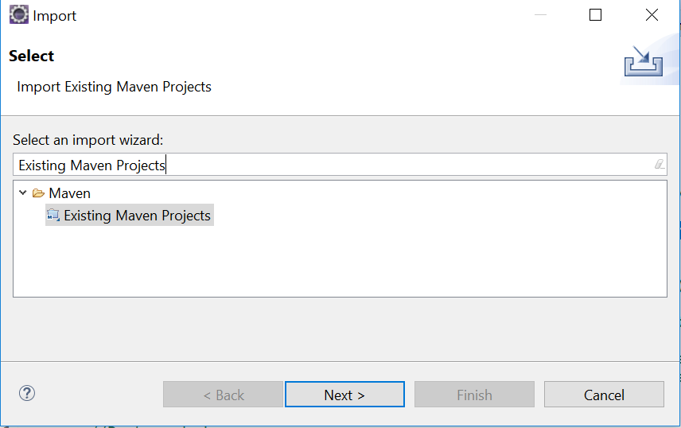
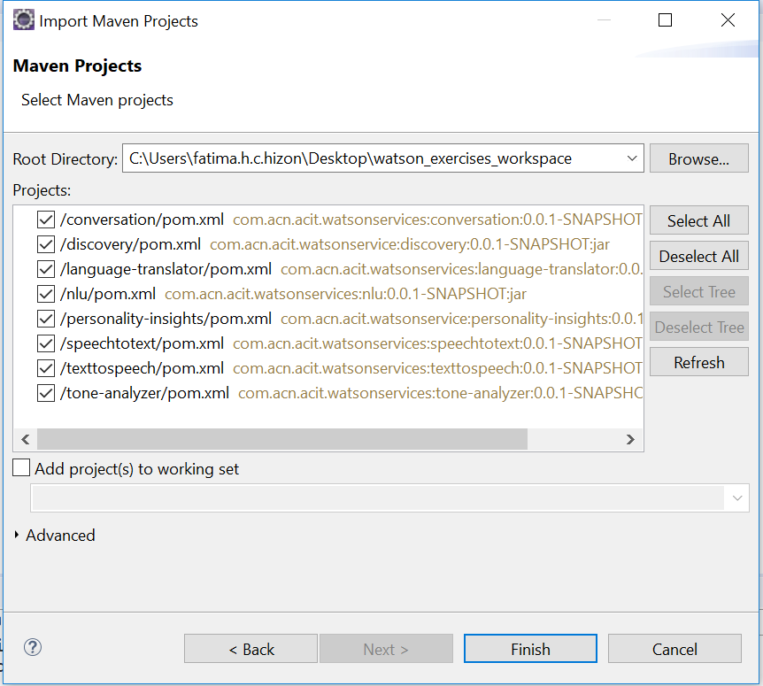
NLU Hands On
3.) Clone and open project in eclipse the project: git clone https://github.com/pdcacit/nlu
Open project in eclipse: File > Import > Type in search box: Existing Maven Projects
Browse on your project directory / workspace > Select all projects > Click on finish

Slide 4
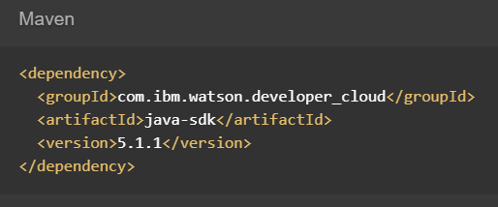
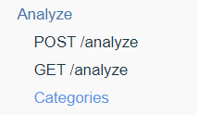
NLU Hands On
4.) Go to the API Reference: https://www.ibm.com/watson/developercloud/natural-language-understanding/api/v1/
5.) Copy Maven dependency in pom.xml, Then update the pom dependency: Right click on project > Maven > Update Project
6.) On the api website > Click Categories tone under Analyze.

Slide 5
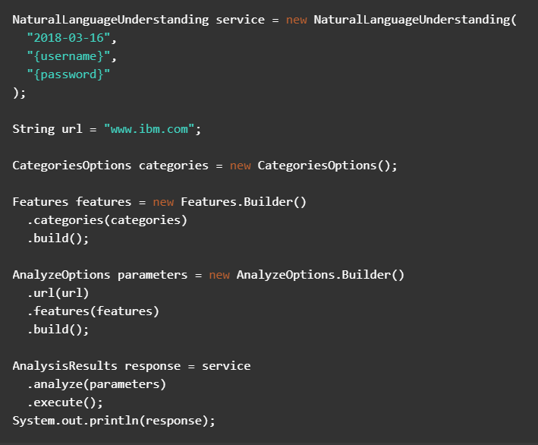
NLU Hands On
7.) Copy the code in the main method:

Slide 6
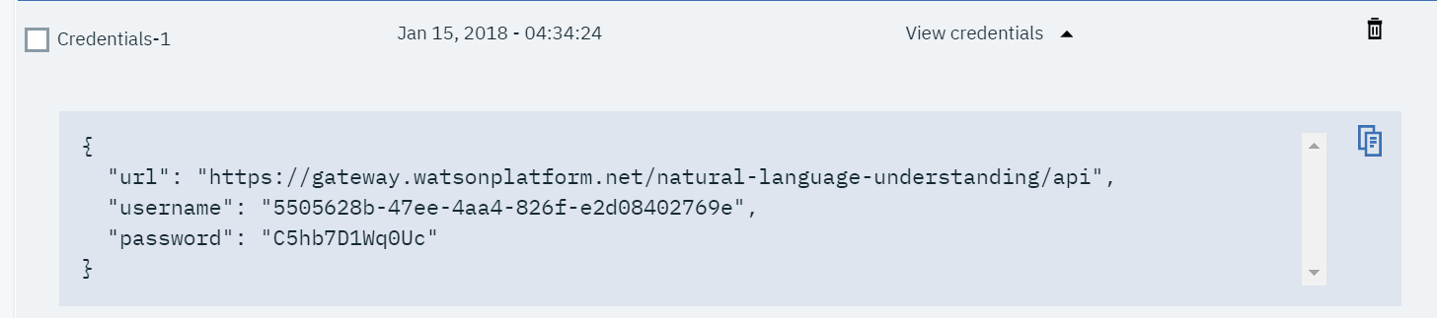
NLU Hands On
8.) Import all necessary libraries
9.) Copy and change the version, username, password based on your nlu service credentials.
Sample credentials:
10.) Right click on your project then run as java application.

Slide 7
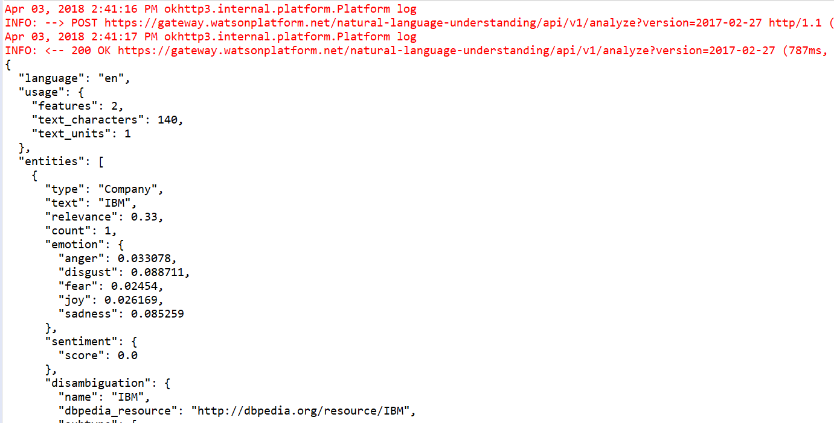
NLU Hands On
Console:

Slide 8
NLU References
About Tone Analyzer:
https://console.bluemix.net/docs/services/natural-language-understanding/index.html#about
Getting Started Tutorial:
https://console.bluemix.net/docs/services/natural-language-understanding/getting-started.html#getting-started-tutorial
API:
https://www.ibm.com/watson/developercloud/natural-language-understanding/api/v1/

