Slide 1

Watson
Personality
Insights

Slide 2
Personality Insights Hands On
1.) Create instance of the service
Login to IBM Cloud. Go to Catalog. Select Watson under Platform. Then Select Tone Analyzer.
Give a service name, select region, org and space. Then click Create.
2.) Copy the credentials to authenticate your service instance.
From your project in the Developer Console, add a new credential, give a credential name then click on Add. Copy the username, password, and url values from the credential you created.

Slide 3
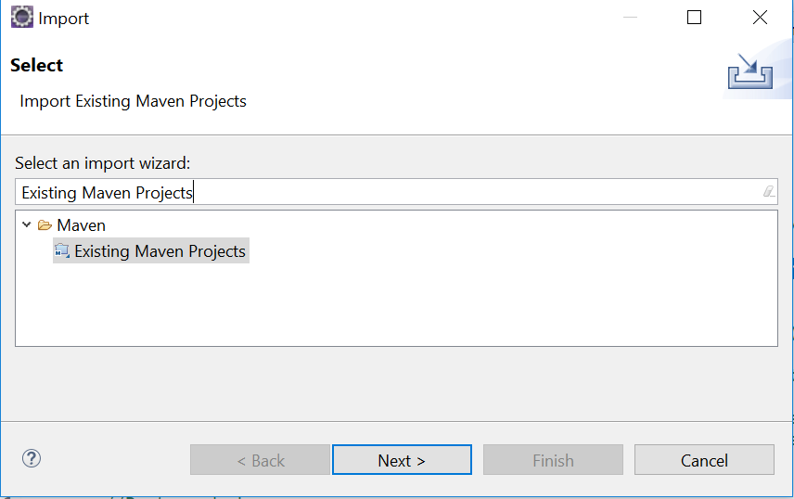
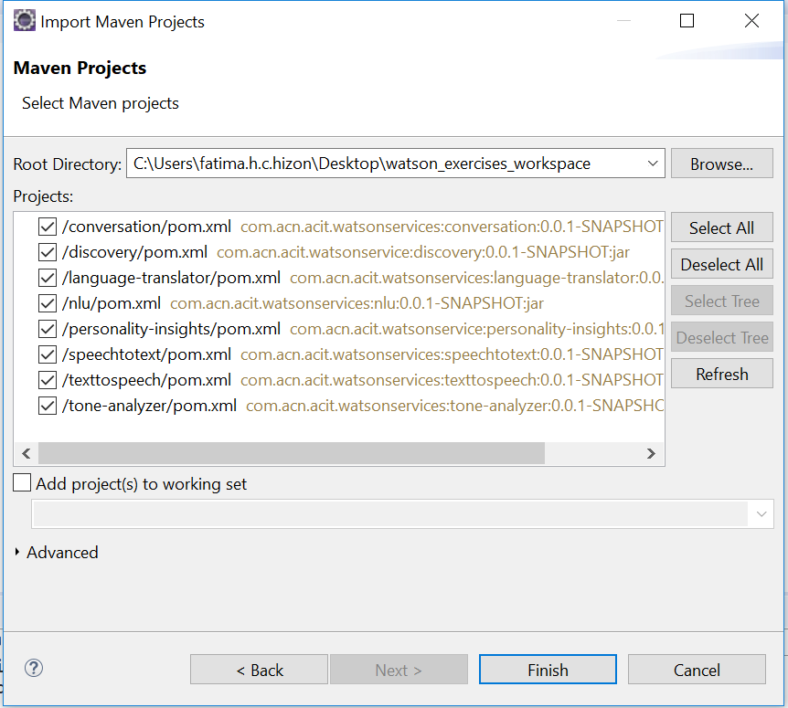
Personality Insights Hands On
3.) Clone and open project in eclipse the project: git clone https://github.com/pdcacit/personality-insights
Open project in eclipse: File > Import > Type in search box: Existing Maven Projects
Browse on your project directory / workspace > Select all projects > Click on finish

Slide 4
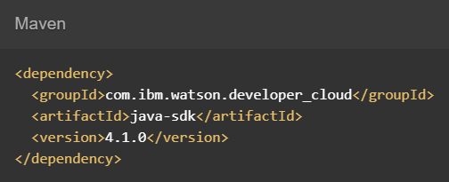

Personality Insights Hands On
4.) Go to https://www.ibm.com/watson/developercloud/personality-insights/api/v3/
5.) Copy Maven dependency in pom.xml
6.) On the api website > Click Get profile under Methods
7.) Download the sample file > profile.json > put this in the project folder

Slide 5
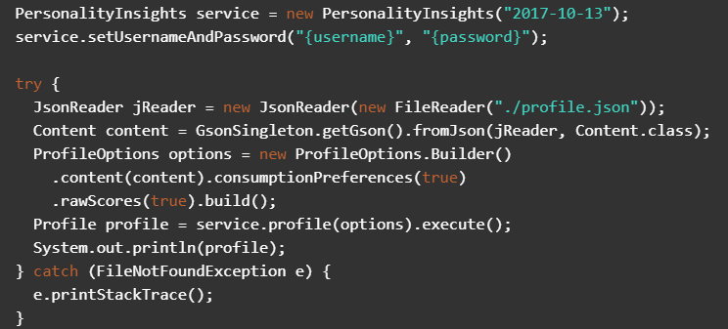
Personality Insights Hands On
8.) Copy the code in the main method:

Slide 6
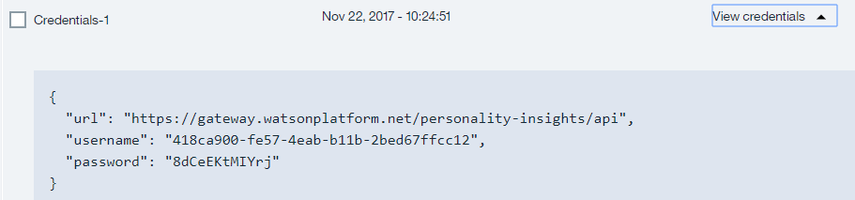

Personality Insights Hands On
9.) Import all necessary libraries
10.) Copy and change the username, password based on the personality insights service credentials.
Sample credentials:
11.) Right click on your project then run as java application.

Slide 7
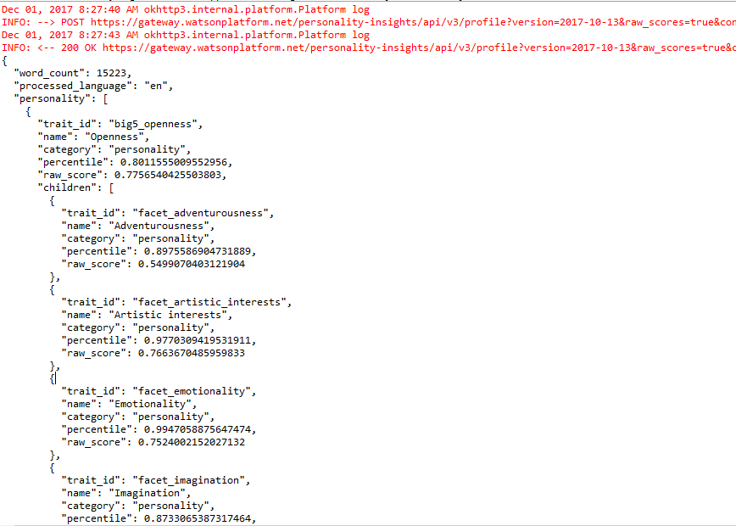
Personality Insights Hands On
Sample result:
Console:

Slide 8
Personality Insights References
About Personality Insights:
https://console.bluemix.net/docs/services/personality-insights/index.html#about
Getting Started Tutorial:
https://console.bluemix.net/docs/services/personality-insights/getting-started.html#getting-started-tutorial
API:
https://www.ibm.com/watson/developercloud/personality-insights/api

