Slide 1

Lab Prereqs

Slide 2
Agenda
Install cloud foundry CLI
Install cURL tool
Install JDK (Java Development Kit)
Install Maven
Setup JDK and Maven in environment variables
Install IDE (Eclipse / VSCode)
IBM Cloud Account

Slide 3
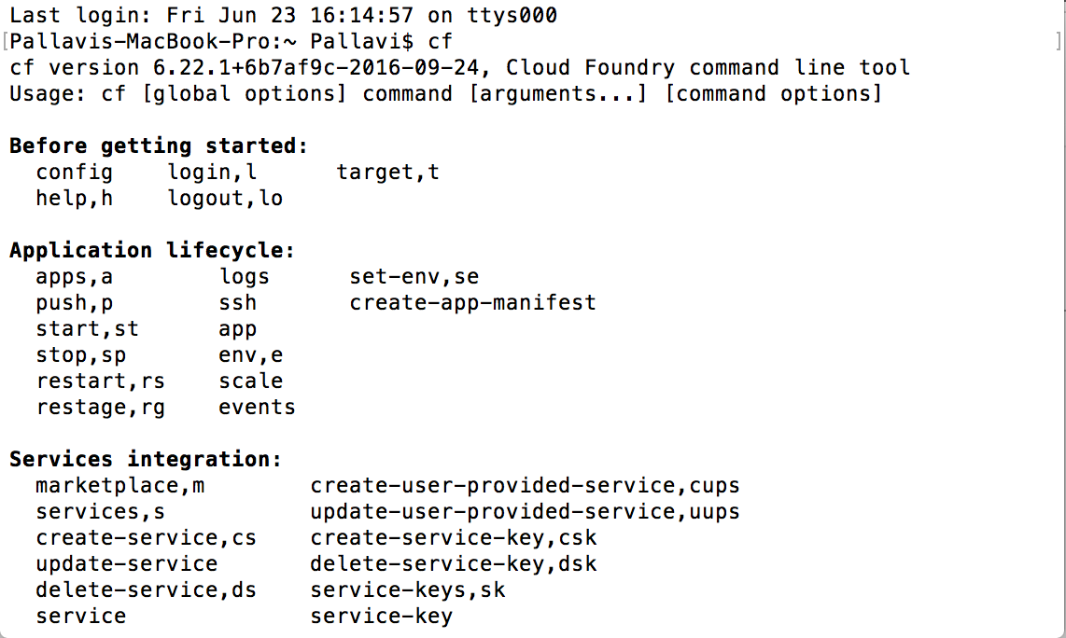
Install Cloud foundry CLI
Visit http://docs.cloudfoundry.org/cf-cli/install-go-cli.html
Download the installable under the section ii
Follow instructions under the section
Test using cf command in the command prompt window, If you see an output similar to the one in the screen shot below. You have installed successfully.
Notes:
Concepts details: Concepts that are detected typically have an associated link to a DBpedia resource.
Entities example: “Paris Hilton stayed in a Hilton Hotel in Paris, France” identifies that “Paris Hilton” is a person, “Hilton Hotel” is a facility, the second mention of “Paris” is a city, and “France” is a country.
Keywords details: Keyword phrases are organized by relevance in the results.
Categories example: “Leonardo DiCaprio won an Oscar” returns “/art and entertainment/movies and tv/movies” as the most confident classification.
Sentiment details: Sentiment information can be returned for detected entities, keywords or user-specified target phrases found in the text.

Slide 4
Install cURL tool
Visit https://bintray.com/vszakats/generic/curl/7.43.0 (for Windows)
Under downloads section find curl-7.43.0-win64-mingw.zip and download the zip
Unzip the folder
Traverse to that directory in the terminal window
Try the command CURL –version. If you get th eversion 7.43 in the output, you have the CURL utility in your system
Notes:
Concepts details: Concepts that are detected typically have an associated link to a DBpedia resource.
Entities example: “Paris Hilton stayed in a Hilton Hotel in Paris, France” identifies that “Paris Hilton” is a person, “Hilton Hotel” is a facility, the second mention of “Paris” is a city, and “France” is a country.
Keywords details: Keyword phrases are organized by relevance in the results.
Categories example: “Leonardo DiCaprio won an Oscar” returns “/art and entertainment/movies and tv/movies” as the most confident classification.
Sentiment details: Sentiment information can be returned for detected entities, keywords or user-specified target phrases found in the text.

Slide 5
Install JDK
Visit http://www.oracle.com/technetwork/java/javase/downloads/jdk8-downloads-2133151.html
Under downloads section, click on Accept License Agreement, Find jdk-8u161-windows-x64.exe and download and install .exe file.
Notes:
Concepts details: Concepts that are detected typically have an associated link to a DBpedia resource.
Entities example: “Paris Hilton stayed in a Hilton Hotel in Paris, France” identifies that “Paris Hilton” is a person, “Hilton Hotel” is a facility, the second mention of “Paris” is a city, and “France” is a country.
Keywords details: Keyword phrases are organized by relevance in the results.
Categories example: “Leonardo DiCaprio won an Oscar” returns “/art and entertainment/movies and tv/movies” as the most confident classification.
Sentiment details: Sentiment information can be returned for detected entities, keywords or user-specified target phrases found in the text.

Slide 6
Install Maven
Visit https://maven.apache.org/download.cgi
Under downloads section find apache-maven-3.5.2-bin.zip and download the zip
Unzip the folder in desired location. Ex: C:\Program Files\apache-maven-3.5.2-bin
Notes:
Concepts details: Concepts that are detected typically have an associated link to a DBpedia resource.
Entities example: “Paris Hilton stayed in a Hilton Hotel in Paris, France” identifies that “Paris Hilton” is a person, “Hilton Hotel” is a facility, the second mention of “Paris” is a city, and “France” is a country.
Keywords details: Keyword phrases are organized by relevance in the results.
Categories example: “Leonardo DiCaprio won an Oscar” returns “/art and entertainment/movies and tv/movies” as the most confident classification.
Sentiment details: Sentiment information can be returned for detected entities, keywords or user-specified target phrases found in the text.

Slide 7
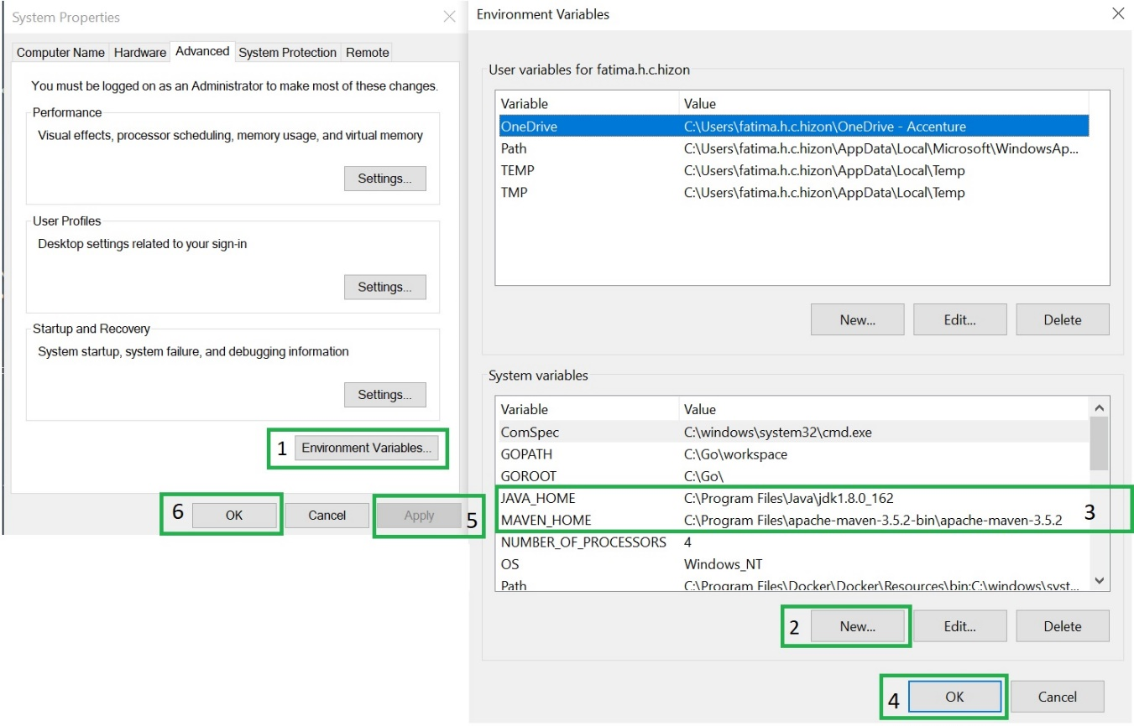
Setup JDK and Maven in environment variables
Click on start and search: ‘Edit environment variables for your account’
1. Click on ‘Environment Variables…’ button.
2. On Environment Variables, Click on ‘New’
3. Add environment variables for JAVA_HOME and MAVEN_HOME indicating the location of the jdk and maven.
4. Click ‘OK’ in the ‘Environment Variables’ window.
5. On System Properties window, click ‘Apply’. To apply the changes.
6. To exit in System Properties click ‘OK’.
Notes:
Concepts details: Concepts that are detected typically have an associated link to a DBpedia resource.
Entities example: “Paris Hilton stayed in a Hilton Hotel in Paris, France” identifies that “Paris Hilton” is a person, “Hilton Hotel” is a facility, the second mention of “Paris” is a city, and “France” is a country.
Keywords details: Keyword phrases are organized by relevance in the results.
Categories example: “Leonardo DiCaprio won an Oscar” returns “/art and entertainment/movies and tv/movies” as the most confident classification.
Sentiment details: Sentiment information can be returned for detected entities, keywords or user-specified target phrases found in the text.

Slide 8
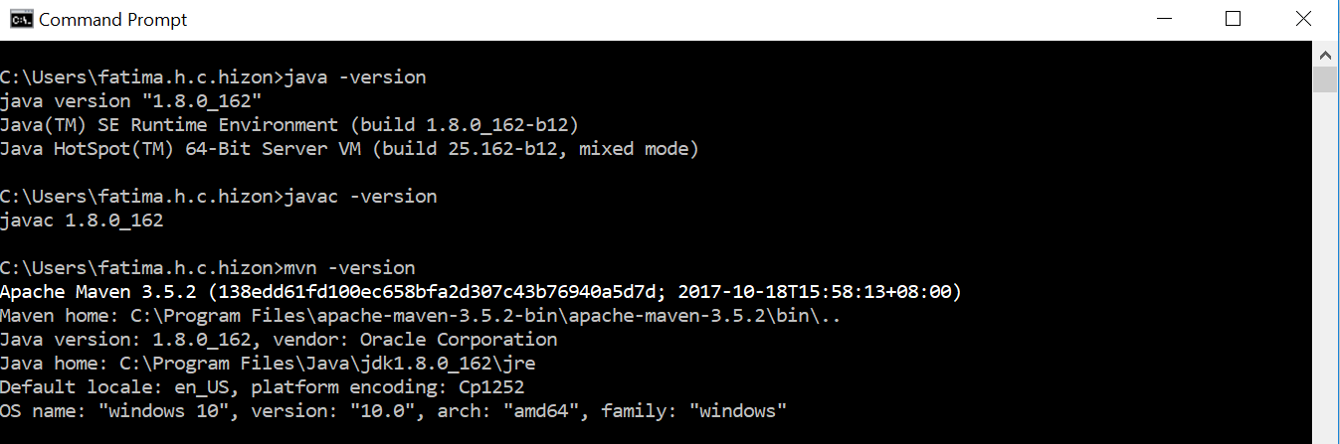
Setup JDK and Maven in environment variables
After setting the environment variables. Check if JDK and MAVEN are installed.
For JDK run this command in cmd:
‘javac –version’
For Maven run this command in cmd:
‘mvn–version’
Notes:
Concepts details: Concepts that are detected typically have an associated link to a DBpedia resource.
Entities example: “Paris Hilton stayed in a Hilton Hotel in Paris, France” identifies that “Paris Hilton” is a person, “Hilton Hotel” is a facility, the second mention of “Paris” is a city, and “France” is a country.
Keywords details: Keyword phrases are organized by relevance in the results.
Categories example: “Leonardo DiCaprio won an Oscar” returns “/art and entertainment/movies and tv/movies” as the most confident classification.
Sentiment details: Sentiment information can be returned for detected entities, keywords or user-specified target phrases found in the text.

Slide 9
Install IDE (Eclipse / VSCode)
VS Code: Visit https://code.visualstudio.com/download download the installer for windows
Eclipse: https://www.eclipse.org/downloads/
Notes:
Concepts details: Concepts that are detected typically have an associated link to a DBpedia resource.
Entities example: “Paris Hilton stayed in a Hilton Hotel in Paris, France” identifies that “Paris Hilton” is a person, “Hilton Hotel” is a facility, the second mention of “Paris” is a city, and “France” is a country.
Keywords details: Keyword phrases are organized by relevance in the results.
Categories example: “Leonardo DiCaprio won an Oscar” returns “/art and entertainment/movies and tv/movies” as the most confident classification.
Sentiment details: Sentiment information can be returned for detected entities, keywords or user-specified target phrases found in the text.

Slide 10
IBM Cloud account
Visit https://console.bluemix.net/registration/?target=%2Fdashboard%2Fapps
Create an account.
Notes:
Concepts details: Concepts that are detected typically have an associated link to a DBpedia resource.
Entities example: “Paris Hilton stayed in a Hilton Hotel in Paris, France” identifies that “Paris Hilton” is a person, “Hilton Hotel” is a facility, the second mention of “Paris” is a city, and “France” is a country.
Keywords details: Keyword phrases are organized by relevance in the results.
Categories example: “Leonardo DiCaprio won an Oscar” returns “/art and entertainment/movies and tv/movies” as the most confident classification.
Sentiment details: Sentiment information can be returned for detected entities, keywords or user-specified target phrases found in the text.

