Slide 1

Watson
Speech to Text

Slide 2
Speech to Text Hands On
1.) Create instance of the service
Login to IBM Cloud. Go to Catalog. Select Watson under Platform. Then Select Speech to Text.
Give a service name, select region, org and space. Then click Create.
2.) Copy the credentials to authenticate your service instance.
From your project in the Developer Console, add a new credential, give a credential name then click on Add. Copy the username, password, and url values from the credential you created.

Slide 3
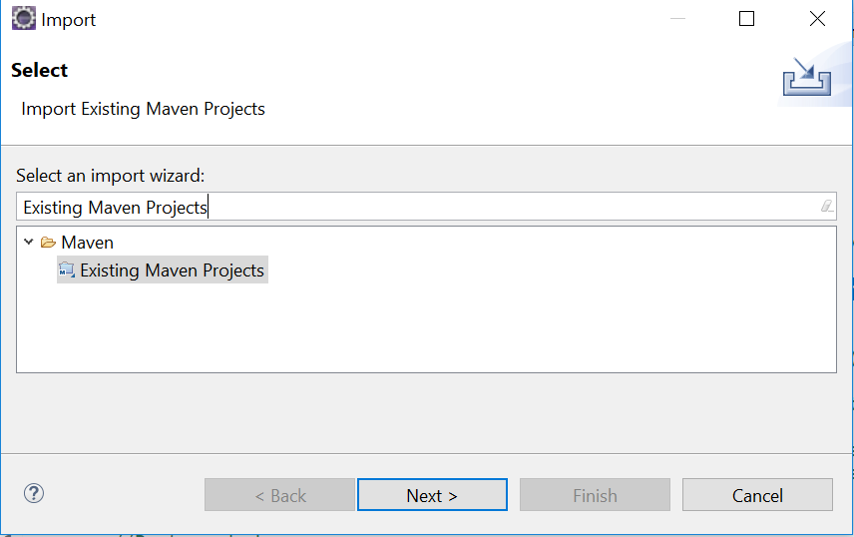
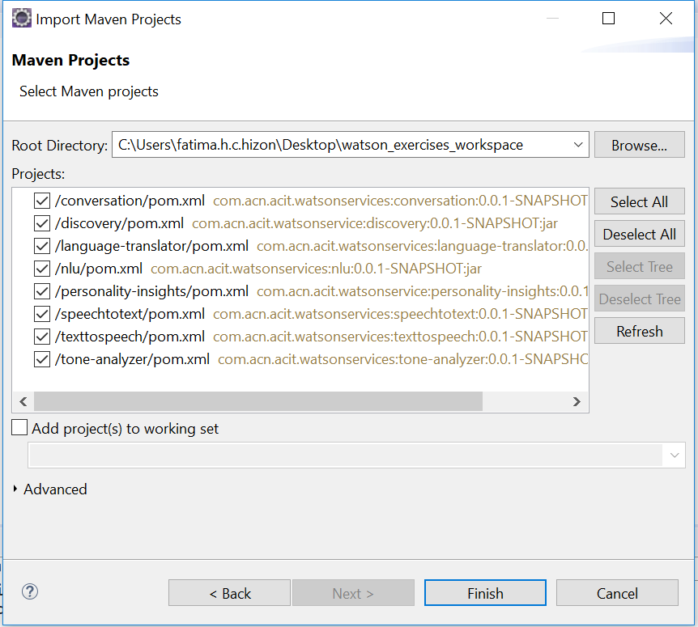
Speech to Text Hands On
3.) Clone and open project in eclipse the project: git clone https://github.com/pdcacit/speechtotext
Open project in eclipse: File > Import > Type in search box: Existing Maven Projects
Browse on your project directory / workspace > Select all projects > Click on finish

Slide 4
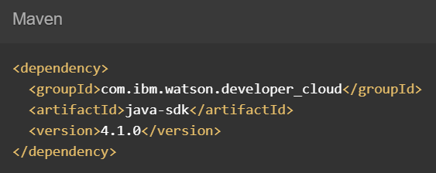

Speech to Text Hands On
4.) Go to https://www.ibm.com/watson/developercloud/speech-to-text/api/v1/
5.) Copy Maven dependency in pom.xml
6.) On the api website > Click Recognize audio under WebSockets
7.) Download the sample audio flac file (audio-file.flac) > then put it in the project folder

Slide 5
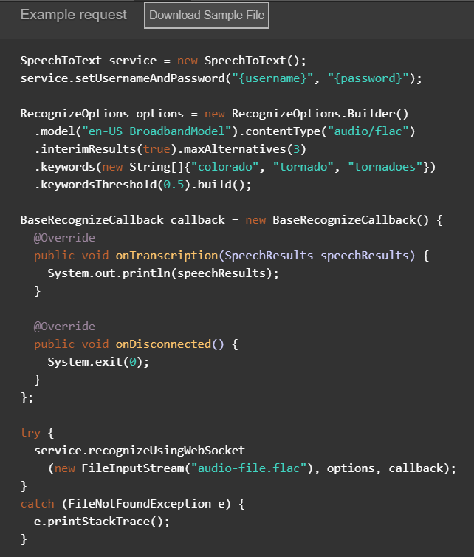
Speech to Text Hands On
8.) Copy the code in the main method:

Slide 6
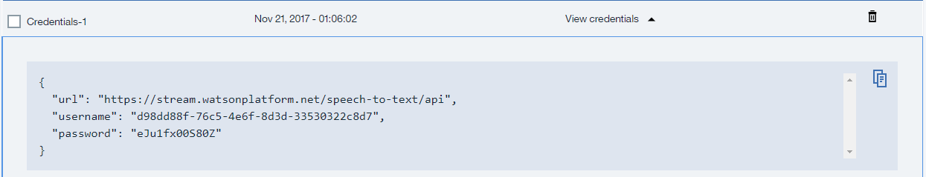
Speech to Text Hands On
9.) Import all necessary libraries
10.) Copy and change the username, password based on the speech to text service credentials.
Sample credentials:
11.) Right click on your project then run as java application.

Slide 7
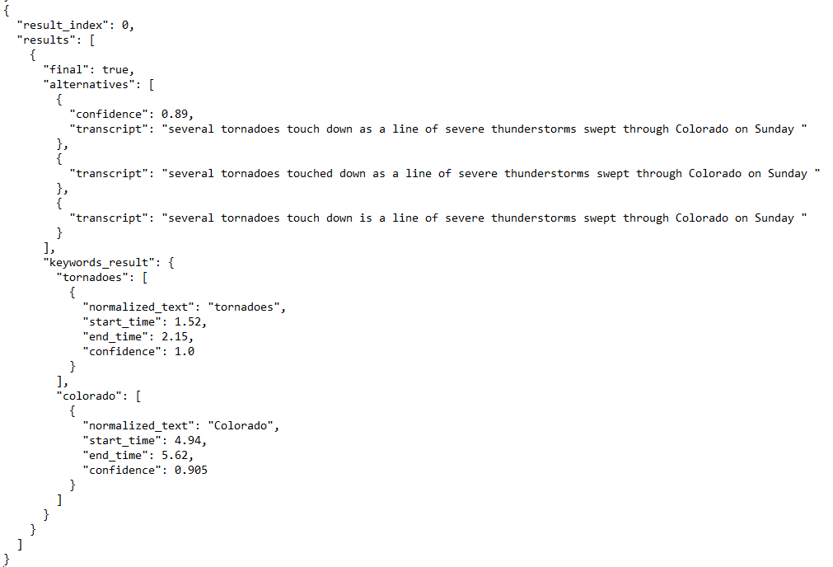
Speech to Text Hands On
Sample result:

Slide 8
Speech To Text References
About Speech to Text:
https://console.bluemix.net/docs/services/speech-to-text/index.html#about
Getting Started Tutorial:
https://console.bluemix.net/docs/services/speech-to-text/getting-started.html#gettingStarted
API:
https://www.ibm.com/watson/developercloud/speech-to-text/api/v1/

