Slide 1

Watson
Text to Speech

Slide 2
Text to Speech Hands On
1.) Create instance of the service
Login to IBM Cloud. Go to Catalog. Select Watson under Platform. Then Select Text to Speech.
Give a service name, select region, org and space. Then click Create.
2.) Copy the credentials to authenticate your service instance.
From your project in the Developer Console, add a new credential, give a credential name then click on Add. Copy the username, password, and url values from the credential you created.

Slide 3
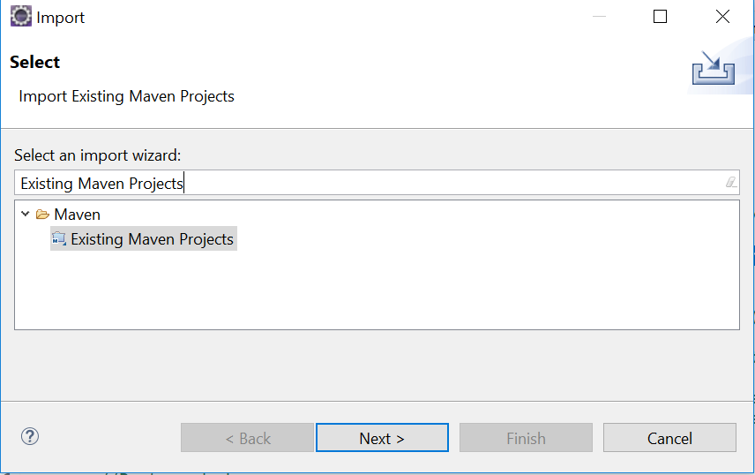
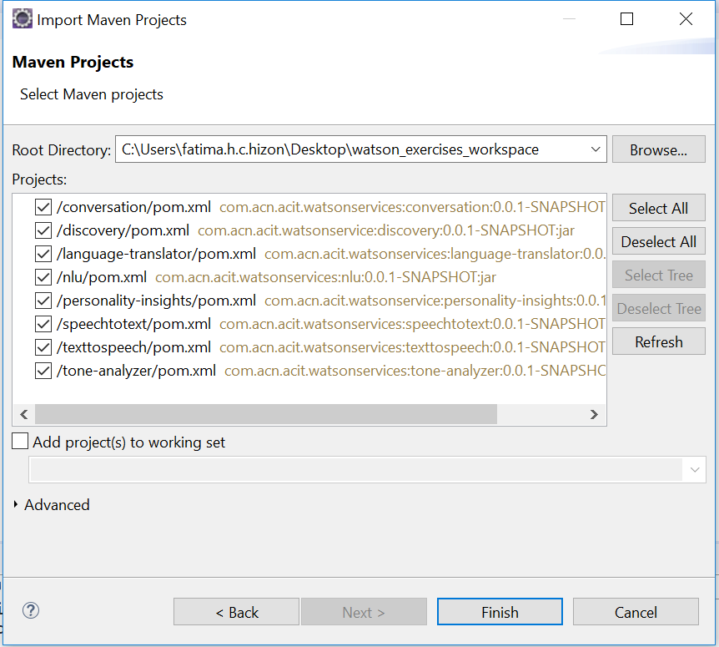
Text to Speech Hands On
3.) Clone and open project in eclipse the project: git clone https://github.com/pdcacit/texttospeech.git
Open project in eclipse: File > Import > Type in search box: Existing Maven Projects
Browse on your project directory / workspace > Select all projects > Click on finish

Slide 4
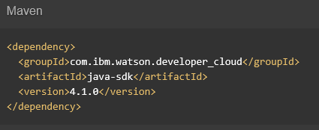

Text to Speech Hands On
4.) Go to https://www.ibm.com/watson/developercloud/text-to-speech/api/v1/
5.) Copy Maven dependency in pom.xml
6.) On the api website > Click Synthesize audio under Synthesis

Slide 5
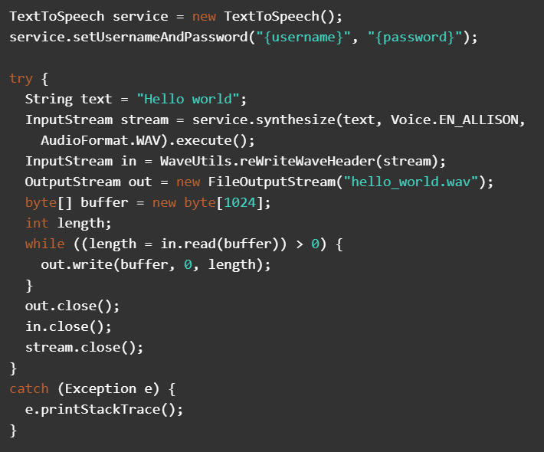
Text to Speech Hands On
7.) Copy the code in the main method:

Slide 6
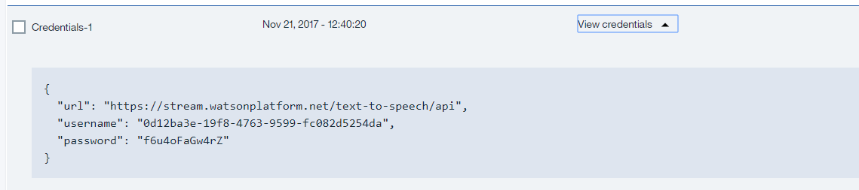

Text to Speech Hands On
8.) Import all necessary libraries
9.) Copy and change the username, password based on the text to speech service credentials.
Sample credentials:
10.) Right click on your project then run as java application.
11.) Refresh your project > you will see hello_world.wav > open the wav file in your media player.

Slide 7
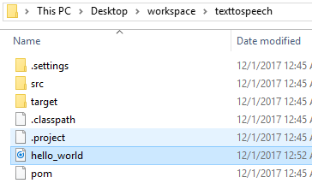
Text to Speech Hands On
Sample result:
Console:
Created wav file:

Slide 8
Text to Speech References
About Text to Speech:
https://console.bluemix.net/docs/services/text-to-speech/index.html#about
Getting Started Tutorial:
https://console.bluemix.net/docs/services/text-to-speech/getting-started.html#gettingStarted
API:
https://www.ibm.com/watson/developercloud/text-to-speech/api/v1/

