Slide 1

Watson
Tone
Analyzer

Slide 2
Tone Analyzer Hands On
1.) Create instance of the service
Login to IBM Cloud. Go to Catalog. Select Watson under Platform. Then Select Tone Analyzer.
Give a service name, select region, org and space. Then click Create.
2.) Copy the credentials to authenticate your service instance.
From your project in the Developer Console, add a new credential, give a credential name then click on Add. Copy the username, password, and url values from the credential you created.

Slide 3
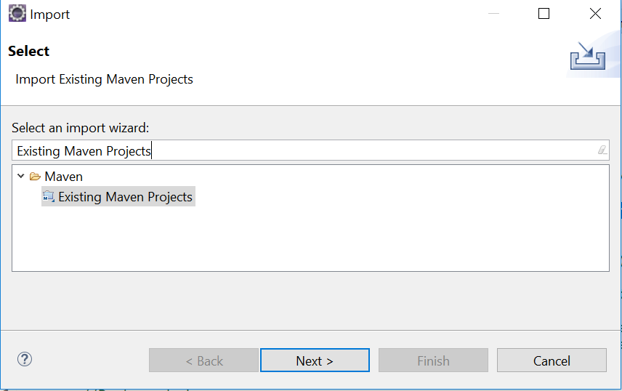
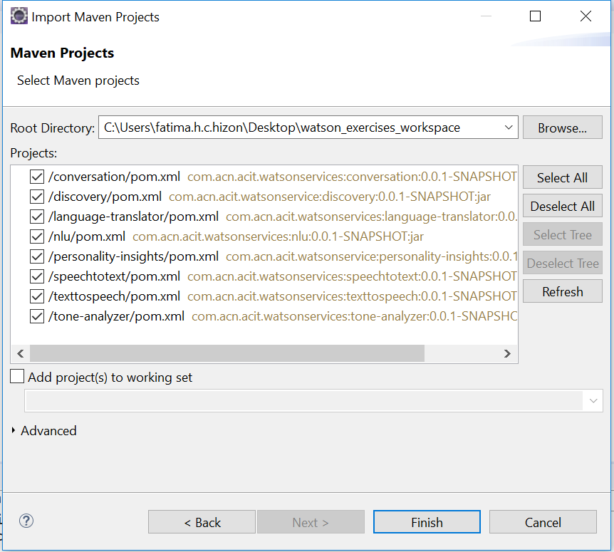
Tone Analyzer Hands On
3.) Clone and open project in eclipse the project: git clone https://github.com/pdcacit/tone-analyzer
Open project in eclipse: File > Import > Type in search box: Existing Maven Projects
Browse on your project directory / workspace > Select all projects > Click on finish

Slide 4
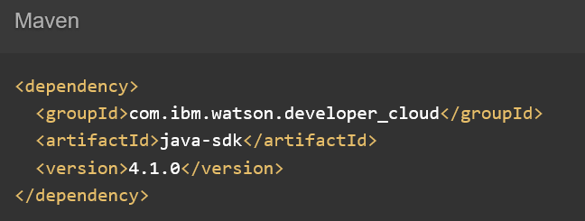

Tone Analyzer Hands On
4.) Go to the API Reference: https://www.ibm.com/watson/developercloud/tone-analyzer/api/v3/
5.) Copy Maven dependency in pom.xml, Then update the pom dependency: Right click on project > Maven > Update Project
6.) On the api website > Click Analyze general tone under Methods.
7.) Download sample files: General Tone (tone.json) and Customer Engagement Tone (tone-chat.json)
8.) Copy both files in project folder.

Slide 5
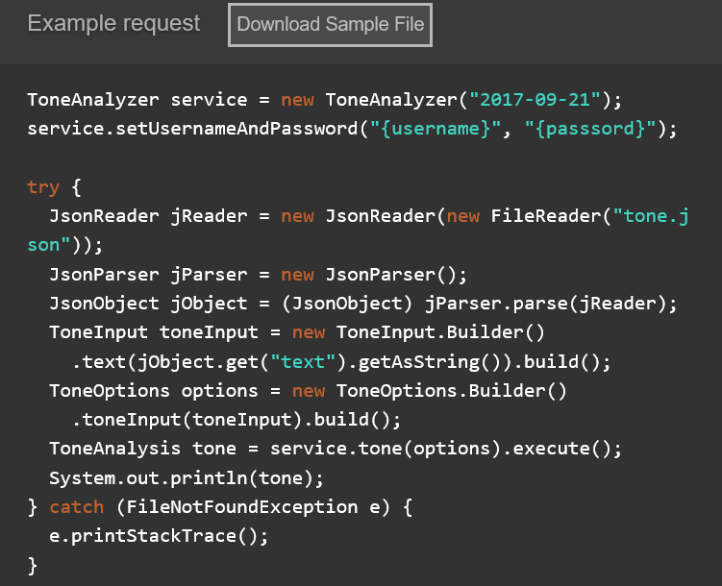
Tone Analyzer Hands On (GeneralToneAnalyzerDemo.java class)
9.) Copy the code in the main method:

Slide 6
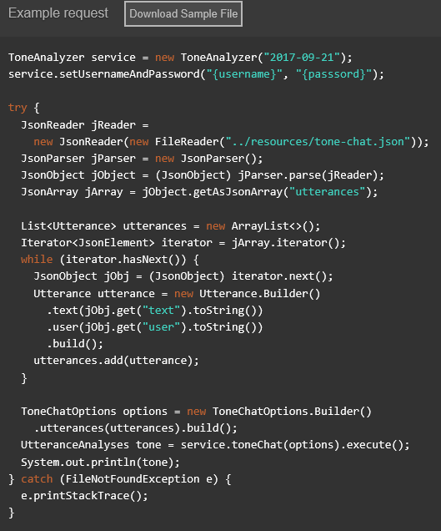
Tone Analyzer Hands On (CustomerEngagementToneAnalyzerDemo.java class)
10.) Copy the code in the main method:

Slide 7
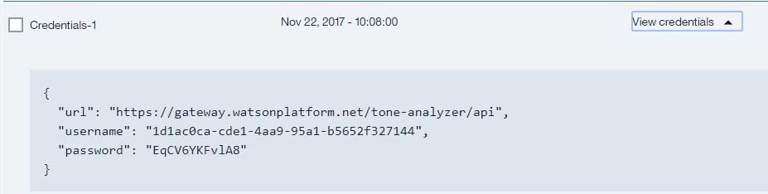
Tone Analyzer Hands On
11.) Import all necessary libraries
12.) Copy and change the version, username, password based on your tone analyzer service credentials.
Sample credentials:
13.) Right click on your project then run as java application.

Slide 8
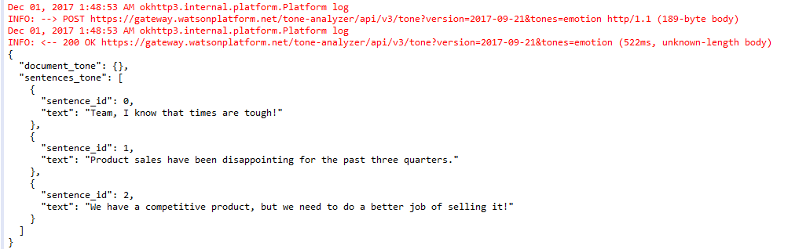
Tone Analyzer Hands On
Console:
General Tone Analyzer Output:

Slide 9
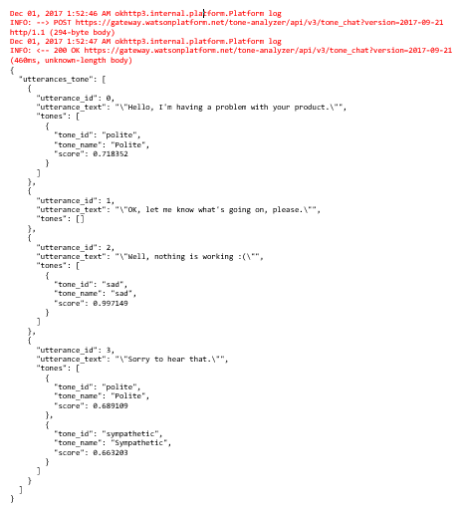
Tone Analyzer Hands On
Console:
Customer Engagement Tone Analyzer Output:

Slide 10
Tone Analyzer References
About Tone Analyzer:
https://console.bluemix.net/docs/services/tone-analyzer/index.html#about
Getting Started Tutorial:
https://console.bluemix.net/docs/services/tone-analyzer/getting-started.html#getting-started-tutorial
API:
https://www.ibm.com/watson/developercloud/tone-analyzer/api/v3/

