Slide 1

Watson
Visual
Recognition

Slide 2
Visual Recognition Hands On
1.) Create instance of the service
Login to IBM Cloud. Go to Catalog. Select Watson under Platform. Then Select Visual Recognition.
Give a service name, select region, org and space. Then click Create.
2.) Copy the credentials to authenticate your service instance.
From your project in the Developer Console, add a new credential, give a credential name then click on Add. Copy the username, password, and url values from the credential you created.

Slide 3
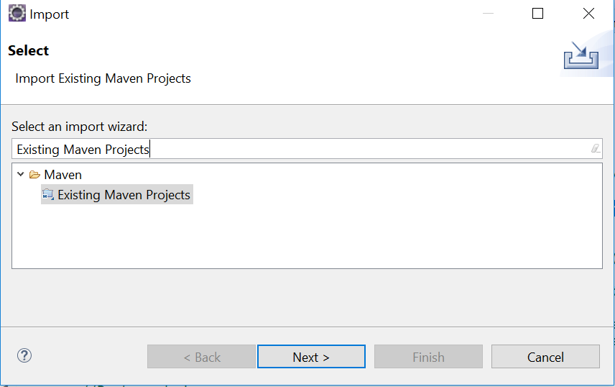
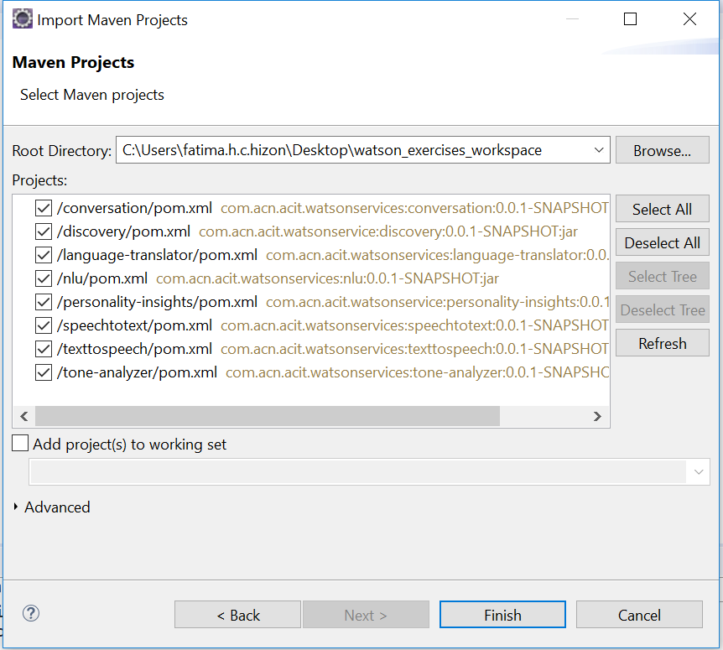
Visual Recognition Hands On
3.) Clone and open project in eclipse the project: git clone https://github.com/pdcacit/visual-recognition
Open project in eclipse: File > Import > Type in search box: Existing Maven Projects
Browse on your project directory / workspace > Select all projects > Click on finish

Slide 4
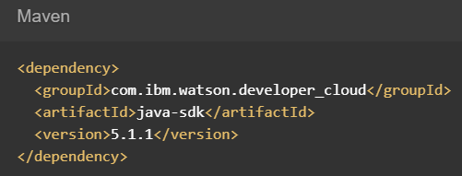
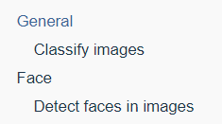
Visual Recognition Hands On
4.) Go to the API Reference: https://www.ibm.com/watson/developercloud/visual-recognition/api/v3
5.) Copy Maven dependency in pom.xml, Then update the pom dependency: Right click on project > Maven > Update Project
6.) On the api website > Click Classify images under General / Click Detect faces in images under Face

Slide 5
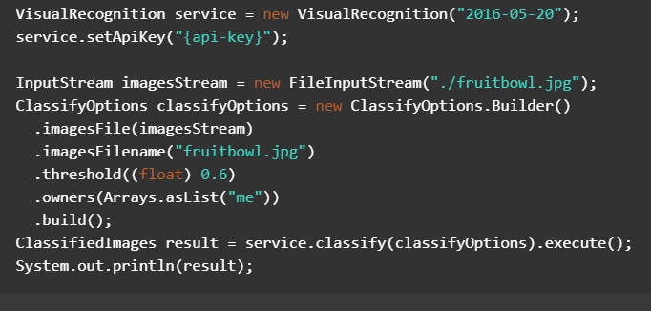
Visual Recognition Hands On (ClassifyImage.java class)
7.) Copy the code in the main method:
Note: change “me” to “IBM” to use the default classifier.

Slide 6
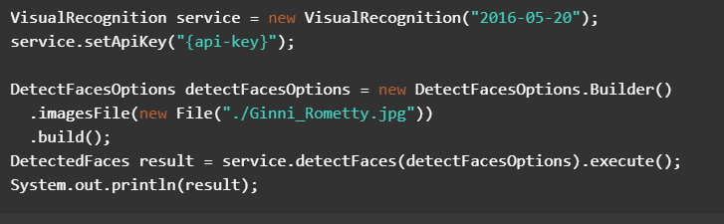
Visual Recognition Hands On (DetectFace.java class)
8.) Copy the code in the main method:

Slide 7
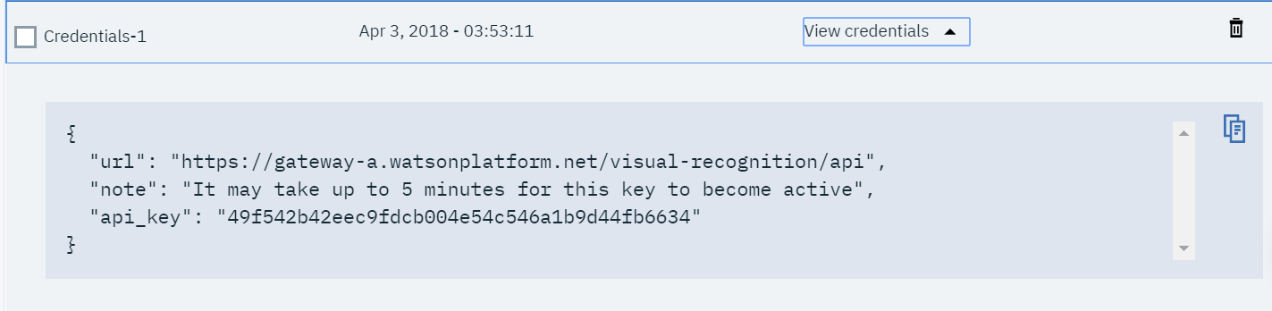

Visual Recognition Hands On
9.) Import all necessary libraries
10.) Copy and change the api-key based on your visual recognition service credentials.
Sample credentials:
11.) Right click on your project then run as java application.

Slide 8
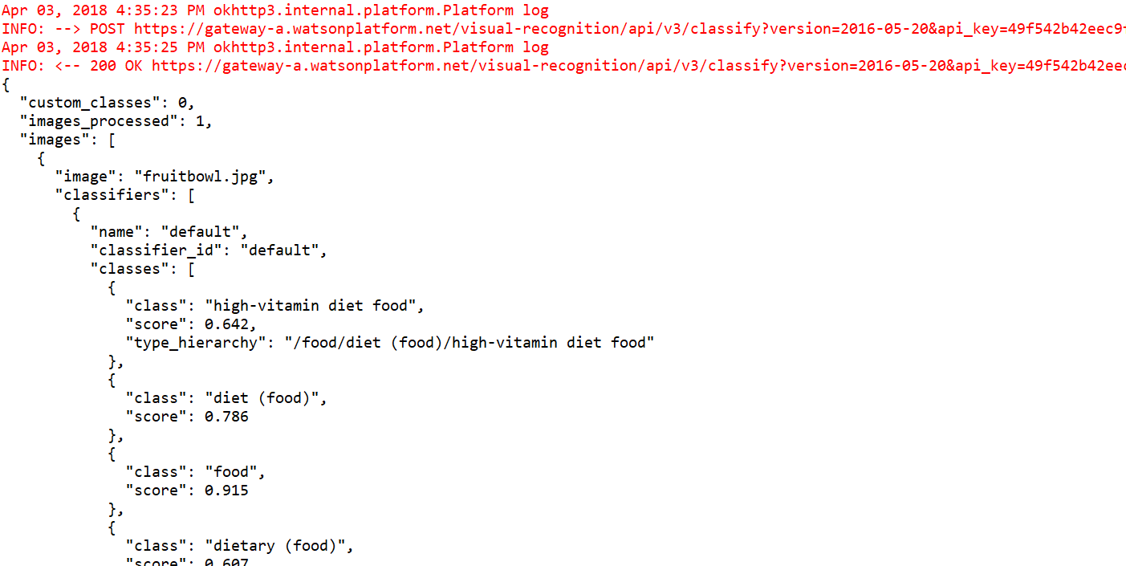
Visual Recognition Hands On
Console:
Classify Image Output:

Slide 9
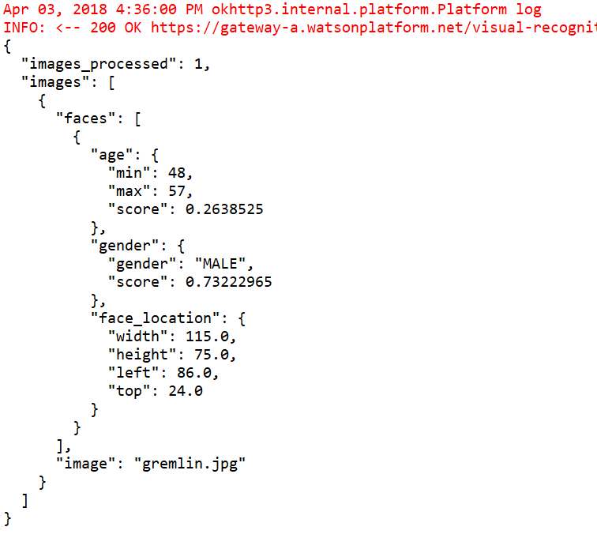
Visual Recognition Hands On
Console:
Detect Face Output:

Slide 10
Visual Recognition References
About Visual Recognition:
https://console.bluemix.net/docs/services/visual-recognition/index.html#about
Getting Started Tutorial:
https://console.bluemix.net/docs/services/visual-recognition/getting-started.html#getting-started-tutorial
API:
https://www.ibm.com/watson/developercloud/visual-recognition/api/v3/

