Slide 1
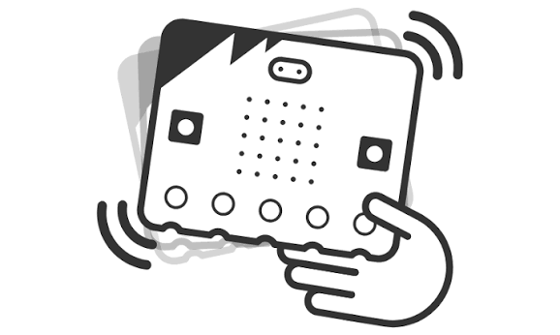
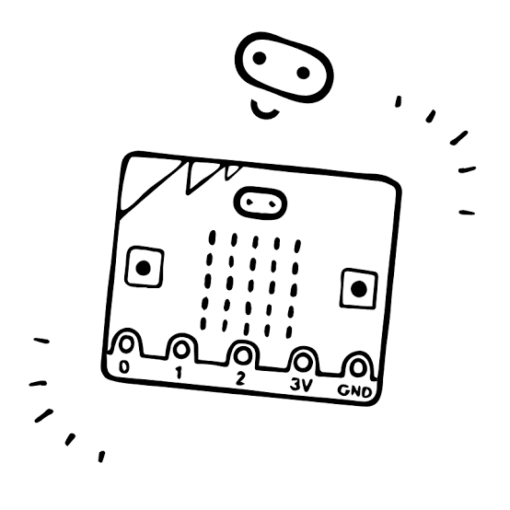
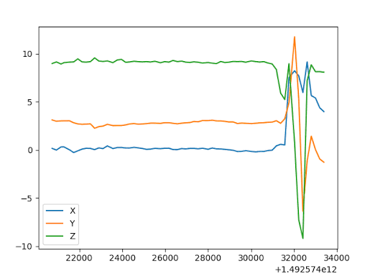

Multiple micro:bits send motion capture data via radio
One micro:bit receives radio data, processes accelerometer values and streams motion capture data
Multiple people running Blender can control 3d objects (position and rotation) using live streamed motion capture data

