Slide 1

Scalability
Sankarshan and Paul
Airbnb Prediction Project

Slide 2
meaning of scalability for our project
Built a model pipeline in Spark that instantiates every possible regression model based on parameter inputs and combinations of input features
Pipeline: Model Instantiation, Feature Importance, Evaluation Metrics
Goal: find the best model features with brute force - or at least get an idea of where to look!

Slide 3
performance
We have only run our code in Spark on a personal computer - AWS coming soon!
Works for as many as 9 features (1.5 hours), breaks with 10 or more.

Slide 4
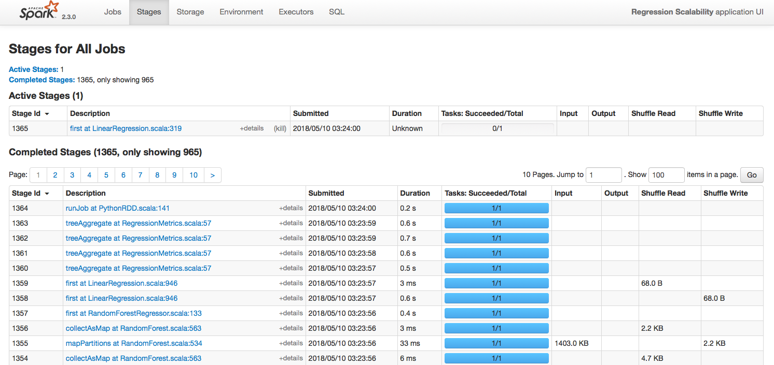
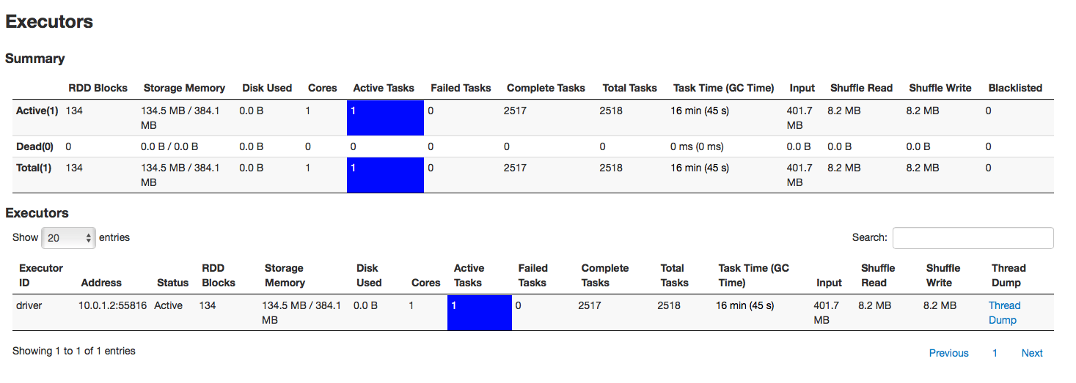

Slide 5
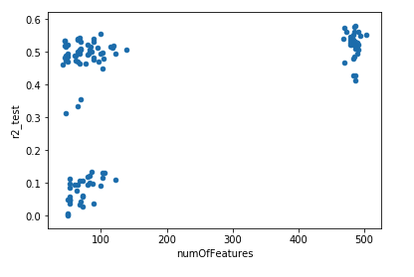
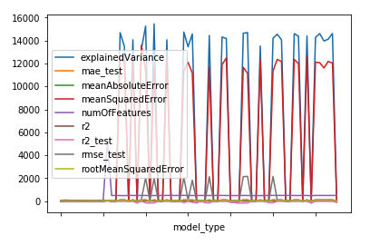
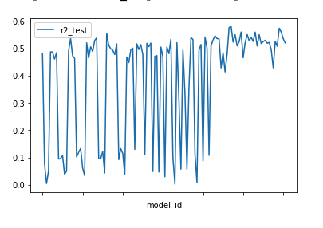
results

Slide 6
data pipeline
Data Transformations
Compute Price Statistics
Text: LDA, NLTK, Clustering
Unstructured Features
Geo Features: Distance from Ocean, Park/Recreation Site, Active Businesses, Local Events
Data Acquisition
insideairbnb.com
Scraper?
Modeling
Model Exploration Phases
Scaled Modeling
Final Evaluation & Model Choice

Slide 7
Next Steps
Run in AWS
Expand capabilities of scalable pipeline
Conclude work on scraper

