Slide 1
Teams Governance Through Graph API, Flow and SharePoint 365
Phillip Demro

Slide 2
Teams Governance Through the Graph API, Flow and SharePoint 365
The collaborative power of Microsoft Teams may never be realized without attention to governance. This session will cover governance concepts as they relate to Microsoft Teams, and will demonstrate a Teams approval workflow using Flow and the Microsoft Graph API
Wednesday, August 28, 2019 - 1:45 PM 2:45 PM
Notes:
Status 2019-07-18
Presentation dry run took about 49 minutes. That leaves 10 minutes for the demo and 1 minutes for questions. Don’t be afraid to go quick through slides it seems like
Next step – dry run on the demo to see how much time it takes

Slide 3
About this Presentation
Additional Resources
Resources from this Presentation
https://github.com/pdemro/teams-govenernance-2019
Manage who can create Office 365 Groups
https://docs.microsoft.com/en-us/office365/admin/create-groups/manage-creation-of-groups?redirectSourcePath=%252fen-us%252farticle%252fManage-Office-365-Group-creation-4c46c8cb-17d0-44b5-9776-005fced8e618&view=o365-worldwide
Clone a Team
https://docs.microsoft.com/en-us/graph/api/team-clone?view=graph-rest-1.0
Teams and Office 365 evolves constantly!
Stay up-to-date on Teams and other tech topics with @WithumDigital
https://aka.ms/Teamsblog
BREAKING: Teams private channels?

Slide 4


About Phil Demro
IT Consulting 9 Years
Software Developer, Systems Architect for Withum
Minneapolis, MN
pdemro.com
github.com/pdemro
Backpacked AT In MD, PA, and NH
@demroPhillip

Slide 5
Agenda
Introduction to
Teams
Graph API
Office 365 Groups
Flow
Review Content Governance concepts
Demo: Configure Teams Provisioner with Flow and GraphAPI

Slide 6
Teams, Graph, Groups, Flow
Intro to Technologies used in Demo

Slide 7
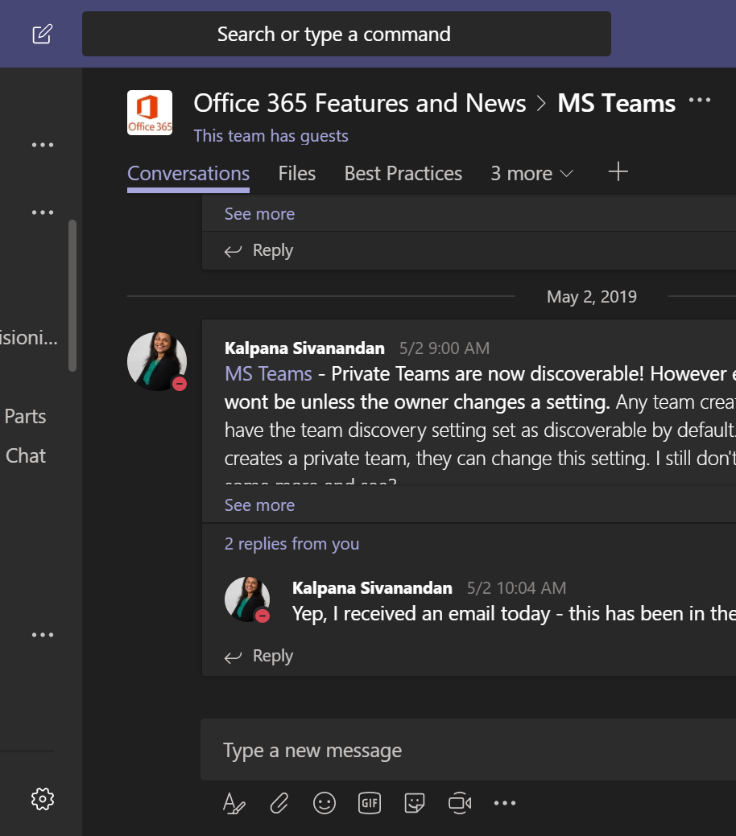
Microsoft Teams
A team collaboration platform built on Office 365
Chat & VoIP (similar to Skype)
Document Storage & Collaboration (similar to SharePoint)
Microsoft’s alternative to Slack, Discord
Notes:
Show of hands –
Who is currently using Microsoft Teams?
Who is still thinking about it?
Do a demo of teams if a lot of people are still thinking about it

Slide 8
Why Teams at SharePoint Tech Con?
Common Functionality to SharePoint
Document storage, collaboration
Editing within browser
Permission management (limited)
Cross platform features
SharePoint Framework (SpFx)
Document storage/versioning
Notes:
Show of hands – who is currently using Microsoft Teams

Slide 9
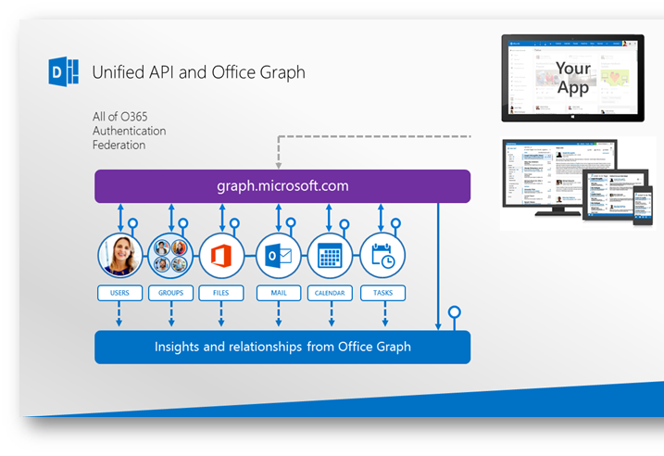
What is Office 365 Graph API?
Unified API for Office 365 Features
Integrate Office365 applications with one another, Azure, or 3rd party systems
https://blogs.msdn.microsoft.com/helgesolheim/2015/04/30/office-graph-goes-crud/
Notes:
Show of hands – who is currently using Graph API
https://blogs.msdn.microsoft.com/helgesolheim/2015/04/30/office-graph-goes-crud/

Slide 10
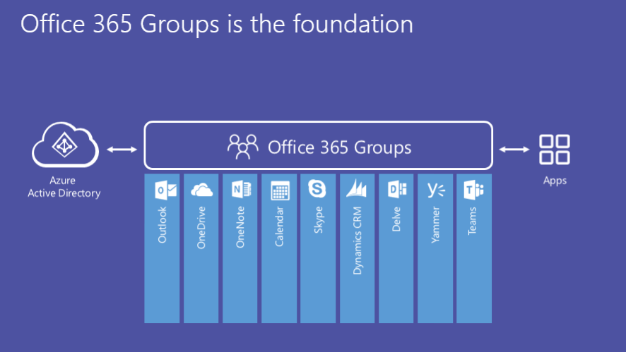
Office 365 Groups
A group of Office 365 users (similar to Active Directory groups, distribution lists, or shared mailboxes in exchange)
Tightly coupled with Office 365 Applications
Teams
SharePoint Modern Sites
Unified way to manage Access Control Lists (ACLs) in Office 365
Notes:
https://www.avepoint.com/blog/microsoft-teams/office-365-groups-vs-teams/

Slide 11
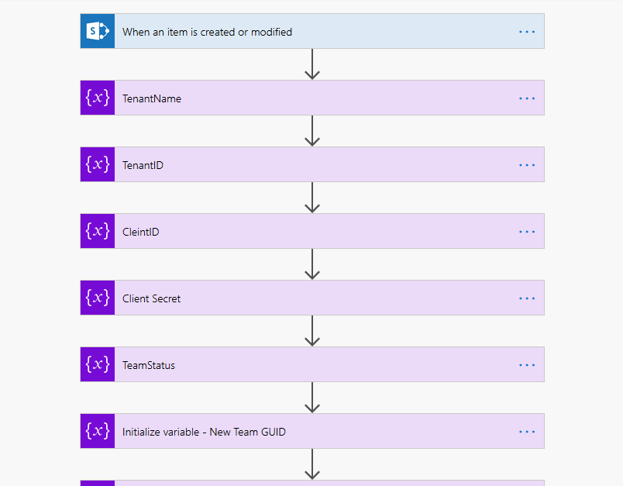
What is Microsoft Flow?
Workflow Engine for Office 365
Replaces SharePoint Designer workflows
Similar features, look & feel to Nintex Workflow
Built on Azure Logic Apps
Deep integration with Office 365 products
Third party connector support
Notes:
Show of hands – who is currently using Flow

Slide 12
Governance Concepts

Slide 13

Generate content & collaborate quickly. Store data I need at a moment’s notice.
Strict guidelines around content creation. Features disabled. Users should not be trusted
Notes:
Tug of War by Robert Clemens (https://www.flickr.com/photos/robert_clemens/12356445454, https://www.flickr.com/photos/robert_clemens/)
CC BY-ND 2.0 (https://creativecommons.org/licenses/by-nd/2.0/)
Type rope or tug-of-war? I see it as a tug of war because at the end of the day if a governance process is too cumbersome, users will find ways to subvert that process to be more efficient (back-channels, shadow IT, etc)

Slide 14
Common concerns
People will create too many teams and sites and there will be duplications, confusion
Intellectual property will be lost
Guests will have access to things shouldn’t
People won’t be able to access things they need
Performance will suffer due to too many teams and sites
Licensing will get out of control

Slide 15
Common concerns
The application is too difficult to use
I probably won’t get approval so why bother
I just need to collaborate, I don’t have time to learn corporate policy
Why conform to company standards when I can use Slack or Discord for free
I am new to the company and can’t figure out the tools I need to do my job

Slide 16
Governance Planning
Who can create
Create site (SharePoint)
Create team (Teams)
Configure expiry
Set expiration duration
Configure guest access
Create shared library (OneDrive)
Create group (Outlook)
Naming conventions
Custom blocked words
Manage who can add guest users
Set policies
Use of templates
SharePoint site designs
Themes
Teams templates
Monitoring
Teams Admin Center
Office 365 admin center
Office 365 adoption content pack
Groups report
SharePoint Admin Center
Prefix-suffix naming policies, fixed strings or user attributes
Turn sharing option on or off
Choose which Groups policy will apply to
Configure external sharing for SharePoint
Turn on or off guest access to group files and OneNote
Retention
eDiscovery
Data Loss Prevention
Mark Kashman (Microsoft)
Melissa Hubbard (MVP)

Slide 17
Teams Provisioning
Who can create teams?
Open policy
Limit to Single Office 365 Group of administrators
Provisioning workflow/process

Slide 18
Teams Provisioning – Naming Policy
Help yourself – tracking and auditing of Teams & Groups made easier with naming conventions
AAD P1 – Group naming policy enforcement
Based on AAD profile attributes
Team name -256 character limit
Prefix + suffix 53 character max
Provisioning policy naming convention enforcement
Notes:
https://docs.microsoft.com/en-us/azure/active-directory/users-groups-roles/groups-naming-policy
https://docs.microsoft.com/en-us/powershell/module/teams/set-team?view=teams-ps

Slide 19
Teams Guest Access
Will my organization benefit from guest access?
Whitelist/blacklist domains
Who is allowed to invite guests to the tenant
Guest Inviter Role
How/when is guest access tracked and audited?
AAD B2B
Invite users with any email address – user signs in with outlook.com or AD identity

Slide 20
Content Expiration
Don’t fill your Office 365 Environment with ROT (Redundant, Obsolete, Trivial data)!
Group Expiration policy
Configuration
Admin Center -All groups, selected groups, no groups
Group create time (API)
Notes:
https://docs.microsoft.com/en-us/graph/api/resources/group?view=graph-rest-beta
https://docs.microsoft.com/en-us/graph/teams-concept-overview

Slide 21
Content Expiration
Owner notified via email and/or Teams that their Group (Team) is expiring (30 days, 15 days)
Given the option to renew at these intervals
Admins can restore up to 30 days after expiration
Teams should have multiple owners!
Communication & training
IT and Pilot group of users. Renewal process, etc.
Notes:
https://docs.microsoft.com/en-us/office365/admin/create-groups/office-365-groups-expiration-policy?view=o365-worldwide

Slide 22
Governance Summary
Provisioning
Self-service
Either unlimited or via approving group
Naming Policy
Protect Resources
Guest access
Open or restricted
Guest inviter role
Domain whitelist/blacklist
Manage Group Lifecycle
Set up group expiration to avoid ROT ROT - redundant, obsolete, and trivial.
Transparent and easy to consume expiration policy (training)
Transparent renewal process
Notes:
Tug of War by Robert Clemens (https://www.flickr.com/photos/robert_clemens/12356445454, https://www.flickr.com/photos/robert_clemens/)
CC BY-ND 2.0 (https://creativecommons.org/licenses/by-nd/2.0/)

Slide 23
Clone MS Team Template
Scan for completion
Send Completion Notification
Yes
Prepare App Context
Approved?
No
Send Rejection Notification

Slide 24
Governance Planning
Who can create
Create site (SharePoint)
Create team (Teams)
Configure expiry
Set expiration duration
Configure guest access
Create shared library (OneDrive)
Create group (Outlook)
Naming conventions
Custom blocked words
Manage who can add guest users
Set policies
Use of templates
SharePoint site designs
Themes
Teams templates
Monitoring
Teams Admin Center
Office 365 admin center
Office 365 adoption content pack
Groups report
SharePoint Admin Center
Prefix-suffix naming policies, fixed strings or user attributes
Turn sharing option on or off
Choose which Groups policy will apply to
Configure external sharing for SharePoint
Turn on or off guest access to group files and OneNote
Retention
eDiscovery
Data Loss Prevention
Mark Kashman (Microsoft)
Melissa Hubbard (MVP)

Slide 25
Demo: Teams Approval Provisioner (Identity)
Notes:
Restrict group creation
Create security group
Apply PS script to restrict group creation across tenant
Generate authorized Token for group/teams creation in Azure AD
Create SharePoint list schema w/ Team metadata
Title
Description
Department
Create a Team Template
Channels
Tabs
Create Flow to build a team using the Authorized Token
On List item add
Request approval
On approval, create team
Naming convention <Title>-<Department Code>
Loop to check when team provisioned
Email notification that team is created

Slide 26

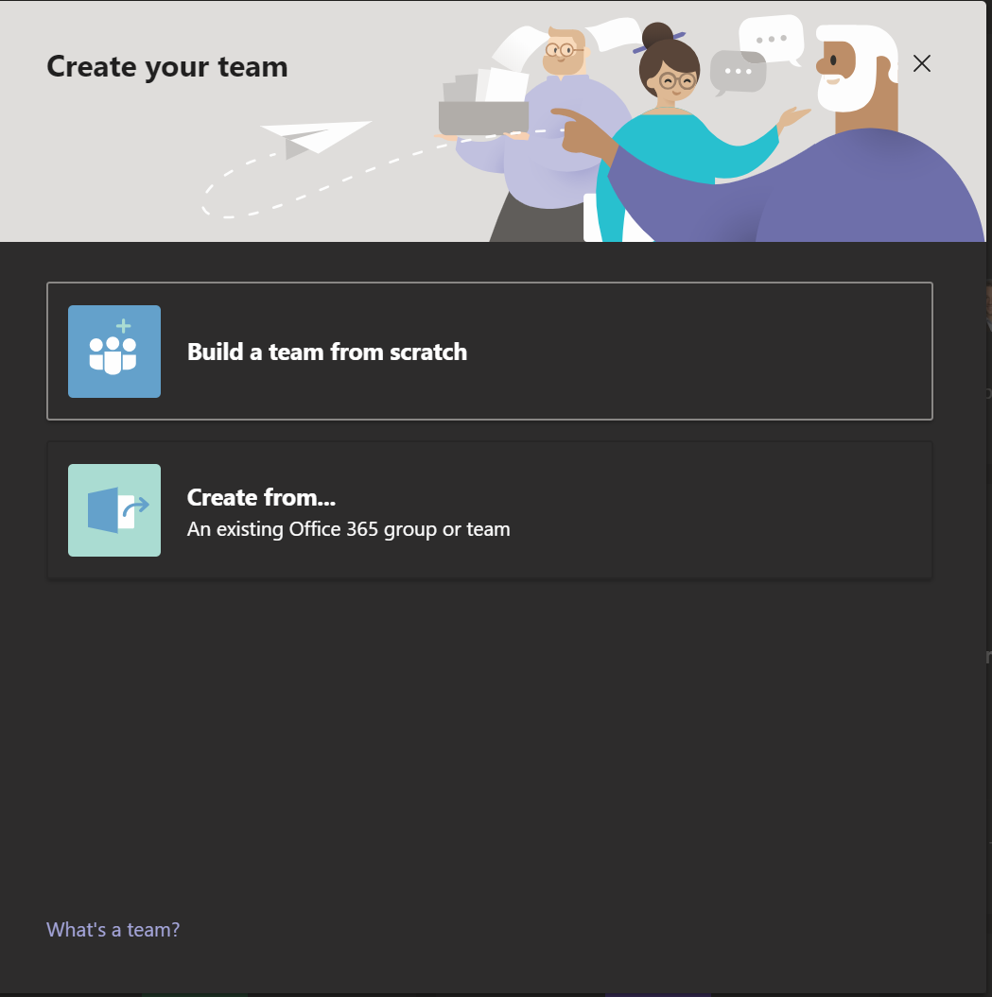
Teams Provisioner Identity
Create an App Principal context
Grant app permissions to create Groups
In this context, Groups === Teams
✔
Notes:
https://www.flickr.com/photos/jpgpearson/16979097310/in/photolist-rSoj65-38EXQ7-6U6jTT-2Rji3Z-bxrnpQ-s9Wi-6X9XsW-64HZaK-bvBtP-6Z3v19-626SgT-2sxZBg-dW8Tmm-d2EUi-253i2q8-66EEor-4gPheP-5MYNE-7t5BDs-5PSmS1-D2r3s-5VpEr-9zpYpp-o41NWD-eV2Dd-6hHzvc-4YAkPo-qYhAKx-nxPg3-6jWDz8-6hHz64-Vz5XMS-o2u1QG-7UCbw1-6hMJVU-dr4ngm-8wnysh-9pjpEw-7Puamg-B1Vr8-6hMJEj-6KZEKf-e4tzo4-dtAV6J-ab9iZY-9kMSgS-aEh6nK-9XDEo-szMPe-fZw7M
Robot 5 Jonathan Pearson

Slide 27
Demo: Clone a team With flow & Graph API
Notes:
Restrict group creation
Create security group
Apply PS script to restrict group creation across tenant
Generate authorized Token for group/teams creation in Azure AD
Create SharePoint list schema w/ Team metadata
Title
Description
Department
Create a Team Template
Channels
Tabs
Create Flow to build a team using the Authorized Token
On List item add
Request approval
On approval, create team
Naming convention <Title>-<Department Code>
Loop to check when team provisioned
Email notification that team is created

Slide 28
Demo: Create a Teams Provisioner
Restrict group creation
Create security group
Apply PS script to restrict group creation across tenant
Generate authorized Token for group/teams creation in Azure AD
Create SharePoint list schema w/ Team metadata
Title
Description
Department
Create a Team Template
Channels
Tabs
Create Flow to build a team using the Authorized Token
On List item add
Request approval
On approval, create team
Naming convention <Title>-<Department Code>
Loop to check when team provisioned
Email notification that team is created

Slide 29
Summary: Create a Teams Provisioner
Team Template
Users request Team creation via form
Once approved, team is created via Graph API using token authorization (Azure AD)
Teams can be generated based on a template (improves findability)

Slide 30
Summary: Create a Teams Provisioner
Place reasonable restrictions on who can create a team and for what purpose
Templatize Teams to encourage consistency, usability, findability
Other provisioning features
Manage ACLs
Prefix/Suffix
Create Channels
Apply Teams Tabs
SpFx Application Provisioning
Integration with 3rd party applications

Slide 31
Licensing
Naming conventions (auto-prefix) Premium P1
Dynamic Groups Premium P1
Flow “Advanced” Connectors (Flow P1 for authors)
February 2019 Licensing changes to Flow
Complex rules w/r/t who needs licenses for what
In general, when working with SharePoint, only Authors need P1 licensing
External Sharing – 5 Guest users per licensed teams user
Notes:
==Prefix==
Premium P1 License (see below Dynamic Groups)
==Dynamic Groups==
https://docs.microsoft.com/en-us/azure/active-directory/users-groups-roles/groups-dynamic-membership​
​
This feature requires an Azure AD Premium P1 license for each unique user that is a member of one or more dynamic groups. You don't have to assign licenses to users for them to be members of dynamic groups, but you must have the minimum number of licenses in the tenant to cover all such users. For example, if you had a total of 1,000 unique users in all dynamic groups in your tenant, you would need at least 1,000 licenses for Azure AD Premium P1 to meet the license requirement.​
​
https://azure.microsoft.com/en-us/pricing/details/active-directory/​
Basic $1 user/month​
Premium P1 $6 user/month​
==Flow Advanced Connectors==
https://jussiroine.com/2019/01/the-comprehensive-licensing-guide-to-microsoft-flow-and-powerapps/
February 2019 Licensing changes to Flow
$5 user/month P1

Slide 32
Dynamic Distribution Groups
Security groups which can be managed centrally
Historically – Active Directory Groups assigned to SharePoint security groups
“IT Managers” security group which gives access to Virtual Machines
“HR” group which gives elevated access to HR contents
Active Directory Premium for Office 365 unlocks this feature ($6/user/month)
Community has developed custom scripts to synchronize groups as an alternative to AD premium
Notes:
SharePoint people – think of using an Active Directory group in a SharePoint security group. AD group can be managed centrally and permissions are applied to all sites inheriting this group instantly
Demro – Test me

Slide 33
Build your own Governance Process
Experiment with Flow, Graph API.
Start simple, add complexity only when necessary
Use Team templates. Create templates which are relevant to your business entities (channels, tabs, etc.)
Pilot new governance policies with small group. Build training materials
Hold a kick off meeting to communicate expectations and guidance
Provide a means for feedback to be submitted
Check in regularly
usage, identify patterns, recognize points of value and deficiencies.
Update governance policies as needed

Slide 34
Thank you!
https://github.com/pdemro/teams-govenernance-2019 | Slides and resources from this session
aka.ms/SPC/Sessions/SharePoint | Learn more from related sessions from SPC19
aka.ms/SharePoint/Resources | Explore resources for deployment and adoption
aka.ms/SharePoint/Blog | Stay up to date on the latest product news
aka.ms/teamwork/governance | Get up-to-speed on all governance options across teamwork apps
aka.ms/M365Roadmap | Discover what’s coming with the Microsoft 365 Roadmap
https://docs.microsoft.com/en-us/graph/api/resources/teams-api-overview?view=graph-rest-1.0 | Teams Graph API guidance & documentation
@demroPhillip | Follow me and share this session

