Slide 1

Top 5 products in category "1423"
Coding Exercise by Pratik Deshmukh
For – Staples Data Science Pricing Internship
5th April 2022

Slide 2
What metrics would determine the "Top Products" in category "1423"?
The factors assumed for determining which products are important within the category "1423" are as follows (in the given sequence of importance) -
Higher "number of sales" of that product (Calculated by counting the number of transactions for each product)
Sales ($) generated from units sold of the Product are high
Number of units sold in each transaction is higher
Staples' Cost for single unit is higher

Slide 3
With the above criteria, these are the "Top 5 Products" in category "1423"
Product_IDs in descending order of Importance -
Product 1 = 3910992
Product 2 = 3910526
Product 3 = 3910528
Product 4 = 3910996
Product 5 = 3910995

Slide 4
How did we go about forecasting the future?
We had 6 months of transactional data (from 1st May 2017 to 1st November 2017) and Staples' cost $ for single unit of the product
We used an algorithm called "fbprohet" to analyze this data and predict the future 8 weeks following week ending in 28th October 2017 for each of the top 5 Products

Slide 5
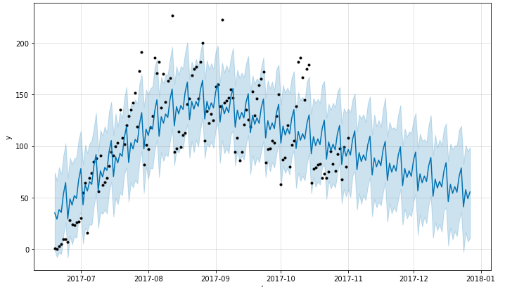
Sample model for Product 1
The blue line shows the prediction in the future
The black points are our historical datapoints

Slide 6
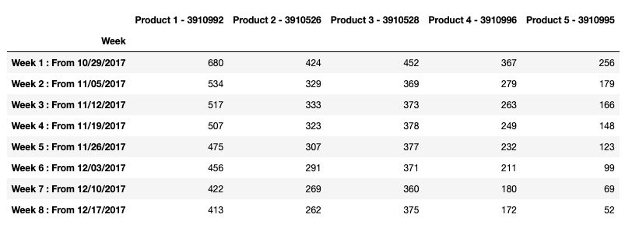
Forecast of units sold per week for next 8 weeks based on the analysis

Slide 7
Thank you
Presented by -
Pratik Deshmukh

