Slide 2
Project Goals
The goal of this project is to answer :
Can Implied Volatility predict Future Realized Volatility or vice-versa
Do the corelationships significantly impact the multi-step/long forecast of the IVS?
Validate the hypothesis that TimeSeries statistical Models such as ARMA, ARIMA & GARCH are good for Short lookahead periods of forecasting
Does RNN architecture significantly outperform traditional time series models in a multi-step out-of-sample forecast of the IVS?
Can CNN Architecture help predict the price movement for multi-step forecast

Slide 3
Data Preparation
1. Data Cleansing:
Data sourced from the publishers like ALPACA and Fred.Stlouisfed is ready to be used without having to check for dataquality aspects.
2. Data pre-processing:
For Univariate models use the Vix Dataset
For multivariate forecasting models use previous closing prices to caluculate the Realized Volatility to predict Implied Volatility.
Use 70% of the data for training and 30% of the data for testing in each model
Slice the data and time box it for the n day window.
using MinMaxScaler scale X and y values for the model. for Multivariate & multi dimensional data set, create matrix of MinMaxScalers to suppoort Vectors of more than 2 dimensions.
In case of multistep forecasting, the dimensions of our samples will be more than 2 dimensions. for building the LSTM models, the input shape has to be in the form of (n_samples, n_features and n_steps) which is a 3 dimensional vector. using Reshape method, x_train & x_test data sets are converted into the input shape for the LSTM models.

Slide 4
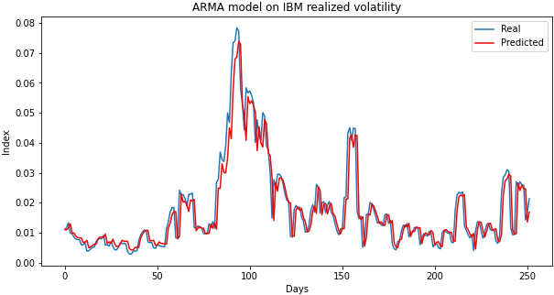
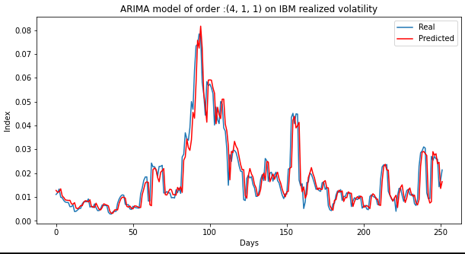
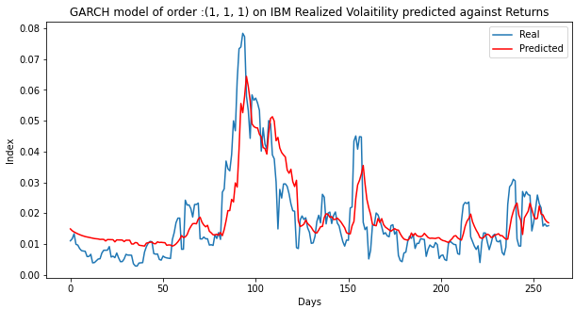
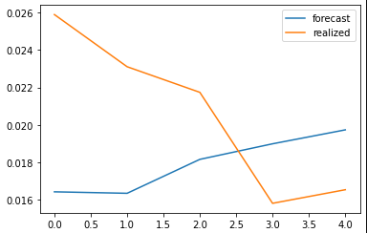
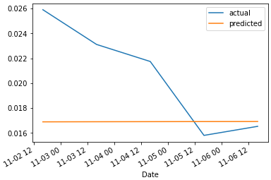
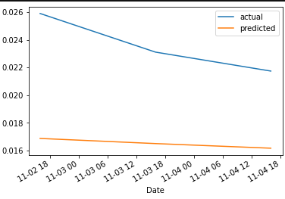
Univariate Time Series Model Predictions
MSE: 0.0; RMSE: 0.0054: MAE: 0.0137
MSE: 0.0; RMSE: 0.0053: MAE: 0.0137
MSE: 0.0001; RMSE: 0.0082: MAE: 0.0136
MSE: 0.0001; RMSE: 0.0072: MAE: 0.0128
MSE: 0.0; RMSE: 0.0058: MAE: 0.0114
MSE: 0.0; RMSE: 0.0054: MAE: 0.0114

Slide 5

Can TS Stat Models accurately predict multi-step forecast?
y_test
t.day+1 t.day+1 t.day+1 t.day+1 t.day+1
y_pred
f.day+1 f.day+2 f.day+3 f.day+4 f.day+5
p.day+1
p.day+1
p.day+1
p.day+1
p.day+1
Observation:
TimeSeries Models do predict both direction and scale with reasonably high accuracy.
When predicting long look ahead periods, TimeSeries models lose the ground on direction & scale.

Slide 6
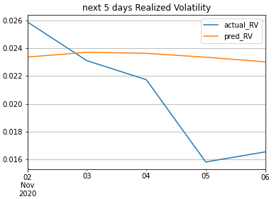
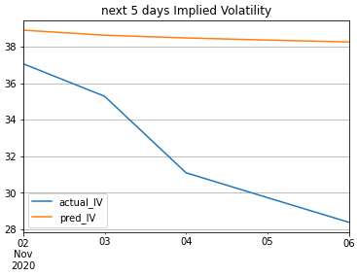
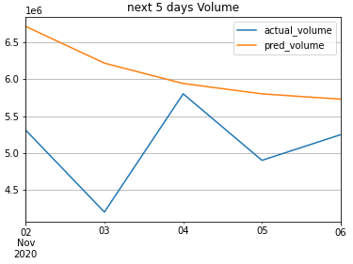
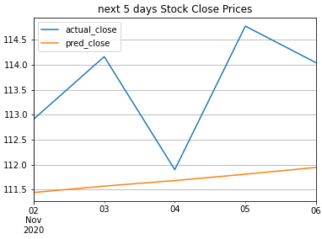
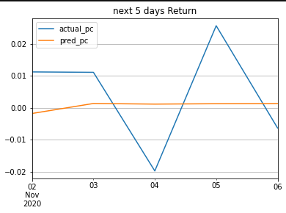
Multi-Variate TS - Stat Model- VAR Predictions
RMSE : 0.008114496437544914
RMSE : 10.248285312092737
RMSE: 2926717.3003807445
RMSE : 31.186011485370532
RMSE : 0.013354583459296972

Slide 7
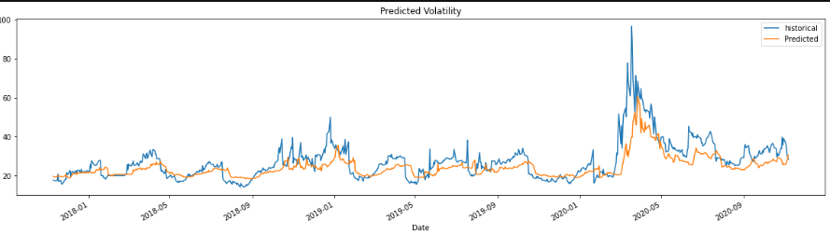
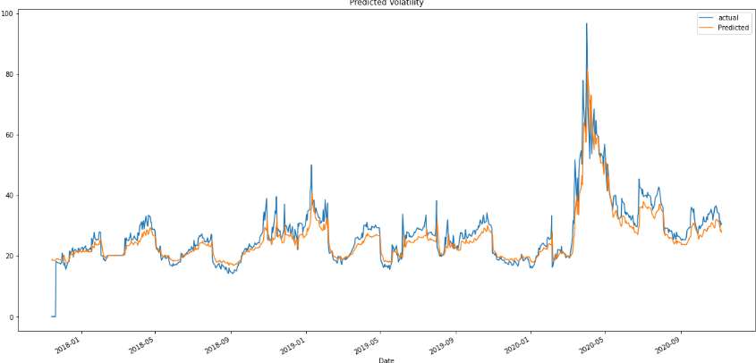
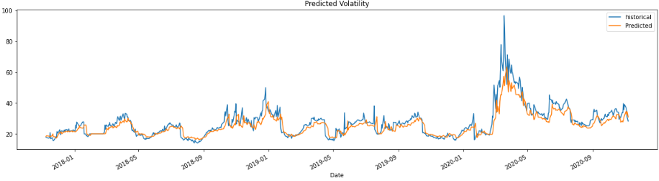
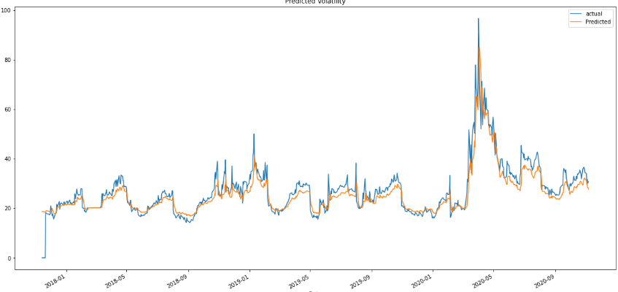
Univariate - RNN (LSTM) multi Step Predictions 3 layer LSTM, Activator = adam, loss=MSE, dropout 20%, 70% train test split, 20% Validation Split
Initial prediction Results - without hyper parameter tuning
3rd round : nnodes=100; batch_size=50, epocs=200
2nd round prediction Results: With hyper parameter tuning
nnodes=50; batch_size=50, epocs=100
Final prediction Results: With nnodes=100; batch_size=100, epocs=500

Slide 8
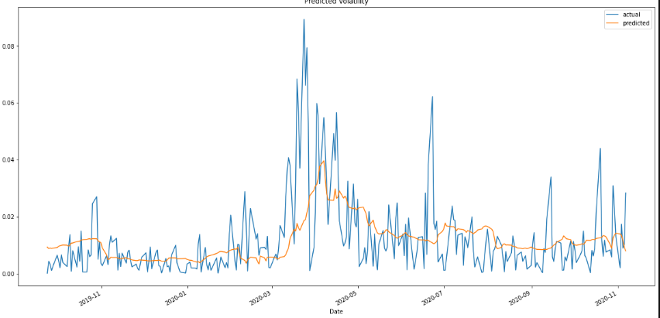
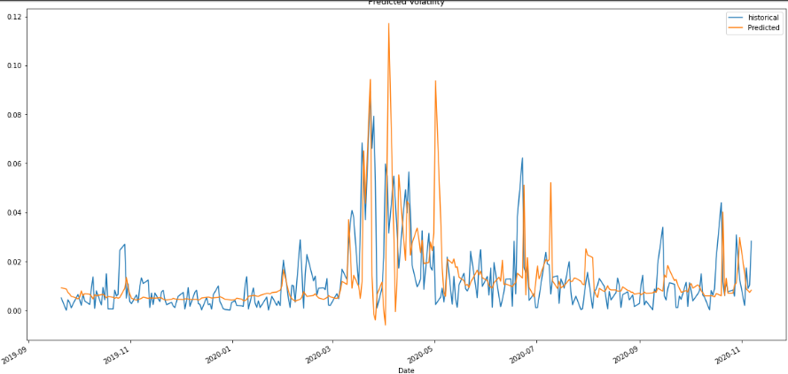
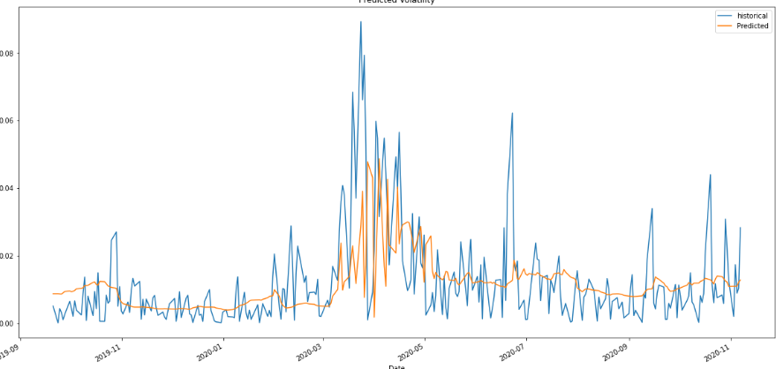
MultiVariate RNN Prediction - Volume, IV & RV - 3 layer LSTM, Activator = adam, loss=MSE, dropout 20%, 70% train test split, 20% Validation Split
Initial prediction Results - without hyper parameter tuning
Challenges -
1. MinMaxScaler/Std Scalers dont accept more
than 2dimensional Vectors.
2. Our data set has n smaples ,2 features and 5 day window,
making it 3D Vector
3. Had to create scaler Matrix with minMax scaler for
each of the extra dimensiion
Final prediction with nnodes=100, batch_size=20, epocs=100

Slide 9
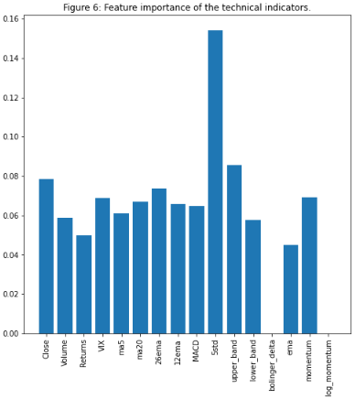
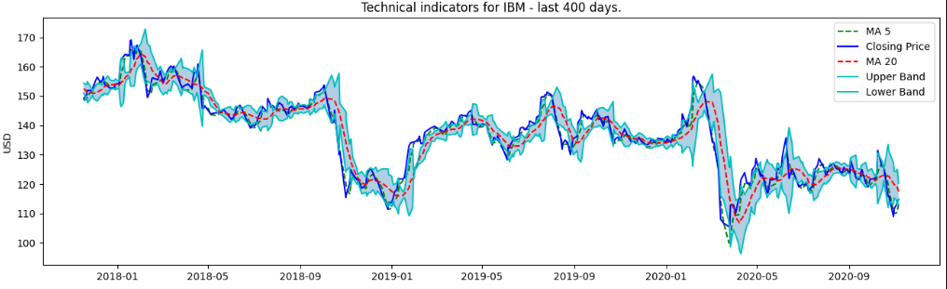
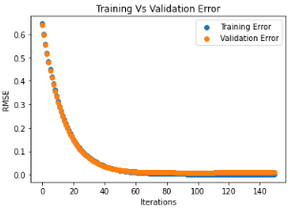
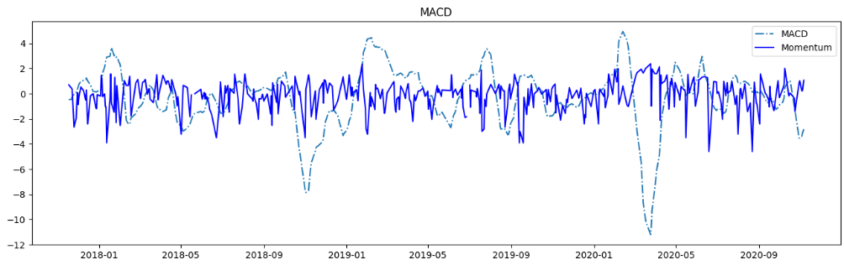
Feature Engineering - Using Technical Indicators & XGBoost Decision Tree Model to identify Feature Importance
gamma=0.0,n_estimators=150,base_score=0.7,colsample_bytree=1,learning_rate=0.07

Slide 10
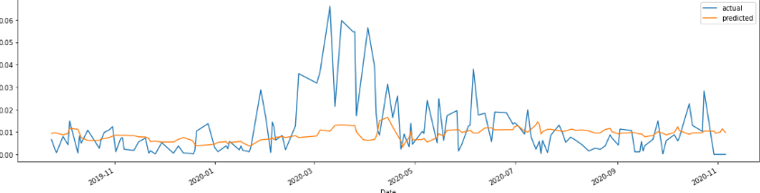
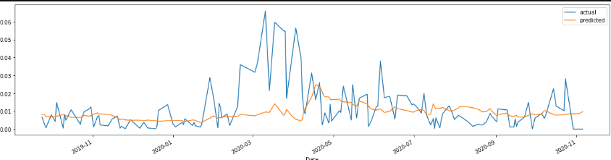
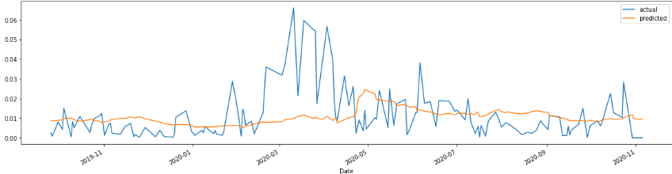
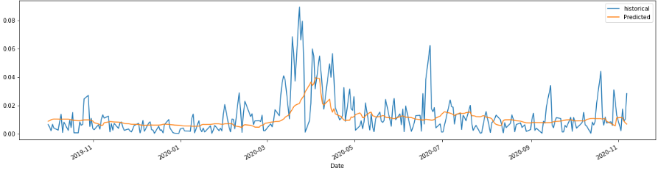
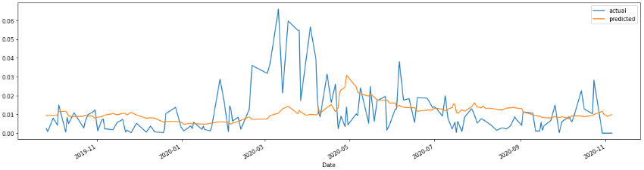
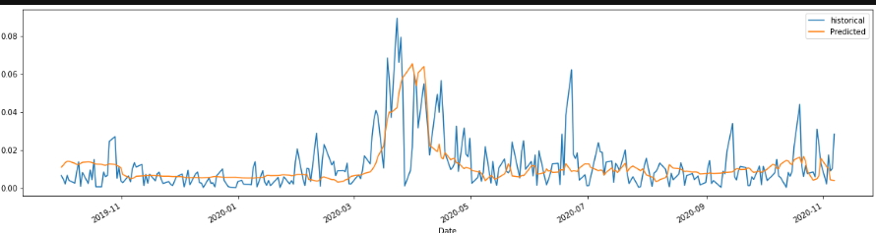
Feature Engineered RNN - 10 features, 5day Predictions nnodes = 100, Batch_size=5, epochs=100, dropout=0, train test: 70% validate-10%

Slide 11
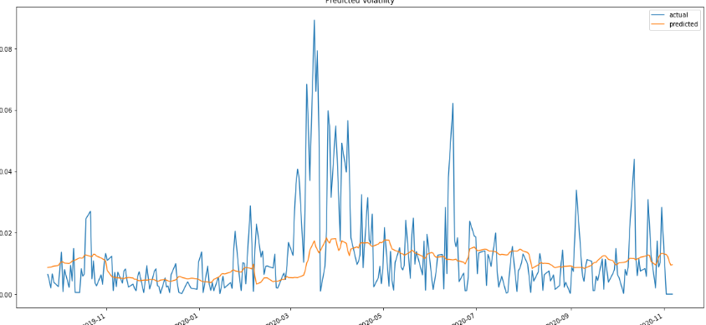
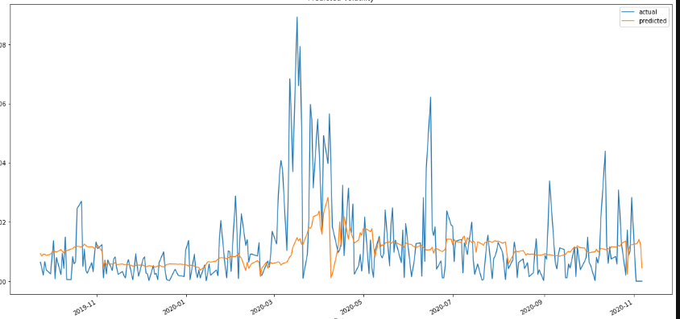
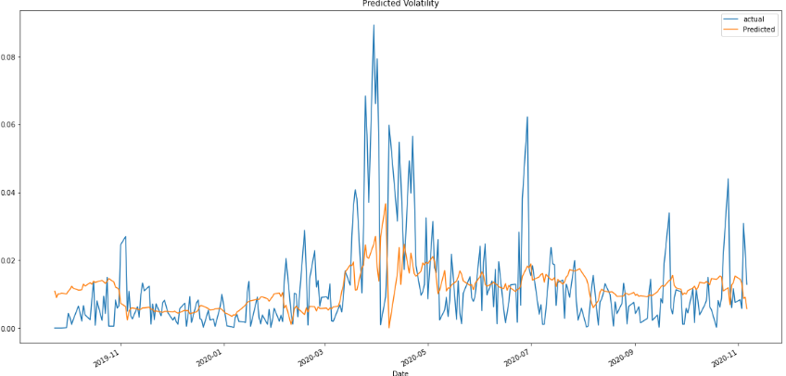
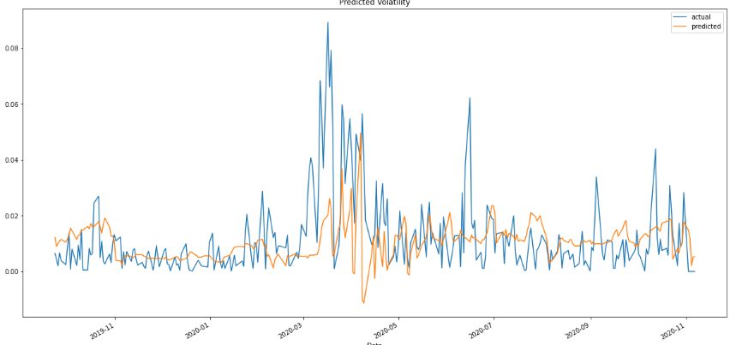
Dimensional reduction using PCA - RNN predictions

Slide 12
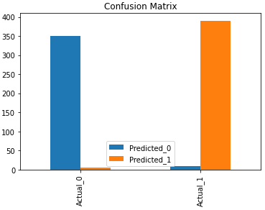
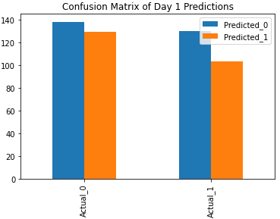
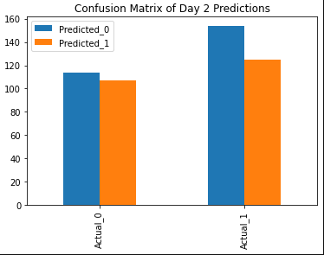
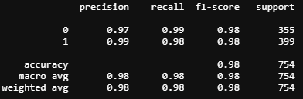
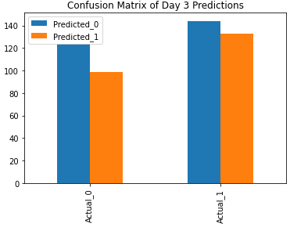
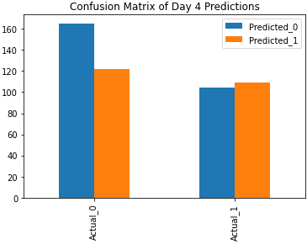
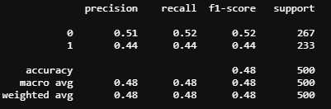
Multi-Variate CNN Predictions- 1 day Vs 5day
1 - day CNN prediction Accuracy
5-day CNN Accuracy Report

