Slide 1
Pyjama
‹#›
iPDC Summer Institute

Slide 2
Why PyJama?
Easy to learn syntax for writing parallel programs based on OpenMP
OpenMP in C/C++ is standard for scientific parallel computing
So students will be familiar with the C/C++ omp syntax when they take their upper division parallel computing elective
Java is a commonly used language in CS1 and CS2
Caveat: PyJama is not mature (yet)
Lacks full core OpenMP features
Has some peculiarities (more later)

Slide 3
Pyjama Installation: Environment
Online Guide: https://www.csc.tntech.edu/pdcincs/index.php/installation/
Install Java JDK
Download our version of Pyjama (modified to mitigate some of the original problems)
Run script to set PATH variable:
source setpath.sh (Linux/Mac)
setpath.bat (Windows)

Slide 4
Pyjama Installation: Compile/Run
Compile with:
java -jar $pyjama FileName.java (linux/mac)
java -jar %pyjama% FileName.java (Windows)
Run with:
java -cp $pyjama:. ExecutableName (Linux/Mac)
java -cp %pyjama%;. ExecutableName (Windows)

Slide 5
Pyjama Vs. OpenMP Syntax
OpenMP
Pyjama
int main( int argc, char *argv[])
{
int thread_count = atoi(argv[1]);
#pragma omp parallel num_threads(thread_count)
{
int my_id = omp_get_thread_num();
int t_count = omp_get_num_threads();
cout <<"Hello from "<<my_id<<" of "<<t_count<<endl;
}
return 0;
}
public class PyjamaHelloWorld {
public static void main(String[] args) {
int threadCount = Integer.parseInt(args[0]);
//#omp parallel num_threads(threadCount)
{
int myID = Pyjama.omp_get_thread_num();
int tCount = Pyjama.omp_get_num_threads();
System.out.println("Hello from "+myID +" of "+tCount);
}
}
}

Slide 6
Pyjama Coverage of OpenMP?

Slide 7
First Example
(Hello World, of course)
public class HelloWorld {
public static void main(String[] args) {
int threadCount = Integer.parseInt(args[0]);
//#omp parallel num_threads(threadCount)
{
int myID = Pyjama.omp_get_thread_num();
int tCount = Pyjama.omp_get_num_threads();
System.out.println("Hello from "+myID +" of "+tCount);
}
}
}

Slide 8
Pyjama: Parallel Sum
public class ParallelSum {
public static void main(String[] args) {
int numThreads = Integer.parseInt(args[0]);
int n = Integer.parseInt(args[1]);
int sum = 0;
int [] results = new int[numThreads];
int [] arr = new int[n];
for (int i = 0; i < n; i++) arr[i] = 1;
//#omp parallel num_threads(numThreads) shared(numThreads, n, arr, results)
{
int id = Pyjama.omp_get_thread_num();
int chunk = (int)n/numThreads;
int start = id * chunk;
int end;
if (id == numThreads - 1) end = n;
else end = start + chunk;
for (int i = start; i < end; i++)
results[id] += arr[i];
}
for (int i = 0; i < numThreads; i++)
sum += results[i];
System.out.println("sum = " + Integer.toString(sum));
}
}

Slide 9
Working with Arrays
Many parallel computations happen on arrays
For data decomposition, you must partition the array among the child threads
Pyjama does this for you with omp parallel for
Typically, partitioning is done by assigning a number of items per each thread
And then having the thread compute its starting and ending index based on its thread id
But, Pyjama does all the calculations for you with omp parallel for
‹#›

Slide 10
import java.lang.*;
import java.lang.Math;
import java.util.Random;
import java.util.concurrent.ThreadLocalRandom;
public class ArraySum {
public static void main(String[] args) {
int numThreads = 0;
int numItems = 0;
if (args.length < 2) {
System.err.println("usage: Hello <numThreads> <numItems>");
System.exit(0);
}
try {
numThreads = Integer.parseInt(args[0]);
numItems = Integer.parseInt(args[1]);
} catch (Exception ex) {
System.err.println("Bad argument");
System.exit(1);
}
double[] a = new double[numItems];
fillArray(a);
double sum = 0;
//#omp parallel for shared(a) num_threads(numThreads) reduction(+:sum)
for (int i = 0; i < a.length; i++) {
sum += a[i];
}
System.out.println("Sum is " + String.valueOf(sum));
}
private static void fillArray(double[] a) {
for (int i = 0; i < a.length; i++) {
a[i] = Math.random() * 100;
}
}
}
Array Sum Version 2
Using parallel for

Slide 11
Pyjama: Parallel Min/Max
import java.util.concurrent.ThreadLocalRandom;
public class ParallelMinMax {
public static void main(String[] args) {
int numThreads = Integer.parseInt(args[0]);
int n = Integer.parseInt(args[1]);
int max_val = 0;
int [] arr = new int[n];
for (int i = 0; i < n; i++)
arr[i] = ThreadLocalRandom.current().nextInt(0, 101);
//#omp parallel num_threads(numThreads) shared(n, arr) reduction(max:max_val)
{
//#omp for
for (int i = 0; i < n; i++)
{
if (arr[i] > max_val)
max_val = arr[i];
}
}
for (int i = 0; i < n; i++) System.out.print(arr[i] + " ");
System.out.println("\nmax value = " + max_val);
}
}

Slide 12
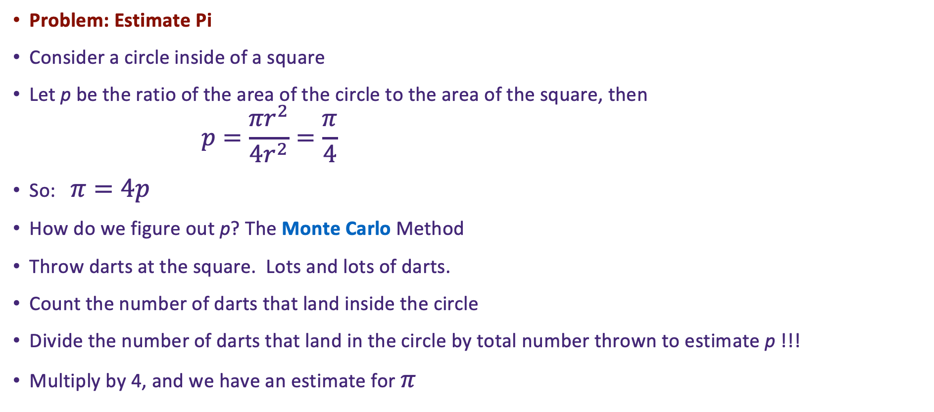

Slightly More Complex Example
‹#›

Slide 13

Some Unresolved Questions
How does a computer throw darts? By generating random x,y coordinates for where the dart would land
Given an (x,y), how can the computer tell if it landed in the circle
Make it simple, use the unit circle, and only throw darts at the upper right quadrant
Calculate the distance from 0,0
Just calculate the hypotenuse of the triangle
If hyp < 1, then the point falls within the unit circle!
Use ThreadLocalRandom instead of Random to get random numbers
Its thread safe
0,1
x,y
hyp
y
0,0
x
1,0
‹#›

Slide 14
Algorithm
class Pi
function main
get number of threads from the command line
argument as numThreads
In parallel with four threads {
create random number generator
set numInside to 0
set numOutside to 0
loop numIterations times
set x to new random number
set y to new random number
calculate hyp = square root of x^2+y^2
if hyp < 1.0
add 1 to numInside // local version
else
add 1 to numOutside // local version
end if
end loop
Sum each thread local numInside and thread local numOutside
}
Calculate p = numInside / (numInside/numOutside)
Calculate result = 4 * p
print result
end function main
end class main
‹#›

Slide 15
import java.lang.*;
import java.lang.Math;
import java.util.Random;
import java.util.concurrent.ThreadLocalRandom;
public class Monte {
public static void main(String[] args) {
int numIters = 0;
try {
numIters = Integer.parseInt(args[0]);
} catch (Exception ex) {
System.err.println("Exception when parsing argument");
System.exit(1);
}
int numIn = 0;
int numOut = 0;
//#omp parallel num_threads(4) shared(numIters) reduction(+:numIn) reduction(+:numOut)
{
int myIters = numIters / 4;
ThreadLocalRandom rand = ThreadLocalRandom.current();
numIn = 0;
numOut = 0;
//#omp for
for (int i = 0; i < myIters; i++) {
// get random number from 0 to 1
double x = rand.nextDouble();
double y = rand.nextDouble();
double hyp = Math.sqrt(x*x + y*y);
if (hyp < 1.0) {
numIn++;
} else {
numOut++;
}
}
}
float p = (((float)numIn)/(numIn+numOut));
float fourp = 4*p;
System.out.println("Pi is " + String.valueOf(fourp));
}
}
The
Code

Slide 16
Pyjama Pitfalls
Implied “default(none)” clause
Scope of variables must be declared explicitly in clause (ex. shared(var), private(var)) to use them in parallel region
Pyjama is based on Java 1.5. Newer features such as Lambdas will not work
All Pyjama lines must begin with “//#omp” - extra whitespace will mess this up
If you use the -j2j (source to source) option and do not use the -d (output directory) option when compiling, Pyjama will overwrite your source code
If you do use -d option, the directory must already exist

Slide 17
Pyjama Pitfalls
To use array in parallel region, it must be declared with brackets before variable name not after
int [] arr_var = new int[n]; ✓
int arr_var [] = new int[n]; X
Can’t use Pyjama function names as variables
This is not an exhaustive list!

