Slide 1
OpenMPTraining with Eclipse: Installation Instructions on Windows

Slide 2
Table of Contents
Setting up the C++ development environment
Setting Up the Eclipse C++ Environment
Importing the Training Git Project
Building Project (Once)
Editing and Running Project

Slide 3
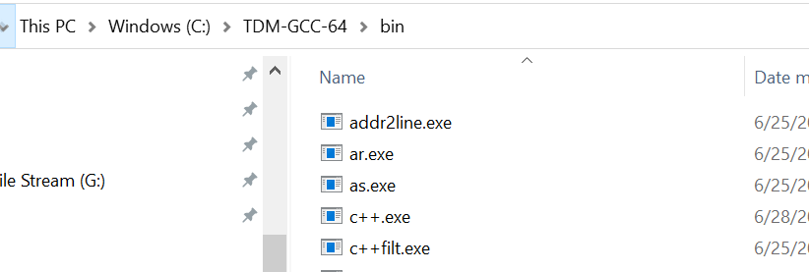
Install TDM-GCC
Download the TDM-GCC zip and extract it.
In the examples below, we will assume it is extracted into: C:\TDM-GCC-64
Keep the location of bin sub folder of the extracted folder.
In the examples below we will assume it is: C:\TDM-GCC-64\bin

Slide 4
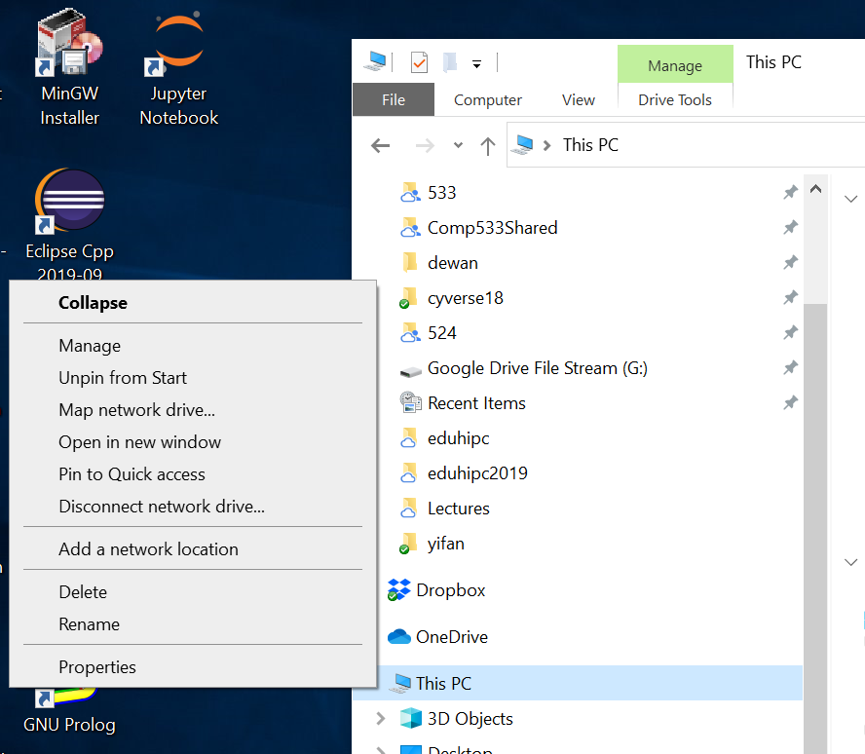
Change Path: This PC→Properties (Right Click)

Slide 5
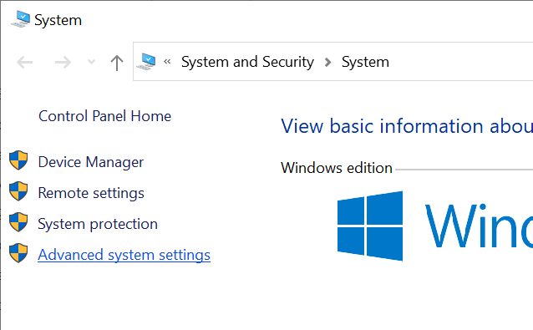
Change Path: Go to Advanced System Settings

Slide 6
Change Path: Go to Environment Variables

Slide 7
Change Path: Go to Environment Variables

Slide 8
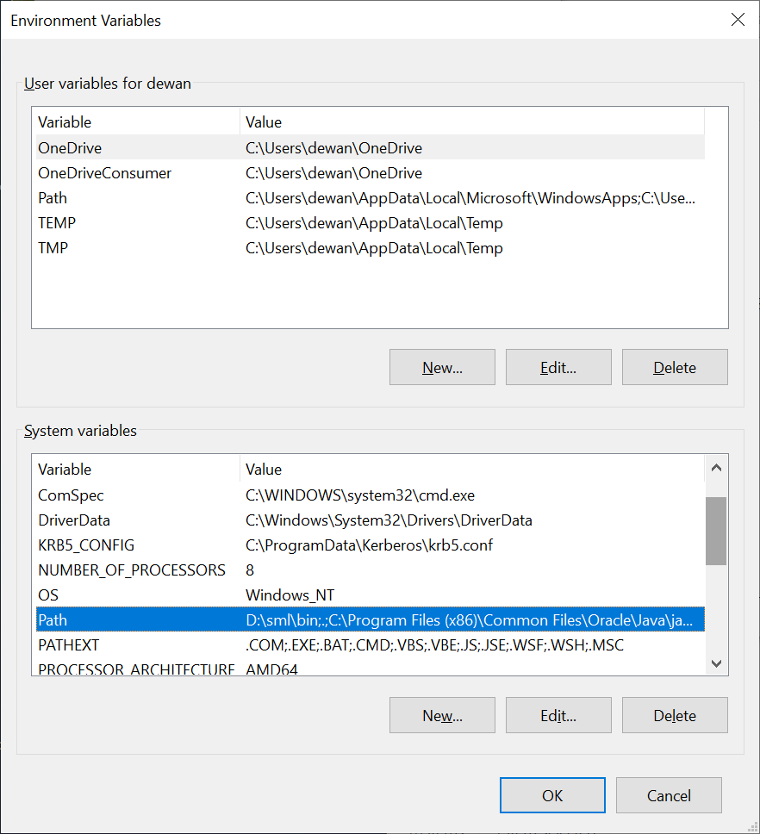
Change Path: Select Path in System Variables

Slide 9
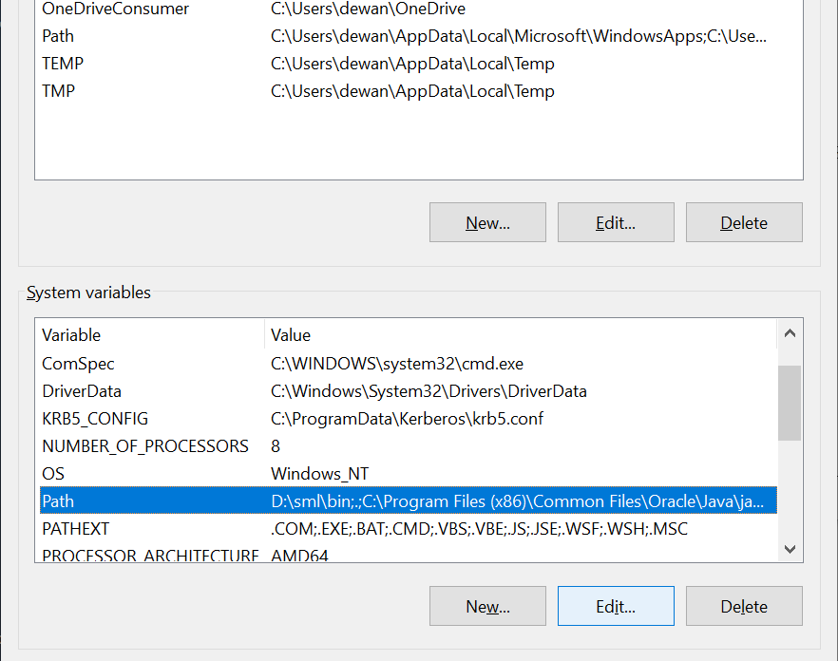
Change Path: Select Path and Execute Edit

Slide 10
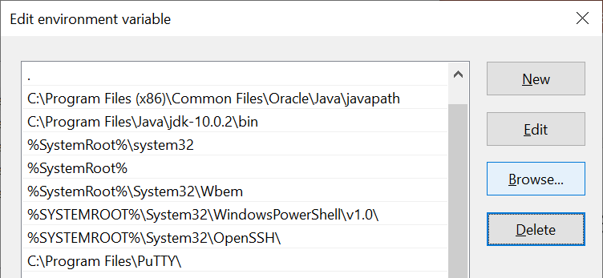
Change Path: Execute Browse

Slide 11
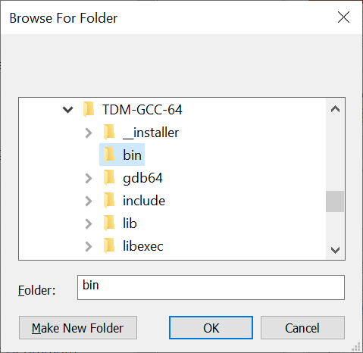
Change Path: Select the bin directory

Slide 12
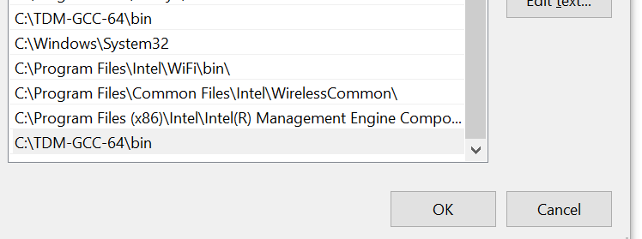
Change Path: The directory should appear at the bottom

Slide 13
Change Path: Press OK and then Apply

Slide 14
Eclipse C++ Support

Slide 15
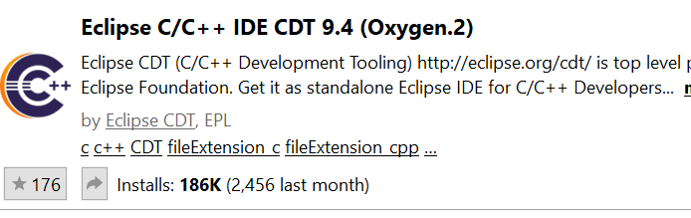
If you already have Eclipse
Choose Help→Eclipse MarketPlace
Find: CDT
Choose the following and press Install and then restart Eclipse

Slide 16
If you already do not have Eclipse
Search for Eclipse C++ download
Download the windows installer for 64 bt
Choose C++ when installing

Slide 17
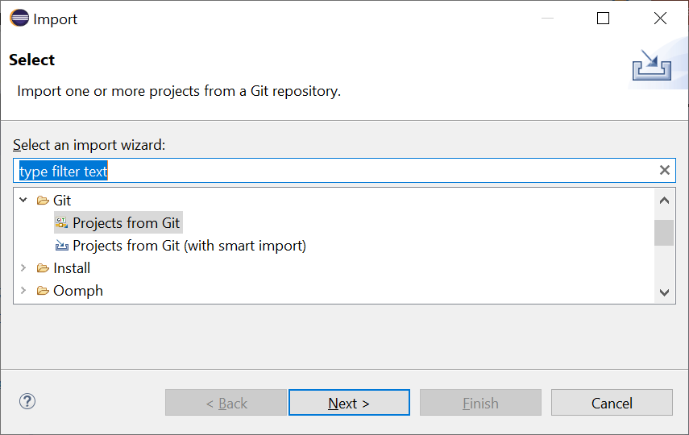
Import Git Project: ExecuteFile→Import→Git→Projects from GIT

Slide 18
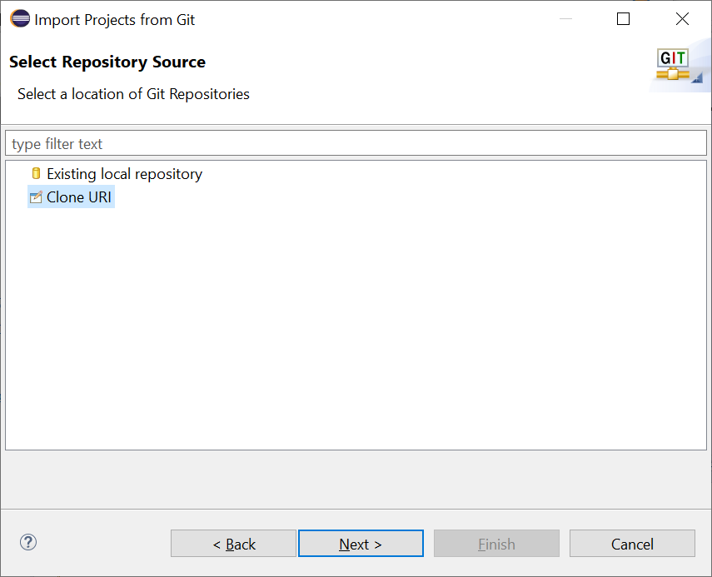
Import Git Project: CloneURI

Slide 19
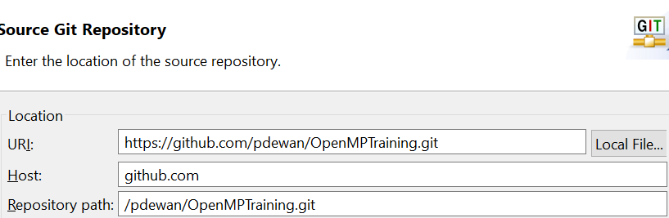
Import Git Project: CloneURI
https://github.com/pdewan/OpenMPTraining.git

Slide 20
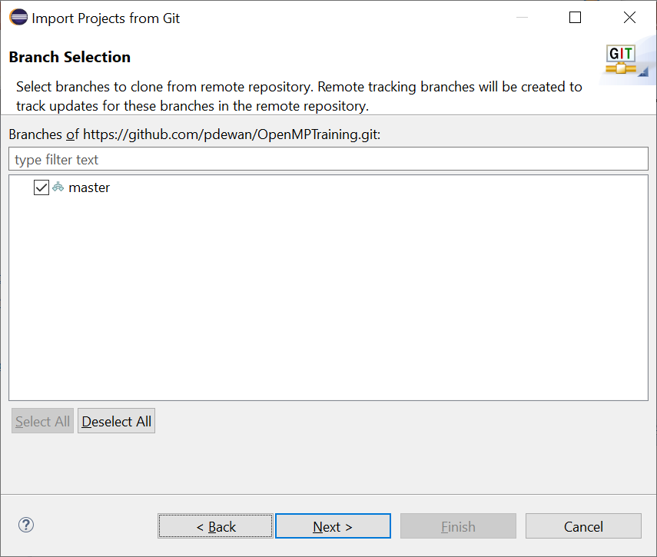
Import Git Project: Select Branch

Slide 21
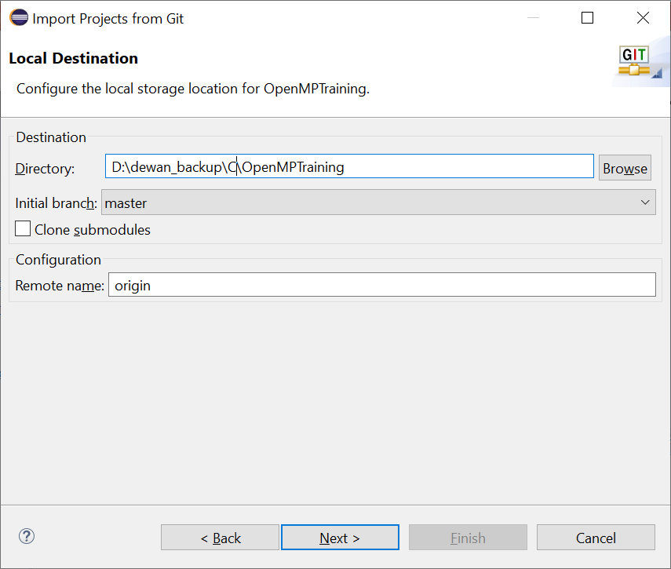
Import Git Project: Save in Local Directory

Slide 22
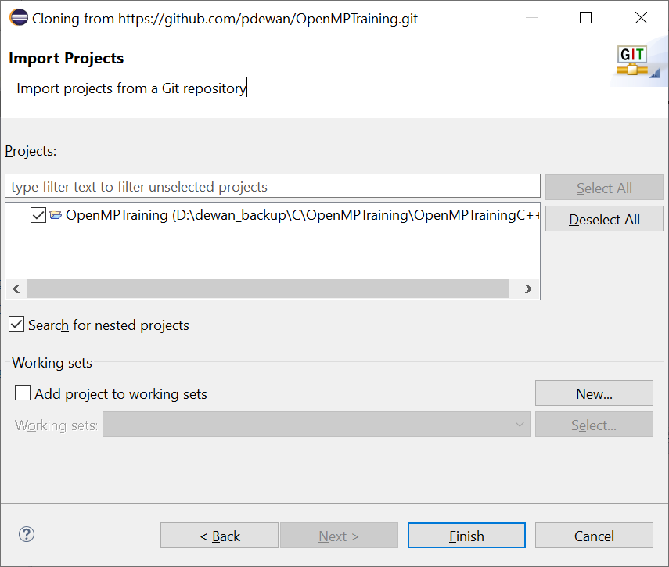
Import Git Project: Select OpenMPTraining

Slide 23
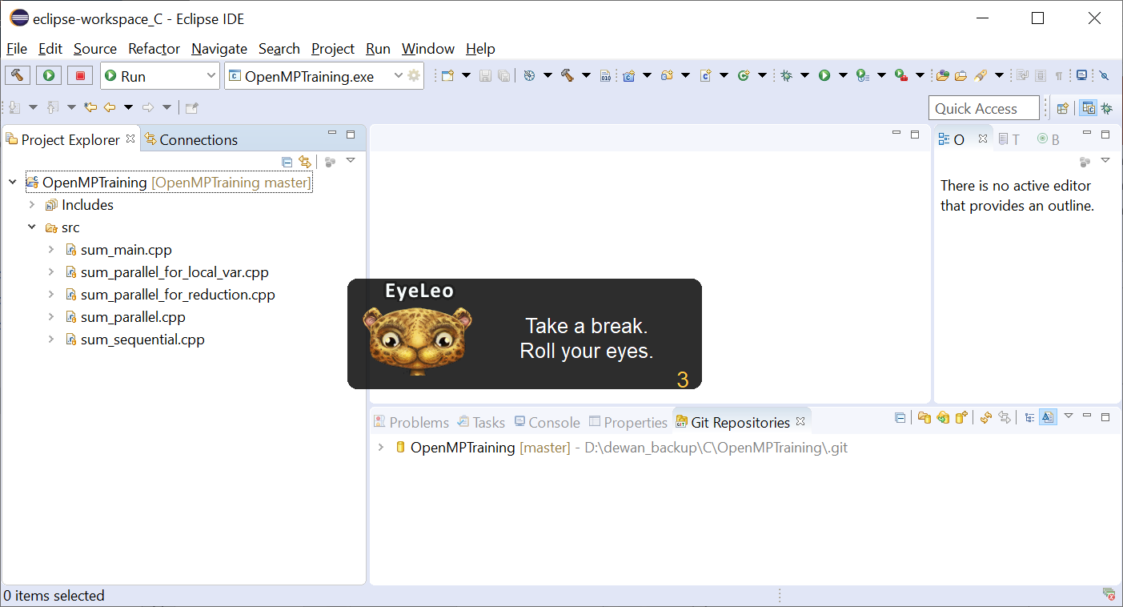
Import Git Project: Select Finish

Slide 24
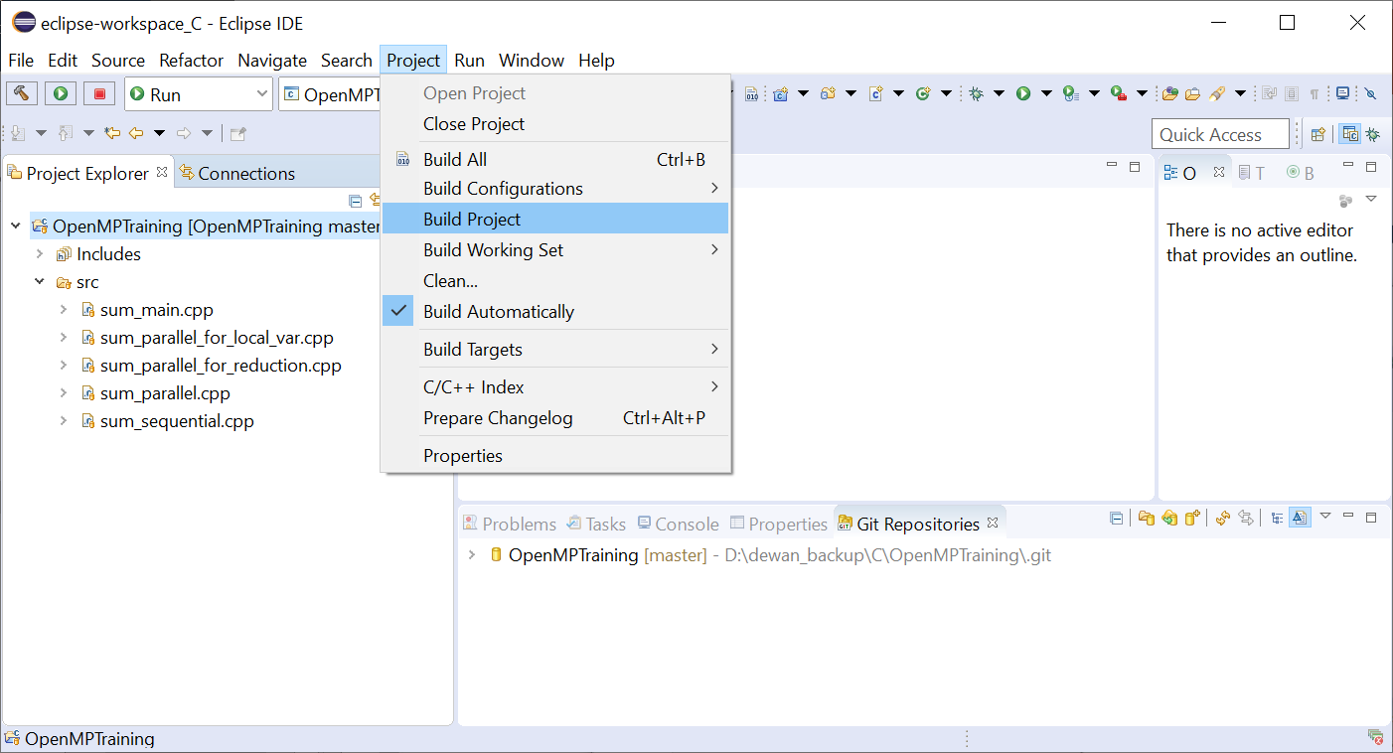
Build Project

Slide 25
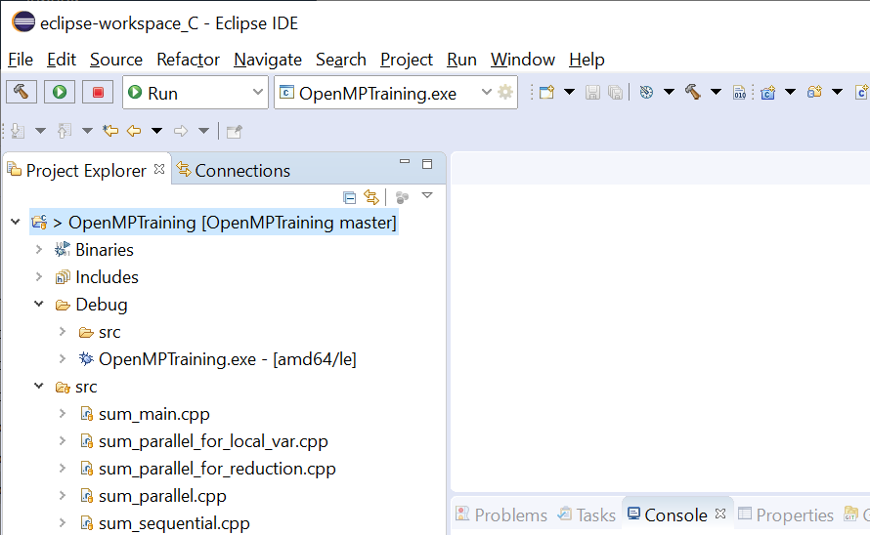
Built Project

Slide 26
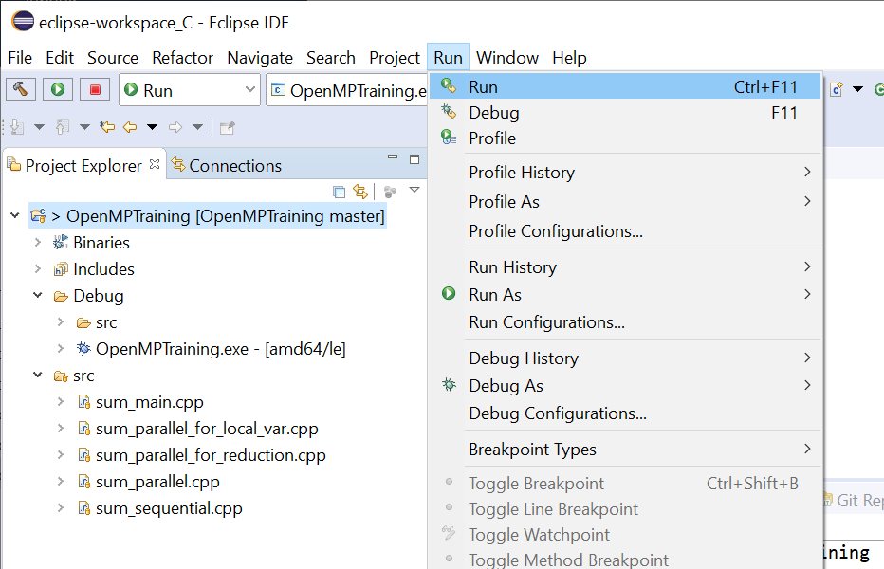
Run Project

Slide 27
Run Project

Slide 28
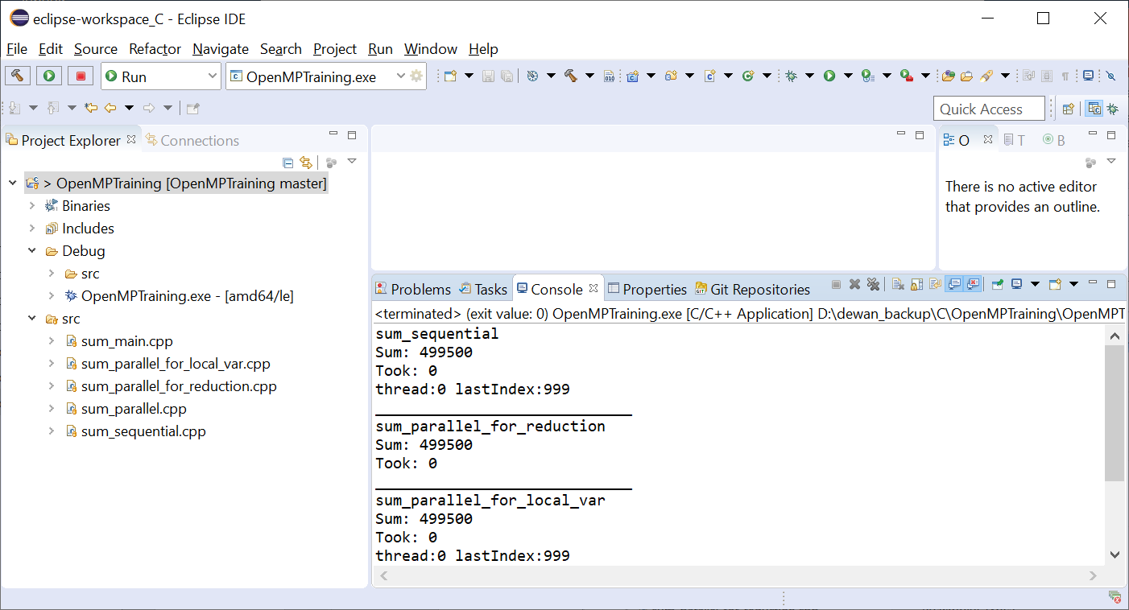
Output

Slide 29
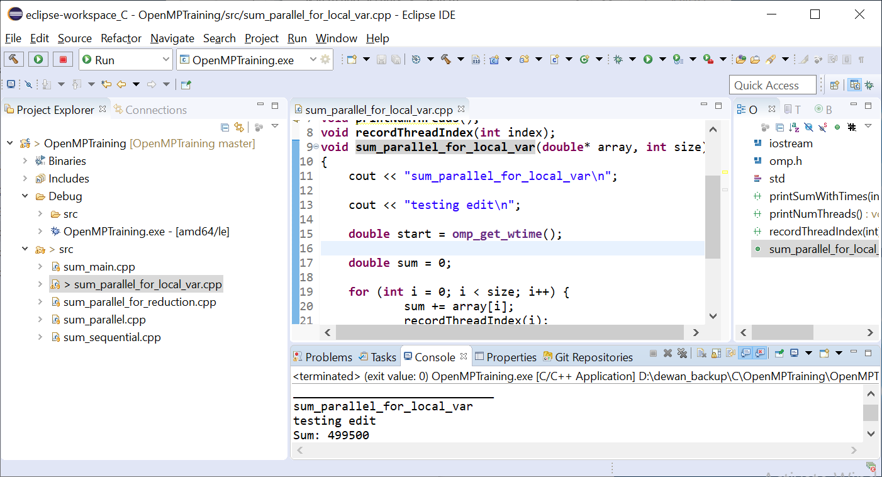
Adding “Testing edit” and Running again
CTRL-F11 runs the project again

