Slide 1
OpenMPTraining with Eclipse: Installation Instructions on Windows

Slide 2
Table of Contents
Setting up the C++ development environment
Setting Up the Eclipse C++ Environment
Installing Logging Plug-in
Importing the Training Git Project
Building Project (Once)
Editing and Running Project
Recording Difficulties
Uninstalling Logging Plugin

Slide 3
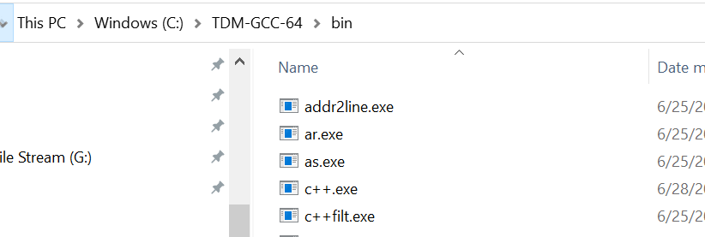
Install TDM-GCC
Download the TDM-GCC zip and extract it.
In the examples below, we will assume it is extracted into: C:\TDM-GCC-64
Keep the location of bin sub folder of the extracted folder.
In the examples below we will assume it is: C:\TDM-GCC-64\bin

Slide 4
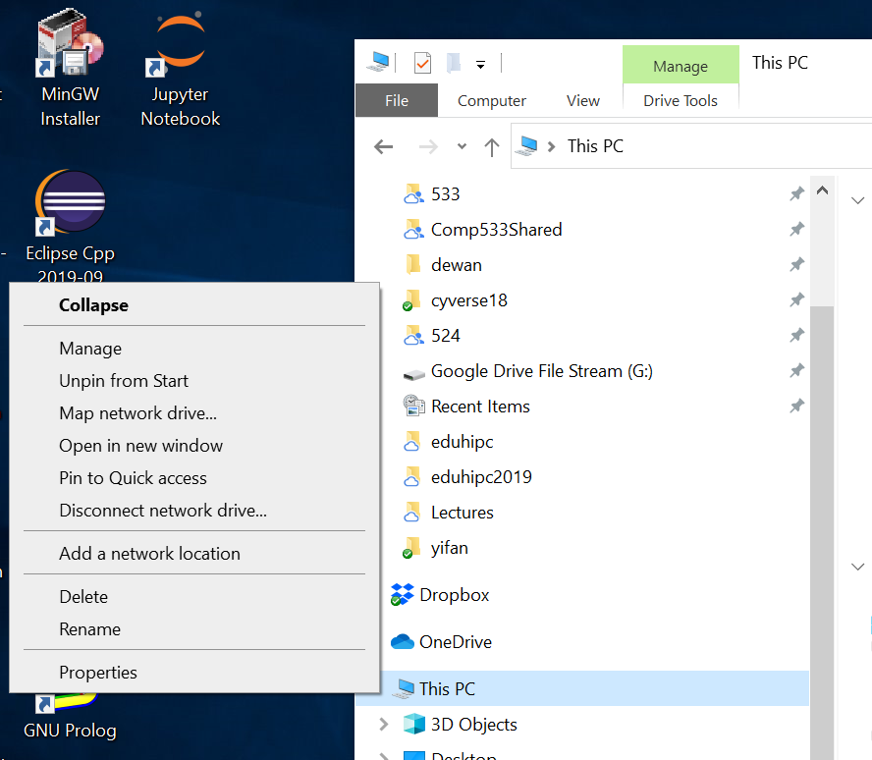
Change Path: This PC→Properties (Right Click)

Slide 5
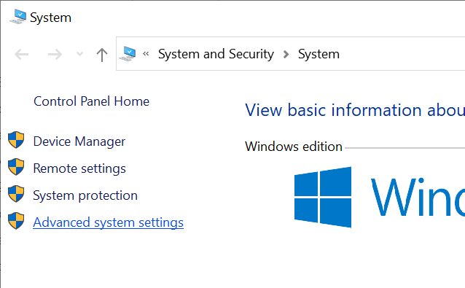
Change Path: Go to Advanced System Settings

Slide 6
Change Path: Go to Environment Variables

Slide 7
Change Path: Go to Environment Variables

Slide 8
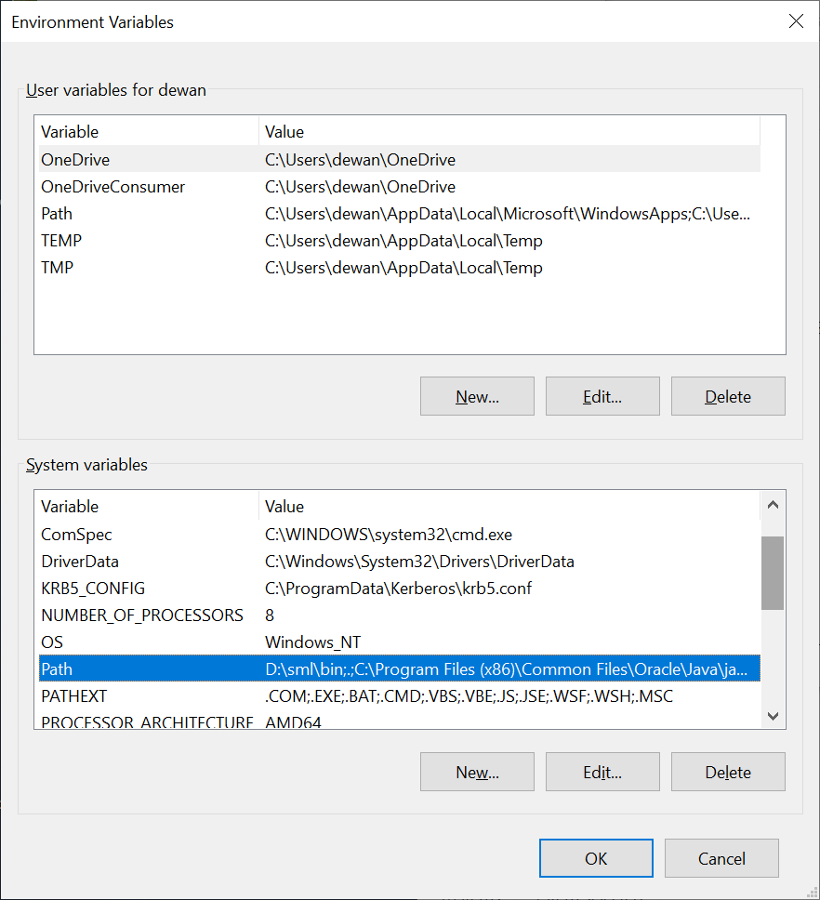
Change Path: Select Path in System Variables

Slide 9
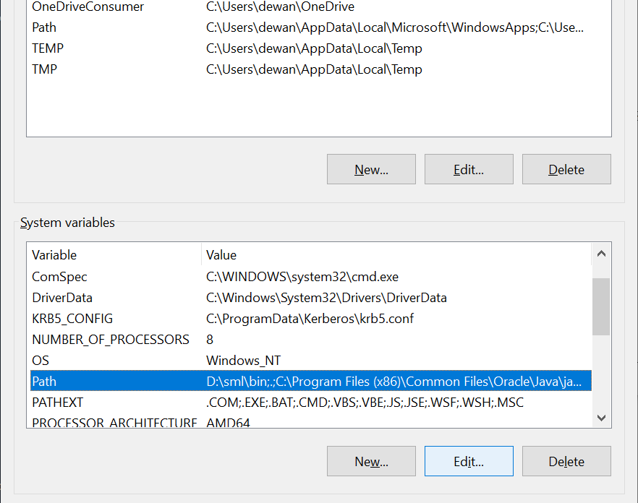
Change Path: Select Path and Execute Edit

Slide 10
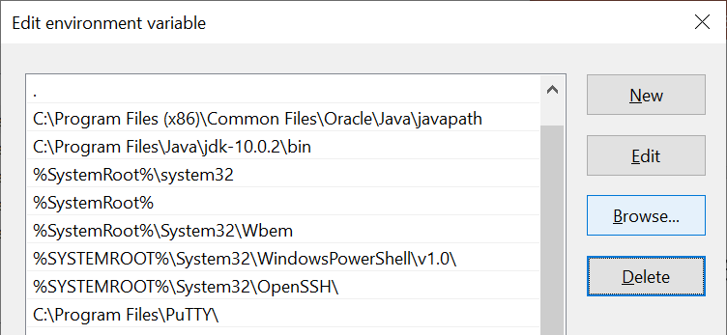
Change Path: Execute Browse

Slide 11
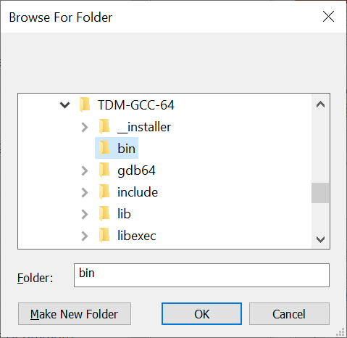
Change Path: Select the bin directory

Slide 12
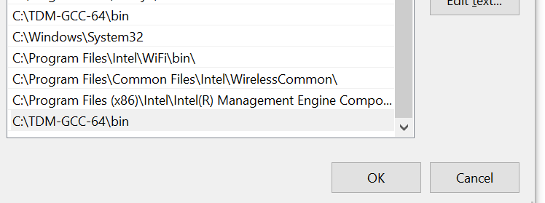
Change Path: The directory should appear at the bottom

Slide 13
Change Path: Press OK and then Apply

Slide 14
Eclipse C++ Support

Slide 15
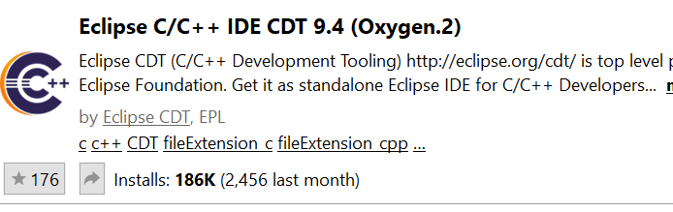
If you already have Eclipse
Choose Help→Eclipse MarketPlace
Find: CDT
Choose the following and press Install and then restart Eclipse

Slide 16
If you already do not have Eclipse
Search for Eclipse C++ download
Download the windows installer for 64 bt
Choose C++ when installing

Slide 17
Installing Logging Plug-in
A plug-in can possibly misbehave/slow you down
We show you both how to install it and uninstall it

Slide 18
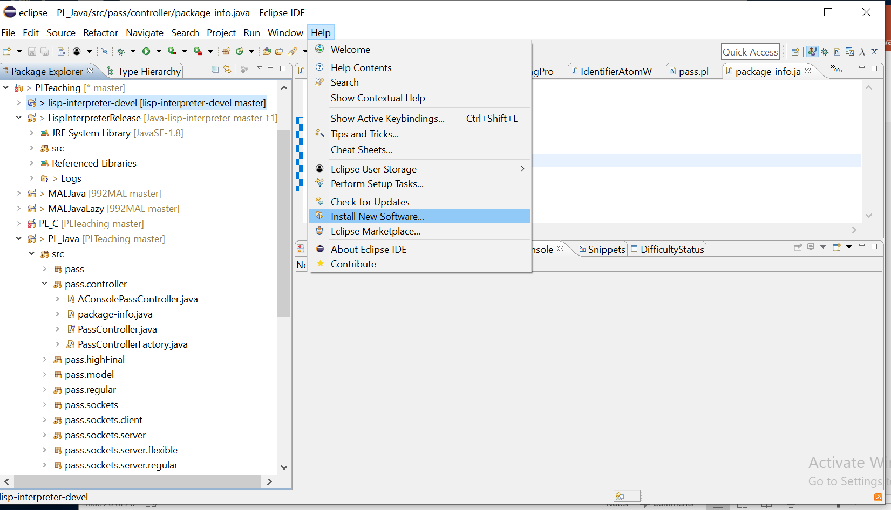
Help→Install New Software

Slide 19
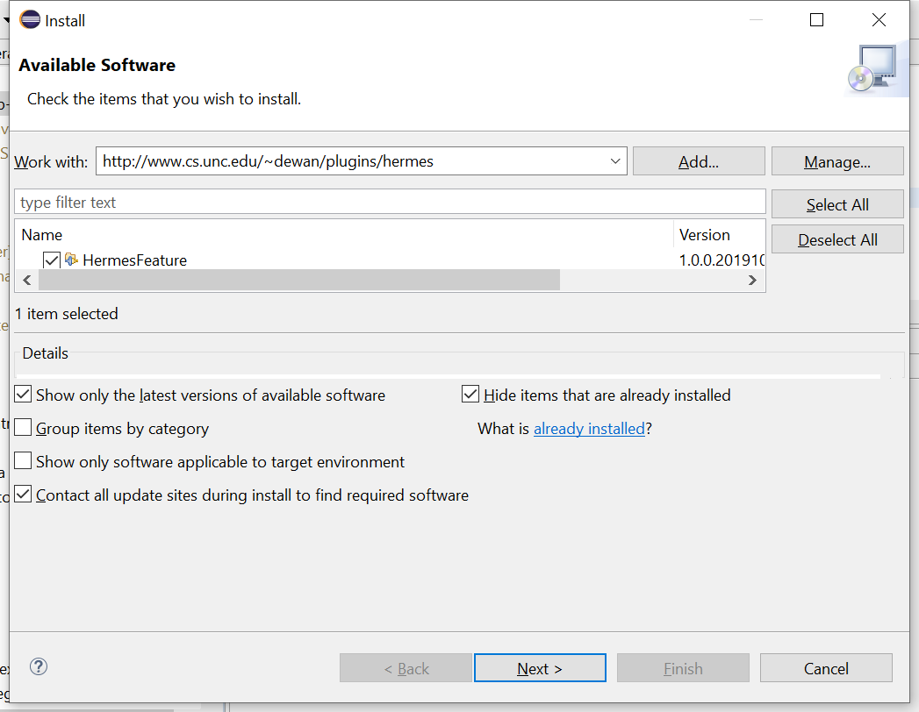
Hermes Plug-in Site and Check Hermes:
Enter: http://www.cs.unc.edu/~dewan/plugins/hermes in work with and hit return
Check HermesFeature
Next

Slide 20
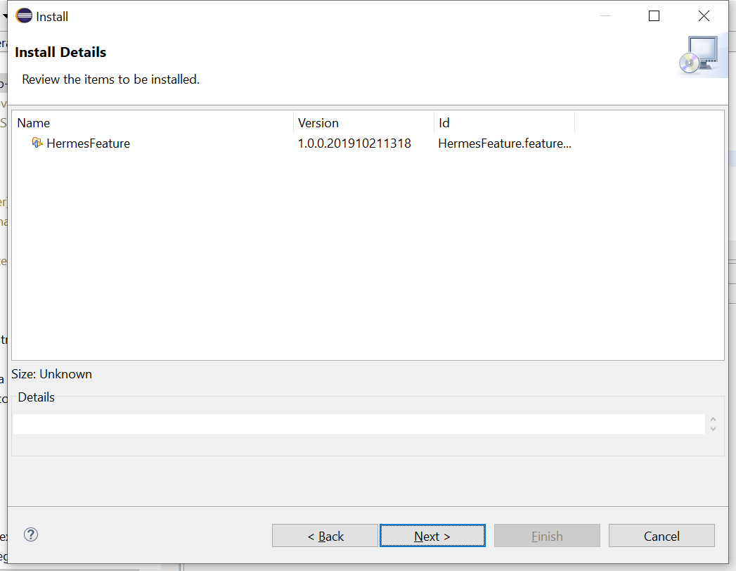
Confirm
Check HermesFeature

Slide 21
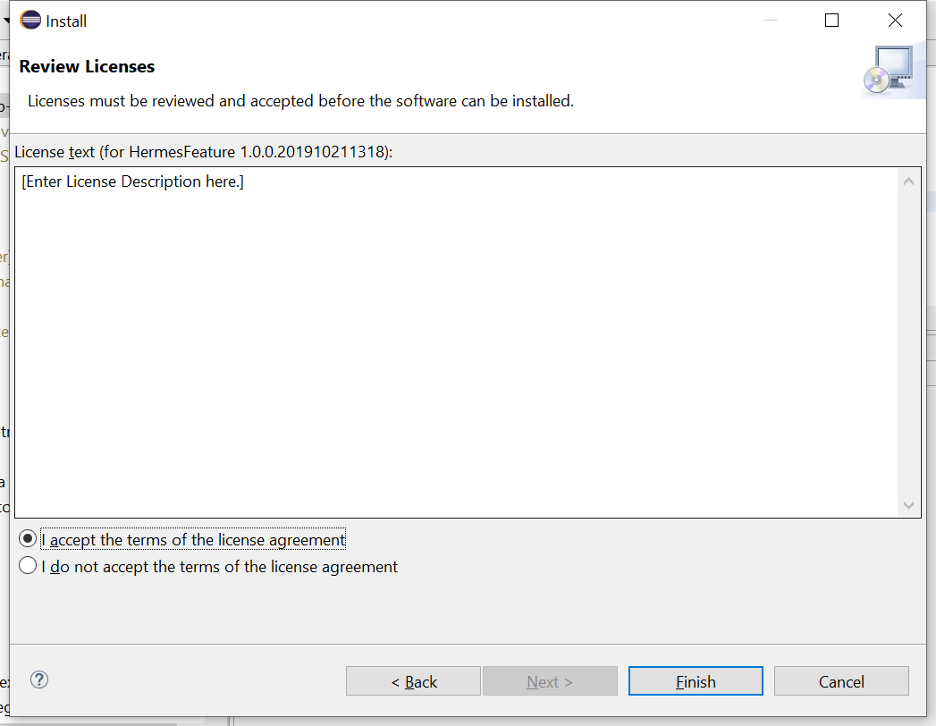
Accept License
License is empty now, but may add text

Slide 22
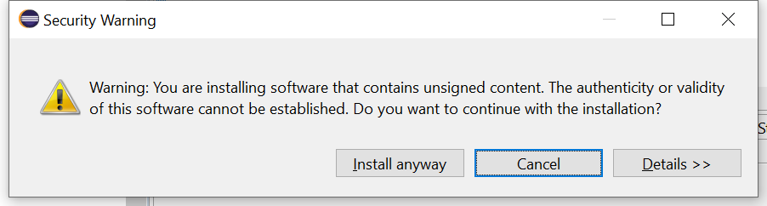
Trust Us

Slide 23
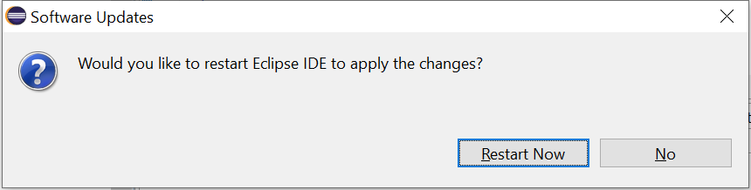
Restart Eclipse

Slide 24
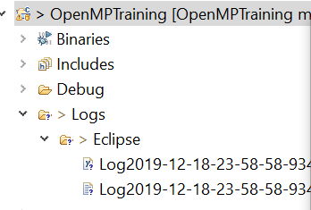
Logs
After some interaction, refreshing the project will show you the logs folder

Slide 25
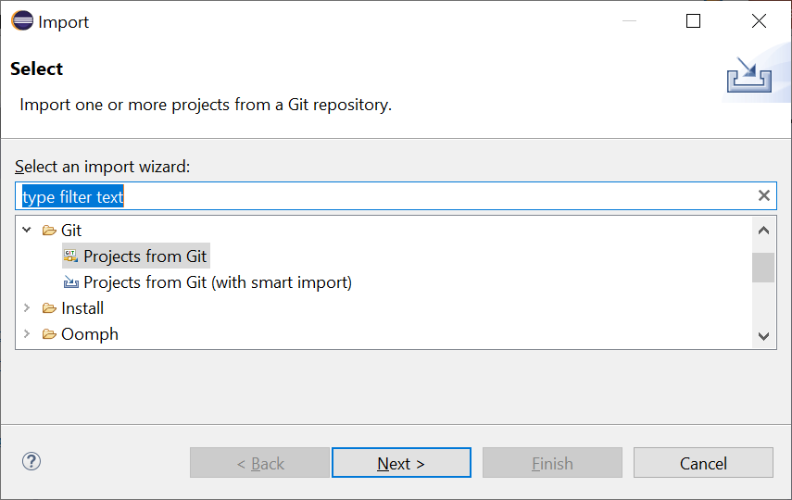
Import Git Project: ExecuteFile→Import→Git→Projects from GIT

Slide 26
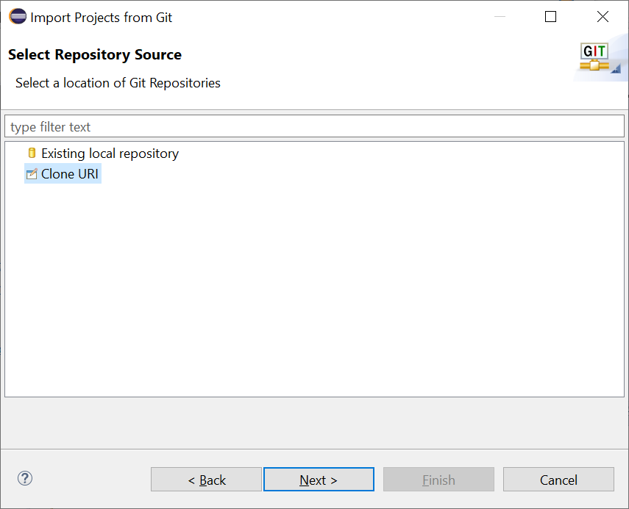
Import Git Project: CloneURI

Slide 27
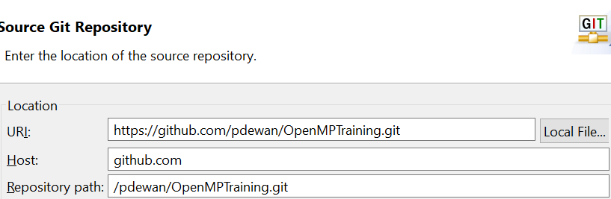
Import Git Project: CloneURI
https://github.com/pdewan/OpenMPTraining.git

Slide 28
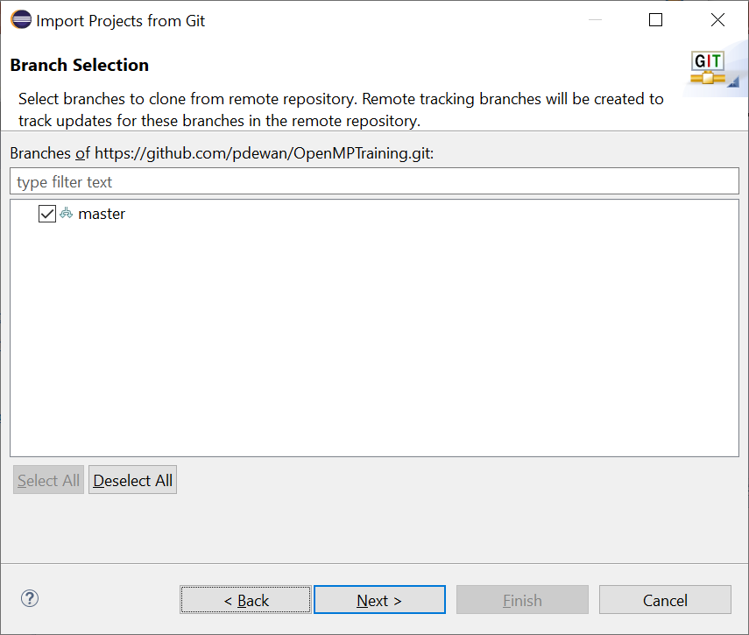
Import Git Project: Select Branch

Slide 29
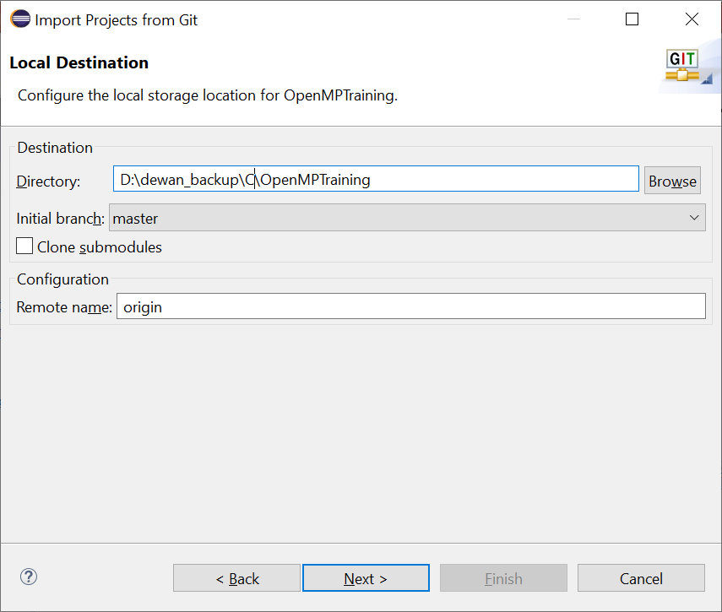
Import Git Project: Save in Local Directory

Slide 30
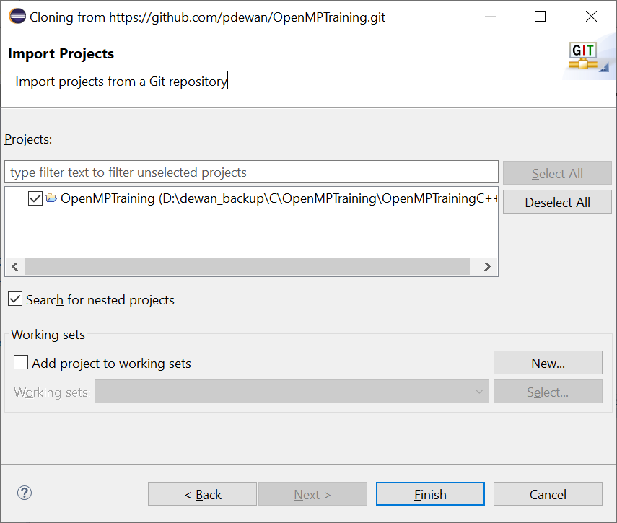
Import Git Project: Select OpenMPTraining

Slide 31
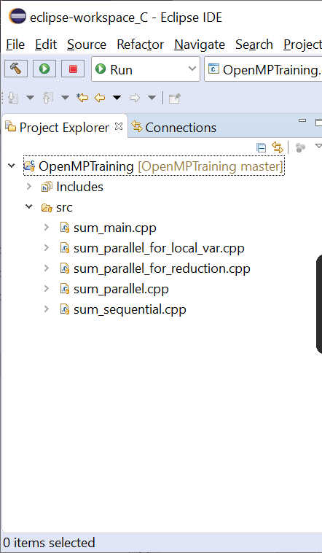
Import Git Project: Select Finish

Slide 32
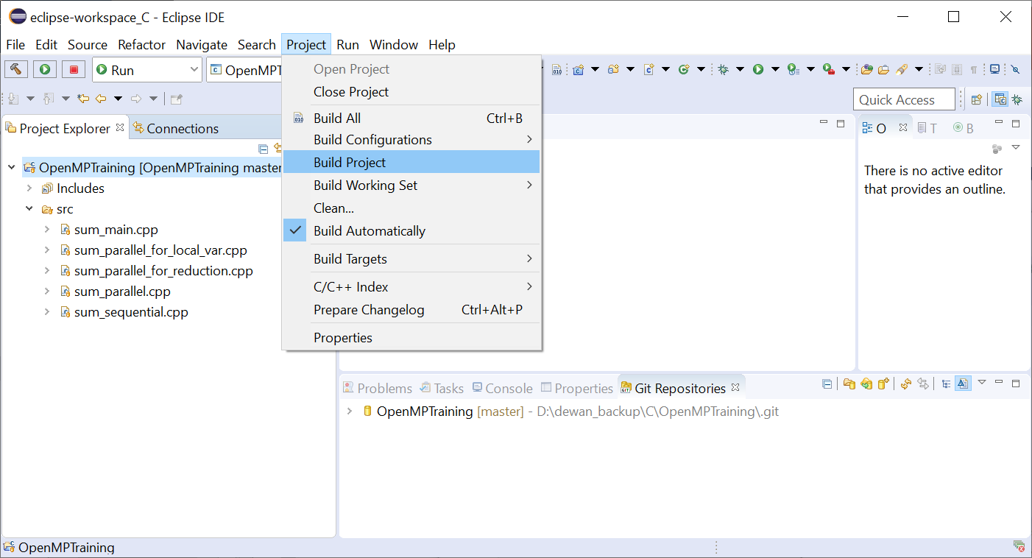
Build Project

Slide 33
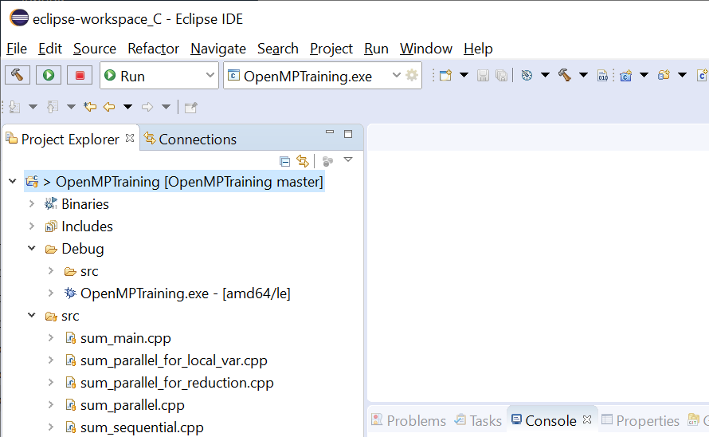
Built Project

Slide 34
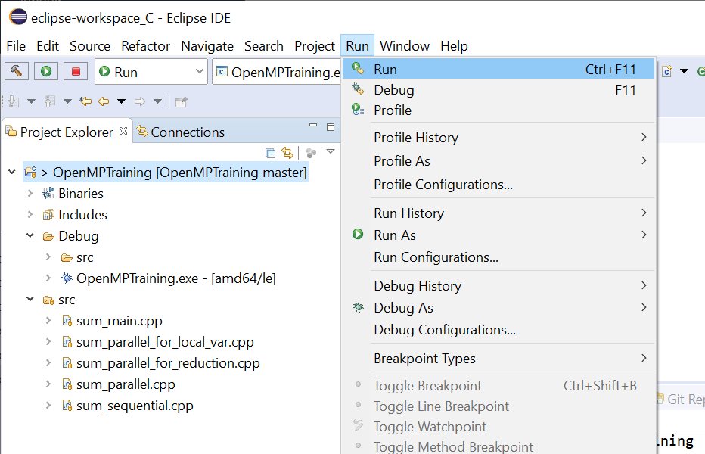
Run Project

Slide 35
Run Project

Slide 36
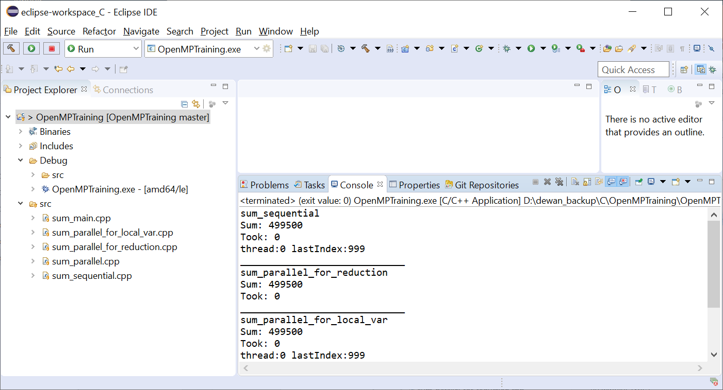
Output

Slide 37
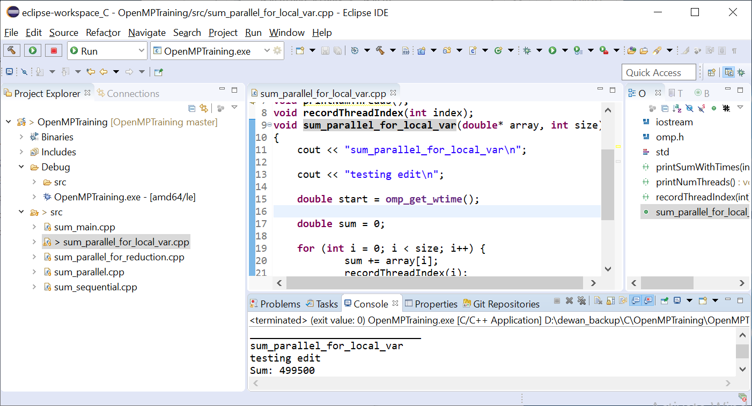
Adding “Testing edit” and Running again
CTRL-F11 runs the project again

Slide 38
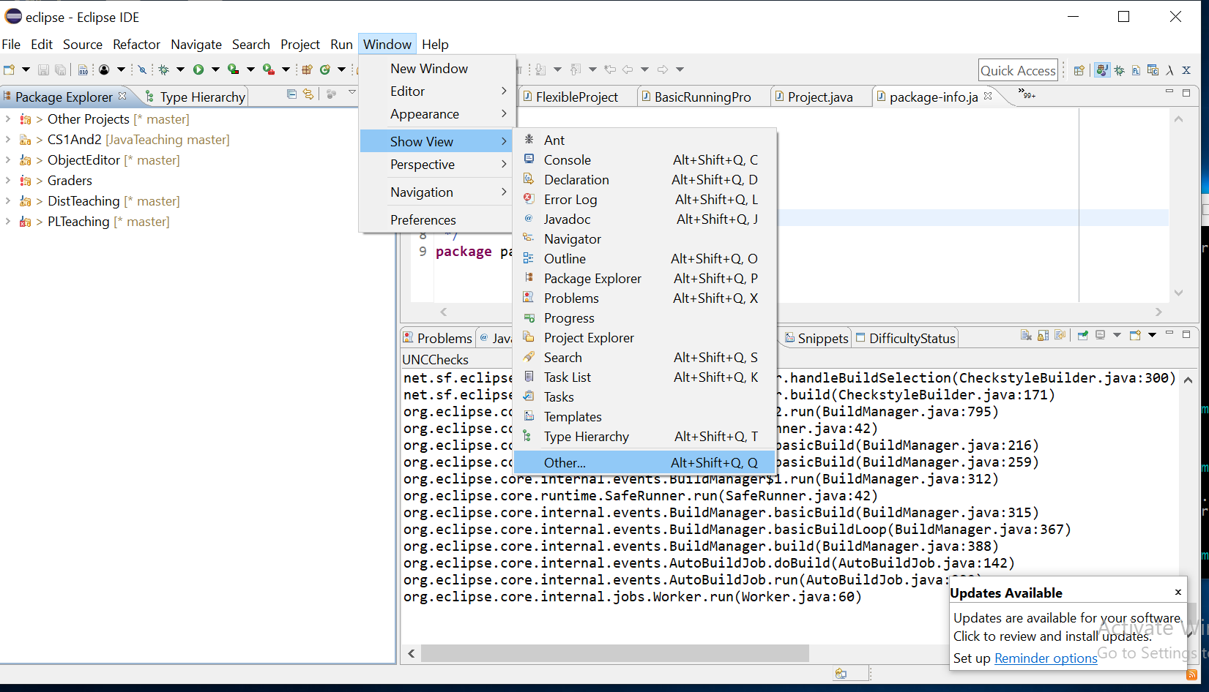
Getting to View to Record Difficulties
Window→Others

Slide 39
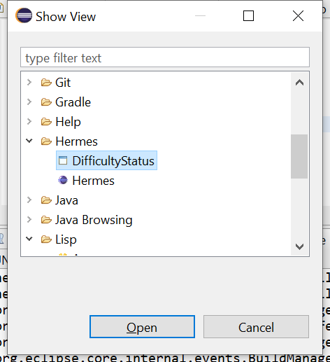
Open View
Hermes→DifficultyStatus

Slide 40
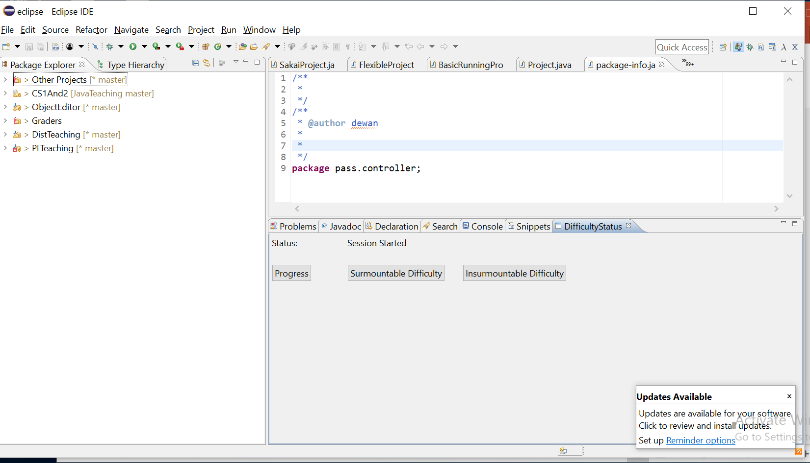
Difficulty Status View
When in Difficulty, press surmountable or insurmountable difficulty.
Progress: After having thought about it, you know exactly what to do (normal mode, no difficulty)
Surmountable: After having thought about it, you have some ideas on how the difficulty may be solved, but do not know the exact solution
Insurmountable: After having thought about it, you have no clue right now on how to solve the problem and are stopping to ask for help or think later

Slide 41
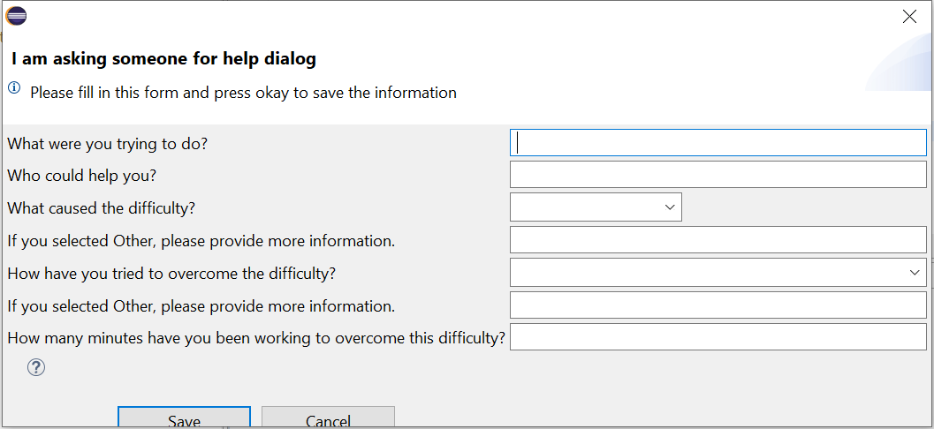
Elaborate on Surmountable or Insurmountable Difficulty

Slide 42
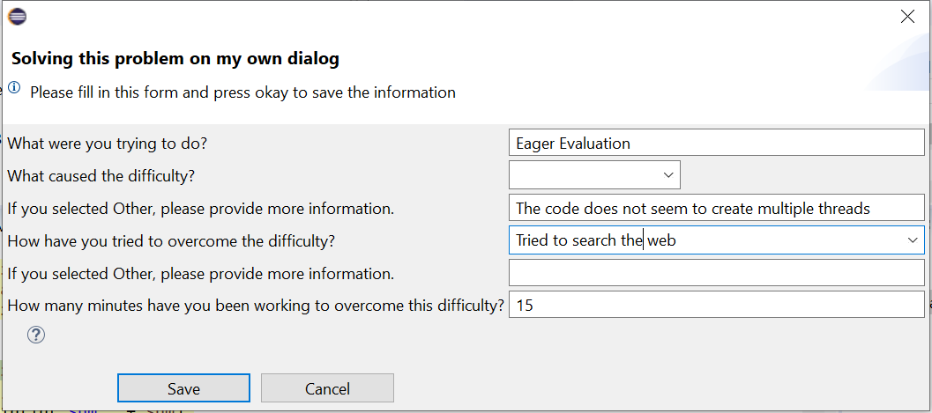
Example Filled Form

Slide 43
Uninstalling Plugin

Slide 44
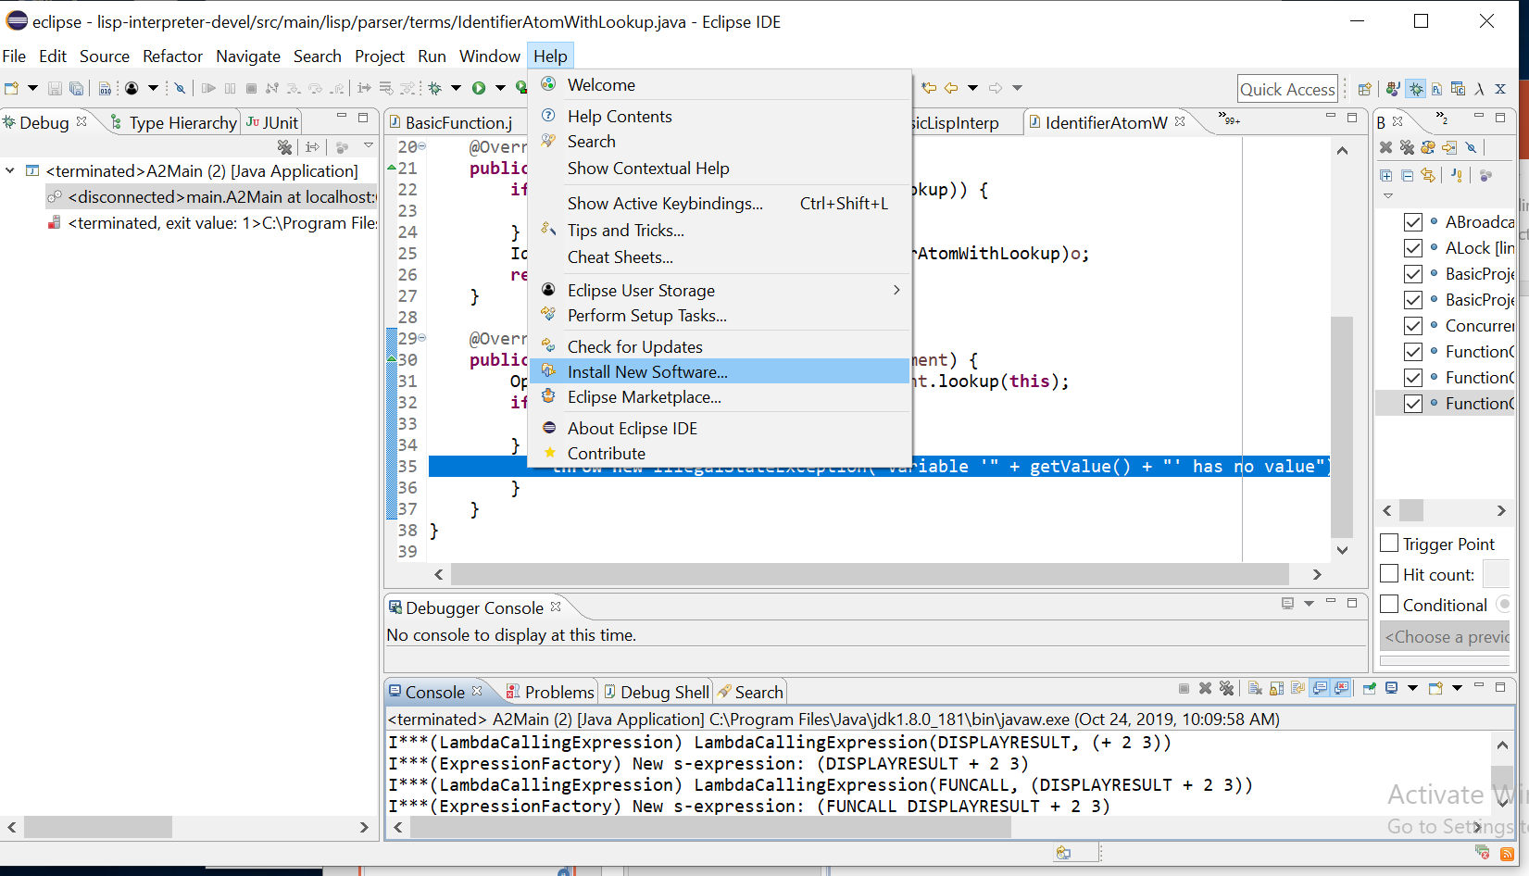
Help→Install New Software

Slide 45
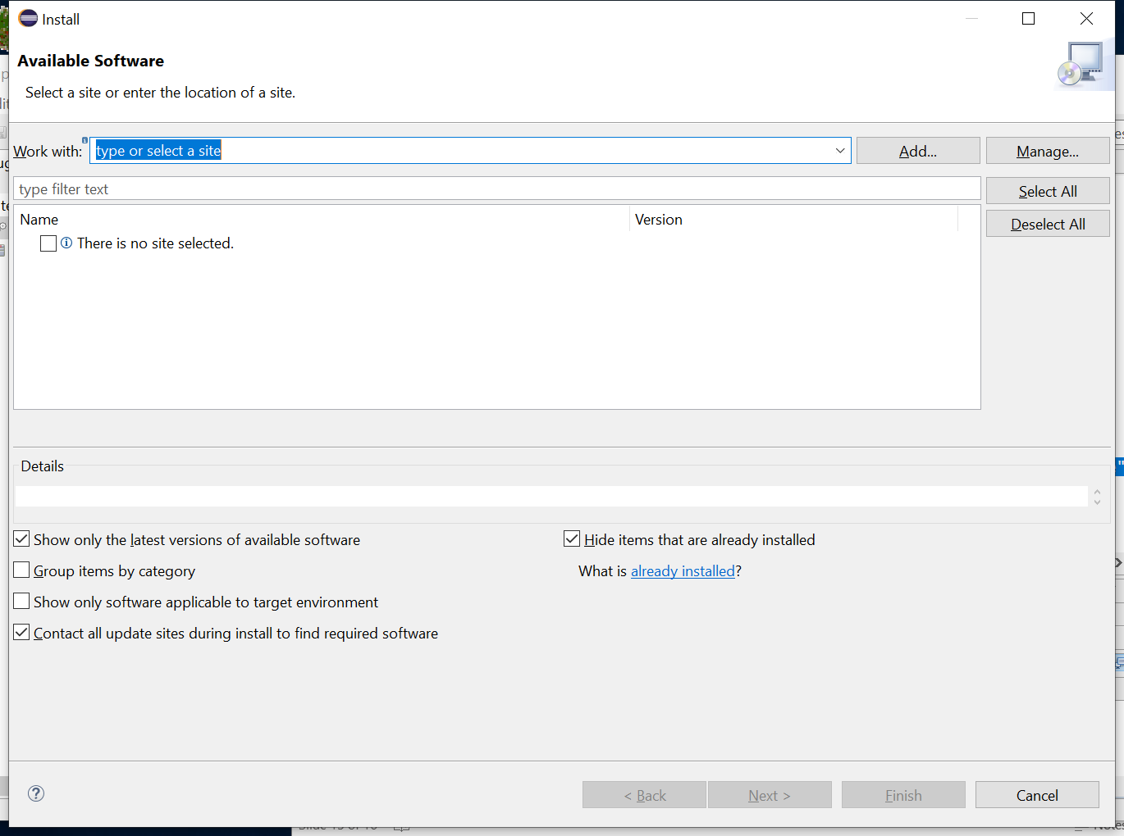
Click on: Already Installed

Slide 46
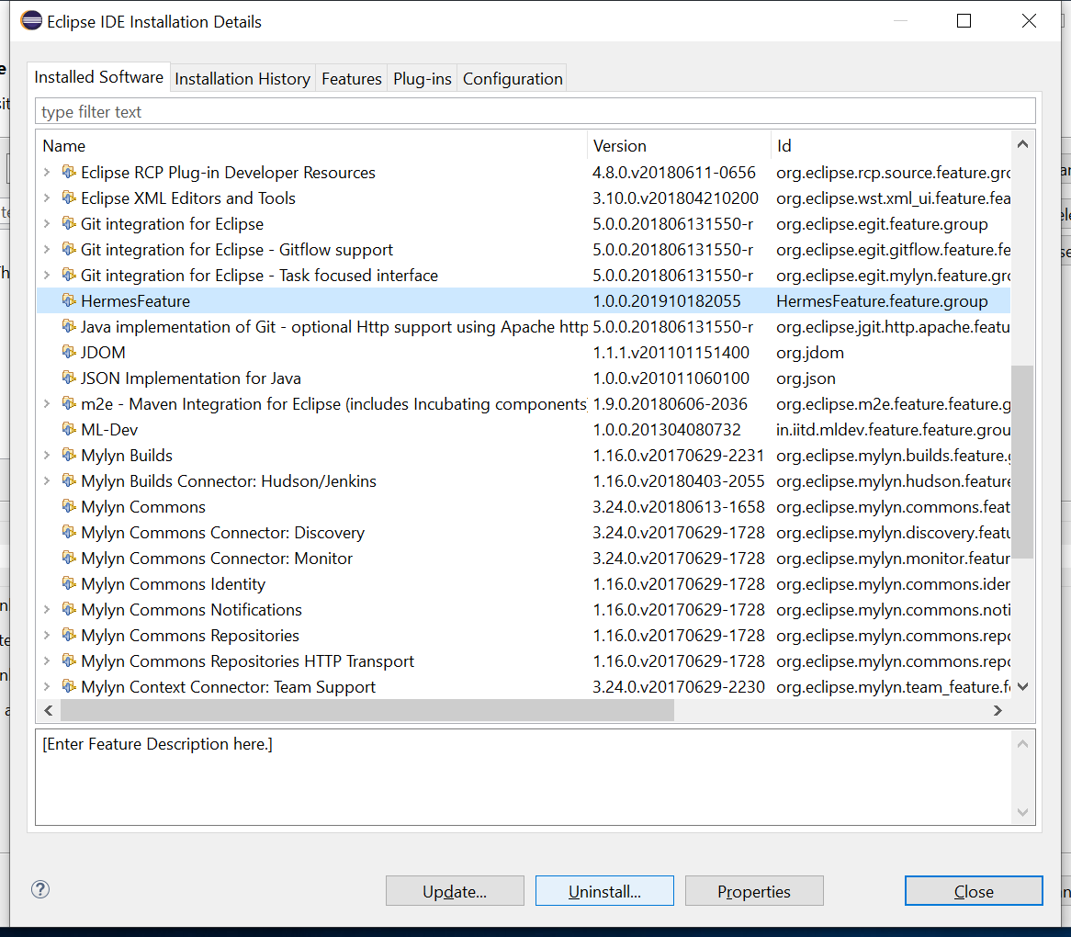
HermesFeature Uninstall

Slide 47
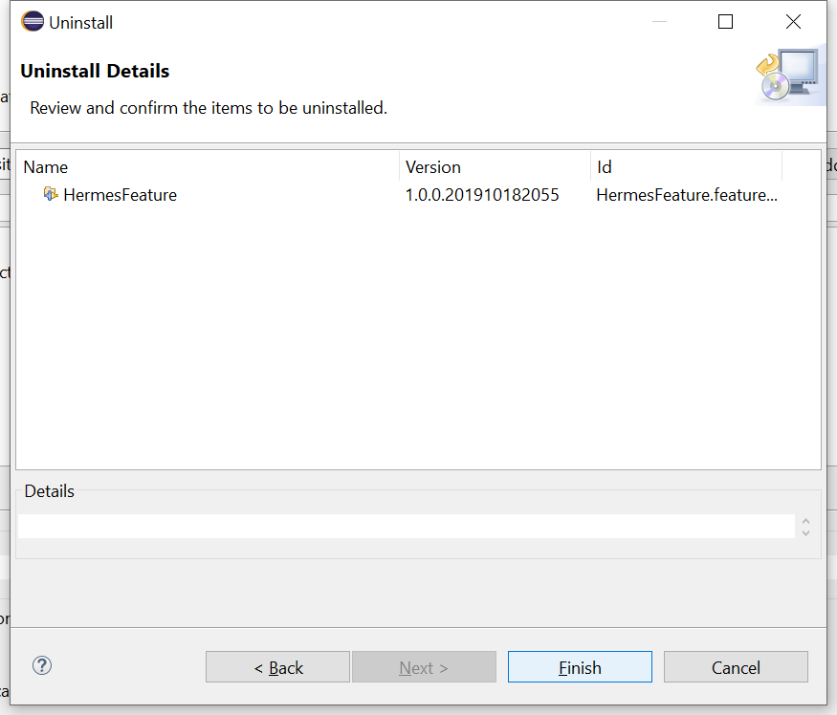
Click Finish

Slide 48
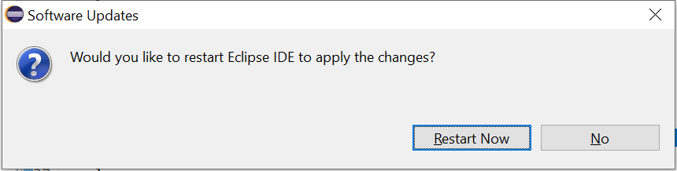
Restart Eclipse

