Slide 1
Java Threads
‹#›
iPDC Summer Institute

Slide 2
Introduction
“Java is the first mainstream programming language to explicitly include threading within the language itself, rather than treating threading as a facility of the underlying operating system.” https://www.ibm.com/developerworks/java/tutorials/j-threads/j-threads.html
This can be good (portability), or very, very bad (speed, flexibility)
Java threading tends to be heavy weight, and slower than the native thread interface of the OS
Note: Java is not widely used for parallel computing, but Java threads are good for teaching concepts
Java threads API is an object oriented version of a common thread API
E.g. Similar to POSIX threads, but Object Oriented
A program starts with one thread
The main thread
The main thread then creates child threads to help with computations
The main then joins with the child threads when the computation is done
However, the programmer must do the above steps manually
Unlike OpenMP, which implements the fork-join model for you
‹#›

Slide 3
Creating a Java Threads Program
Typically, you need the following parts:
Create the main class
Implement the main method
Code that creates the child threads, waits for them to complete, and then prints the answer
Implement a Runnable class
Implement the run() method
Contains the thread’s logic
Implement a constructor
Typically sets the partition information for a thread
‹#›

Slide 4
Creating a Java Threads Program
The structure and pseudocode for a typical Java threads program look like the following:
1 2 3 4 5 6 7 8 9 10 11 12 13 14 15 16 17 18 19 20 21 22 23 24 | class main method main // Note: main is executed by the main thread, only // given n partitions that you want to compute in parallel: create n objects that implements Runnable (in this example MyRunnable - see below), passing the partition size to their constructors for each MyRunnable object create an object of type Thread and pass the MyRunnable object to its constructor start the thread object end for wait for n threads print results end method main end class main class MyRunnable implements Runnable method run do the computation of my part end method run method constructor set my part end method constructor end class MyRunnable
‹#›

Slide 5
First Example
(Hello World, of course)
1 2 3 4 5 6 7 8 9 10 11 12 13 14 15 16 17 18 19 20 21 22 23 24 25 26 27 28 29 30 31 | import java.lang.*; public class Hello { public static void main(String[] args) { int numThreads = 0; // Number of threads to be executed should be passed // on the command line // If nothing was passed on the command line, // then print error and exit if (args.length < 1) { System.err.println("usage: Hello <numthreads>"); System.exit(0); } // Convert the command line string to an integer, // exit if error try { numThreads = Integer.parseInt(args[0]); } catch (Exception ex) { System.err.println(“Invalid argument”); System.exit(1); } // Spawn the number of threads passed on // the command line Thread[] threads = new Thread[numThreads]; for (int i = 0; i < numThreads; i++) { threads[i] = new Thread(new HelloWorker(i)); threads[i].start(); }
32 33 34 35 36 37 38 39 40 41 42 43 44 45 46 47 48 49 50 51 52 53 54 55 56 57 58 59 60 | // Wait for the threads to finish for (int i = 0; i < numThreads; i++) { try { threads[i].join(); } catch (Exception ex) { System.err.println("Error waiting: thread " + i); } } } } class HelloWorker implements Runnable { public int id; // Constructor to set the id for this thread HelloWorker(int iden) { id = iden; } // This method is invoked when the thread starts. // It will print a friendly message. public void run() { synchronized(this) { System.out.println("Hello World from thread " + id); } } }
‹#›
Compile: javac Hello.java
Run: java Hello 10

Slide 6
First Example
(Hello World, of course)
1 2 3 4 5 6 7 8 9 10 11 12 13 14 15 16 17 18 19 20 21 22 23 24 25 26 27 28 29 30 31 | import java.lang.*; public class Hello { public static void main(String[] args) { int numThreads = 0; // Number of threads to be executed should be passed // on the command line // If nothing was passed on the command line, // then print error and exit if (args.length < 1) { System.err.println("usage: Hello <numthreads>"); System.exit(0); } // Convert the command line string to an integer, // exit if error try { numThreads = Integer.parseInt(args[0]); } catch (Exception ex) { System.err.println(“Invalid argument”); System.exit(1); } // Spawn the number of threads passed on // the command line Thread[] threads = new Thread[numThreads]; for (int i = 0; i < numThreads; i++) { threads[i] = new Thread(new HelloWorker(i)); threads[i].start(); }
32 33 34 35 36 37 38 39 40 41 42 43 44 45 46 47 48 49 50 51 52 53 54 55 56 57 58 59 | // Wait for the threads to finish for (int i = 0; i < numThreads; i++) { try { threads[i].join(); } catch (Exception ex) { System.err.println("Error waiting: thread " + i); } } } } class HelloWorker implements Runnable { public int id; // Constructor to set the id for this thread HelloWorker(int iden) { id = iden; } // This method is invoked when the thread starts. // It will print a friendly message. public void run() { synchronized(this) { System.out.println("Hello World from thread " + id); } } }
Wait for threads to finish
This is how the thread gets its id
‹#›
The thread’s computation
Create thread objects, passing them Runnables
Start the threads

Slide 7
Notes, Caveats, and Advice
Two ways exists to create threads in Java
Extending Thread or implementing Runnable
Note that a Thread object is not really a OS thread
You actually do not know when the real thread is created - that is according to the Java implementation
If a thread needs thread specific information, such as what data it is supposed to compute:
Then that info should be in the Runnable object
It can be passed to the constructor when the Runnable is created
It's a bad idea to start() threads from within a constructor
A thread ends when:
It come to the end of its run() method
It throws an exception that is not caught
Another thread calls the deprecated stop() method (do not use)
Note that the program will not exit until the last thread is finished (except for daemon threads)
But do not count on this “feature”, you should always join with your threads if you need to wait for them to finish
‹#›

Slide 8
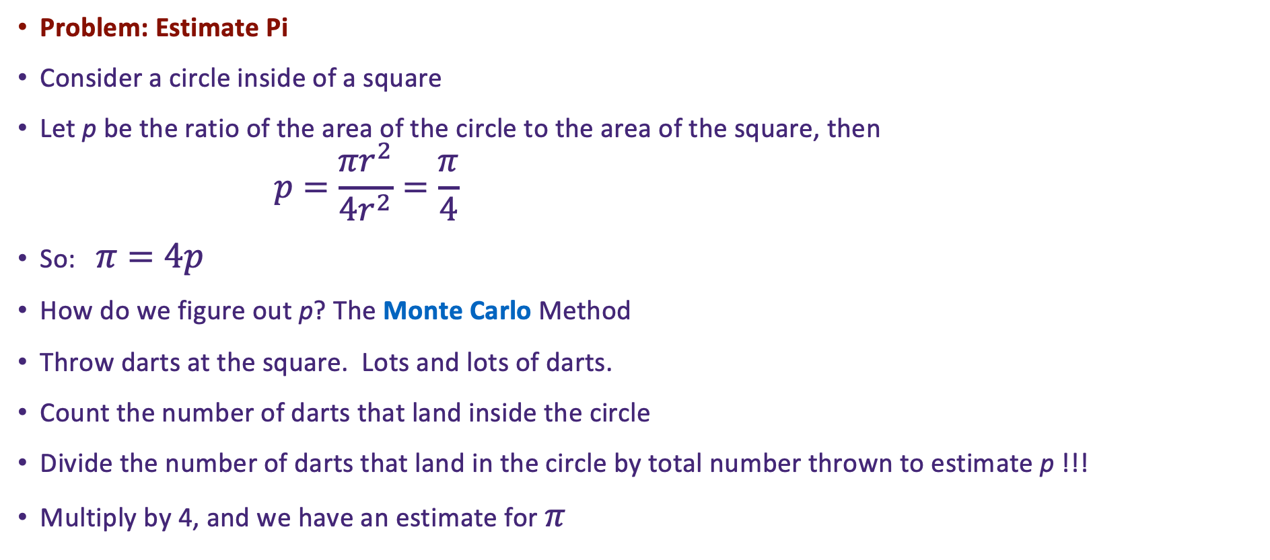

Slightly More Complex Example
‹#›

Slide 9

Some Unresolved Questions
How does a computer throw darts? By generating random x,y coordinates for where the dart would land
Given an (x,y), how can the computer tell if it landed in the circle
Make it simple, use the unit circle, and only throw darts at the upper right quadrant
Calculate the distance from 0,0
Just calculate the hypotenuse of the triangle
If hyp < 1, then the point falls within the unit circle!
Use ThreadLocalRandom instead of Random to get random numbers
Its thread safe
0,1
x,y
hyp
y
0,0
x
1,0
‹#›
2

Slide 10
Algorithm
class Monte implements Runnable
has integer numIterations
has double answer
function run
create random number generator
set numInside to 0
loop numIterations times
set x to new random number
set y to new random number
calculate hyp = square root of x^2+y^2
if hyp < 1.0
add 1 to numInside
end if
end loop
return numInside and numOutside
end function run
function constructor(iters)
set numIterations to iters
end function constructor
end class MyRunnable
class Pi
function main
get number of iterationss from the command line
argument as numThreads
create four objects of class Monte
passing numThreads / 4 to each of their constructors
for each Runnable object
create an object of class Thread and pass the Runnable
to its constructor
start the thread object
end for
wait for 4 threads
Sum numInside and numOutside from each of the four Monte objects into result
p = numInside / (numInside+numOutside)
Print 4*p
end function main
end class main
‹#›

Slide 11
The Code
1 2 3 4 5 6 7 8 9 10 11 12 13 14 15 16 17 18 19 20 21 22 23 24 25 26 27 28 29 30 31 32 33 34 35 36 37 38 39 40 41 42 | import java.lang.*; import java.lang.Math; import java.util.Random; import java.util.concurrent.ThreadLocalRandom; public class Pi { public static void main(String[] iters) { int numIter = 0; if (iters.length < 1) { System.err.println("usage: Pi <iterations>"); System.exit(0); } try { numIter = Integer.parseInt(iters[0]); } catch (Exception ex) { System.err.println("Bad argument"); System.exit(1); } Runnable[] runnables = new Runnable[4]; Thread[] threads = new Thread[4]; for (int i = 0; i < 4; i++) { runnables[i] = new Monte(numIter/4); threads[i] = new Thread(runnables[i]); threads[i].start(); } double numIn = 0; double numOut = 0; try { for (int i = 0; i < 4; i++) { threads[i].join(); numIn += ((Monte) runnables[i]).getNumIn(); numOut += ((Monte) runnables[i]).getNumOut(); } } catch (Exception ex) { System.err.println("Thread interrupted"); System.exit(2); } double p = ((double)numIn) / (numIn+numOut); double fourp = 4*p; System.out.println(fourp); } }
39 40 41 42 43 44 45 46 47 48 49 50 51 52 53 54 55 56 57 58 59 60 61 62 63 64 65 66 67 68 69 70 71 72 73 74 75 76 77 78 79 80 | class Monte implements Runnable { private int numIn; private int numOut; private int iters; public void run() { int[] both = doMonte(iters); numIn = both[0]; numOut = both[1]; } public Monte(int iterations) { iters = iterations; } public int getNumIn() { return numIn; } public int getNumOut() { return numOut; } private int[] doMonte(int iterations) { ThreadLocalRandom rand = ThreadLocalRandom.current(); int lnumIn = 0; int lnumOut = 0; for (int i = 0; i < iterations; i++) { // get random number from 0 to 1 double x = rand.nextDouble(); double y = rand.nextDouble(); double hyp = Math.sqrt(x*x + y*y); if (hyp < 1.0) { lnumIn++; } else { lnumOut++; } } int[] ret = new int[2]; ret[0] = lnumIn; ret[1] = lnumOut; return ret; } }
‹#›

Slide 12
Working with Arrays
Many parallel computations happen on arrays
For data decomposition, you must partition the array among the child threads
Typically, partitioning is done by assigning a number of items per each thread
And then having the thread compute its starting and ending index based on its thread id
‹#›

Slide 13
Array Example
Simple example to print an array using four threads
In this example, we will not spawn multiple runnable, but we will spawn on only one
The threads will share a single array in the runnable
Algorithm:
15 16 17 18 19 20 21 22 23 24 25 26 27 28 29 30 31 32 33 34 35 36 37 38 39 40 41 | class Printer has integer array intArray has integer nextId initialized to 0 method constructor() fill intArray with random integers end method constructor method run() // Note that the next two lines must be atomic // How do we do this in Java? set myId to nextId increment nextId set howBig to length of intArray devided by 4 set myStart to myId * howBig // Why do the following? if this is the last thread (has myId 3) set myEnd to length of intArray minus 1 else set my End to myStart + howBig - 1 end if loop i from myStart to myEnd print item at the ith index of intArray end loop end method run end class Printer
1 2 3 4 5 6 7 8 9 10 11 12 13 14 | class PrintArray method main get number of items from the command line argument as numItems create one object of class Printer passing numItems its constructor for i from 1 to 4 create an object of class Thread and pass the Printer object to its constructor start the thread object end for wait for 4 threads end method main end class main
‹#›

Slide 14
The Code
1 2 3 4 5 6 7 8 9 10 11 12 13 14 15 16 17 18 19 20 21 22 23 24 25 26 27 28 29 30 31 32 | import java.lang.*; import java.util.Random; public class PrintArray { public static void main(String[] args) { int numItems = 0; if (args.length < 1) { System.err.println("usage: Hello <numItems>"); System.exit(0); } try { numItems = Integer.parseInt(args[0]); } catch (Exception ex) { System.err.println(“Bad argument"); System.exit(1); } Runnable runnable = new Printer(numItems); Thread[] threads = new Thread[4]; for (int i = 0; i < 4; i++) { threads[i] = new Thread(runnable); threads[i].start(); } for (int i = 0; i < 4; i++) { try { threads[i].join(); } catch (Exception ex) { System.err.println("Error waiting for “ + i); } } } }
33 34 35 36 37 38 39 40 41 42 43 44 45 46 47 48 49 50 51 52 53 54 55 56 57 58 59 60 61 62 63 64 65 | class Printer implements Runnable { public int[] intArray; private int nextId = 0; Printer(int numItems) { intArray = new int[numItems]; Random rand = new Random(); for (int i = 0; i < numItems; i++) { intArray[i] = rand.nextInt(50); } } public void run() { int myId = 0; synchronized(this) { myId = nextId; nextId++; } int howBig = intArray.length / 4; int myStart = myId * howBig; int myEnd = myStart + howBig-1; if (myId == 3) { myEnd = intArray.length-1; } for (int i = myStart; i <= myEnd; i++) { synchronized(this) { System.out.println("Thread " + myId + " index " + i + " in (" + myStart + “.." + myEnd + "): " + intArray[i]); } } } }
‹#›

Slide 15
Counting Primes in an Array
Implement a Java program to count primes
Your program should accept a count n of numbers from the command line
The program will generate n numbers randomly from [1..50) in an array, and then test each number to see if it is prime
Use a naive algorithm for testing for primeness (for example, loop from 2 to the square root of the number and attempt to divide it by the loop counter)
The result of the program should be the number of primes found in the array
Divide the array evenly among four threads
‹#›

Slide 16
Algorithm
1 2 3 4 5 6 7 8 9 10 11 12 13 14 15 16 17 18 19 20 21 22 23 24 25 26 27 28 29 30 31 32 33 34 35 | class Counter has integer array intArray has integer nextId initialized to 0 Has integer array answers method constructor() fill intArray with random integers Fill answers with all 0s end method constructor method run() // Note that the next two lines must be atomic set myId to nextId increment nextId set howBig to length of intArray devided by 4 set myStart to myId * howBig // Why do the following? if this is the last thread (has myId 3) set myEnd to length of intArray minus 1 else set my End to myStart + howBig - 1 end if loop i from myStart to myEnd if isPrime(value of intArray at index i) Increment value of answers at index myId by 1 end if end loop end method run method isPrime(num) // you can figure this out end method isPrime end class Printer
1 2 3 4 5 6 7 8 9 10 11 12 13 14 15 16 | class Primes method main get number of items from the command line argument as numItems create one object of class Counter passing numItems its constructor for i from 1 to 4 create an object of class Thread and pass the Counter object to its constructor start the thread object end for wait for 4 threads set answer to sum of answers from the threads print answer end method main end class main
‹#›

Slide 17
The Code
1 2 3 4 5 6 7 8 9 10 11 12 13 14 15 16 17 18 19 20 21 22 23 24 25 26 27 28 29 30 31 32 33 34 35 36 37 38 39 40 41 42 43 | import java.lang.*; import java.lang.Math; import java.util.Random; public class Primes { public static void main(String[] args) { int numItems = 0; if (args.length < 1) { System.err.println("usage: Hello <numItems>"); System.exit(0); } try { numItems = Integer.parseInt(args[0]); } catch (Exception ex) { System.err.println(“Bad argument"); System.exit(1); } Runnable runnable = new Counter(numItems); Thread[] threads = new Thread[4]; for (int i = 0; i < 4; i++) { threads[i] = new Thread(runnable); threads[i].start(); } int answer = 0; for (int i = 0; i < 4; i++) { try { threads[i].join(); answer += ((Counter) runnable).getAnswer(i); } catch (Exception ex) { System.err.println("Error waiting for " + i); } } System.out.println("The number of primes is: " + answer); } } class Counter implements Runnable { public int[] intArray; private int nextId = 0; private int[] answers;
44 45 46 47 48 49 50 51 52 53 54 55 56 57 58 59 60 61 62 63 64 65 66 67 68 69 70 71 72 73 74 75 76 77 78 79 80 81 82 83 84 85 86 87 88 | Counter(int numItems) { intArray = new int[numItems]; Random rand = new Random(); for (int i = 0; i < numItems; i++) { intArray[i] = rand.nextInt(50); } answers = new int[] {0,0,0,0}; } public void run() { int myId = 0; synchronized(this) { myId = nextId; nextId++; } int howBig = intArray.length / 4; int myStart = myId * howBig; int myEnd = myStart + howBig-1; if (myId == 3) { myEnd = intArray.length-1; } for (int i = myStart; i <= myEnd; i++) { if (isPrime(intArray[i])) { answers[myId]++; } } } boolean isPrime(int num) { if (num == 2) return true; for (int i = 3; i < Math.sqrt(num); i++) { if ((num % i) == 0) { return false; } } return true; } Int getAnswer(int idx) { return answers[idx]; } }
‹#›

Slide 18
Your Challenge
Write a Java program to find the smallest integer in an array.
Your program should evenly partition the work among four threads
Note that the master thread should wait for the other thread to find the smallest integer in their partition,
and then choose the smallest from their results
Your program should generate the initial array by filling it with random numbers
The size of the array should be given on the command line
‹#›

Slide 19
Synchronization
The dining philosophers problem
Classical CS problem
A video is worth a thousand words
‹#›

Slide 20
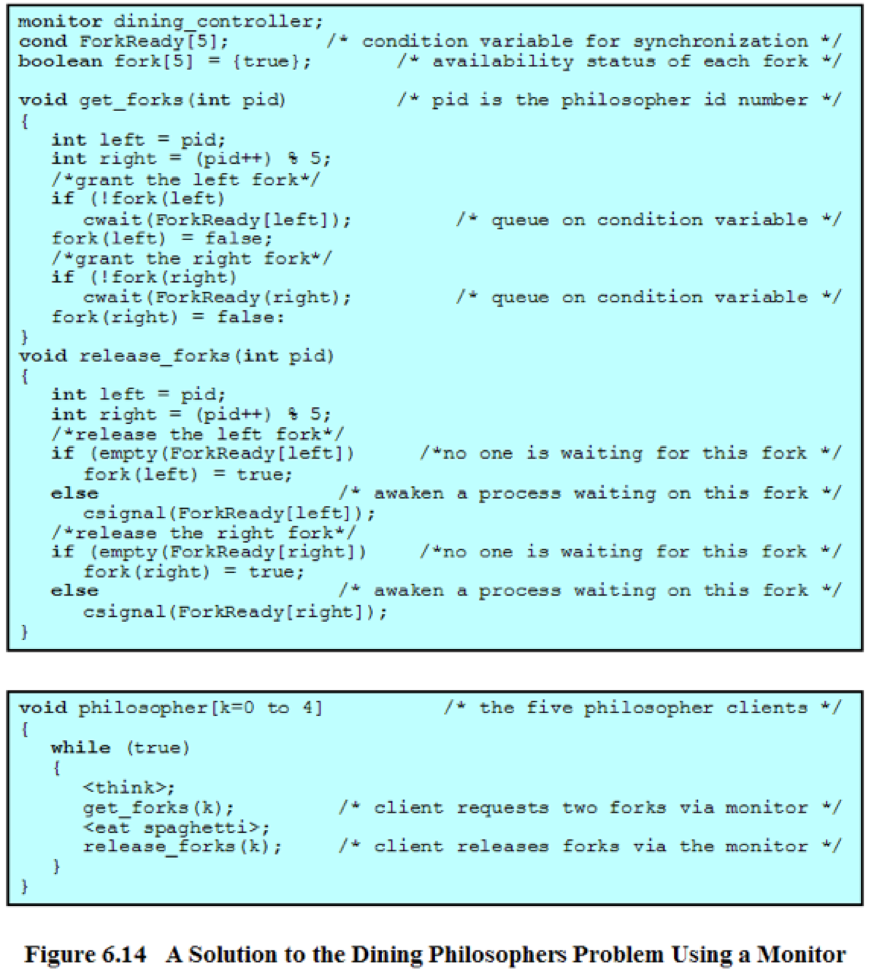
Pseudocode from William Stallings OS Book
This trick is that this code guarantees that at least one person will get two forks
We can use Java ReentrantLock and Condition to implement a Monitor
Use try..finally to lock and unlock
‹#›

Slide 21
1 2 3 4 5 6 7 8 9 10 11 12 13 14 15 16 17 18 19 20 21 22 23 24 25 26 27 28 29 30 31 32 33 34 35 36 37 38 39 40 41 42 43 44 45 46 47 48 49 50 51 52 53 54 55 56 57 58 59 60 61 62 | import java.lang.*; import java.util.concurrent.locks.Lock; import java.util.concurrent.locks.ReentrantLock; import java.util.concurrent.locks.Condition; import java.util.Random; class DiningPhil { public static void main(String[] args) { Runnable phils = new Philosophers(); Thread[] threads; threads = new Thread[5]; for (int i = 0; i < 5; i++) { threads[i] = new Thread(phils); threads[i].start(); } } } class Philosophers implements Runnable { private Lock lock; private int nextId = 0; private boolean[] fork; private Condition[] forkReady; Philosophers() { lock = new ReentrantLock(); fork = new boolean[5]; forkReady = new Condition[5]; for (int i = 0; i < 5; i++) { forkReady[i] = lock.newCondition(); fork[i] = true; } } private void getForks(int pid) { lock.lock(); try { int left = pid; int right = (pid+1) % 5; System.out.println("Grabbing forks (" + pid + ")..."); while (!fork[left]) { System.out.println("Left not available, waiting (" + pid + ")..."); try { forkReady[left].await(); } catch (Exception ex) { System.out.println("Await error"); ex.printStackTrace(); System.exit(1); } } System.out.println("Got left fork (" + pid + ")"); fork[left] = false; while (!fork[right]) { System.out.println("Right not available, waiting (" + pid + ")..."); try { forkReady[right].await();
63 64 65 66 67 68 69 70 71 72 73 74 75 76 77 78 79 80 81 82 83 84 85 86 87 88 89 90 91 92 93 94 95 96 97 98 99 100 101 102 103 104 105 106 107 108 109 110 111 112 113 114 115 116 117 118 119 120 121 | } catch (Exception ex) { System.out.println("Await error"); ex.printStackTrace(); System.exit(1); } } System.out.println("Got right fork (" + pid + ")"); fork[right] = false; } finally { lock.unlock(); } } private void releaseForks(int pid) { lock.lock(); try { int left = pid; int right = (pid+1) % 5; System.out.println("Releasing forks (" + pid + ")..."); fork[left] = true; forkReady[left].signal(); fork[right] = true; forkReady[right].signal(); } finally { lock.unlock(); } } public void run() { int myId = 0; lock.lock(); try { myId = nextId; nextId++; } finally { lock.unlock(); } Random rand = new Random(); try { while (true) { System.out.println("In deep thought (" + myId + ")..."); Thread.sleep(rand.nextInt(2000)); getForks(myId); System.out.println("Eating, yum (" + myId + ")..."); Thread.sleep(rand.nextInt(2000)); releaseForks(myId); } } catch (Exception ex) { System.out.println("Error in run"); ex.printStackTrace(); } } }
‹#›

