Slide 1
OpenMPy
IPDC Workshop
Thanks to Caleb Huck for help on the slides

Slide 2
Why OpenMPy
Top three languages used in teaching early CS:
C/C++
Java
Python
OpenMP only supports FORTRAN, C, C++
Several Java implementations with varying usability (covered later)
Pyjama with fixes and additions is what we are using in this workshop
No implementations in Python
Note: main reason for adding OpenMP Python support is not for performance!
It is for teaching parallel concepts

Slide 3
Obstacles
Python has a GIL!
Despite what the Python developers say, having a GIL is not good
Perhaps the most problematic design decision of Python\
The GIL will not be removed any time soon
Solution: Use a re-implementation of Python that has no GIL
Jython! It is implemented on the JVM and has no GIL https://www.jython.org/
Python data structure access is serialized!
Access to arrays put serialized code in your program – remember Amdahls law!
Solution: Jython again! It allows access to Java data structures.
Access to Java data structures from Python under Jython is not serialized

Slide 4
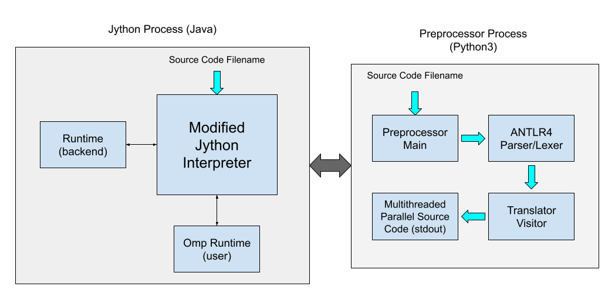
How it works
Our modified Jython interpreter first pre-processes the code to handle the omp directives
Using C-Python (Python3)
The pre-processor produces a second source file will all the necessary parallel code is native Python threads
Jython then loads an omp runtile library and runs the program

Slide 5
First Example
(Hello World, of course)
from omp import *
import sys
threadCount = int(sys.argv[1])
#omp parallel num_threads(threadCount)
myID = omp_get_thread_num()
tCount = omp_get_num_threads()
#omp critical
print("Hello from ", myID, " of ", tCount)

Slide 6
Next Example: Array Sum
from omp import *
import sys
import random
import math
from jarray import array, zeros
def fillArray(a):
ran = random.Random()
for i in range(len(a)):
a[i] = ran.uniform(0,100)
numThreads = 0
n = 0
if len(sys.argv) != 3:
print("usage: ", sys.argv[0], " <num_threads> <num_items>")
sys.exit(1)
try:
numThreads = int(sys.argv[1])
n = int(sys.argv[2])
except ValueError:
print("Cannot convert arguments to integers")
sys.exit(1)
a = zeros(n, float)
fillArray(a)
sum = 0
#omp parallel for shared(a) num_threads(numThreads) reduction(+:sum)
for i in range(len(a)):
sum += a[i]
print("Sum is ", sum)

Slide 7
Next Example: Count Primes
from omp import *
import sys
import random
import math
from jarray import array, zeros
def fillArray(a):
ran = random.Random()
for i in range(len(a)):
a[i] = ran.randint(0,10000)
def isPrime(num):
if num == 2: return True
for i in range(3, int(math.sqrt(num))):
if (num % i) == 0:
return False;
return True;
numThreads = 0
n = 0
if len(sys.argv) != 3:
print("usage: ", sys.argv[0], " <num_threads> <num_items>")
sys.exit(1)
try:
numThreads = int(sys.argv[1])
n = int(sys.argv[2])
except ValueError:
print("Cannot convert arguments to integers")
sys.exit(1)
a = zeros(n, int)
fillArray(a)
count = 0
#omp parallel for shared(a) num_threads(numThreads) reduction(+:count)
for i in range(len(a)):
if isPrime(a[i]):
count += 1
print("Count is ", count)

Slide 8
Third Example: Monte Carlo Method for Calculating Π
from omp import *
import sys
import random
import math
numIters = 0
if len(sys.argv) != 2:
print("usage: ", argv[0], " <num_iterations>")
try:
numIters = int(sys.argv[1])
except ValueError:
print("Cannot convert argument to integer")
sys.exit(1)
numIn = 0
numOut = 0
#omp parallel num_threads(4) reduction(+:numIn) reduction(+:numOut)
localRandom = random.Random()
myIters = numIters
numIn = 0
numOut = 0
#omp for
for i in range(myIters):
#get random number from 0 to 1
x = localRandom.uniform(0,1)
y = localRandom.uniform(0,1)
hyp = math.sqrt(x*x + y*y)
if hyp < 1.0:
numIn += 1
else:
numOut += 1
p = float(numIn)/(numIn+numOut)
fourp = 4*p
print("Pi is ", fourp)

Slide 9
Caveats
Must use our modified Jython interpreter, and must have Java installed
Jython cannot use Python modules written in C
Must use Java array or your program suffers from serial access to native Python lists
Must indent under every #omp comment (even #omp for)f

Slide 10
Caveats
Only supports the following core OpenMP
Directives | Clauses | Runtime Functions
parallel | num_threads([t]) | omp_get_thread_num()
for | reduction([op]:[var]) | omp_get_num_threads()
parallel for | shared([var₁], [var₂],…,[var_{n}]) | omp_get_wtime()
barrier | private([var₁], [var₂],…,[var_{n}])
critical

