Slide 1
A Social Media Mining Toolkit
Jinjing Ma 2014
Notes:
From two independent study courses

Slide 2
Define data mining
Short introduction of

Slide 3
Social Media Mining: design space
Data: generated by online user interaction
Interaction type:
Specific recipients: Email, @User
Unspecific audience: Facebook, twitter, Q&A sites
Mining algorithm: extract desired information from
User static(relatively) relationship/friendship
User dynamic interaction
User-generated contents
User-consumed contents
Desired info: social inferences
quantitive analysis / models
like predict response time, friend group
Notes:
Jump to case studies

Slide 4
Social Media Mining: examples – specific points in design space
Based on:
Relationship network & interaction structure
Modeling future online friendship construction
Modeling social network community evolution
Interaction content / other features
Modeling responsiveness (case study 1) (refer papers read in responsiveness)
Both
Modeling the way user share common topics/interests

Slide 5
Tedious programming work
Choose algorithm & features
Iterative trial & fail
Cost a lot of energy and time because:
Implementation
Algorithm: clustering, regression, classification, topic modeling; each requires a lot to code and parameter adjustment to use

Slide 6
A process is Already tiring for a single research, and it’s been repeated again & again among researchers
Different data sources
Different research teams
Code is lost/unreadable after a while
researchers’ product is knowledge, not code. After the paper has been published nobody would look at the code

Slide 7
Remove tedious work by abstracting the common things among cases & inplementing using toolkits

Slide 8
Common Used Toolkits: Weka
Weka: Machine learning applications to data mining tasks
Supports classification, cluster & regression on various data features
Input: one formatted file(ARFF or XRFF)
Java-based
Main limitation:
Not good for natural language (text) processing

Slide 9
Common Used Toolkits: MALLET
MALLET: Machine learning applications to text
Offers document classification, clustering, topic modeling, optimization
Input: original text (considered as bag-of-words)
Java-based
Main limitation:
Does not support multi-type of data
Examples: why multi-type in social media is needed (case study)

Slide 10
Limitation of existing ML toolkits
No way to use text-based algorithm and multi-type features all in one toolkit
Crucial for social media mining (refer to SM datatype)
Researchers have to switch between / combine different ML toolkits
Existing toolkits are low-level
Data need pre-process to fit there input format
Posts retrieved into threads, then features abstracted
Acquaintance with API is required
Notes:
Limitation & new
Explain why user want to switch between toolkits

Slide 11
Limitation of existing ML toolkits
Combination of toolkits is in need & input for each toolkit must be formatted differently
Researchers have to
Transform original data to fit EACH toolkit’s input format; transform one toolkit’s output to fit another toolkit’s input format
Do these all over again when data source changed
Refer to past responsiveness research work
No combination of toolkits: models used is limited
For example case 1 is not using LDA but it may be useful to
Tedious data preprocess: mapping text to vector…,etc.

Slide 12
A high-level, retargetable toolkit is in need
General research agenda
Integrates the research process for
Switching between data sources
Retargeting multiple low-level toolkits
Narrow focus
Say which part of 3-d space I’m targeting
Before & after using high-level toolkit diagrams
Notes:
Elabrate : algorithm make & implementation
Underline the relationship & iteration(lots of code)
=>pic ? Show existing toolkits are low level and not interchangable
=> Make a high level designed toolkit that can be retargeted to multi low level toolkits

Slide 13
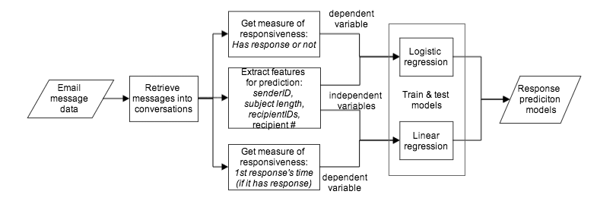
Social Media Mining: case study 1(on going project)
Predict email response time
Notes:
Introduce on the 3-d space
In detail-> more

Slide 14
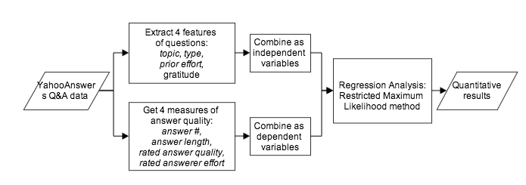
Case study 2
Factoring of answer quality on YahooAnswers
Part of a published work
Notes:
Predictors of Answer Quality in Online Q&A Sites

Slide 15
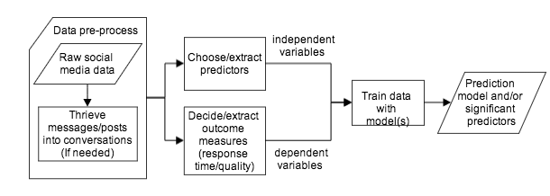
Remove tedious work by abstracting the common things among cases & inplementing using toolkits

Slide 16
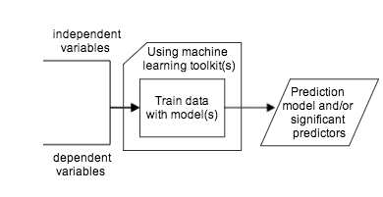
Previous work: ML toolkits
Algorithm implementation: solved
Existing machine learning toolkits
Common-used toolkits:
Weka
Mallet

Slide 17
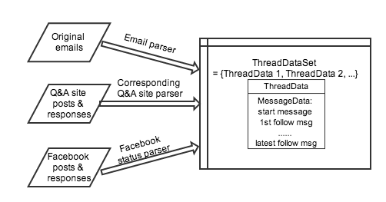
A New Framework: parsing raw data
ThreadDataSet
solution for interchange data
Inner structure & reason
Notes:
Come from issues => solutions
Review narrow goal: solution for multi source is threadData

Slide 18
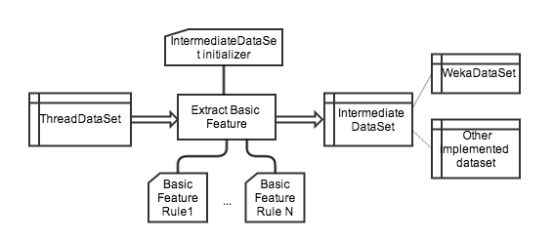
A New Framework: IntermediateDataSet
IntermediateDataSet &Feature extracting system
Solution for low-level toolkits union/interchange
How: feature extracting rules
Notes:
Problem 1st, then solution(part of framework)

Slide 19
A New Framework: Feature extracting system
Flowchat
Show variety of feature rules
Extracting features can be layered infinitely depending on domain
Feature rules: How multi toolkits collaboration is allowed

Slide 20
Completion of algorithm: model evaluation
Using evaluation code of low-level toolkits
Through predefined interface of particular super feature rules
Programmer self defined evaluation
Through accessible result produced by algorithm on test dataset and ground truth

Slide 21
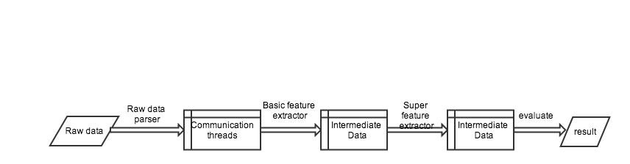
A New Framework: data flow
Briefly introduce each data phase
Notes:
Raw data: email, stackoverflow
Data source crawler: external
ThreadRetriver is external code
Basic feature extactor: can extract features for both cases
Show why both basic feature extracting step & super feature extracting step are needed:
Replace thread dataformat with others, when other research(like user interest prediction) are applied with this framework
One can change without the other changing
Result: models & predictions

Slide 22
Toolkit evaluation/experiment result
Code for each original work
Case 1: xxx lines, xxx interfaces, xxx classes
Case 2: yyy lines, …
Code shared: zzz lines, …
Effort to switch data source / toolkits: sss lines
Notes:
How long is this part?
Explain how the cases are implemented?

Slide 23
A New Framework: feasibility (extensibility?)
Replicable part
Datasource & parser
Feature rules
External toolkit (must write corresponding rules)
Unlimited use of feature rules
Request external info: online or from database/files
Use any toolkit
Notes:
Integrate with other parts: ???

Slide 24
Feature work: with extensibility
Possible work
Include more data source pre-processor
Facebook, instant-messaging
Introduce Mahout as low-level toolkit
Enable collaborative filtering algorithm
Evolve to distributed framework if needed
Enhance flexibility of usage of models
An extension in need: group predicting
Researcher has showed interest in this
Notes:
Future work

Slide 25
Contribution
A framework for responsiveness research
Data source switched easily
Low-level toolkits retargeting & union
Trial & error process largely promoted
Parts can be used independently
Provide data converter to transform source data to low-level toolkit input format

Slide 26
Acknowledgement

