Slide 1
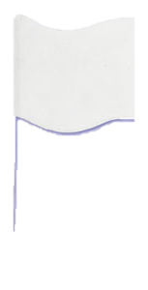

Slide 2
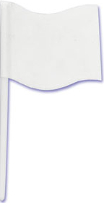
cropped

Slide 3
Recolor transparent
ffff

Slide 4
Recolor transparent
ffff

Slide 5
Recolor transparent
ffff

