Slide 1
Exemples d’utilisation de la nouvelle spécification du tag advertising
Paul Desgranges v0.53

Slide 2
Exemples d’utilisation de la nouvelle spécification du tag ‘advertising’
Introduction : pour présenter des exemples d’utlisation du tag advertising
    Panneaux scellés au sol
    Panneaux muraux
    Enseignes temporaires
    Sucettes
    Abris de transport
    Enseignes totem
    Enseignes scellées au sol
    Colonnes
    Drapeaux
    Bâches
    JEI
    Préenseignes

Slide 3
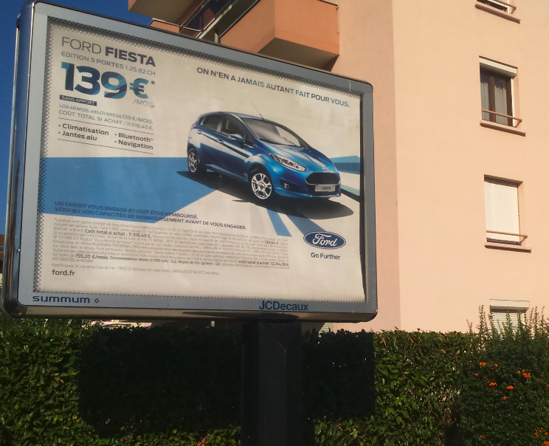
Panneau scellé au sol (Grenoble)
man_made=advertising
advertising=billboard
support=trunk
faces=2
size=3*2
height=6
lit=yes lit:type=transmission
animated=winding_posters
land_property=private
legal_type:FR=publicité
legal_status:FR=à vérifier
access=no
message=commercial
operator=JCDecaux
ref=?
orientation=front
location_side=same

Slide 4
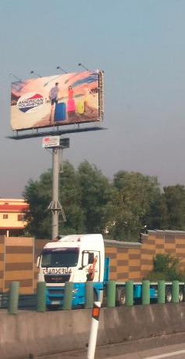
Panneau scellé au sol (Porto, Portugal)
man_made=advertising
advertising=billboard
support=pole
faces=2
size=8*3.5
height=15
lit=yes lit:type=projection
animated=no
land_property=private
access=no
message=commercial
operator=?
ref=?
orientation=front
location_side=same

Slide 5
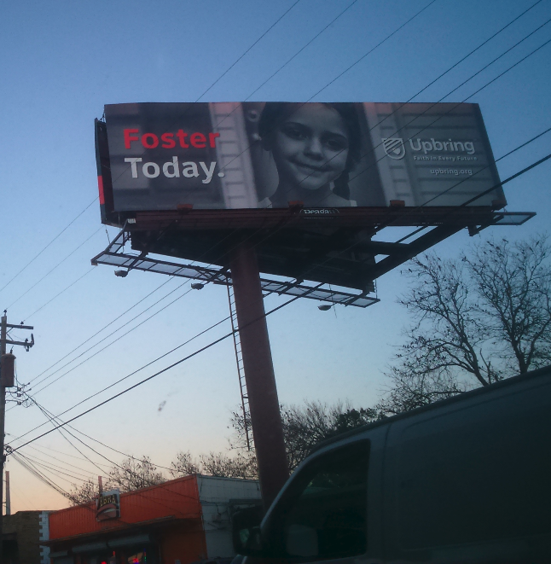
Panneau scellé au sol (Austin,Texas)
man_made=advertising
advertising=billboard
support=trunk
faces=2
size=8*3.5
height=15
lit=yes lit:type=projection
animated=no
land_property=private
access=no
message=commercial
operator=?
ref=?
orientation=front
location_side=same

Slide 6
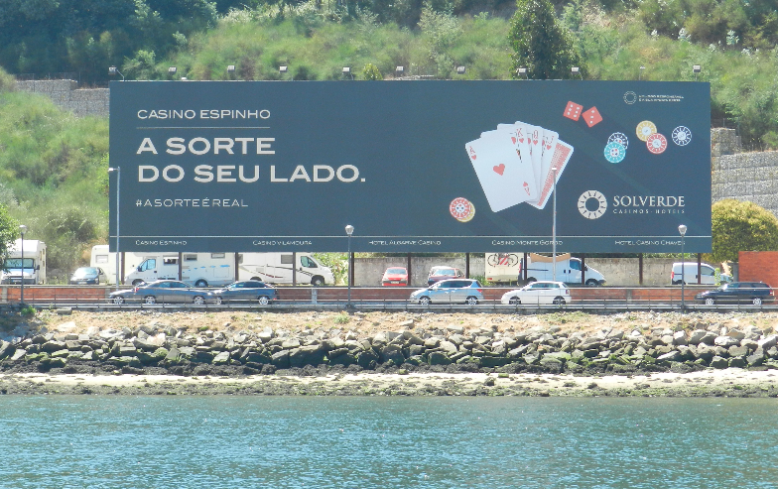
Panneau scellé au sol (Porto, Portugal)
man_made=advertising
advertising=billboard
support=poles
faces=1
size=26*8
height=10
lit=yes lit:type=projection
animated=no
land_property=private
access=no
message=commercial
operator=?
ref=?
orientation=multi

Slide 7
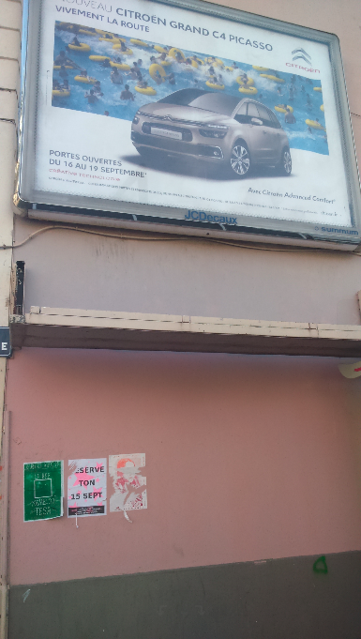
Panneau mural (Grenoble)
building=yes
advertising=billboard
support=wall
faces=1
size=3*2
height=6
lit=yes lit:type=transmission
animated=winding_posters
land_property=private
legal_type:FR=publicité
legal_status:FR=ko:passerelle dépliée
message=commercial
operator=JCDecaux
ref=?
orientation=front
location_side=same

Slide 8
Panneau mural (Grenoble)
building=yes
advertising=billboard
support=wall
faces=1
size=3*2
height=6
lit=yes lit:type=transmission
animated=winding_posters
land_property=private
legal_type:FR=publicité
legal_status:FR=ko:passerelle dépliée
message=commercial
operator=JCDecaux
ref=?
orientation=front
location_side=same

Slide 9
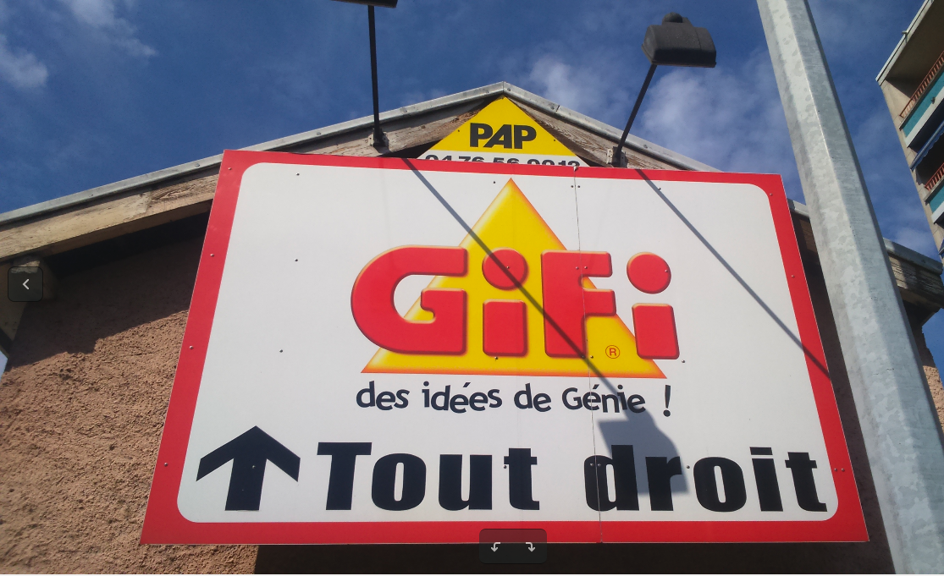
Panneau mural (Fontaine)
building=yes
advertising=billboard
support=wall
faces=1
size=1.5*1
height=6
lit=yes lit:type=projection
animated=no
land_property=private
legal_type:FR=publicité
legal_status:FR=ko:dépasse mur; dépasse égout du toit; saillie trop importante
message=commercial
operator=PAP
ref=?
orientation=front
location_side=same

Slide 10
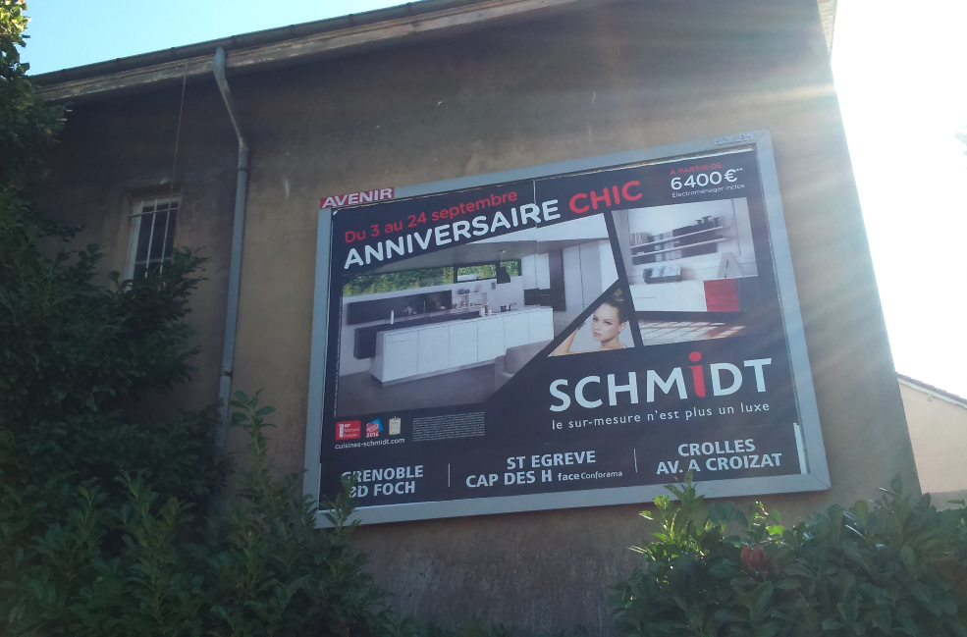
Panneau mural (Grenoble)
building=yes
man_made=advertising
advertising=billboard
support=wall
faces=1
size=3*2
height=5
lit=no
animated=no
land_property=private
legal_type:FR=publicité
legal_status:FR=ko; mur non aveugle
access=no
message=commercial
operator=Avenir
ref=?
orientation=front
location_side=opposite

Slide 11
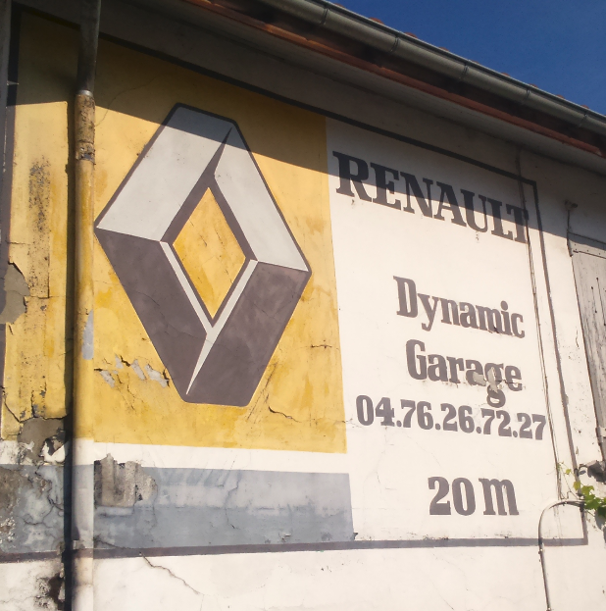
Peinture murale (Fontaine)
building=yes
advertising=wall_painting
support=wall
faces=1
size=3*2
height=5
lit=no
animated=no
land_property=private
legal_type:FR=publicité
legal_status:FR=ok
access=no
message=commercial
operator=Renault
ref=?
orientation=front
location_side=same

Slide 12
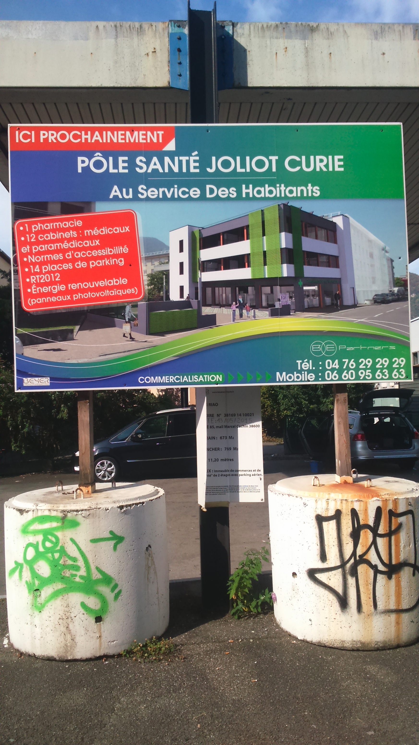
Enseigne temporaire (Fontaine)
man_made=advertising
advertising=billboard
support=put_on_ground
faces=1
size=3*2
height=4
lit=no
animated=no
land_property=private
legal_type:FR=enseigne:temporaire
legal_status:FR=à vérifier: sur la voie publique
access=no
message=commercial
operator=?
ref=?
orientation=parallel

Slide 13
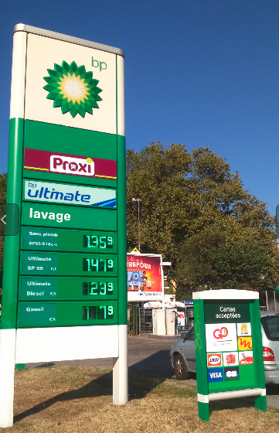
Enseigne Totem
man_made=advertising
advertising=totem
faces=2
size=1.2*6
height=6
message=commercial
lit=yes
animated=digital_prices
land_property=private
legal_type:FR=enseigne
legal_status:FR=ok
access=no
operator=BP
ref=?
orientation=front
location_side=same

Slide 14
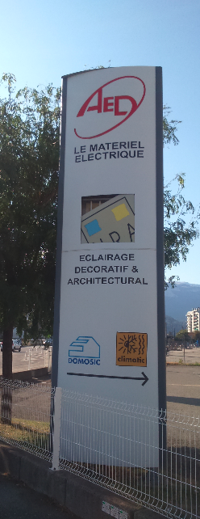
Enseigne Totem
man_made=advertising
advertising=totem
faces=2
size=1.2*6.5
height=6.5
message=commercial
lit=yes
animated=no
land_property=private
legal_type:FR=enseigne
legal_status:FR=ok
access=no
operator=AED
ref=?
orientation=multi

Slide 15
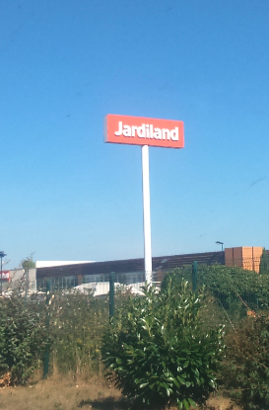
Enseigne scellée au sol
man_made=advertising
advertising=sign
faces=2
size=7*2
height=15
message=commercial
lit=yes
animated=no
land_property=private
legal_type:FR=enseigne
legal_status:FR=ko: beaucoup trop haut
access=no
operator=Jardiland
ref=?
orientation=multi

Slide 16
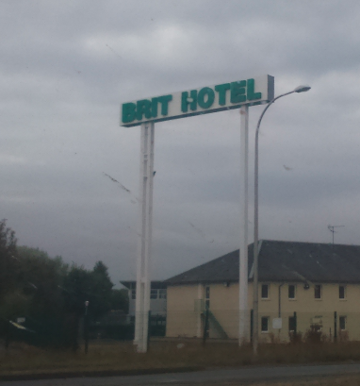
Enseigne scellée au sol
man_made=advertising
advertising=sign
faces=2
size=9*1.1
height=13
lit=yes
animated=no
land_property=private
legal_type:FR=enseigne
legal_status:FR=ko: beaucoup trop haut
access=no
operator=Brit Hotel
ref=?
orientation=multi

Slide 17
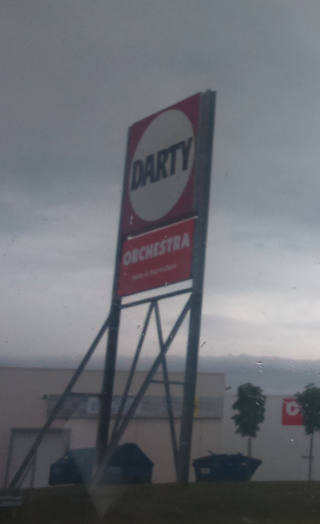
Enseigne scellée au sol
man_made=advertising
advertising=sign
faces=2
size=6*8
height=15
message=commercial
lit=no
animated=no
land_property=private
legal_type:FR=enseigne
legal_status:FR=ko: beaucoup trop haut
operator=Darty
ref=?
orientation=multi

Slide 18
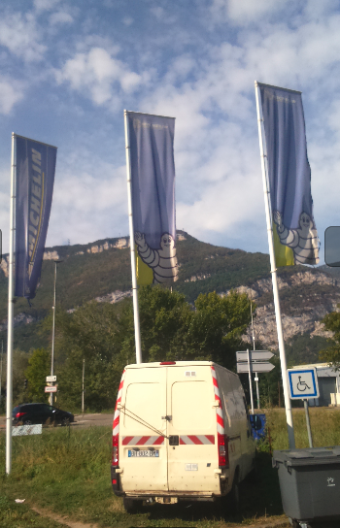
Drapeau
man_made=advertising
advertising=flag
size=1*5
height=8
message=commercial
lit=no
animated=no
land_property=private
legal_type:FR=enseigne
legal_status:FR=ok
access=no
operator=?
ref=?
orientation=multi

Slide 19
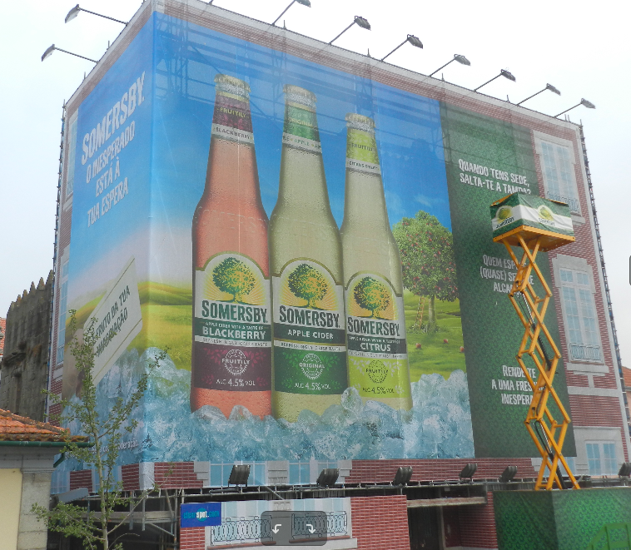
Bâche
man_made=advertising
advertising=tarp
support=scaffold
size=10*8
height=10
message=commercial
lit=yes lit:type=projection
animated=no
land_property=private
legal_type:FR=publicité
legal_status:FR=à vérifier
access=no
operator=?
ref=?
orientation=multi

Slide 20
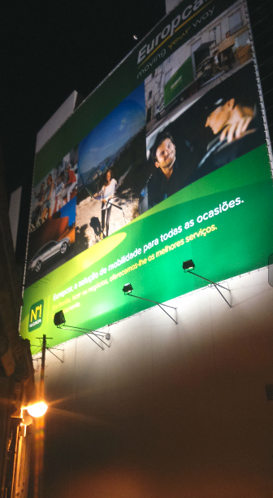
Bâche
man_made=advertising
advertising=tarp
size=10*10
height=13
message=commercial
lit=yes lit:type=projection
animated=no
land_property=private
legal_type:FR=publicité
legal_status:FR=à vérifier
access=no
operator=?
ref=?
orientation=multi

Slide 21
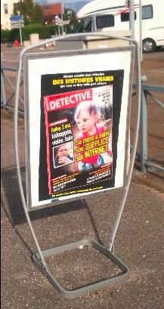
Chevalet
man_made=advertising
advertising=easel
support=easel
size=0.8*1
height=1.4
message=commercial
lit=no
animated=no
land_property=public
legal_type:FR=enseigne
legal_status:FR=ok
access=no
operator=?
ref=?
orientation=front
location_side=same

Slide 22
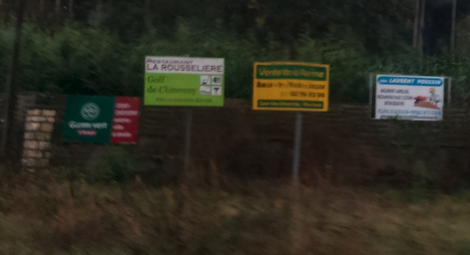
Préenseigne
man_made=advertising
advertising=board
support=post
size=1.5*1.2
height=2.5
message=commercial
lit=no
animated=no
land_property=private
legal_type:FR=préenseigne
legal_status:FR=ko: préenseignes illégales
access=no
operator=?
ref=?
orientation=front
location_side=same

Slide 23
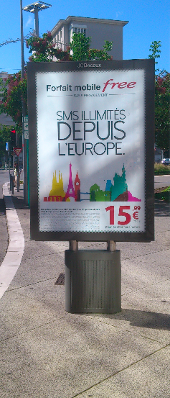
Mobilier urbain : sucette (Lyon)
man_made=advertising
advertising=poster_box
faces=2
size=1.2*1.5
height=2.2
lit=yes lit:type=transmission
animated=no
land_property=public
legal_type:FR=publicité:mobilier_urbain:panneau
legal_status:FR=à vérifier:
access=no
message=mix
operator=JCDecaux
ref=?
orientation=front
location_side=same

Slide 24
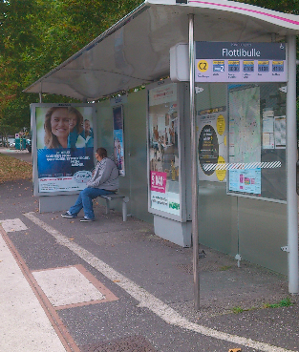
Mobilier urbain : abribus (Echirolles)
amenity=shelter bench=yes building=yes shelter_type=public_transport
advertising=poster_box
support=street_furniture:transit_shelter
faces=3
size=1.2*1.8
height=2.2
lit=yes lit:type=transmission
animated=no
land_property=public
legal_type:FR=publicité:mobilier_urbain:abri_transport
legal_status:FR=ok
access=no
operator=JCDecaux
ref=?
orientation=front
location_side=same

Slide 25
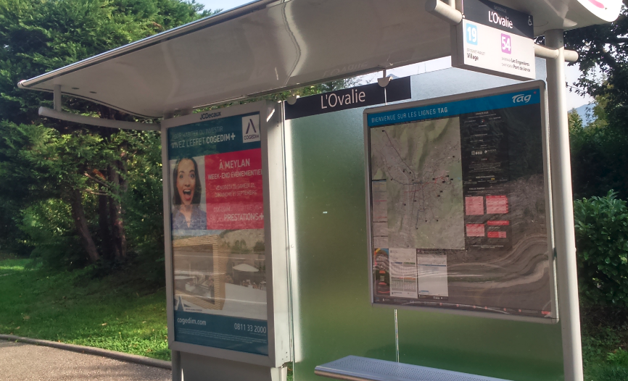
Mobilier urbain : abribus (Fontaine)
amenity=shelter bench=yes building=yes shelter_type=public_transport
advertising=poster_box
support=street_furniture:transit_shelter
faces=1
size=1.2*1.8
height=2.2
message=commercial
lit=yes lit:type=transmission
animated=no
land_property=public
legal_type:FR=publicité:mobilier_urbain:abri_transport
legal_status:FR=ok
access=no
operator=JCDecaux
ref=?
orientation=parallel

Slide 26
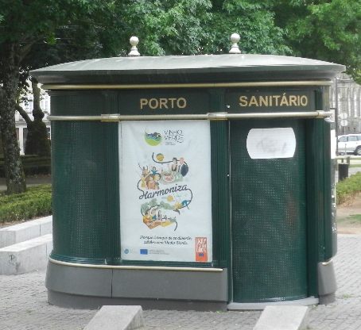
Mobilier urbain : sanitaires
advertising=board
support=street_furniture:toilets
size=1.2*1.8
height=2
message=commercial
lit=no
animated=no
land_property=public
legal_type:FR=publicité:mobilier_urbain
legal_status:FR=ko
access=no
operator=Porto
ref=?
orientation=multi

Slide 27
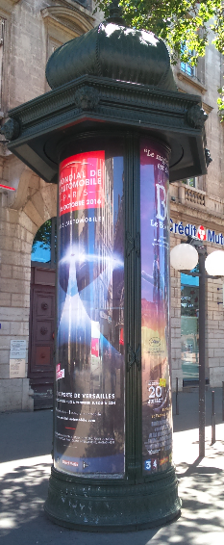
Mobilier urbain : colonne
man_made=advertising
advertising=column
size=2*8
height=8
message=commercial
lit=yes lit:type=transmission
animated=no
land_property=public
legal_type:FR=publicité:mobilier_urbain:colonne
legal_status:FR=à vérifier
operator=Ville de Lyon/JCDecaux
ref=?
orientation=multi

Slide 28
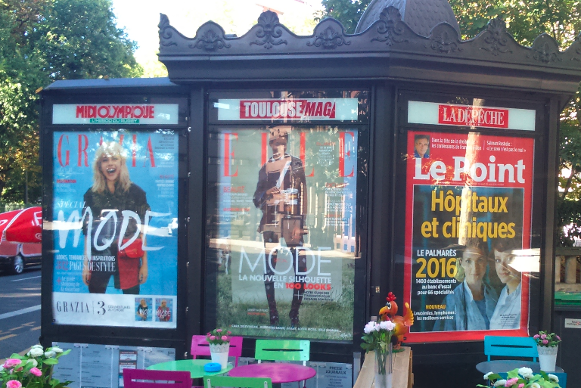
Mobilier urbain : kiosque
building=retail shop=kiosk
advertising=billboard
support=street_furniture:newspaper_kiosk
size=1.2*2*6
height=2.4
message=commercial
lit=yes lit:type=transmission
animated=no
land_property=public
legal_type:FR=publicité:mobilier_urbain:kiosque
legal_status:FR=ko:surface pub trop grande
access=no
operator=Ville de Toulouse
ref=?
orientation=multi

Slide 29
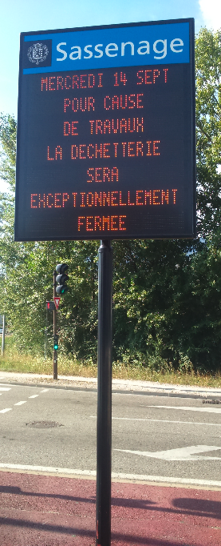
JEI
man_made=advertising
advertising=board
size=1.2*1.5
height=5
message=information
lit=numeric
animated=digital_message
land_property=public
legal_type:FR=JEI
legal_status:FR=ok
access=no
operator=Ville de Sassenage
ref=?
orientation=multi

Slide 30
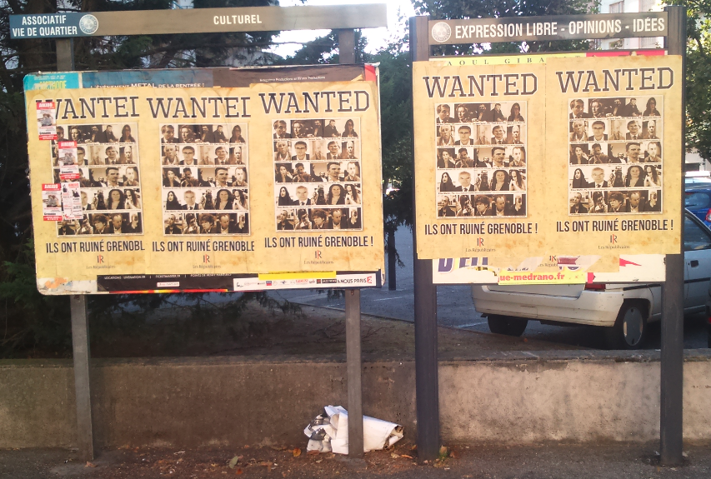
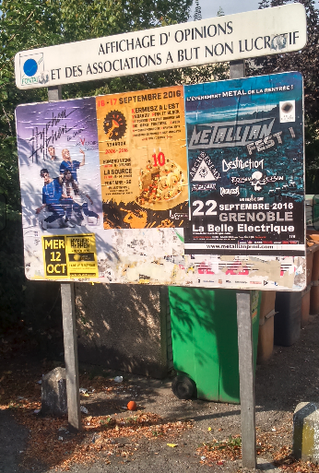
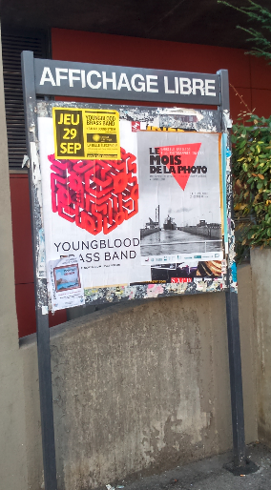
Affichage d’opinions et publicité à l’usage des associations à but non-lucratif
man_made=advertising
advertising=board
support=post
size=2.4*1.2
height=2.5
message=display_opinion; non_profit; associations
lit=no
animated=no
land_property=public
legal_type:FR=opinions_associations
legal_status:FR=ok
access=yes
operator=Ville de Fontaine
ref=?
orientation=front
location_side=same

