Slide 1
Board Games and Algorithms
Paul Grayson, 2012-07-18

Slide 2
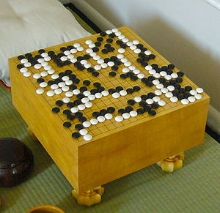
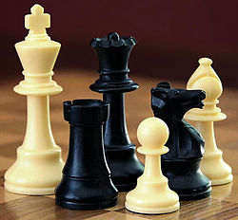
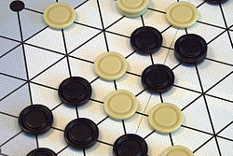
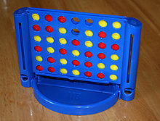
Abstract strategy games
Two players
Turn-based
No secrets
No randomness

Slide 3
Solving games
They have a “solution”:
X Wins

Slide 4
Solving games
They have a “solution”:
X Wins
X Wins

Slide 5
More complicated games
Limited by computational time
Search n levels deep
Evaluate the positions
New problem: find the “best” move
9
3
-2

Slide 6
Find the best move with: minimax
Player 1 moves
Player 2 moves
5
0
11
-1
5
-2

Slide 7
Find the best move with: minimax
Player 1 moves
0
-1
-2
Player 2 moves
MINIMIZE
5
0
11
-1
5
-2

Slide 8
Find the best move with: minimax
0
Player 1 moves
MAXIMIZE
0
-1
-2
Player 2 moves
MINIMIZE
5
0
11
-1
5
-2

Slide 9
But we can do better...
≥ 0
Player 1 moves
x
y
0
Player 2 moves
5
0
11
-1
Since -1 < 0, move y is
worse than move x.

Slide 10
But we can do better...
≥ 0
Player 1 moves
x
y
0
XXXXXX
Player 2 moves
5
0
11
-1
Since -1 < 0, move y is
worse than move x.
We can skip evaluating
the other move.

Slide 11
Generalization: alpha-beta
Say we know the score is between α and β.
Player 1 looks for a way to increase α.
Player 2 looks for a way to decrease β.
If α ≥ β, stop working on this move.

Slide 12
Show alpha-beta in Ruby

Slide 13
Alpha-beta is an algorithm
It consists of a specific list of steps (a program).
It solves a well-defined problem.
A solution is always found (in a finite time).

