Slide 1
Introduction to gnuplot
Paul Grayson
2015-07-08

Slide 2
WYSIWYG vs. code
Reproducibility
Automation
Performance

Slide 3
What is gnuplot?
Open source
Multi-platform
Command-line-driven
Under development since 1986
Does 2D/3D graphing, data analysis, annotation
LOTS of output formats

Slide 4
Output formats
canvas HTML Canvas object
cgm Computer Graphics Metafile
corel EPS format for CorelDRAW
dpu414 Seiko DPU-414 thermal printer [small medium large]
dumb ascii art for anything that prints text
dxf dxf-file for AutoCad (default size 120x80)
eepic EEPIC -- extended LaTeX picture environment
emf Enhanced Metafile format
emtex LaTeX picture environment with emTeX specials
epslatex LaTeX picture environment using graphicx package
epson_180dpi Epson LQ-style 180-dot per inch (24 pin) printers
epson_60dpi Epson-style 60-dot per inch printers
epson_lx800 Epson LX-800, Star NL-10, NX-1000, PROPRINTER ...
fig FIG graphics language for XFIG graphics editor
gif GIF images using libgd and TrueType fonts
gpic GPIC -- Produce graphs in groff using the gpic preprocessor
hp2623A HP2623A and maybe others
hp2648 HP2648 and HP2647
hp500c HP DeskJet 500c, [75 100 150 300] [rle tiff]
hpdj HP DeskJet 500, [75 100 150 300]
hpgl HP7475 and relatives [number of pens] [eject]
hpljii HP Laserjet series II, [75 100 150 300]
hppj HP PaintJet and HP3630 [FNT5X9 FNT9X17 FNT13X25]
imagen Imagen laser printer
jpeg JPEG images using libgd and TrueType fonts
latex LaTeX picture environment
lua Lua generic terminal driver

Slide 5
mf Metafont plotting standard
mif Frame maker MIF 3.00 format
mp MetaPost plotting standard
nec_cp6 NEC printer CP6, Epson LQ-800 [monocrome color draft]
okidata OKIDATA 320/321 Standard
pbm Portable bitmap [small medium large] [monochrome gray color]
pcl5 HP Designjet 750C, HP Laserjet III/IV, etc. (many options)
pdfcairo pdf terminal based on cairo
png PNG images using libgd and TrueType fonts
pngcairo png terminal based on cairo
postscript PostScript graphics, including EPSF embedded files (*.eps)
pslatex LaTeX picture environment with PostScript \specials
pstex plain TeX with PostScript \specials
pstricks LaTeX picture environment with PSTricks macros
qms QMS/QUIC Laser printer (also Talaris 1200 and others)
regis REGIS graphics language
starc Star Color Printer
svg W3C Scalable Vector Graphics driver
tandy_60dpi Tandy DMP-130 series 60-dot per inch graphics
tek40xx Tektronix 4010 and others; most TEK emulators
tek410x Tektronix 4106, 4107, 4109 and 420X terminals
texdraw LaTeX texdraw environment
tgif TGIF X11 [mode] [x,y] [dashed] ["font" [fontsize]]
tikz TeX TikZ graphics macros via the lua script driver
tkcanvas Tk/Tcl canvas widget [perltk] [interactive]
tpic TPIC -- LaTeX picture environment with tpic \specials
vttek VT-like tek40xx terminal emulator
wxt wxWidgets cross-platform windowed terminal
x11 X11 Window System
xlib X11 Window System (gnulib_x11 dump)
xterm Xterm Tektronix 4014 Mode

Slide 6
Installation
Linux: use package manager
OSX: brew install gnuplot
Windows: download from www.gnuplot.info

Slide 7
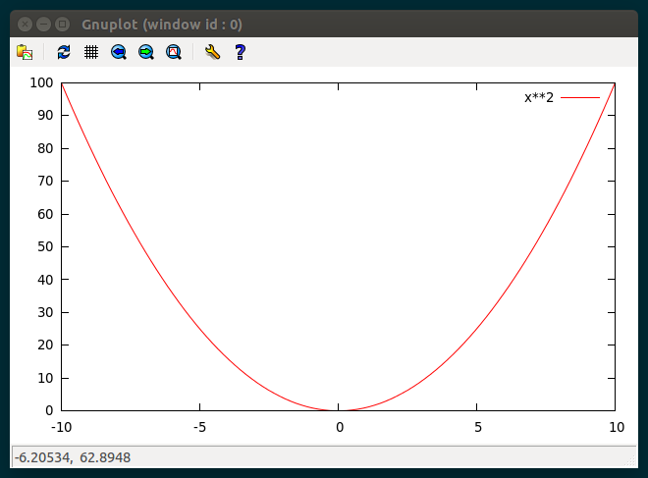
Plotting a function
gnuplot> set xrange [-10:10]
gnuplot> plot x**2

Slide 8
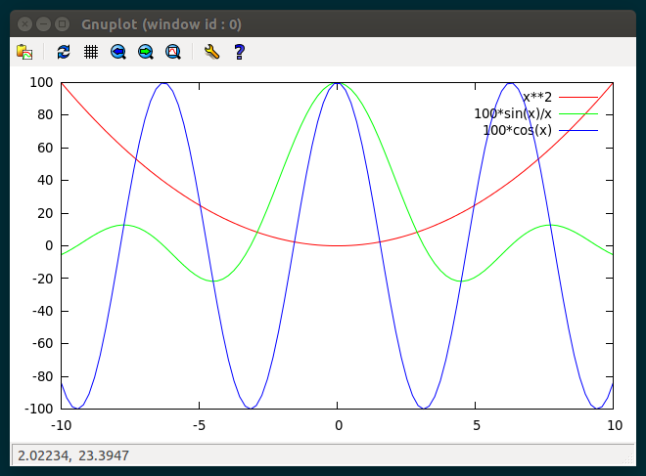
Plotting multiple functions
gnuplot> set xrange [-10:10]
gnuplot> plot x**2,100*sin(x)/x,100*cos(x)

Slide 9
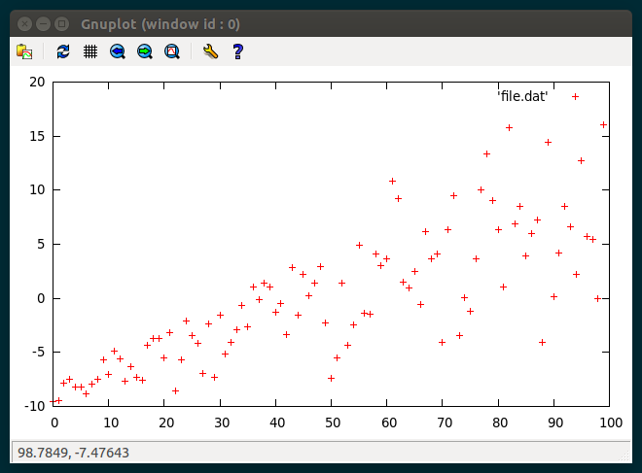
Plotting data from files
gnuplot> plot 'file.dat'

Slide 10
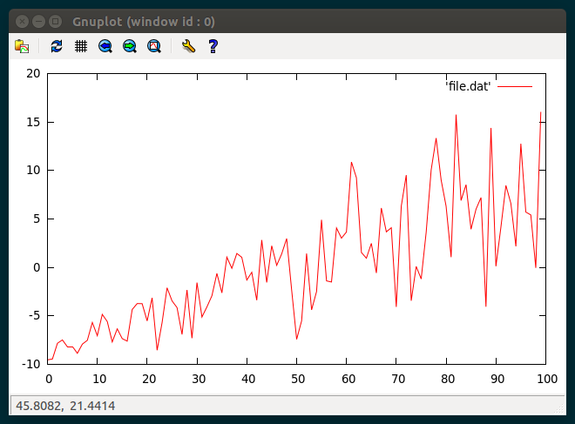
...with lines
gnuplot> plot 'file.dat' with lines

Slide 11
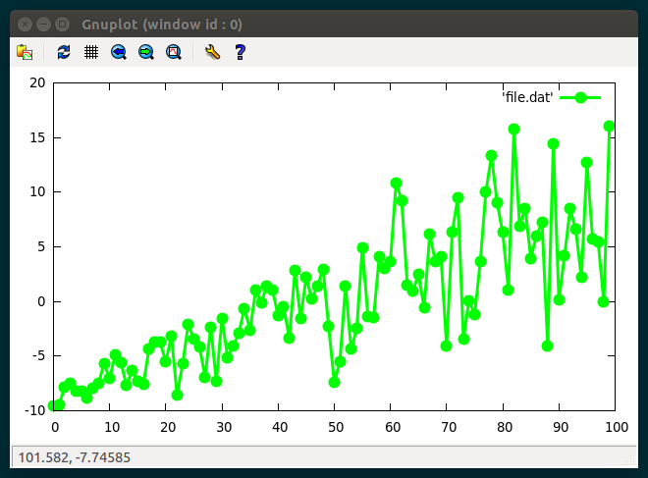
...with styles
gnuplot> plot 'file.dat' with linespoints \
pt 7 ps 1.5 lt 2 lw 3

Slide 12
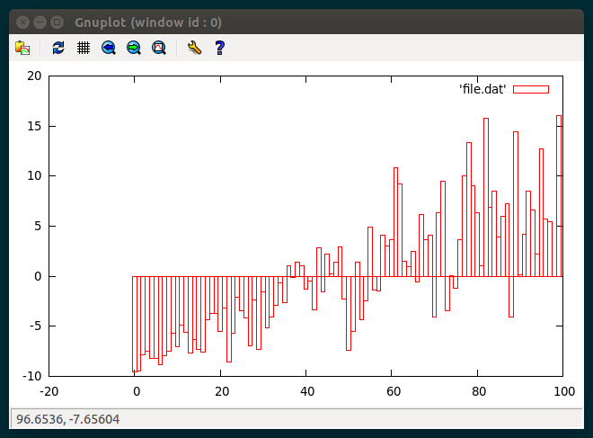
...bargraphs
gnuplot> plot 'file.dat' with bars

Slide 13
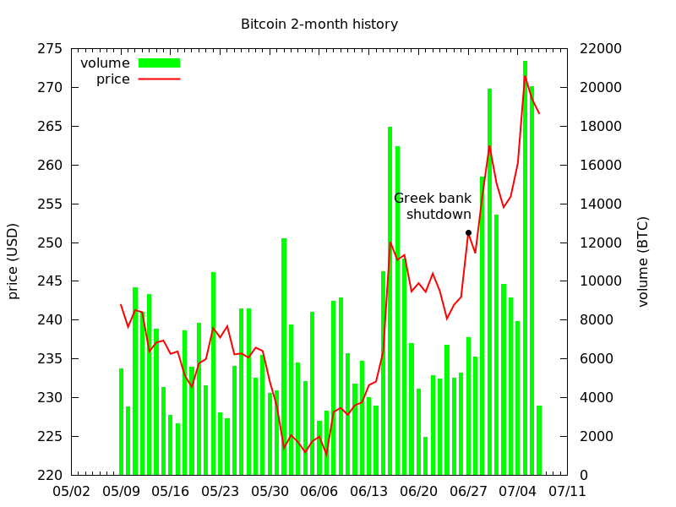
Complex data with using

Slide 14
Automating gnuplot
Generate datafile, then run gnuplot
Have gnuplot run your script
Generate gnuplot file with a script

Slide 15
Getting help
PDF manual
Command-line help

