Slide 1
Controlling the world with Ruby
AKA “8-bit stuff”
Paul Grayson
Las Vegas Ruby User Group
2015-01-21

Slide 2
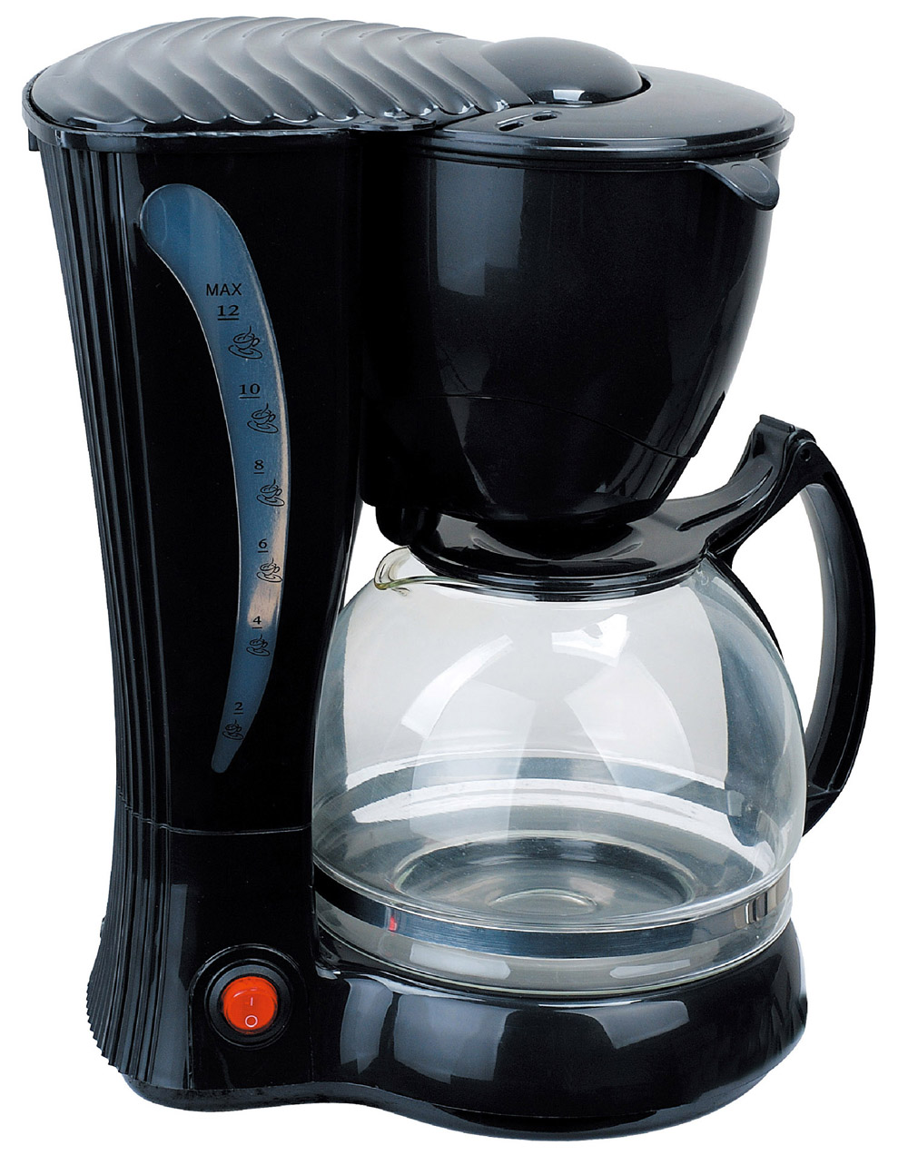
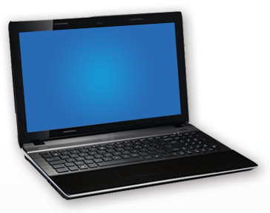
Thinking outside the box

Slide 3
Controlling physical devices
Need to build circuitry
Precise timing requirements (microseconds)
Variety of interfaces

Slide 4
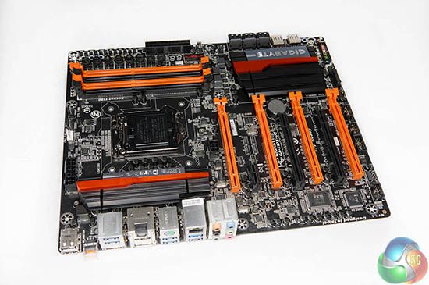
CPUs aren't good at that
Not easy to wire up to things
Unpredictable timing - milliseconds
Few low-level interfaces

Slide 5
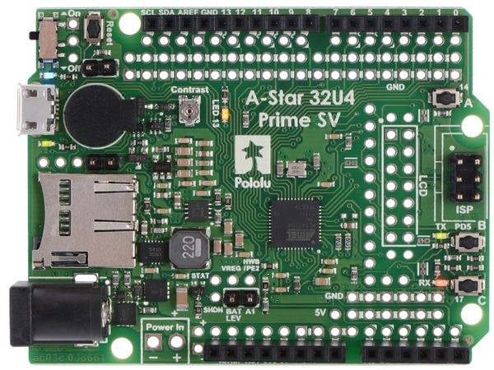
Microcontrollers!
Available in hacker-friendly packages
Precise sub-microsecond timing
Many interfaces, timers, ADC, etc.
Typically 8-bit / 32k program / 2k RAM

Slide 6
Solution: microcontroller + CPU
?
Serial (RS-232)
I²C
Audio
USB

Slide 7
USB virtual serial port
Bytes sent and received on /dev/ttyACM*, /dev/cu.usbmodem*, COM*

Slide 8
LED demo
RGB 5-bit color = 15 bits/pixel
byte 1 byte 0
0rrrrrgg gggbbbbb

Slide 9
Bit operators in Ruby
&, |, ^ - AND, OR, XOR
<<, >> - left, right shift
0bxxxxxxxx << 3 = 0bxxx_xxxxx000
0bxxxxxxxx >> 3 = 0b000xxxxx
0rrrrrgg gggbbbbb =
(r << 10) + (g << 5) + b
better: ((r & 31) << 10) + ...

