Slide 1
Rake: Ruby Make
Paul Grayson
2011-05-18
git://github.com/pdg137/rakepres.git

Slide 2
What is Rake?
A simple build and task program with:
  Standard Ruby syntax
  Prerequisites
  Implicit rules
  FileList collections
  A task library
Rake is not only for ruby applications!

Slide 3
Advantages over Make
Uses a complete language (Ruby)
Clear distinction between tasks and files
Task descriptions
…?

Slide 4
Disadvantages wrt Make
Uses an unstable language (Ruby)
  (My simplest Rakefile broke when upgrading from 1.8.7 to 1.9.2)
Poor documentation
No multi-process support (make -jN)

Slide 5
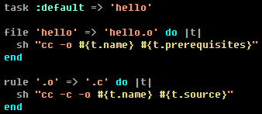
Rakefile Basics
Task
File
Rule

Slide 6
Running Rake
rake # runs :default
rake --tasks # list tasks
rake abcd # runs task :abcd
rake abcd[def] # argument ”def”
rake VAR=value # set env. variable
VAR=value rake # (set var. with sh)

Slide 7
Rake and Rails
Basic operations like rake db:migrate
Custom tasks in lib/tasks
  Include your environment with the :environment dependency.
  Specify environment with RAILS_ENV=...
Special tasks like rake db:seed

Slide 8
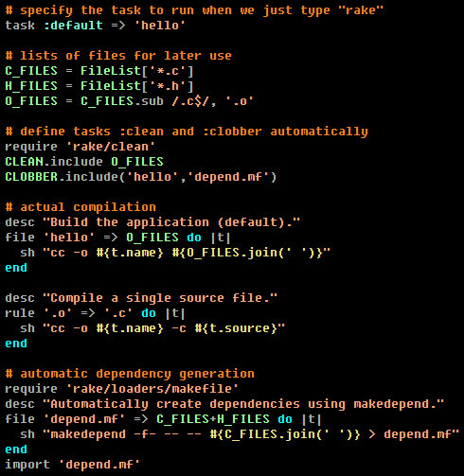
Advanced Rake

Slide 9
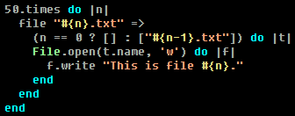
More Advanced Rake
You can define tasks in a loop!
Recursive Rake...???

Slide 10

Thank you!
Now go rake!

