Slide 1
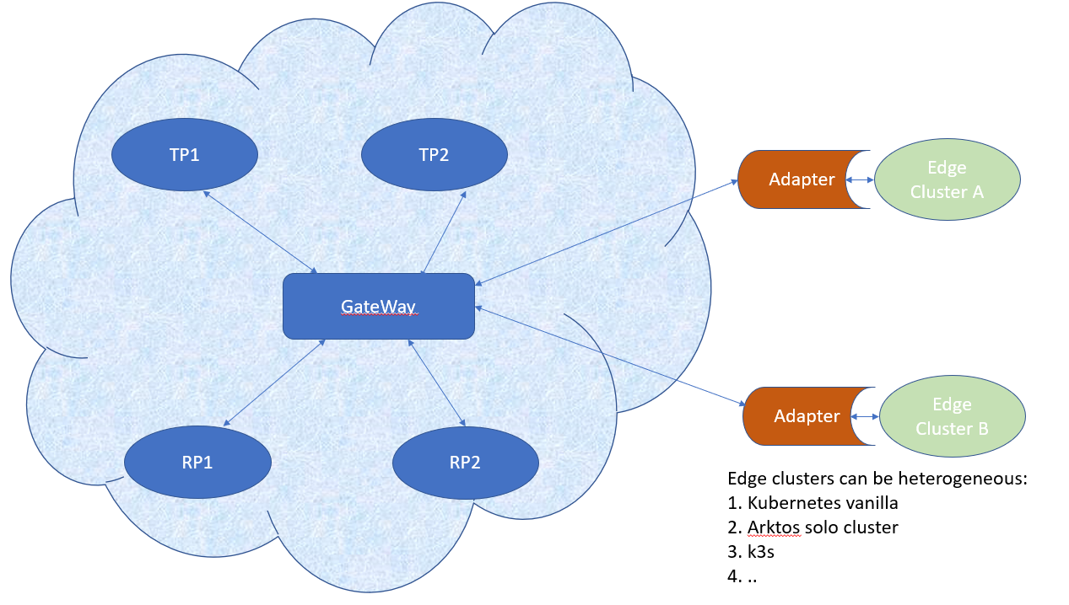

Slide 2
Cloud Worker Fleet
Cloud
Cloud Control Plane
Workload
Workload
Edge DS
Edge Master Node
Edge Worker Node
Edge Worker Node
Edge Worker Node
Edge Worker Node
Device

Slide 3
Cloud Worker Fleet
Cloud
Cloud Control Plane
Workload
Workload
Edge Master Node
Edge DS
Edge Worker Node
Autonomy
Scalability & Elastic
Fault tolerance
Edge Worker Node
Edge Worker Node
Edge Worker Node
Device

Slide 4
Cloud Worker Fleet
Cloud
Cloud Control Plane
Workload
Workload
Edge Worker Node
Edge DS
KubeEdge
SuperEdge (Tencent)
OpenYurt (Ali)
OpenEdge (Baidu)
More here
Device

Slide 5
Cloud Worker Fleet
Cloud
Cloud Control Plane
Workload
Workload
Edge DS
Edge Master Node
RKE + K8s or K3s, RKE2
KubeEdge Site (??)
Edge Worker Node
Edge Worker Node
Edge Worker Node
Device

Slide 6
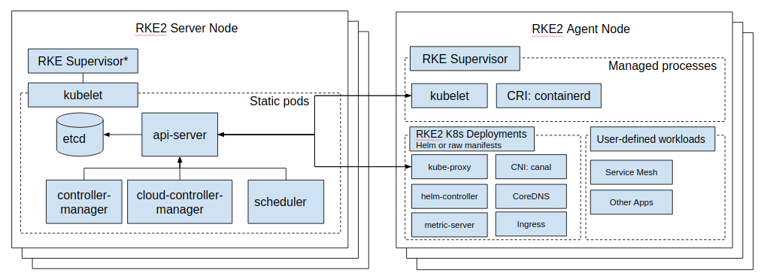
Cloud Worker Fleet
Cloud
Cloud Control Plane
Workload
Workload
Edge DS
Edge Master Node
RKE2
Edge Worker Node
Edge Worker Node
Edge Worker Node
Device

Slide 7
master
Cloud
node
node
node
Node Group 1
Node Group 2
Edge DS
Node group master/worker
Node group master
node
node
node

Slide 8
Cloud
Arktos API Server
node
node
node
node
Cloud Core
Edge DS
node
node
node
node
node
node
node

Slide 9
Cloud
Arktos API Server
node
node
node
node
Cloud Core
Edge DS
node
node
node
node
node
node
node

Slide 10
Cloud
Arktos API Server
node
node
node
node
Cloud Core
Edge DS
node
node
node
node
node
node
node
Local Scaling

Slide 11
Cloud
Arktos API Server
node
node
node
node
Cloud Core
Edge DS
node
node
node
node
node
node
node

Slide 12
Cloud
Arktos API Server
node
node
node
node
Cloud Core
Edge DS
node
node
node
node
node
node
node
Local Recovery

Slide 13
Cloud
Arktos API Server
node
node
node
node
Cloud Core
Edge DS
node
node
node
node
node
node
node
Local Scaling

Slide 14
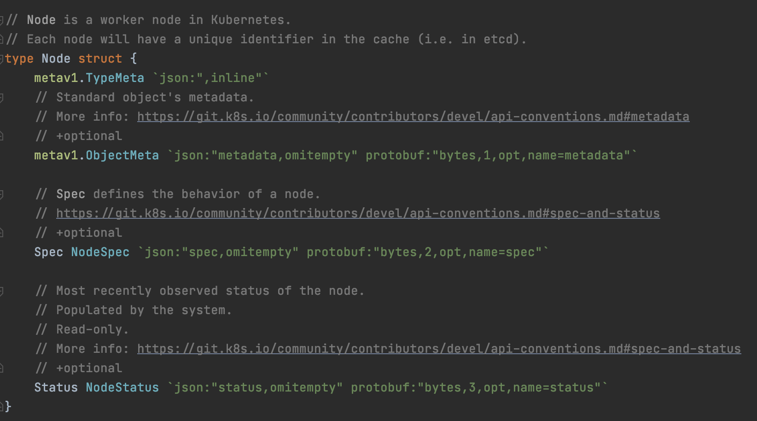
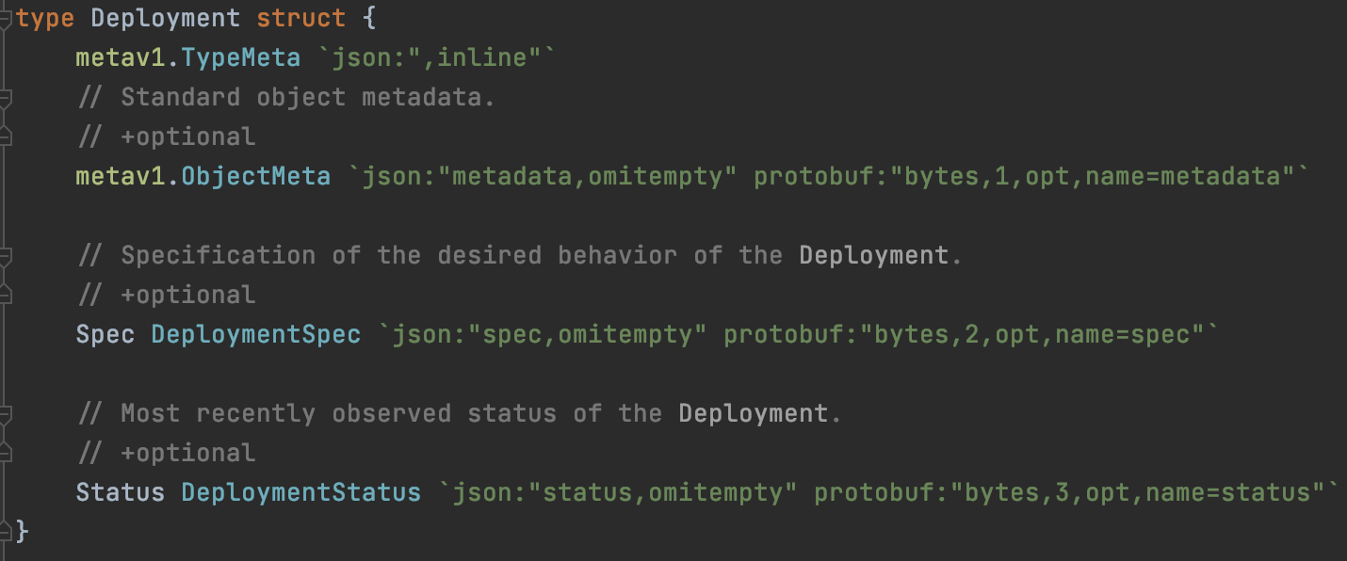
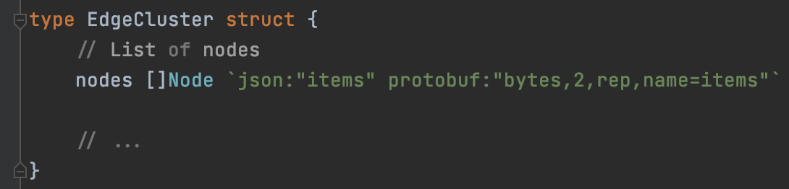
Abstraction
Node
Deployment
scheduler
EdgeCluster
Scheduler:
Schedule workload on nodes
Construct EdgeCluster on edge nodes
Schedule workload on EdgeCluster

Slide 15
Arktos API Server
node
node
node
node
Cloud Core
Cloud
Edge DS
EdgeHub
(tunnel, proxy)
MetaManager
node
node
node
DeviceTwin
EventBus
Kubelet/edged
ServiceBus

Slide 16
master
node
EdgeCluster
EdgeCluster
EdgeCluster
Cloud
Edge DS
Node group master/worker
EdgeHub
(tunnel, proxy)
Node group master
apiserver (“RP”)
MetaManager
controller
node
node
node
DeviceTwin
scheduler
EventBus
Kubelet/edged
ServiceBus

Slide 17
Arktos API Server (“TP”)
Node Group
Cloud
Edge DS
EdgeHub
(tunnel, proxy)
apiserver (“RP”)
controller
scheduler
EventBus
ServiceBus
MetaManager
DeviceTwin
Kubelet/edged
Kubelet/edged
ServiceBus
EventBus
Kubelet/edged
Regular pod
Cluster control pod

