Slide 1
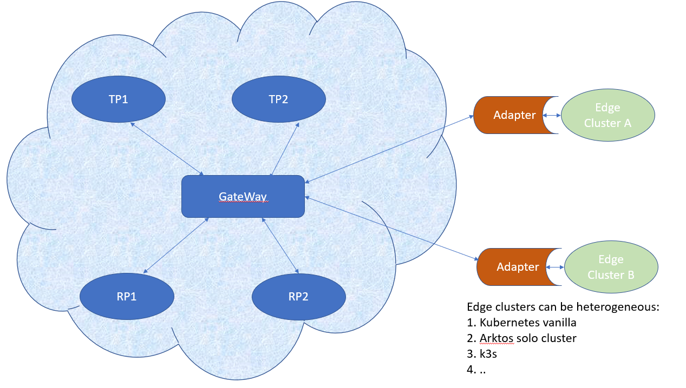

Slide 2
Cloud Worker Fleet
Cloud
Cloud Control Plane
Workload
Workload
Edge DS
Edge Master Node
Edge Worker Node
Edge Worker Node
Edge Worker Node
Edge Worker Node
Device

Slide 3
Cloud Worker Fleet
Cloud
Cloud Control Plane
Workload
Workload
Edge Master Node
Edge DS
Edge Worker Node
Autonomy
Scalability & Elastic
Fault tolerance
Edge Worker Node
Edge Worker Node
Edge Worker Node
Device

Slide 4
Cloud Worker Fleet
Cloud
Cloud Control Plane
Workload
Workload
Edge Worker Node
Edge DS
KubeEdge
SuperEdge (Tencent)
OpenYurt (Ali)
OpenEdge (Baidu)
More here
Device

Slide 5
Cloud Worker Fleet
Cloud
Cloud Control Plane
Workload
Workload
Edge DS
Edge Master Node
RKE + K8s or K3s, RKE2
KubeEdge Site (??)
Edge Worker Node
Edge Worker Node
Edge Worker Node
Device

Slide 6
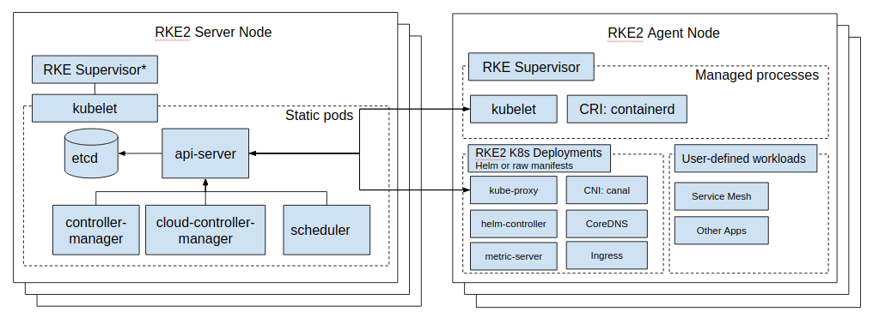
Cloud Worker Fleet
Cloud
Cloud Control Plane
Workload
Workload
Edge DS
Edge Master Node
RKE2
Edge Worker Node
Edge Worker Node
Edge Worker Node
Device

