Slide 1
Ramp-Up on KubeEdge
Qian Chen
Feb 17 2021

Slide 2
Progress
Deploying a test kube-edge environments using two AWS machines.
WikiDoc: https://github.com/chenqianfzh/kubeedge/wiki/Deploying-Kube-Edge
Ramp-Up on KubeEdge
Official repo: https://github.com/kubeedge/kubeedge
Official doc: https://kubeedge.io/en/
https://kubeedge-docs.readthedocs.io/en/latest/modules/kubeedge.html (very helpful!)
Youtube talks ( good starting point)

Slide 3
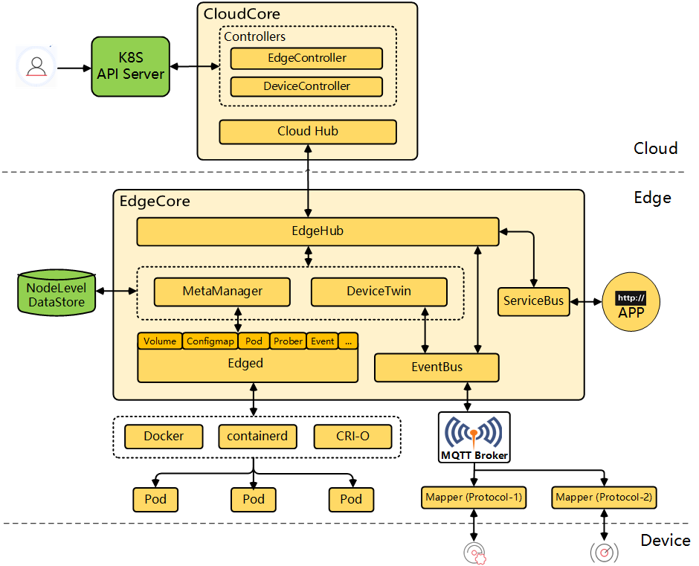
Architecture ( from KubeEdge Repo)

Slide 4

Device
Device
K8s Cluster
pod1
pod2
http:// app
Core Site
Edge Site
Direct Connection is undesirable because：
Latency
security

Slide 5
K8s Cluster
Device
Device
pod1
pod2
http:// app
Resource Interface Layer
EdgeD
Pod lifecycle management(comparable to kubelet)
EventBus
A MQTT client interacting MQTT server(mosquito), to publish/subscribe to other devices
ServerBus
Server to HTTP clients
Device Ctrler
watch/sync data of pod/node..
Edge Ctrler
watch/sync data of device/deviceStatus (CRDs in kubeedge.io)
MetaManager
watch/sync/persiste data of pod/node..
Data Sync Layer
DeviceTwin
watch/sync data of device/deviceStatus
Messaging Layer
CloudHub
EdgeHub
WebSocket(default)
QUIC (alternte)
CloudCore
EdgeCore
Core Site
Edge Site

Slide 6
Device
Device
Arktos Cluster
pod1
pod2
http:// app
Core Site
Edge Site
Next …

Slide 7
Edge Compute Projects
Akraino, EdgeX Foundry, StarlingX, AirShip, CORD …
Among them, the Kubernetes native open-source projects:
Baetyl (Previously named OpenEdge) from Baidu
OpenYurt From Alibaba
SuperEdge From Tencent
KubeEdge from Huawei

Slide 8
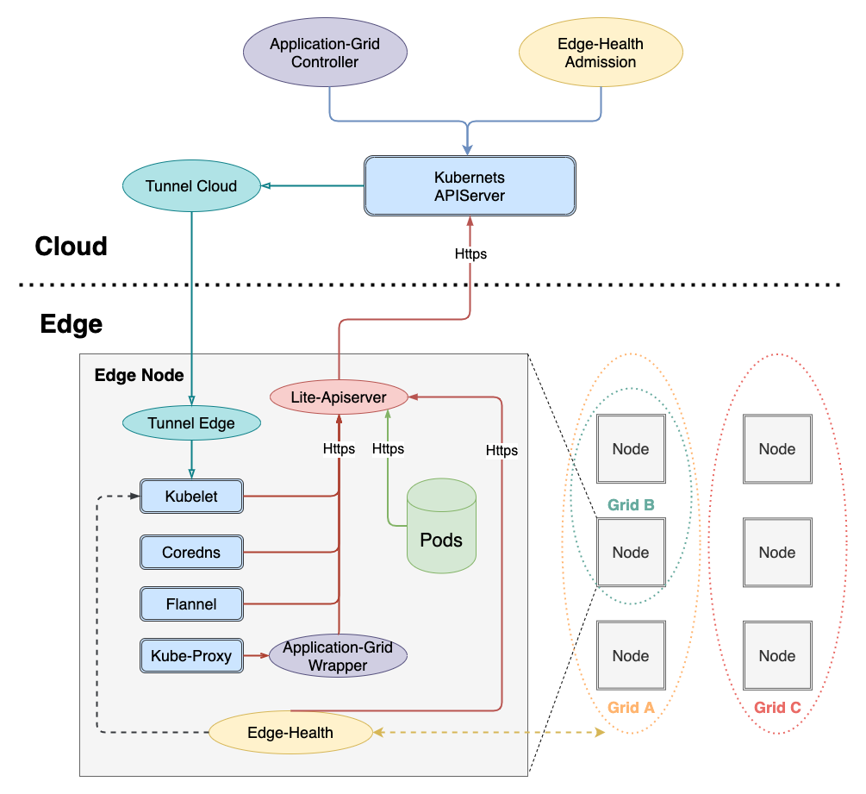
SuperEdge

Slide 9
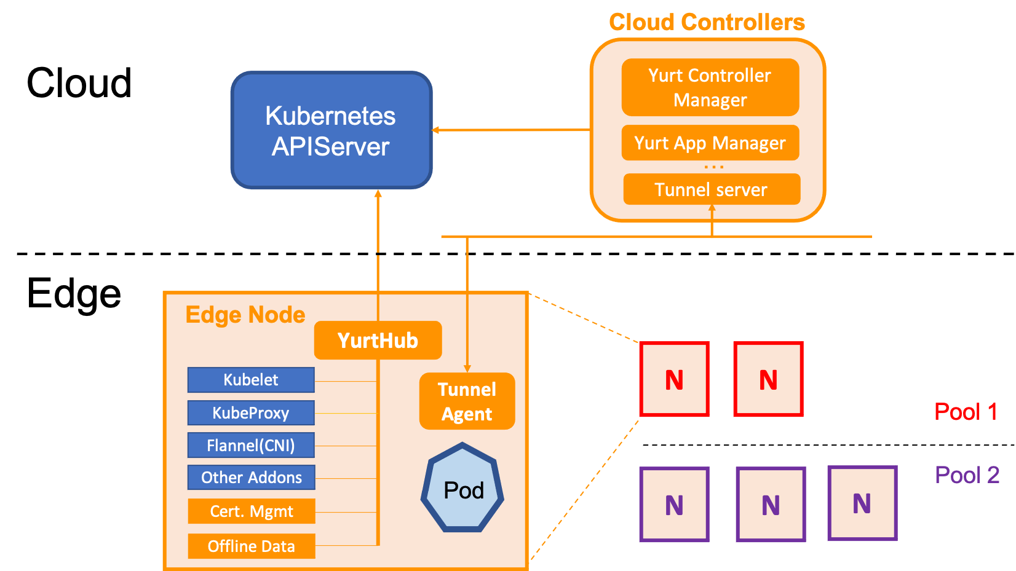
OpenYurt

Slide 10
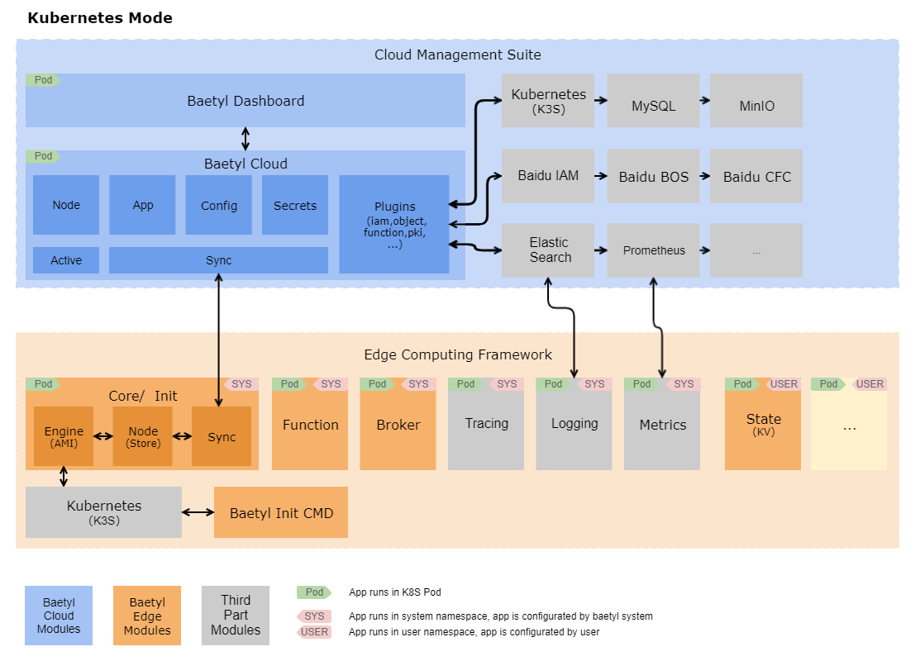
Baetyl

Slide 11
 | Kubeedge | SuperEdge | OpenYurt | OpenEdge(Baetyl)
Non_intrusive in master side | Y | Y | Y | N, seems it is closely coupled with Baidu cloud
Edge Nodes compatible with legacy nodes | N | Y | Y | Looks like an edge node can be obtained by upgrading from a regular node
Operation Tunnel into Edge Node | N | Y | Y | N, (sync via Baidu Cloud internal interface?)
Edge node autonomy( two points) | Y | Y | Y | Y
Site-constrained deployment | N for now But doable with scheduler change | Y Via the feature of ServiceGroup, application-grid-controller | Y Via Yurt-App-Manager | Probably not
Edge Site (Not just Edge Node) | Started but not done | No plan | No plan | N
Extra |  | Distributed node health monitoring (sound interesting! Kind of related to the edge-node auto-discover & auto-networking that Xiaoning mentioned) |  | It is probably the heaviest of all, as it needs deployment of a completed K8s Cluster (k3s acceptable) in each node.

