Slide 1
P2P Inter Cluster Communication
Jun-30-2021, Eunju Kim

Slide 2
Contents
Cilium, Skupper, Istio, libP2P
What they do?
How they are implemented?
Whether they could be used for our p2p solution?

Slide 3
1. Cilium
eBPF-based Networking, Observability, and Security
Functions:
CNI plugin
Networking among clusters across heterogeneous cloud providers
Non-overlapping CIDR ranges among VPCs
Overlapping CIDR ranges among VPCs (complicated)
Network security
Load Balance

Slide 4
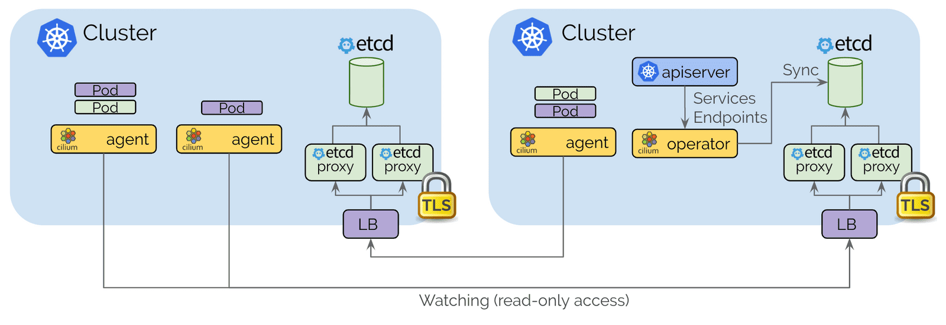
Cilium – Control Plane
Control plane is based on etcd & maintain cluster status.
etcd & etcd proxy per cluster
1
2
Security between cluster communication
eBPF
(1) https://cilium.io/blog/2019/03/12/clustermesh
Notes:
4

Slide 5
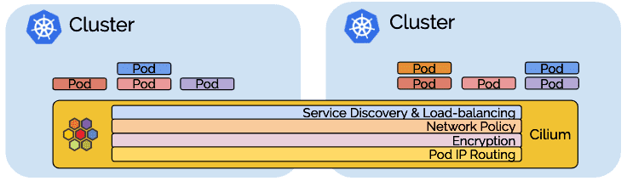
Cilium – Agent
Listens for events from Kubernetes when containers are started and stopped.
Manages the eBPF programs which the Linux kernel uses to control all network access in / out of those containers.

Slide 6
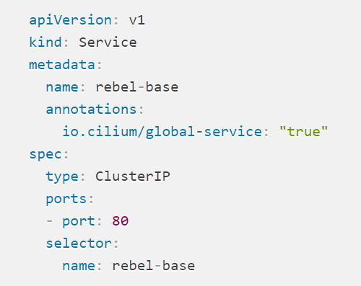
Cilium – Agent : Service Discovery
Kubernetes Service
monitors Kubernetes services and endpoints and
watches for services with an annotation
io.cilium/global-service: "true“
Form a global service that is available across clusters
Notes:
6

Slide 7
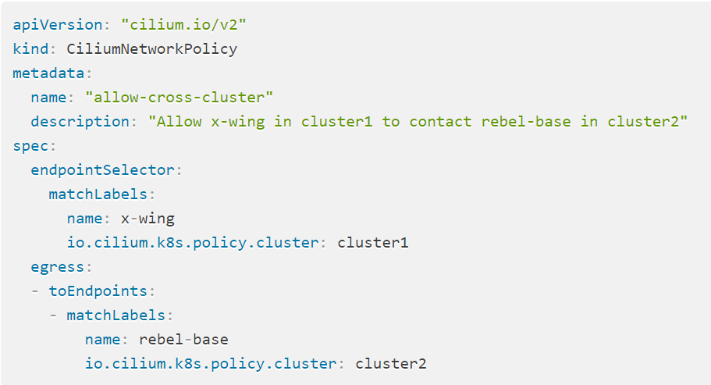
Cilium – Agent : Multi-cluster network policy
Cilium does not automatically propagate NetworkPolicy or CiliumNetworkPolicy across clusters. It is the responsibility of the user to import the policy into all clusters.

Slide 8
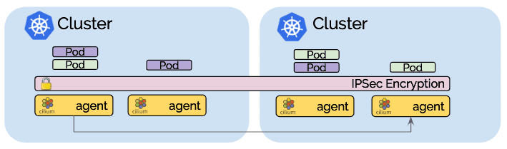
Cilium – Agent : Transparent Encryption
Make sure to configure all nodes across all clusters with a common key and all communication between nodes is automatically encrypted.

Slide 9
2. Skupper
Virtual Application Network (VAN)
VAN connects the services in a distributed application with a microservices architecture.
Layer7 encryption
Skupper is a layer 7 service interconnect. It enables secure communication across Kubernetes clusters with no VPNs or special firewall rules.

Slide 10
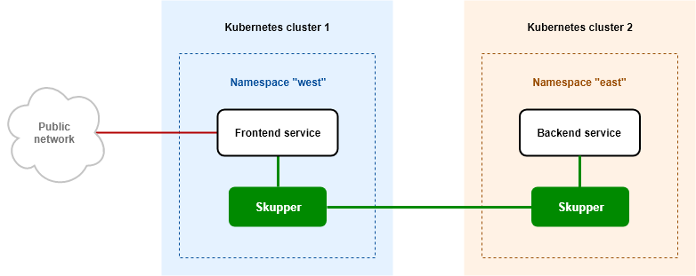
Skupper - Architecture

Slide 11
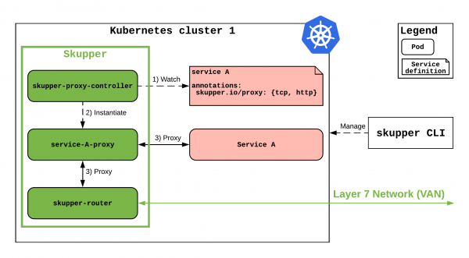
Skupper – Detailed Architecture

Slide 12
Skupper - Components
skupper-router
an instance of Apache Qpid, Messaging transport protocol for IoT and Edge
Advanced Message Queuing Protocol (AMQP) router is responsible for creating the VAN.
Qpid helps Kubernetes clusters communicate by tunneling HTTP and TCP traffic into AMQP
skupper-proxy-controller
Operator that watches for services annotated with skupper.io/proxy and instantiates, for each of them, a service-*-proxy pod

Slide 13
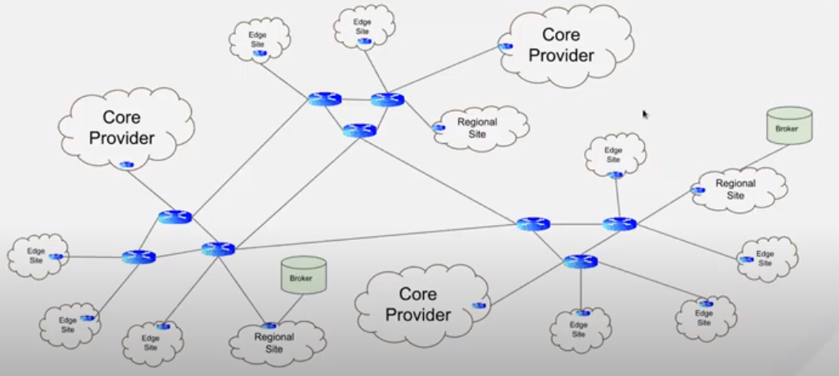
Skupper – Layer7 Router

Slide 14
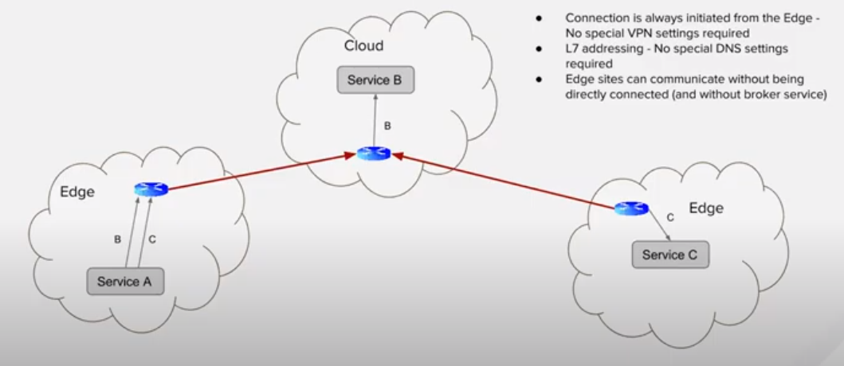
Skupper – Layer7 Router
L7 router : no VPN, no DNS
no direct connection between two edges
Connection is always initiated from Edge

Slide 15

Istio
Open platform-independent service mesh that provides traffic management, policy enforcement, and telemetry collection
Open: open-source software
Platform-independent: not only Kubernetes-based deployments but also other environments.
Service mesh: manage communications between microservices and applications without requiring changes to the underlying services. Istio provides automated baseline traffic resilience, service metrics collection, distributed tracing, traffic encryption, protocol upgrades, and advanced routing functionality for all service-to-service communication.

Slide 16
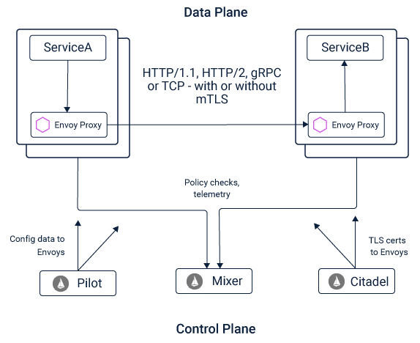
Istio - Architecture
Pilot: abstracts platform-specific service discovery mechanisms and synthesizes them into a standard format that any sidecar conforming with the Envoy API can consume.
Mixer: provides three core features:
Precondition Checking – authentication, policy
Quota Management
Telemetry Reporting
Citadel: enables strong service-to-service and end-user authentication with built-in identity and credential management
(1) https://istio.io/latest/docs/ops/deployment/architecture/

Slide 17
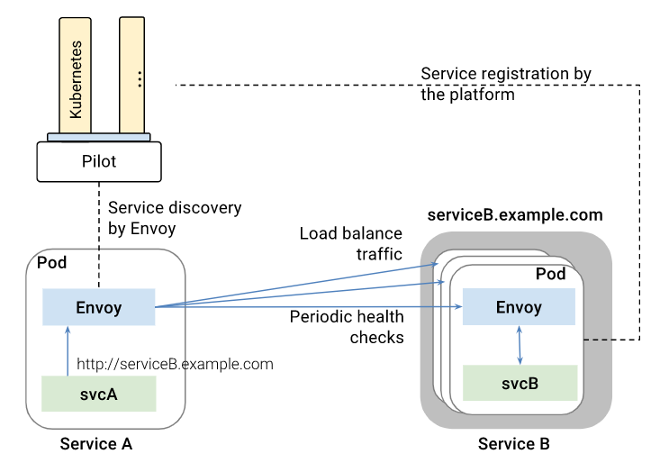
Istio – Service Discovery
How serviceA-Envoy find serviceB?
roundrobin?

Slide 18
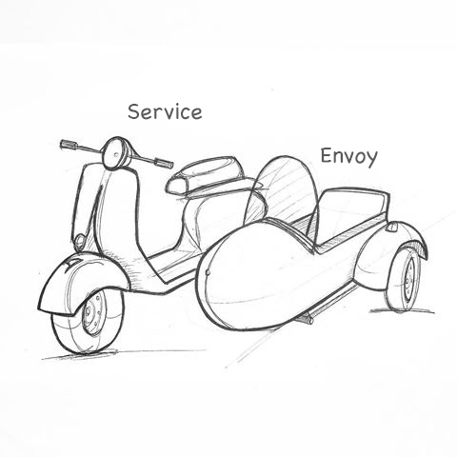
Envoy Proxy
L7 proxy and communication bus designed for micro services architectures.
Service discovery and dynamic configuration:
Health checking
Load balancing
L3/L4 filter architecture: TCP proxy, UDP proxy, HTTP proxy, TLS client certificate authentication
HTTP L7 filter architecture:HTTP connection management subsystem that perform different tasks such as buffering, rate limiting, routing/forwarding
HTTP L7 routing: When operating in HTTP mode, Envoy supports a routing subsystem that is capable of routing and redirecting requests based on path, authority, content type, runtime values
gRPC support: gRPC is an RPC framework from Google that uses HTTP/2 or above as the underlying multiplexed transport.

Slide 19
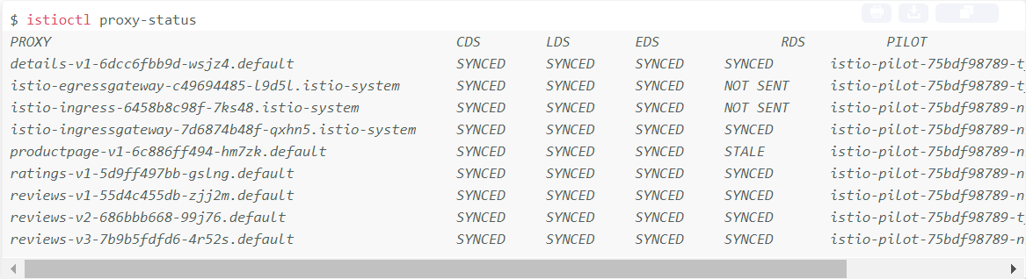
Envoy Proxy Configuration
CDS: Cluster
LDS: Listener (TCP, UDP)
EDS: Endpoint
RDS: Route
SYNCED: Envoy has acknowledged the last configuration Pilot has sent to it.
NOT SENT: Pilot hasn’t sent anything to Envoy. This usually is because Pilot has nothing to send.
STALE: Pilot has sent an update to Envoy but has not received an acknowledgement. This usually indicates a networking issue between Envoy and Pilot or a bug with Istio itself.

Slide 20
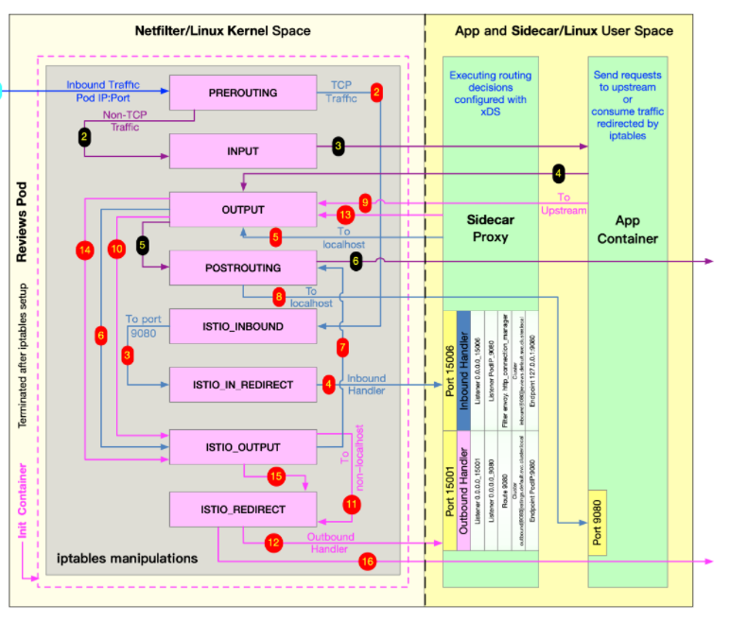
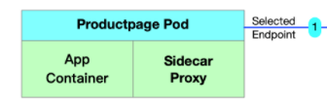
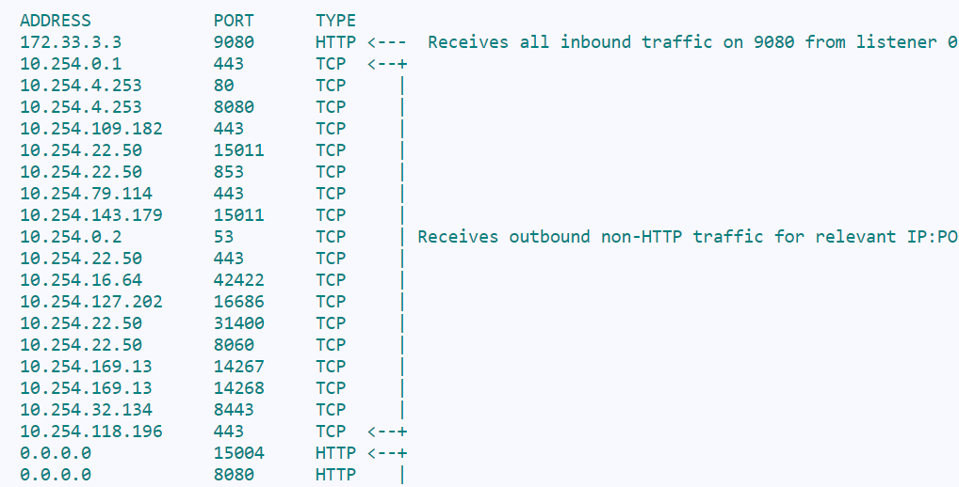
Example: Envoy handles route forwarding
http://reviews.default.svc.cluster.local:9080/

Slide 21
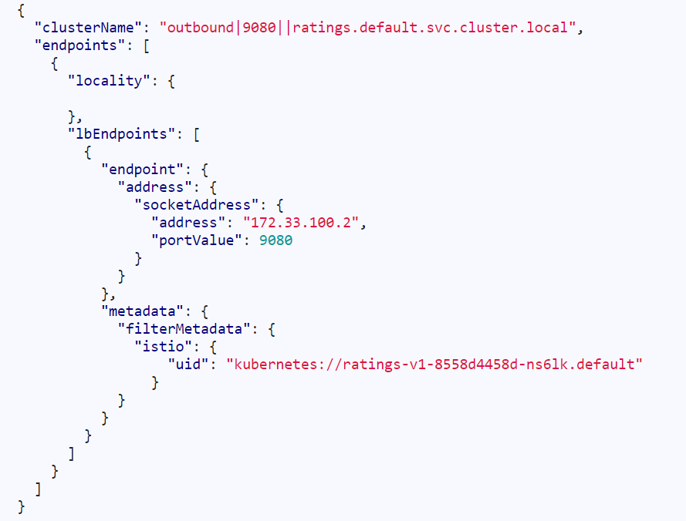
Envoy Proxy Data Format

Slide 22
4. libP2P
libp2p began as part of the IPFS project (InterPlanetary File System)
Transport
NAT Traversal
Secure Communication
Circuit Relay
Protocols
Peer Identity
Content Routing
Peer Routing
Addressing
Security Considerations
Publish/Subscribe
Stream Multiplexing

Slide 23
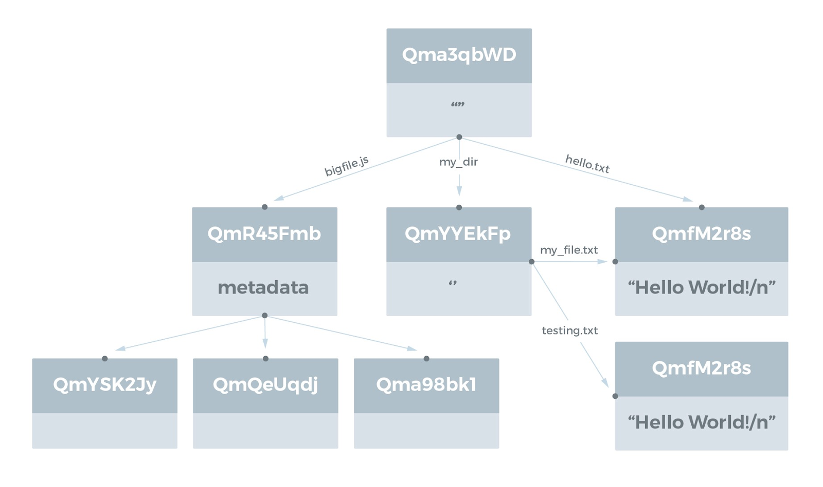
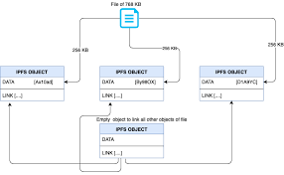
IPFS – Distributed Object
Split a file to 256 kb
Hash each split
IPFS object : <name, link, size>

Slide 24
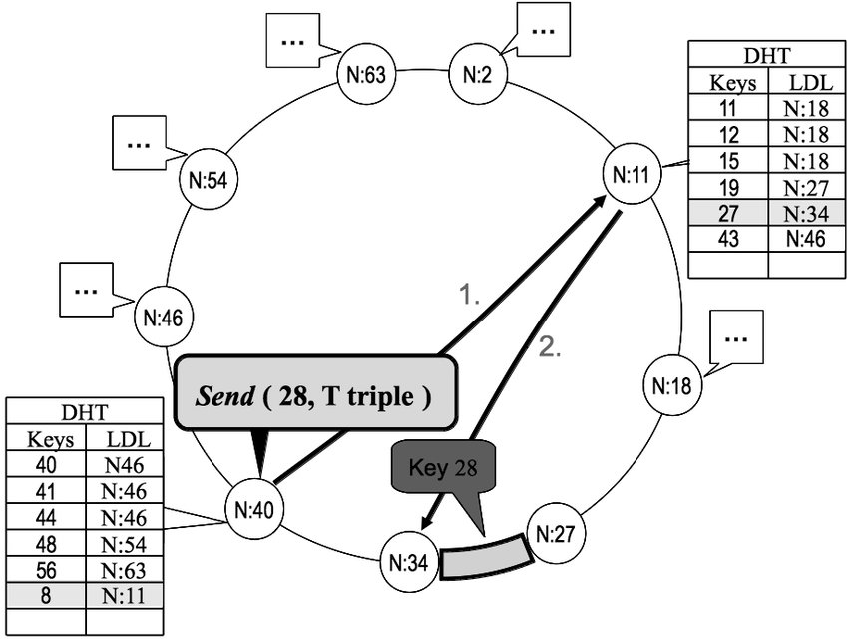
IPFS Routing - DHT (Distributed Table Hashing)
The IPFS discover content using a DHT that's provided by libp2p

Slide 25
Cillium, Skupper, Istio, libP2P
 | Cillium | Skupper | Istio | libP2P
Target | Cluster of heterogeneous cloud providers | IoT Edge clusters | Service mesh | Distributed web contents
Messaging technique | eBPF | AMQP, Apache Qpid | Envoy Proxy (including amqp) | Hash table
Components | Cillium Agent | skupper-router skupper-proxy-controller | Pilot, Mixer, Citadel | Transport, Routing, PubSub…
Security | Layer3 IPSEC | Layer7 | Layer7 | n/w stack
Service Discovery | Agent etcd proxy | Service proxy watches service events | Pilot transform service data format for Envoy Proxy | DHT
Advantage | eBPF based | no Layer3 VPN, scalable | no Layer3 VPN, support many protocols | Flexible
Disadvantage | Additional Layer3 VPN | AMQP is active? | too many things | How to apply to cloud?

Slide 26
Demo

