Slide 1


Earn 1 Million Dollars?
legally
without working too hard
Why?
Retire young (in 30s, 40s or 50s)
Never have to work for anyone else
Never have to worry about money (living on interest)
Do things you like
“Financial Freedom” – best thing money can buy
This section is for learning and demo of coding and problem solving only.
This is NOT an investment advice by any means.

Slide 2
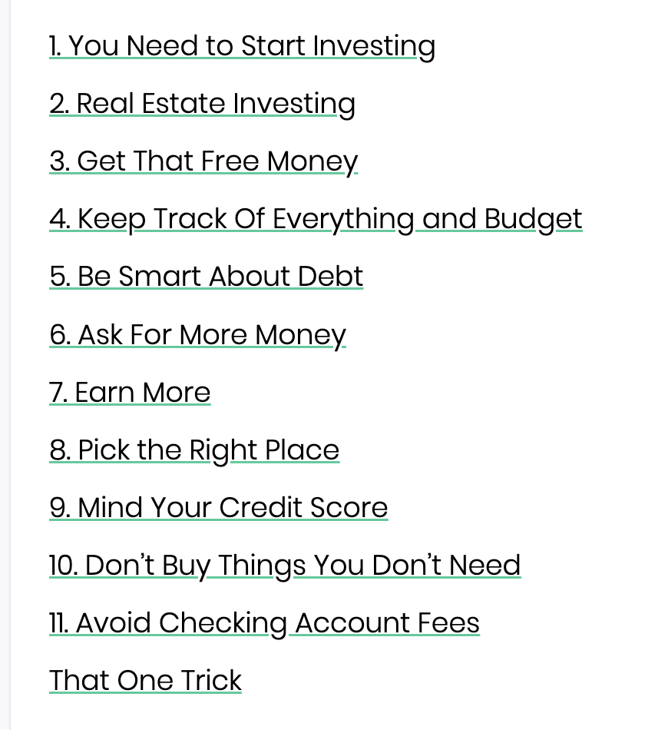
$1,000,000
How?
Inheritance?
Salary?
Lottery?
Start a business
What else?
https://www.listenmoneymatters.com/one-million-dollars/
This section is for learning and demo of coding and problem solving only.
This is NOT an investment advice by any means.

Slide 3
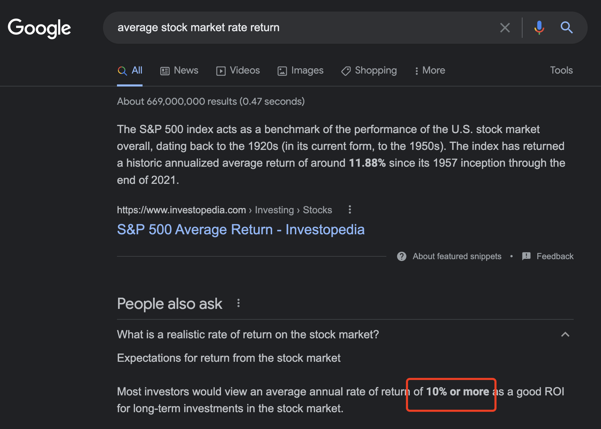






This section is for learning and demo of coding and problem solving only.
This is NOT an investment advice by any means.
Year 1
$$\$100$$
$$+ \$100 ×10\%$$
$$=\$100+\$10=\$110$$
Year 2
$$\$110+ \$110 ×10\%=$$
$$\$121$$
$$\$100 → \$121$$

Slide 4
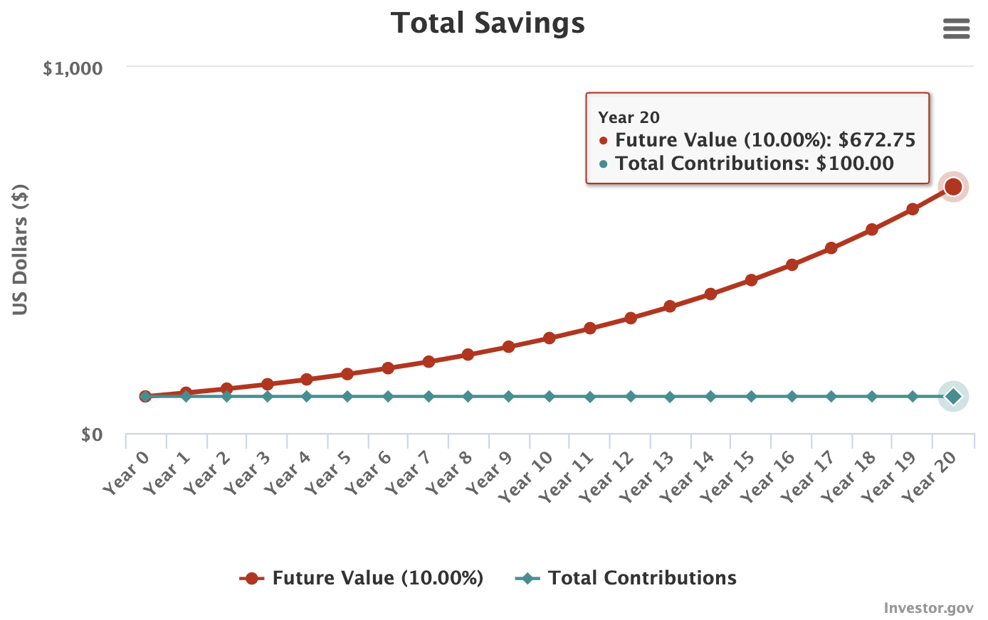


This section is for learning and demo of coding and problem solving only.
This is NOT an investment advice by any means.
1 year: $\$100 → \$121$
20 years: $?$
Start with an initial deposit of $200
Put in $500/month
10% interest (on average)
How many years to reach 1M?
<CODE>

Slide 5
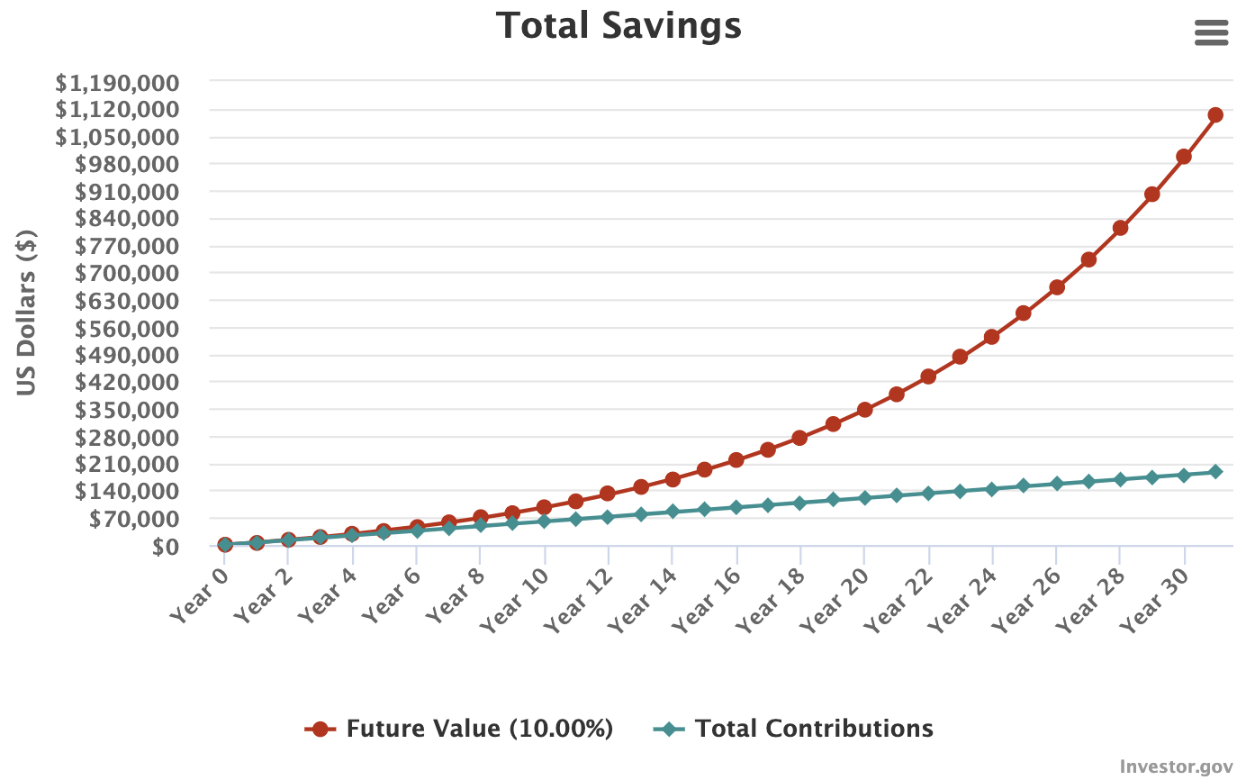
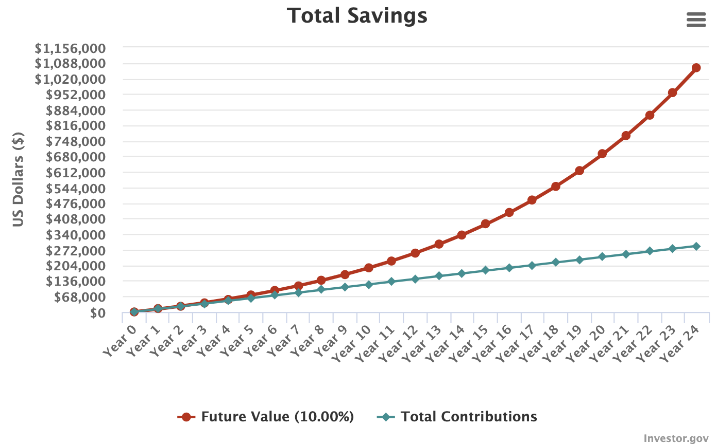
This section is for learning and demo only.
This is NOT an investment advice by any means.
500/month
1000/month
1M in 24 years!

