Slide 1
AWS (CLOUD)
create a VM (t2.micro)
Run 0_node_setup_master.sh
Run kubeadm join to the cloud machine
“Kubectl get nodes” should return 3 nodes (1 cloud, 1 cloud worker, 1 edge node)
Label worker nodes following (label)
Run hello world pod on both cloud and edge worker nodes
Cloud Host
K8s Worker Node
Mount volume
Read file
Print file
Cloud Storage
(S3)
Kubelet
K8s
Edge (laptop, ras pi)
EdgeCore
Mount volume
Read file
Print file

Slide 2
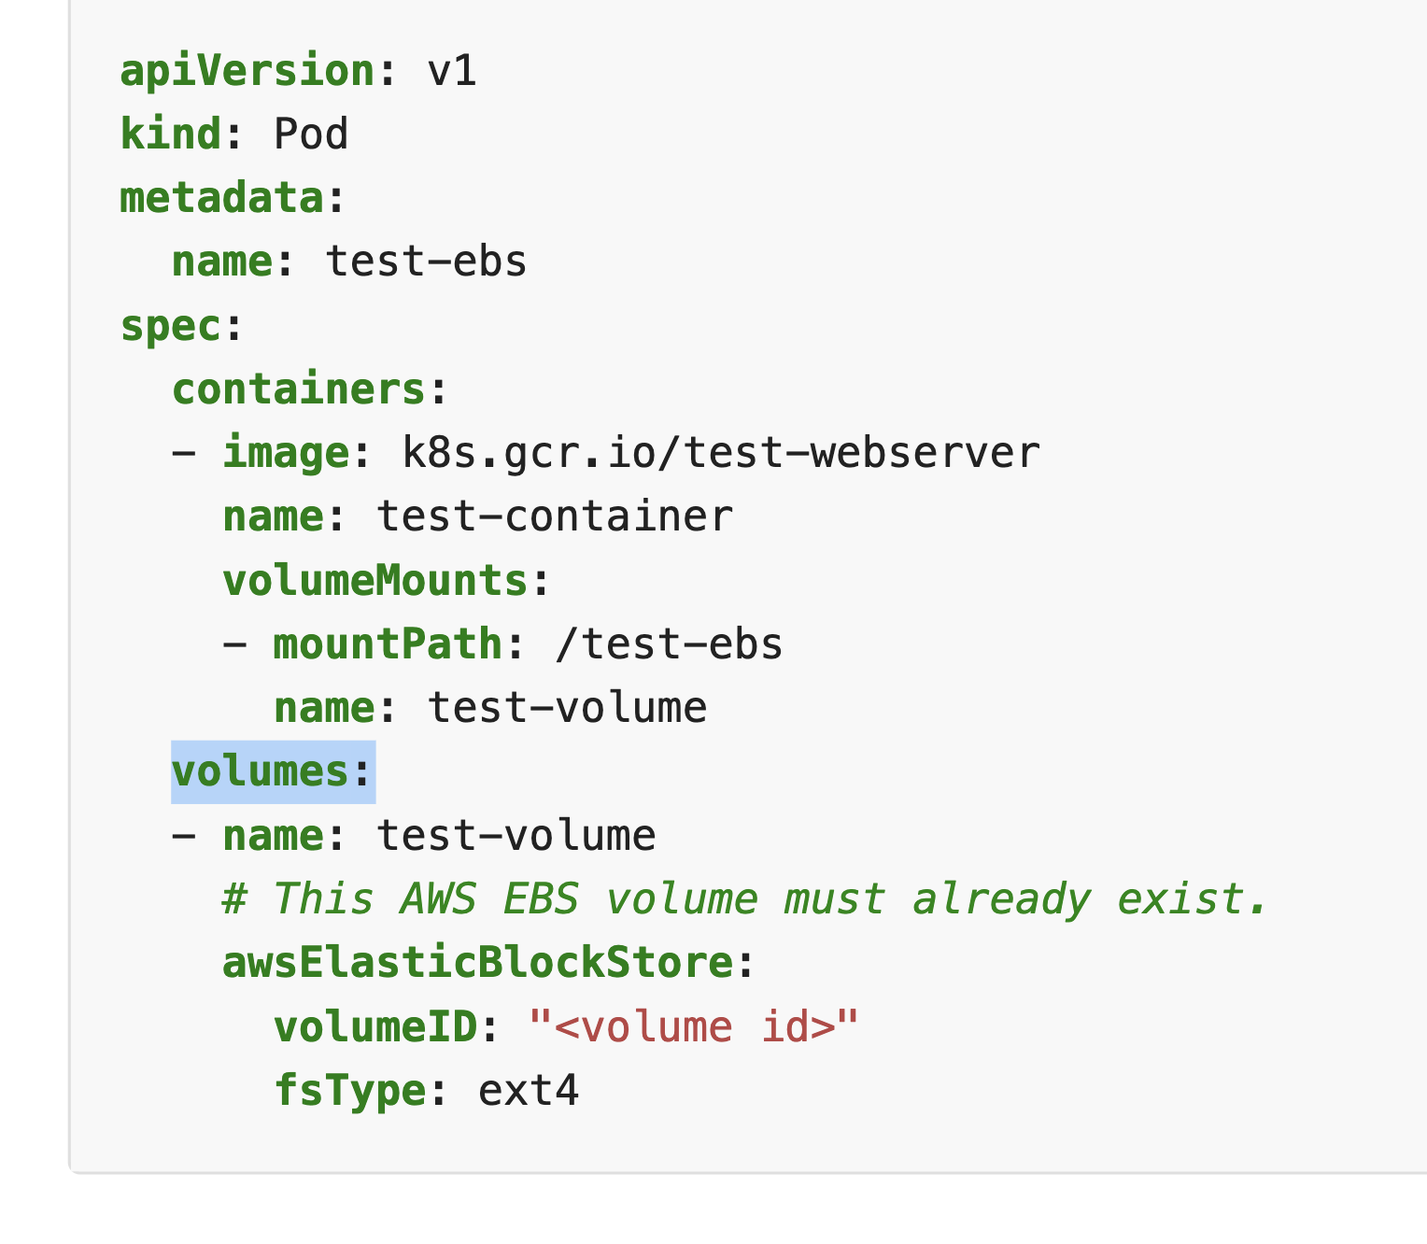
EdgeCore Host
Pod
ls → /abc → {x, y}
/[path to your data folder]/{x}
ref
Persistent Volume (PV)

Slide 3
https://github.com/pdgetrf/mizar_cluster_scripts/blob/main/restart_cluster.sh

Slide 4
AWS (CLOUD)
K8s Worker Node
Step 2: aws s3 cp s3://a/b/c/file1.doc file1.doc
Cloud Host
/usr/file1.doc
Cloud Storage
(S3)
K8s
/a/b/c/file1.doc
Edge (laptop, ras pi)
EdgeCore
Step 1: aws s3 cp file1.doc s3://a/b/c/file1.doc

Slide 5
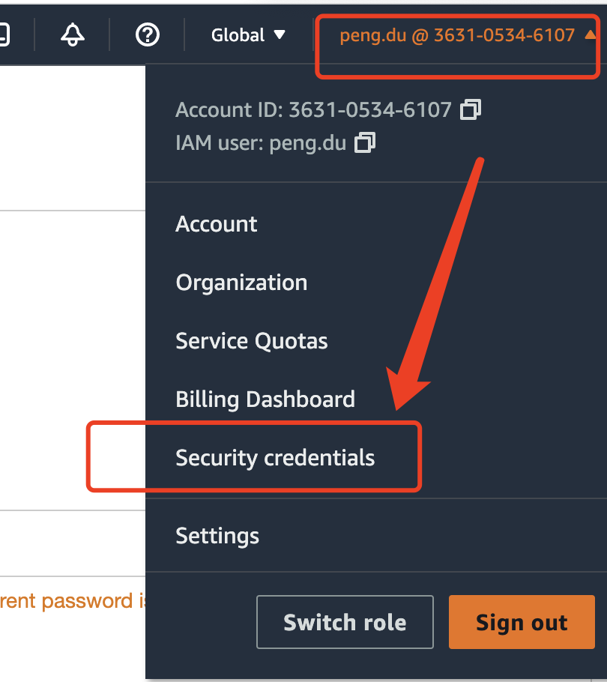
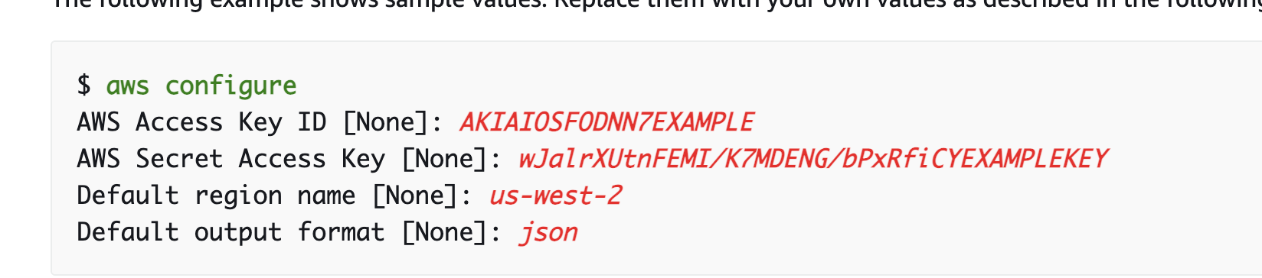

Any EC2 VM (Ubuntu):
Install aws cli with -y
Create access key on Aws console
On EC2 VM, configure security credentials →
On EC2 VM, s3 copy (to and from bucket, e.g., fw-yuanjun-test)
Do all the above in a docker image

