Slide 1
Requirement

Slide 2
Design

Slide 3
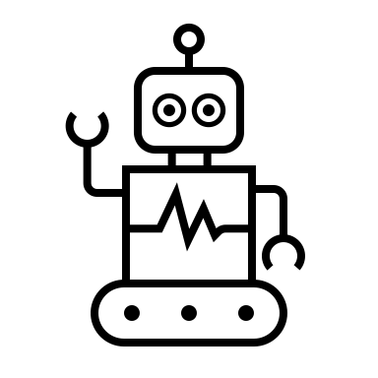
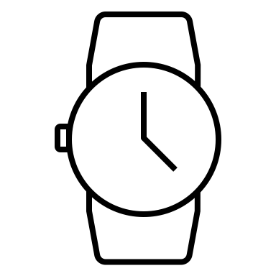
Architecture
Public Cloud (e.g. AWS)
Cloud Control Plane
Cloud Worker
trained model
Model training
Federated Learning
Cloud Storage
Data backup
Data Warehouse
Edge Node
Data cleansing
Model inferencing
cleaned sensor data
sensor data
Edge Node

Slide 4
Environment
Wearable devices
KubeEdge
Cloud
Master
Worker
Edge
Cloud Storage
Miscellaneous
tmux

Slide 5
Wearable device generate data and send to the ‘Edge’
Edge Node

Slide 6
The data flow from ‘Edge’ to ‘Cloud’
Edge Node
Cloud Storage
(S3)
Cloud Worker

Slide 7
Next Step

Slide 8
Summary
Docker/Containerd
Dockerfile
Image
K8s
Kubeadm/Kubelet/Kubectl
Networking: Flannel/DNS in Pod (8.8.8.8)
Host volume
Workload: Pod, Deployment
KubeEdge
Cloud- and edge-core
keadm
Wearable device
Emulator
AWS
EC2, S3
CLI

Slide 9
Intern Experience

