Slide 1
Java Core – OOP part 1
Vo Hoang Long (Lead Engineering – TBV Technical Group)

Slide 2
Agenda
Java OOPs Concepts
Naming Convention
Object and Class
Constructor
static keyword
this keyword

Slide 3
Java OOPs Concepts
Object means a real-world entity such as a pen, chair, table, computer, watch, etc. Object-Oriented Programming is a methodology or paradigm to design a program using classes and objects. It simplifies software development and maintenance by providing some concepts:
Object
Class
Inheritance
Polymorphism
Abstraction
Encapsulation

Slide 4
Java OOPs Concepts
Apart from these concepts, there are some other terms which are used in Object-Oriented design:
Coupling
Cohesion
Association
Aggregation
Composition

Slide 5
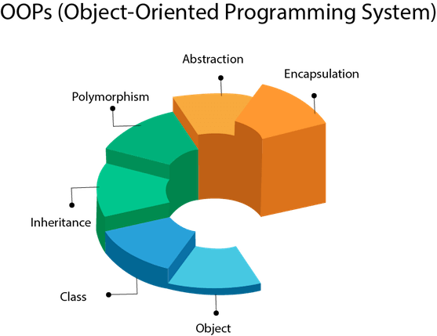
Java OOPs Concepts

Slide 6
Java Naming conventions
Class
It should start with the uppercase letter.
It should be a noun such as Color, Button, System, Thread, etc.
Use appropriate words, instead of acronyms.
Notes:
Cho xem vi du

Slide 7
Java Naming conventions
Interface
It should start with the uppercase letter.
It should be an adjective such as Runnable, Remote, ActionListener.
Use appropriate words, instead of acronyms.

Slide 8
Java Naming conventions
Method
It should start with lowercase letter.
It should be a verb such as main(), print(), println().
If the name contains multiple words, start it with a lowercase letter followed by an uppercase letter such as actionPerformed().

Slide 9
Java Naming conventions
Variable
It should start with a lowercase letter such as id, name.
It should not start with the special characters like & (ampersand), $ (dollar), _ (underscore).
If the name contains multiple words, start it with the lowercase letter followed by an uppercase letter such as firstName, lastName.
Avoid using one-character variables such as x, y, z.

Slide 10
Java Naming conventions
Package
It should be a lowercase letter such as java, lang.
If the name contains multiple words, it should be separated by dots (.) such as java.util, java.lang.
Constant
It should be in uppercase letters such as RED, YELLOW.
If the name contains multiple words, it should be separated by an underscore(_) such as MAX_PRIORITY.
It may contain digits but not as the first letter.

Slide 11
Java Naming conventions
CamelCase in java naming conventions
Java follows camel-case syntax for naming the class, interface, method, and variable.
If the name is combined with two words, the second word will start with uppercase letter always such as actionPerformed(), firstName, ActionEvent, ActionListener, etc.

Slide 12
Objects and Classes in Java
An entity that has state and behavior is known as an object e.g., chair, bike, marker, pen, table, car, etc. It can be physical or logical (tangible and intangible). The example of an intangible object is the banking system.
An object has three characteristics:
State: represents the data (value) of an object.
Behavior: represents the behavior (functionality) of an object such as deposit, withdraw, etc.
Identity: An object identity is typically implemented via a unique ID. The value of the ID is not visible to the external user. However, it is used internally by the JVM to identify each object uniquely.

Slide 13


Objects and Classes in Java

Slide 14
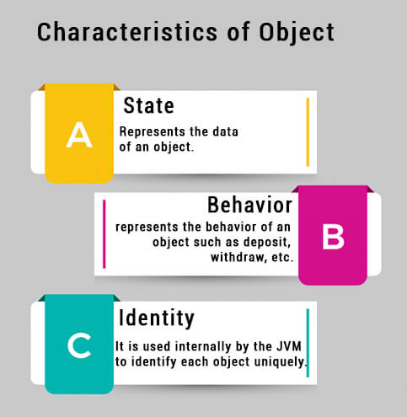
Objects and Classes in Java

Slide 15
Objects and Classes in Java
An object is an instance of a class. A class is a template or blueprint from which objects are created. So, an object is the instance(result) of a class.
Object Definitions:
An object is a real-world entity.
An object is a runtime entity.
The object is an entity which has state and behavior.
The object is an instance of a class.

Slide 16
Objects and Classes in Java
What is a class in Java
A class is a group of objects which have common properties. It is a template or blueprint from which objects are created. It is a logical entity. It can't be physical.
A class in Java can contain:
Fields
Methods
Constructors
Blocks
Nested class and interface

Slide 17
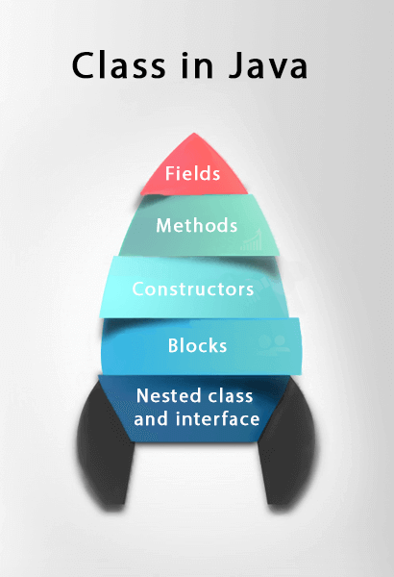
Objects and Classes in Java

Slide 18
Objects and Classes in Java
Instance variable in Java
A variable which is created inside the class but outside the method is known as an instance variable. Instance variable doesn't get memory at compile time. It gets memory at runtime when an object or instance is created. That is why it is known as an instance variable.
Method in Java
In Java, a method is like a function which is used to expose the behavior of an object.
Advantage of Method
Code Reusability
Code Optimization

Slide 19
Objects and Classes in Java
new keyword in Java
The new keyword is used to allocate memory at runtime. All objects get memory in Heap memory area.
Object and Class Example: main within the class
Object and Class Example: main outside the class

Slide 20
Objects and Classes in Java
3 Ways to initialize object
There are 3 ways to initialize object in Java.
By reference variable
By method
By constructor

Slide 21
Objects and Classes in Java
Object and Class Example: Initialization through reference
Initializing an object means storing data into the object

Slide 22
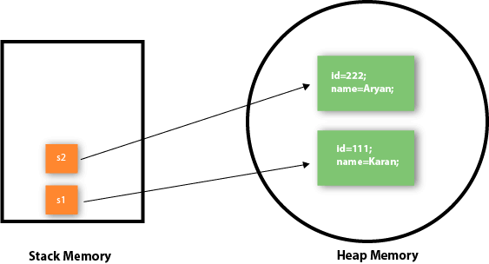
Objects and Classes in Java
Object and Class Example: Initialization through method
In this example, we are creating the two objects of Student class and initializing the value to these objects by invoking the insertRecord method. Here, we are displaying the state (data) of the objects by invoking the displayInformation() method.

Slide 23
Objects and Classes in Java
Object and Class Example: Initialization through a constructor

Slide 24
Objects and Classes in Java
What are the different ways to create an object in Java?
There are many ways to create an object in java. They are:
By new keyword
By newInstance() method
By clone() method
By deserialization
By factory method etc.

Slide 25
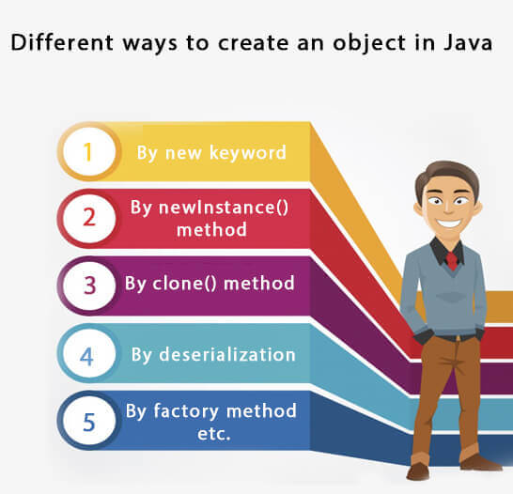
Objects and Classes in Java

Slide 26
Constructors in Java
In Java, a constructor is a block of codes similar to the method. It is called when an instance of the class is created. At the time of calling constructor, memory for the object is allocated in the memory.
It is a special type of method which is used to initialize the object.
Every time an object is created using the new() keyword, at least one constructor is called.
It calls a default constructor if there is no constructor available in the class. In such case, Java compiler provides a default constructor by default.
There are two types of constructors in Java: no-arg constructor, and parameterized constructor.

Slide 27
Rules for creating Java constructor
There are two rules defined for the constructor.
Constructor name must be the same as its class name
A Constructor must have no explicit return type
A Java constructor cannot be abstract, static, final, and synchronized

Slide 28
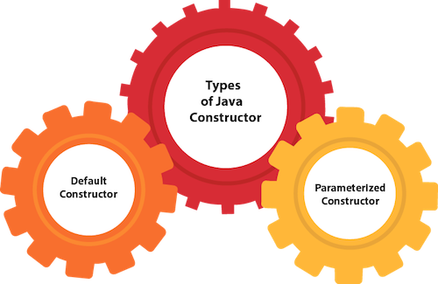
Types of Java constructors
There are two types of constructors in Java:
Default constructor (no-arg constructor)
Parameterized constructor

Slide 29
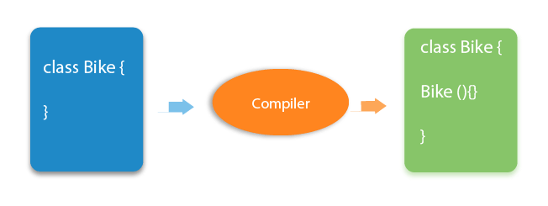
Java Default Constructor
A constructor is called "Default Constructor" when it doesn't have any parameter.
Example of default constructor
The default constructor is used to provide the default values to the object like 0, null, etc., depending on the type.

Slide 30
Java Parameterized Constructor
A constructor which has a specific number of parameters is called a parameterized constructor.
Why use the parameterized constructor?
The parameterized constructor is used to provide different values to distinct objects. However, you can provide the same values also.
Example of parameterized constructor

Slide 31
Constructor Overloading in Java
In Java, a constructor is just like a method but without return type. It can also be overloaded like Java methods.
Constructor overloading in Java is a technique of having more than one constructor with different parameter lists. They are arranged in a way that each constructor performs a different task. They are differentiated by the compiler by the number of parameters in the list and their types.

Slide 32
Difference between constructor and method in Java
Java Constructor | Java Method
A constructor is used to initialize the state of an object. | A method is used to expose the behavior of an object.
A constructor must not have a return type. | A method must have a return type.
The constructor is invoked implicitly. | The method is invoked explicitly.
The Java compiler provides a default constructor if you don't have any constructor in a class. | The method is not provided by the compiler in any case.
The constructor name must be same as the class name. | The method name may or may not be same as the class name.

Slide 33
Java static keyword
The static keyword in Java is used for memory management mainly. We can apply java static keyword with variables, methods, blocks and nested class. The static keyword belongs to the class than an instance of the class.
The static can be:
Variable (also known as a class variable)
Method (also known as a class method)
Block
Nested class

Slide 34
Java static variable
If you declare any variable as static, it is known as a static variable.
The static variable can be used to refer to the common property of all objects (which is not unique for each object), for example, the company name of employees, college name of students, etc.
The static variable gets memory only once in the class area at the time of class loading.
Advantages of static variable
It makes your program memory efficient (i.e., it saves memory).

Slide 35
Java static method
If you apply static keyword with any method, it is known as static method.
A static method belongs to the class rather than the object of a class.
A static method can be invoked without the need for creating an instance of a class.
A static method can access static data member and can change the value of it.
Restrictions for the static method
There are two main restrictions for the static method. They are:
The static method can not use non static data member or call non-static method directly.
this and super cannot be used in static context.

Slide 36
Java static method
Why is the Java main method static?
It is because the object is not required to call a static method. If it were a non-static method, JVM creates an object first then call main() method that will lead the problem of extra memory allocation.

Slide 37
Java static block
Is used to initialize the static data member.
It is executed before the main method at the time of classloading.

Slide 38
this keyword in java
In java, this is a reference variable that refers to the current object.
Usage of java this keyword
Here is given the 6 usage of java this keyword.
this can be used to refer current class instance variable.
this can be used to invoke current class method (implicitly)
this() can be used to invoke current class constructor.
this can be passed as an argument in the method call.
this can be passed as argument in the constructor call.
this can be used to return the current class instance from the method.

Slide 39
this keyword in java
this: to refer current class instance variable
The this keyword can be used to refer current class instance variable. If there is ambiguity between the instance variables and parameters, this keyword resolves the problem of ambiguity.

Slide 40
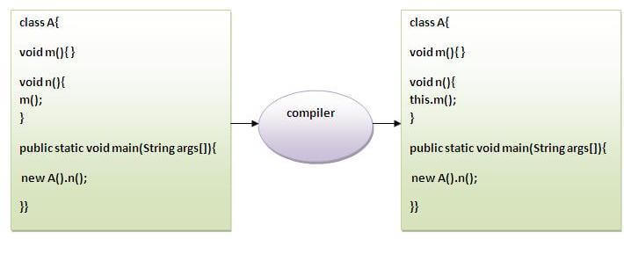
this keyword in java
this: to invoke current class method
You may invoke the method of the current class by using the this keyword. If you don't use the this keyword, compiler automatically adds this keyword while invoking the method. Let's see the example

Slide 41
this keyword in java
this() : to invoke current class constructor
The this() constructor call can be used to invoke the current class constructor. It is used to reuse the constructor. In other words, it is used for constructor chaining.

Slide 42
this keyword in java
Real usage of this() constructor call
The this() constructor call should be used to reuse the constructor from the constructor. It maintains the chain between the constructors i.e. it is used for constructor chaining. Let's see the example given below that displays the actual use of this keyword.
Rule: Call to this() must be the first statement in constructor.

Slide 43
this keyword in java
this: to pass as an argument in the method
The this keyword can also be passed as an argument in the method

Slide 44
this keyword in java
this: to pass as argument in the constructor call
We can pass the this keyword in the constructor also. It is useful if we have to use one object in multiple classes

Slide 45
this keyword in java
this keyword can be used to return current class instance
We can return this keyword as an statement from the method. In such case, return type of the method must be the class type (non-primitive)

