Slide 1
Java Core – OOP part 2
Vo Hoang Long (Lead Engineering – TBV TechGroup)

Slide 2
Agenda
Inheritance
Polymorphism
Overloading
Overriding
super keyword
final keyword

Slide 3
Inheritance in Java
Inheritance in Java is a mechanism in which one object acquires all the properties and behaviors of a parent object. It is an important part of OOPs (Object Oriented programming system).
The idea behind inheritance in Java is that you can create new classes that are built upon existing classes. When you inherit from an existing class, you can reuse methods and fields of the parent class. Moreover, you can add new methods and fields in your current class also.
Inheritance represents the IS-A relationship which is also known as a parent-child relationship.

Slide 4
Inheritance in Java
Why use inheritance in java
For Method Overriding (so runtime polymorphism can be achieved).
For Code Reusability.
Terms used in Inheritance
Class: A class is a group of objects which have common properties. It is a template or blueprint from which objects are created.
Sub Class/Child Class: Subclass is a class which inherits the other class. It is also called a derived class, extended class, or child class.
Super Class/Parent Class: Superclass is the class from where a subclass inherits the features. It is also called a base class or a parent class.
Reusability: As the name specifies, reusability is a mechanism which facilitates you to reuse the fields and methods of the existing class when you create a new class. You can use the same fields and methods already defined in the previous class.

Slide 5
Inheritance in Java
The syntax of Java Inheritance
The extends keyword indicates that you are making a new class that derives from an existing class. The meaning of "extends" is to increase the functionality.
In the terminology of Java, a class which is inherited is called a parent or superclass, and the new class is called child or subclass.

Slide 6
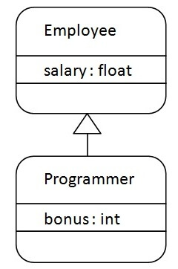
Inheritance in Java

Slide 7
Inheritance in Java
Types of inheritance in java
On the basis of class, there can be three types of inheritance in java: single, multilevel and hierarchical.
In java programming, multiple and hybrid inheritance is supported through interface only. We will learn about interfaces later.

Slide 8
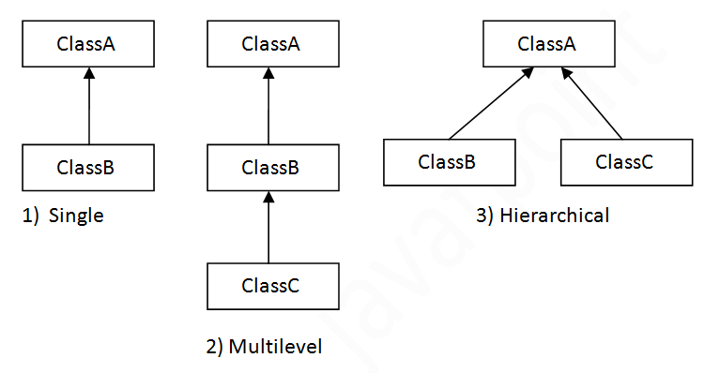
Inheritance in Java

Slide 9
Inheritance in Java
Why multiple inheritance is not supported in java?
To reduce the complexity and simplify the language, multiple inheritance is not supported in java.
Consider a scenario where A, B, and C are three classes. The C class inherits A and B classes. If A and B classes have the same method and you call it from child class object, there will be ambiguity to call the method of A or B class.
Since compile-time errors are better than runtime errors, Java renders compile-time error if you inherit 2 classes. So whether you have same method or different, there will be compile time error.

Slide 10
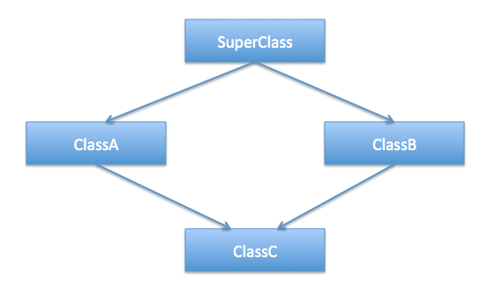
Inheritance in Java
Diamond Problem

Slide 11
Java Polymorphism
Polymorphism in Java is a concept by which we can perform a single action in different ways. Polymorphism is derived from 2 Greek words: poly and morphs. The word "poly" means many and "morphs" means forms. So polymorphism means many forms.
There are two types of polymorphism in Java: compile-time polymorphism and runtime polymorphism. We can perform polymorphism in java by method overloading and method overriding.

Slide 12
Method Overloading in Java
If a class has multiple methods having same name but different in parameters, it is known as Method Overloading.
If we have to perform only one operation, having same name of the methods increases the readability of the program.
Advantage of method overloading
Method overloading increases the readability of the program.
Different ways to overload the method
There are two ways to overload the method in java
By changing number of arguments
By changing the data type
In java, Method Overloading is not possible by changing the return type of the method only.

Slide 13
Method Overloading in Java
Method Overloading: changing no. of arguments
Method Overloading: changing data type of arguments
Why Method Overloading is not possible by changing the return type of method only?
In java, method overloading is not possible by changing the return type of the method only because of ambiguity.
Can we overload java main() method?
Yes, by method overloading. You can have any number of main methods in a class by method overloading. But JVM calls main() method which receives string array as arguments only

Slide 14
Method Overriding in Java
If subclass (child class) has the same method as declared in the parent class, it is known as method overriding in Java.
In other words, If a subclass provides the specific implementation of the method that has been declared by one of its parent class, it is known as method overriding.
Usage of Java Method Overriding
Method overriding is used to provide the specific implementation of a method which is already provided by its superclass.
Method overriding is used for runtime polymorphism

Slide 15
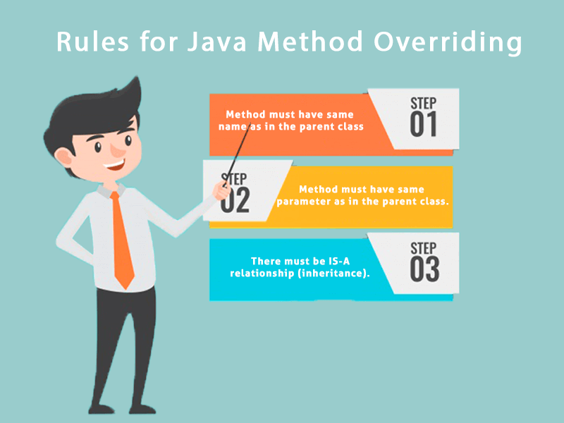
Method Overriding in Java
Rules for Java Method Overriding
The method must have the same name as in the parent class
The method must have the same parameter as in the parent class.
There must be an IS-A relationship (inheritance).

Slide 16
Method Overriding in Java
Example of method overriding
In this example, we have defined the run method in the subclass as defined in the parent class but it has some specific implementation. The name and parameter of the method are the same, and there is IS-A relationship between the classes, so there is method overriding.

Slide 17
Method Overriding in Java
Can we override static method?
No, a static method cannot be overridden. It can be proved by runtime polymorphism, so we will learn it later.
Why can we not override static method?
It is because the static method is bound with class whereas instance method is bound with an object. Static belongs to the class area, and an instance belongs to the heap area.
Can we override java main method?
No, because the main is a static method.

Slide 18
Method Overriding in Java
Method Overloading | Method Overriding
Method overloading is used to increase the readability of the program. | Method overriding is used to provide the specific implementation of the method that is already provided by its super class.
Method overloading is performed within class. | Method overriding occurs in two classes that have IS-A (inheritance) relationship.
In case of method overloading, parameter must be different. | In case of method overriding, parameter must be same.
Method overloading is the example of compile time polymorphism. | Method overriding is the example of run time polymorphism.
In java, method overloading can't be performed by changing return type of the method only. Return type can be same or different in method overloading. But you must have to change the parameter. | Return type must be same or covariant in method overriding.

Slide 19
Method Overriding in Java
A real example of Java Method Overriding
Consider a scenario where Bank is a class that provides functionality to get the rate of interest. However, the rate of interest varies according to banks. For example, SBI, ICICI and AXIS banks could provide 8%, 7%, and 9% rate of interest.;

Slide 20
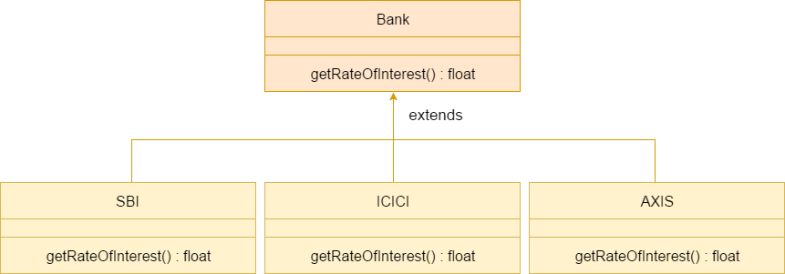
Method Overriding in Java

Slide 21
Super Keyword in Java
The super keyword in Java is a reference variable which is used to refer immediate parent class object.
Whenever you create the instance of subclass, an instance of parent class is created implicitly which is referred by super reference variable.

Slide 22
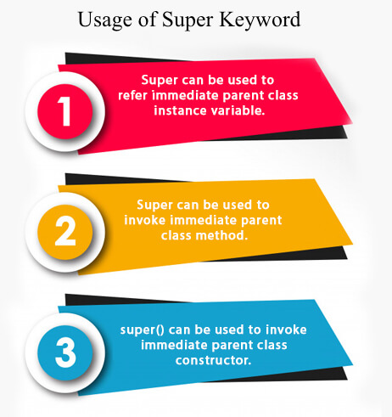
Super Keyword in Java
Usage of Java super Keyword
super can be used to refer immediate parent class instance variable.
super can be used to invoke immediate parent class method.
super() can be used to invoke immediate parent class constructor.

Slide 23
Super Keyword in Java
super is used to refer immediate parent class instance variable.
super can be used to invoke parent class method
super is used to invoke parent class constructor.

Slide 24
Final Keyword In Java
The final keyword in java is used to restrict the user. The java final keyword can be used in many context. Final can be:
variable
method
class
The final keyword can be applied with the variables, a final variable that have no value it is called blank final variable or uninitialized final variable. It can be initialized in the constructor only. The blank final variable can be static also which will be initialized in the static block only

Slide 25
Final Keyword In Java
Java final variable
There is a final variable speedlimit, we are going to change the value of this variable, but It can't be changed because final variable once assigned a value can never be changed.
Java final method
If you make any method as final, you cannot override it.
Java final class
If you make any class as final, you cannot extend it.

Slide 26
Final Keyword In Java
Is final method inherited?
Yes, final method is inherited but you cannot override it.
What is blank or uninitialized final variable?
A final variable that is not initialized at the time of declaration is known as blank final variable.
If you want to create a variable that is initialized at the time of creating object and once initialized may not be changed, it is useful. It can be initialized only in constructor.
Can we declare a constructor final?
No, because constructor is never inherited.

