Slide 1
C++ Primer Primer
Lecture 01
May 05, 2020

Slide 2
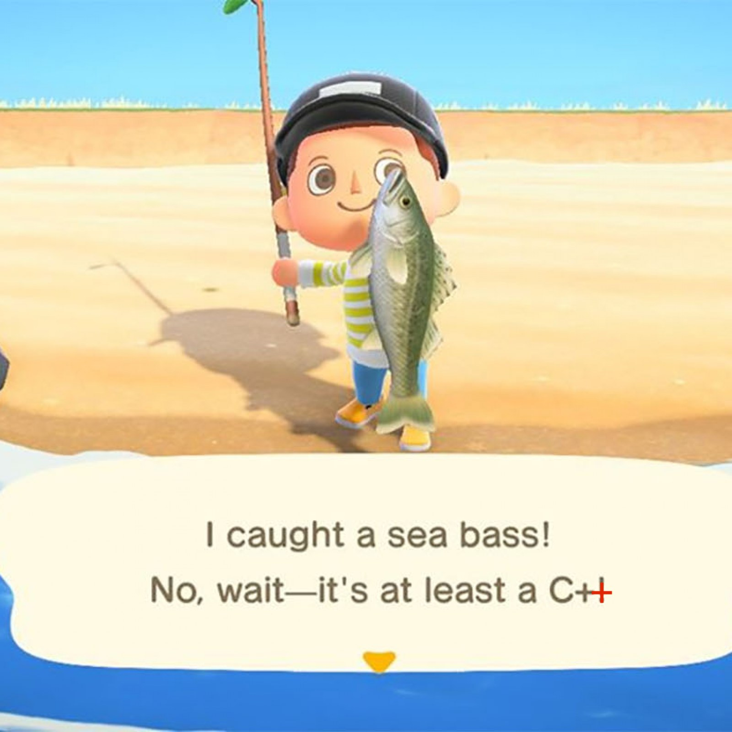
What is C++?

Slide 3
What is C++?
A programming language
“C” with classes
Generic
Functional
Low-level memory manipulation
Compiled
”source code” → “machine code”
Standardized by ISO
Current standard is C++17
…we’re learning C++11
(that’s ok)

Slide 4
Why learn C++
Class discussion time!
Used in
Applications (Adobe suite)
Games
Web Browsers
Operating Systems
Pros
Popular
Portable
Fast
Scalable
Cons
Complicated!
Low-level management
(both a pro and a con)

Slide 5
Course Structure
C++ Primer 5th edition
C++11 standard
No previous experience necessary
12(ish) weeks
(Optional) Friday discussions
Try to do all the exercises!
Chapters 1-7
The essentials
Chapters 8-12
Using the standard library
Chapters 13-19
????? (…I’m on Chapter 11)

Slide 6
Questions before we dive in?

Slide 7
1.1 – Writing a Simple C++ Program
main()
every program has one!
functions
return type int
function name
parameter list (possibly empty)
function body
int main() {
return 0;
}

Slide 8
1.2 – A First Look at Input/Output
Library provides IO
iostream
istream cin
ostream cout
Headers
Expressions
<<,>> operators
string literals
Namespaces
Variables
#include <iostream>
int main() {
std::cout << "Enter two numbers:" << std::endl;
int v1 = 0, v2 = 0;
std::cin >> v1 >> v2;
std::cout << "The sum of " << v1 << " and " << v2
<< " is " << v1 + v2 << std::endl;
return 0;
}

Slide 9
1.3 – A Word about Comments
Everybody loves comments!
The compiler ignores comments.
go nuts.
// this is a single line comment
/*
this is a paired comment.
*/
/* anything between the start and end is commented.
Comment pairs do not nest, so /* */ this is source code. */
*/

Slide 10
1.4 – The while Statement
while (condition)
statement
blocks { }
new operators!
<=, +=, ++
exit when condition false
#include <iostream>
int main() {
int sum = 0, val = 1;
while (val <= 10) {
sum += val;
++val;
}
std::cout << "Sum of 1 to 10
inclusive is " << sum << std::endl;
return 0;
}

Slide 11
1.4 – The for Statement
for ”header”
init-statement
condition
expression
#include <iostream>
int main() {
int sum = 0;
for (int val = 1; val <= 10; ++val)
sum += val;
std::cout << "Sum of 1 to 10 inclusive is "
<< sum << std::endl;
return 0;
}

Slide 12
1.4 – Reading an Unknown Number of Inputs
When are streams invalid?
end-of-file
ctrl + d for Mac
reads something that’s not an int (in this case)
#include <iostream>
int main() {
int sum = 0, value = 0;
while (std::cin >> value) {
sum += value;
}
std::cout << "Sum is: " << sum
<< std::endl;
return 0;
}

Slide 13
1.4 – The if Statement
if (condition)
statement
#include <iostream>
int main() {
int currVal = 0, val = 0;
if (std::cin >> currVal) {
int cnt = 1;
while (std::cin >> val) {
if (val == currVal)
++cnt;
else {
std::cout << currVal << " occurs " << cnt <<
" times " << std::endl;
currVal = val;
cnt = 1;
}
}
std::cout << currVal << " occurs " << cnt << " times "
<< std::endl;
}
return 0;
}

Slide 14
1.5 – Introducing Classes
A toy example…
the bookstore problem
want a data structure to store:
ISBN (aka book number)
number of copies sold
price of each copy
The Sales_item Class
Operations:
isbn() fetches ISBN
<< and >> to read and write
+ and += (if same ISBN)
0-201-70353-X 4 24.99
Sales_item item;

Slide 15
1.5 – The Sales_item Class
Note the #include
Reading and writing
defined in header!
#include <iostream>
#include "Sales_item.h”
int main() {
Sales_item book;
std::cin >> book;
std::cout << book << std::endl
return 0;
}

Slide 16
1.5 – The Sales_item Class
“sum” is defined by class
#include <iostream>
#include "Sales_item.h”
int main() {
Sales_item item1, item2;
std::cin >> item1 >> item2;
std::cout << item1 + item2 <<
std::endl;
return 0;
}

Slide 17
1.5 – Member Functions
isbn
member function
use dot operator
and call operator
no arguments!
#include <iostream>
#include "Sales_item.h”
int main() {
Sales_item item1, item2;
std::cin >> item1 >> item2;
if (item1.isbn() == item2.isbn()){
std::cout << item1 + item2 << std::endl;
return 0;
}
else {
std::cerr << "Data must refer to the same
ISBN" << std::endl;
return -1;
}
}

Slide 18
1.6 – The Bookstore Program
#include <iostream>
#include "Sales_item.h”
int main() {
Sales_item total; // variable to hold the running sum
// read the first transaction and ensure that there are data to process
if (std::cin >> total){
Sales_item trans; // variable to hold data for the next transaction
// read and process the remaining transactions
while (std::cin >> trans){
// if we're still processing the same book
if (total.isbn() == trans.isbn())
total += trans; // update the running total
else{
// print results for the previous book
std::cout << total << std::endl;
total = trans; // total now refers to the next book
}
}
std::cout << total << std::endl; // print the last transaction
}
else{
// no input! warn the user
std::cerr << "No data?!" << std::endl;
return -1; // indicate failure
}
}

Slide 19
Recap
Today we learned about
functions
the main function
input/output
while and for loops, if statements
classes
Homework!
Get a compiler working on your computer
Do Chapter 1 exercises
(solutions on the Github)

