Slide 1
Two-sided Markets
Architectural Overview
Elements of Design
confidential and proprietary

Slide 2
Summary

Slide 3



The goal is to unleash innovation in customer engagement by lowering the complexity and cost of HDHI apps through model-driven development … shifting the threshold of feasibility for new use cases
High Density
High Intensity
Applications
Robotic Process Automation
High
“Let me know when the product is in stock …
“I am looking for new shows at a price point of $16 ….
“I need a babysitter for this Friday ….”
“Does anyone have a place for me to stay this weekend ….
“Notify when the new sermon gets posted ….”
feasibility threshold
Driven by cost and time
Transaction volume
Low
Web Chat, FAQ, AMA
Robotics
Low
High
Increasing value
Complexity Level
Strategic Machines

Slide 4


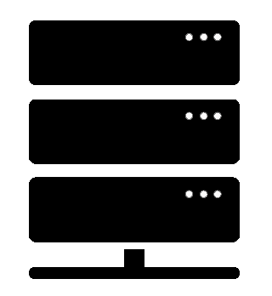


A model-driven business makes customer touch points intelligent
Context is a ‘given’ which constrains the nature, scope and timing of an interaction
Models encompass data and algorithms to monitor and complete atomic interactions
Interactions are slotted and responsive by design
Events are defined dynamically and resolved real-time
Realtime Markets
Subscribe
Component business models (CBM) are atomic and self-contained meta-data
Tell me when ….
processing
Models
Subscribe
If the price is….
Subscribe
Are there any….

Slide 5


Models simplify, and define reactions based on ‘state changes’
Slotted AI gathers as much information as needed
subscribe
“sign me up for any new …”
Server
Models process and match real time
Reactive and real time engagement
publish
Notifications made on relevant subscriptions

Slide 6
Abstract content flow
process
process
publish
mediate input
parse, classify, tag
parse, classify, tag
mediate input
subscribe
Reactive engine
content and knowledge base (component models)
member data
tags
metrics
item data
subscriptions
Strategic Machines

Slide 7
Physical system architecture and topology
mobile app
Web ui
sms
other
get static data
set params
stream
terminal
Server
route/seed
route/change
post
detected changes
MongoDB
CMS
Strategic Machines

Slide 8
Demo

Slide 9
Elements of Design
Proof of Concept
Build a profile of a community and actors
Define Personas for actors and a set of common scripts. Begin with simple cases, and add complexity and nuance over time
Define all the necessary data sets for meeting the requirements of an interaction. Assume that all data needed has already been collected
Define algorithms for clearing ‘subscriptions’. Assume that algorithms have already been developed to tag and classify subscriptions and publications
Model the work
Document the outcomes, including risks and opportunities
Repeat, adding complexity

