Slide 1
Conway’s Game of Life
HPC Project
DA-IICT
Raj Jakasaniya - 201501408
Dhruv Patel - 201501452
Advisor - Prof. BHASKAR CHAUDHARY

Slide 2
Game of Life
Also known as Life is a cellular automaton devised by the British mathematician John Horton Conway in 1970.
Life is a zero-player game, meaning that its evolution is determined by its initial state, requiring no further input.
Life evolves in a sequence of generations. The state of a cell in one generation is determined by the state of the cells in the previous generation.
From a theoretical point of view, Life has the power of a universal Turing machine: that is, anything that can be computed algorithmically can be computed with Conway's Game of Life.

Slide 3
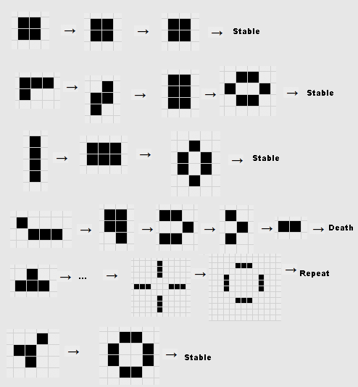
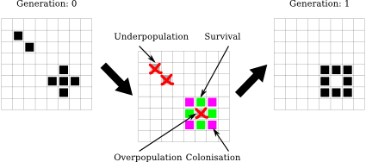
Rules of Life
Any live cell with fewer than two live neighbours dies.
Any live cell with two or three live neighbours lives on to the next generation.
Any live cell with more than three live neighbours dies.
Any dead cell with exactly three live neighbours becomes a live cell.

Slide 4
Analysis of the Problem
Time Complexity of the Problem :-
O(Row*Col*Steps*Constant),
where constant value depends on the approach used.
Different Approaches to the Problem
1. Naive Approach
2. Optimized Approach
3. Prefix Approach
4. Tony Finch Approach

Slide 5
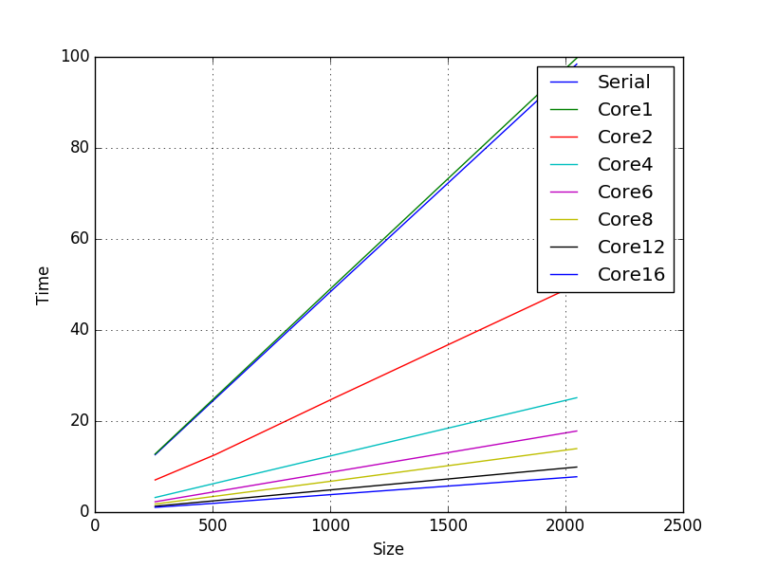
Naive Approach
Graph of size vs time
The entire grid is scanned, the number of neighbours is evaluated for each cell after applying rules the new state of the cell is stored in temporary grid, and the entire grid is updated.

Slide 6
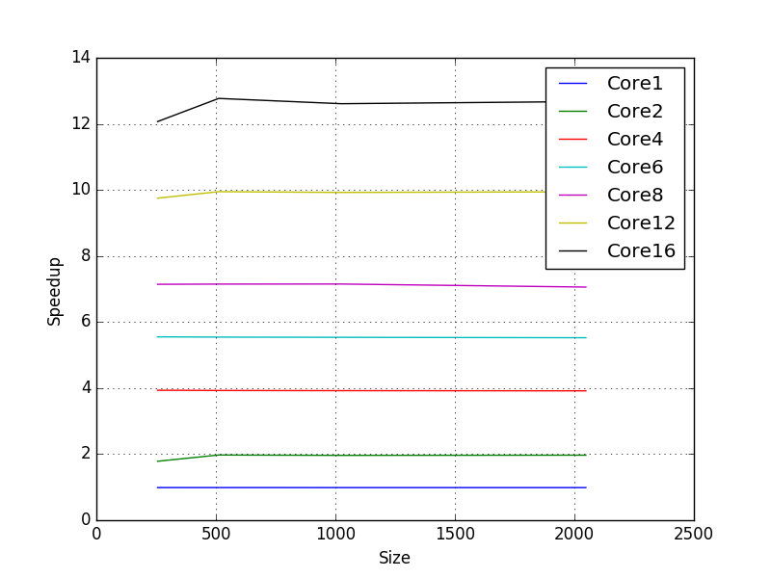
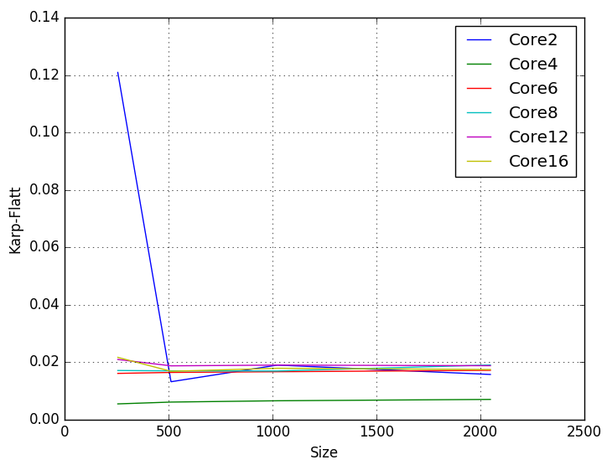
Graph size vs speedup
Graph size vs Karp-flatt
In this approach we are getting speedup of ~13.

Slide 7
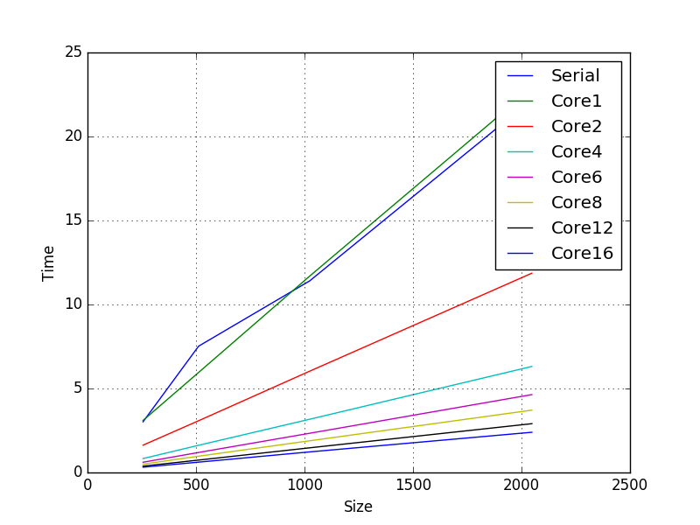
Optimized Approach
Graph size vs time
Extension of Naive Approach is the optimisation approach in which instead of looping the 8 neighbours we have 3 variables (c1,c2,c3) whose sum gives the number of alive neighbours, this 3 variables change their value for every cell.

Slide 8
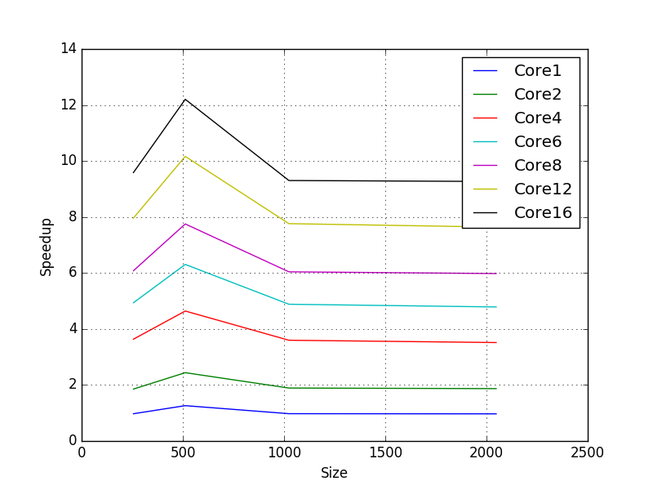
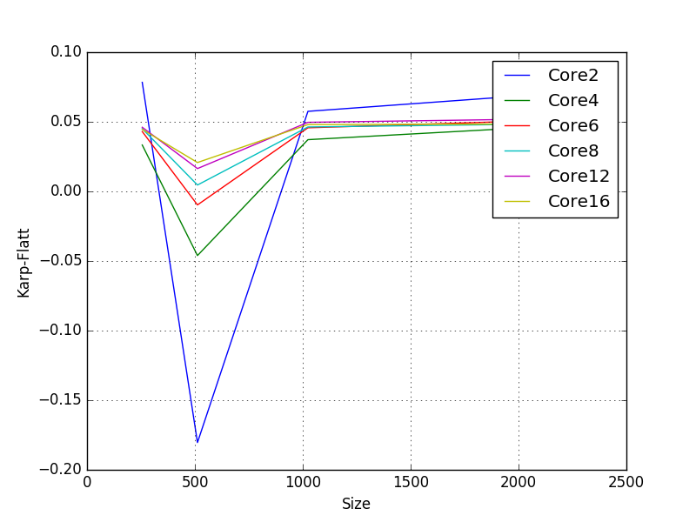
Graph size vs speedup
Graph size vs Karp-flatt
In this approach we are getting speedup of ~9.

Slide 9
Prefix Approach
In this technique firstly we are giving a padding of 2 (i.e. 4 extra row and 4 extra columns) to the grid.
Every time before calculating next generation cell’s we fill the prefix matrix using formula :-
prefix[x][y] = curr[x][y] - prefix[x-1][y-1] + prefix[x-1][y] + prefix[x][y-1];
Here prefix sum will give no. of cells alive in the grid (x,y).
Now this prefix matrix is used to calculate the number of alive neighbours for every cell using formula :-
live = prefix[x+1][y+1] - prefix[x-2][y+1] - prefix[x+1][y-2] + prefix[x-2][y-2] - curr[x][y];

Slide 10
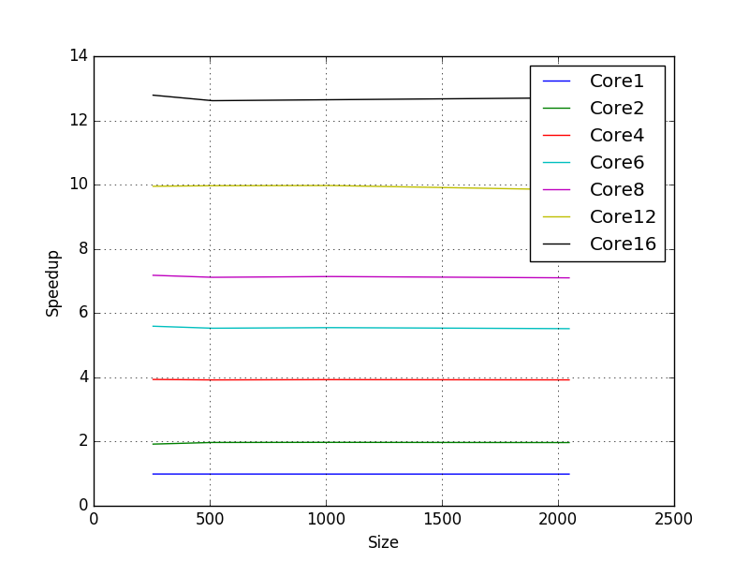

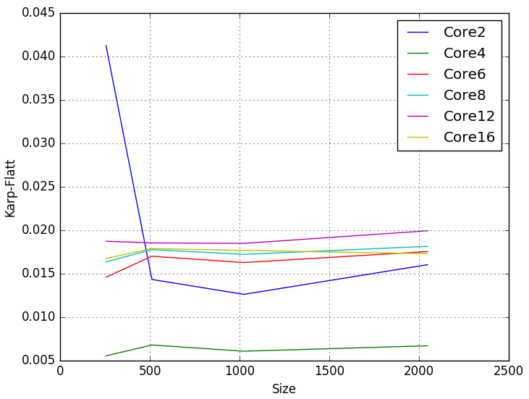
Graph size vs time
Graph size vs Karp-flatt
Graph size vs speedup
In this approach we are getting speedup of ~13.

Slide 11
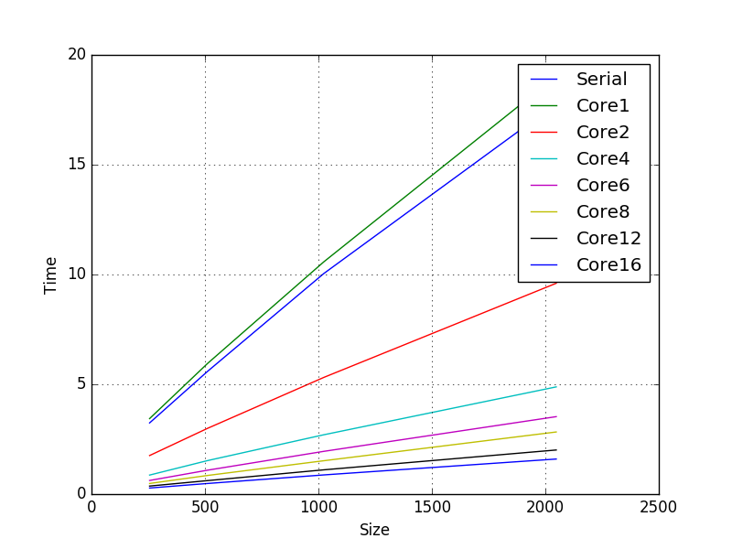
Tony Finch Approach
Graph size vs Time
This technique involves one time calculation of no. of alive neighbours for every cell in a 2D matrix named tem.
Now while iterating through generation we change state of cell according to tem matrix and update neighbours count in duplicate matrix of tem (named next) i.e. if a live cell dies then we will subtract 1 from each of its neighbour in matrix and store all this in next matrix and lastly we copy all this data to matrix tem.

Slide 12
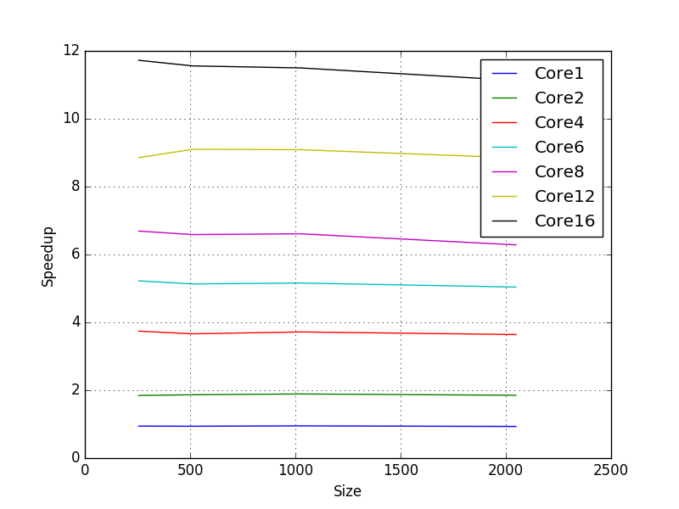
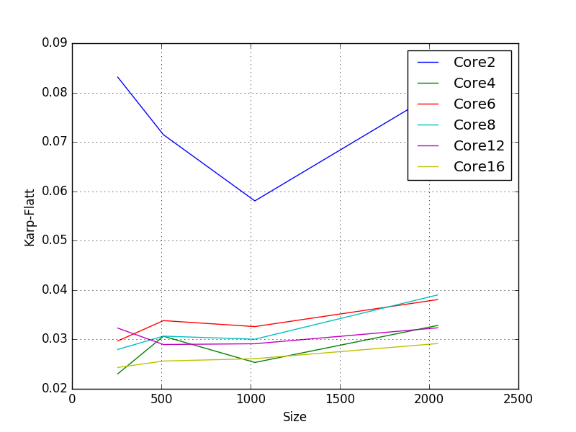
Graph size vs Speedup
Graph size vs Karp Flatt
In this approach we are getting speedup of ~11.

Slide 13
Conclusion
Best approach of all the four approach implemented is the Tony Finch Approach.
Ultimate implementation of Game of Life is Recursive Quad-Tree Algorithm.
Life can used to model many real life systems such as human evolution , Forest Fire scenario and many more.

