Slide 1
MicrobiomeAnalyst
Yelnur Abilakim, Alix Foster, Phil Huddy, Keidi Xhagolli

Slide 2
What is MicrobiomeAnalyst?
“a user-friendly tool that integrates recent progress in statistics and visualization techniques, coupled with novel knowledge bases, to enable comprehensive analysis of common data outputs produced from microbiome studies” [1]
4 Modules
Marker Data Profiling (MDP)
Shotgun Data Profiling (SDP)
Taxon Set Analysis (TSA)
Projection with Public Data (PPD)

Slide 3
Module Details
Marker Data Profiling (MDP): Facilitates analysis of user provided 16S rRNA marker gene survey data
Shotgun Data Profiling (SDP): Contains functions for analyzing user provided metagenomics or metatranscriptomics data
Taxon Set Enrichment Analysis (TSEA): Allows the user to test for biologically or ecologically meaningful patterns from a list of taxa of interest
Projection with Public Data (PPD): Enables users to visually juxtapose their data with public datasets in search of novel patterns or biological insights

Slide 4
Data Input - MDP, PPD
16S rRNA maker gene survey data
Inputs
Taxon or OTU abundance table
Metadata file
Phylogenetic tree (optional)
Formats
BIOM
mothur
.txt
.csv
Notes:
For our demo, we were tasked with utilizing MDP, however we will briefly mention the input types for each tool since they are very different.
MDP and PPD are designed for 16S rRNA maker gene survey data.
This method requires a taxon or OTU abundance table and a sample metadata file containing group info.
MicrobiomeAnalyst supports .txt, .csv, BIOM, and mothur software package files.

Slide 5
Data Input - SDP, TSEA
SDP
Same as MDP, PPD
Also requires gene IDs
KEGG Orthology (KO)
Enzyme Commission (EC)
Cluster of Orthologous Groups (COG)
Other
TSEA
List of taxa with a taxa type
Notes:
SDP is the same as MDP and PPD, however it also requires genes be correlated to some form of an ID, as listed above
TSEA is completely different, as it just requires a list of taxa, as well as the type of taxa being supplied. There are five supported types.

Slide 6
Data Filtering
By default, features are:
excluded if they have all zeros or only appear in a single sample (a.k.a. “minimally cleaned”)
reserved for alpha diversity analyses to understand individual sample diversity
filtered based on abundance levels and sample prevalence
Users can filter features that are:
low count (via minimum count cutoff based on their mean/median values)
low variance (based on their IQRs, SDs or CVs)
Notes:
By default, features containing all zeros or only appear in a single sample are excluded in downstream analyses based on technical, statistical and biological considerations. This so-called ‘minimally cleaned’ data is reserved for various alpha diversity analyses where the primary goal is to understand individual sample diversity. For all other data analysis, further data filtering is necessary. Features are also filtered by default based on their abundance levels and sample prevalence. Users can filter low-count features using a minimum count cutoff based on their mean or median values. If the primary goal is comparative analysis, users should exclude features with low variance based on their inter-quantile ranges, standard deviations or coefficient of variations. These features are very unlikely to be significant in the comparative analysis, so filtering those uninformative features can improve statistical power by reducing the issue of multiple testing in downstream analysis.

Slide 7
Data Normalization
Rarefying
Scaling
Total sum scaling (TSS)
Cumulative sum scaling (CSS)
Upper-quartile normalization (UQ)
Transformation
Relative log expression (RLE)
Trimmed mean of M-values (TMM)
Centered log ratio (CLR)
Notes:
Next we do data normalization.
There are three types:
First, rarefying, which is essentially eliminating a portion of the data.
Second, is data scaling, which is changing the data to fit in a specific range. You have the choice between the three methods listed above.
Third is data transformation, which is changing the data to a specific format. You have the above choices to do this.
Finally, it is of note to mention that other softwares or applications choose these data normalization methods for you, so MicrobiomeAnalyst has the leg up in this sense.

Slide 8
Data Analysis
Visual exploration
Community profiling
Clustering & correlation
Comparison & classification
Functional prediction
We will be going over the first two in the Demo

Slide 9
Clustering & Correlation
Heatmap clustering
Allows for hierarchical clustering which is visualized through the use of a heatmap
Dendrogram analysis
Creates a tree diagram that shows the hierarchical clustering of the data
Correlation network (SparCC)
Can use different correlation algorithms (by default it uses SparCC) to analyze any correlations that exist in the data provided
Pattern search
By entering a pattern (profile or specific feature) the user can perform a search

Slide 10
Comparison & Classification
Univariate analysis
Explore variables in a data set separately
metagenomeSeq
Determines differentially abundant features
RNA-seq methods
Sequencing technique for identifying info about RNA in a sample
LEfSe
Built for microbiome data to extract features for biomarker discovery
Random Forest
Generic non-parametric machine learning algorithm

Slide 11
Functional Prediction
PICRUSt (Greengenes)
Predict the functional composition of a metagenome
Uses marker gene data and database of reference genomes
Tax4Fun (SILVA)
Predict functional potential based on minimum 16SrRNA sequence similarity
Works with data from SILVAngs web server or QIIME against SILVA database
Takes more time to complete (~2 mins)
Notes:
PICRUSt stands for phylogenetic investigation of communities by reconstruction of unobserved states. It is a computational approach to predict the functional composition of a metagenome using marker gene data and a database of reference genomes. In short, PICRUSt uses an extended ancestral-state reconstruction algorithm to predict which gene families are present and then combines gene families to estimate the composite metagenome.
Tax4Fun is designed for functional prediction based on minimum 16SrRNA sequence similarity. It is applicable to outputs obtained from the SILVAngs web server or the application of QIIME against the SILVA database. Note, the process is time consuming and may take ~2 mins to complete.

Slide 12
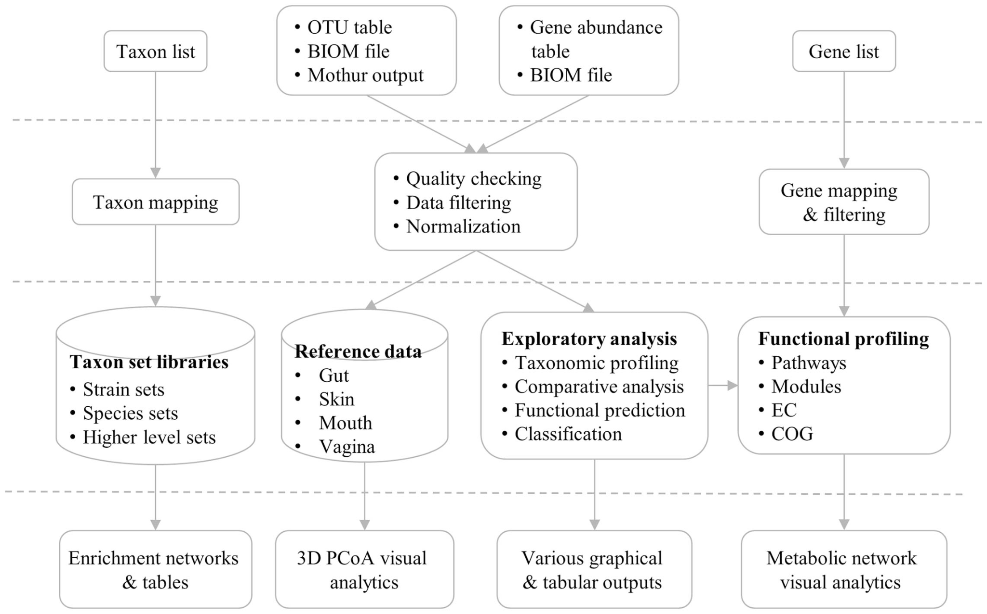

Slide 13
Demo
https://www.microbiomeanalyst.ca/

Slide 14
Resources
https://academic.oup.com/nar/article/45/W1/W180/3760191

