Slide 1
Code Based Software Projects Popularity Estimation
Publish project in 2020
Machine Learning
Github Star in 2022?
Hung Phan (hungphd@iastate.edu )
Iowa State University - COMS 574 Course Project
Github: https://github.com/pdhung3012/CodeBasedProjectStarPrediction

Slide 2
Content
Introduction.
Related Works.
Background.
Materials.
Approach.
Result.
Conclusion.

Slide 3
Introduction
Input: properties of source code project without manual define,
Prediction object:
Popularity: The star of project in Github.
We predict 2 types of popularity:
Levels of popularity.
Score of popularity.

Slide 4
Related Works
https://github.com/simon-weber/Predicting-Code-Popularity:
Relies on Feature Engineering features: num of files, num of commits.
Predict by 2-4 ranges: high-low and high-medium-below-low (specify manually).
Python repos.
Prediction type: Classification.
https://github.com/Doodies/Github-Stars-Predictor
Also rely on Feature Engineering on number of commits, licenses….
Restrict the project data set that has number of star greater than 100.
Prediction type: Regression.

Slide 5
Background
Classification Algorithm:
# create a list of classifiers
random_seed = 2
classifiers = [GaussianNB(), LogisticRegression(random_state=random_seed),DecisionTreeClassifier(),
RandomForestClassifier(random_state=random_seed, n_estimators=50), AdaBoostClassifier(), LinearDiscriminantAnalysis(),QuadraticDiscriminantAnalysis(),
LinearSVC(random_state=random_seed), MLPClassifier(alpha=1), GradientBoostingClassifier(random_state=random_seed, max_depth=5)]

Slide 6
Background
Regression Algorithm:
classifiers = [DecisionTreeRegressor(),
RandomForestRegressor(random_state=2, n_estimators=1000),AdaBoostRegressor(), xgb.XGBRegressor(objective ='reg:linear', colsample_bytree = 0.3, learning_rate = 0.1,
max_depth = 5, alpha = 10, n_estimators = 10),
LinearSVR(random_state=random_seed), MLPRegressor(alpha=1),
GradientBoostingRegressor(random_state=random_seed, max_depth=5)]

Slide 7
Materials
Dataset: Collect from Alon et all (2018): https://github.com/tech-srl/code2seq/blob/master/README.md#datasets
9300 Java Projects.
Technique we use: Java AST Parser by JDT.
Splitting training and testing data:
9000 for training.
300 for testing.
My code is available at: https://github.com/pdhung3012/CodeBasedProjectStarPrediction

Slide 8
Approach
Get Information from AST Node.
Collect non-terminal nodes right above terminal nodes.
Collect for each files in Software Project.
Select top-k files which has the most “import” statements for each projects.
- k=50.
3. Vectorizing from sequences of AST Nodes:
TF-IDF.
4. Running ML models.

Slide 9
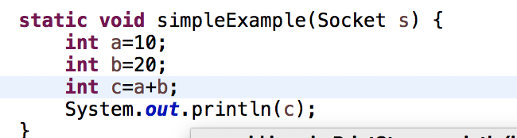
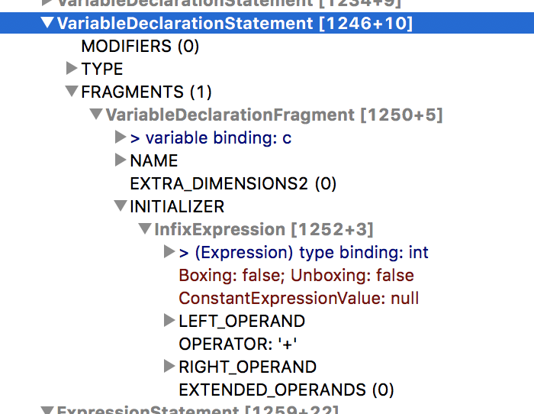
ML Classification
Range
star<=178
(178, 328]
(328, 741]
star > 741
Select top-k informative Java files
Extract AST sequences
TF-IDF Vectorization
Software Project
ML Regression
Predicted Star
200
Vector: [1.25, 0, 0.1,…, 1]
VariableDeclarationFragment
InfixExpression
LEFT_OPERAND
OPERATOR
RIGHT_OPERAND
…

Slide 10
Results
RQ1: Accuracy on Popularity Level Classification.
RQ2: Accuracy on Popularity Prediction.
RQ3: Tuning on Hyper Parameters of Best ML model.
RQ 3.1: SVC Classification.
RQ 3.2: XGBoostRegressor.

Slide 11
RQ1. Accuracy on Popularity Level Classification
We have 4 categories: 0 (star<=178), 1 (star in (178, 328]) , 2 (star in (328, 741]) and 3 (star > 741).
Each ranges have around 25% entities in training data set.
Link (for all experiments): https://docs.google.com/spreadsheets/d/1kFwMrVuUMcuVq9wV2vgQAWpa3i-MuSwCQXc9B-9-fXg/edit?usp=sharing

Slide 12
RQ1. Accuracy on Popularity Level Classification
No | ML Model | Accuracy (%)
1 | GNB | 22.70
2 | LR | 28.62
3 | DT | 22.37
4 | RF | 21.05
5 | AB | 22.70
6 | LDA | 29.61
7 | QDA | 25.99
8 | SVC | 32.89
9 | MLP | 30.26
10 | GBo | 28.62

Slide 13
RQ2. Popularity Prediction
No | ML Model | MAE
1 | DTR | 1111.02
2 | RFR | 878.68
3 | ABR | 4366.48
4 | XGBR | 657.27
5 | LSVR | 604.02
6 | MLPR | 786.77
7 | GBR | 836.53

Slide 14
RQ 3.1. Support Vector Machine Tuning
Metric | Range | Best Param | Best Acc | Origin Acc
C | 1 | 1 | 32.89% | 32.89%
kernel | ['rbf', 'poly', 'sigmoid'] | rbf
Notes:
C; Regularization parameter. The strength of the regularization is inversely proportional to C. Must be strictly positive.
Kernel: polynomial kernel functions (https://towardsdatascience.com/kernel-function-6f1d2be6091).

Slide 15
RQ 3.2. XGBRegressor
Metric | Range | Best Param | Best MAE | Default MAE
objective | reg:linear | reg:linear | 648.02 | 657.27
colsample_bytree | 0.3 | 0.3
learning_rate | [0.1,1] | 0.1
max_depth | [ 1,3,5] | 5
alpha | [10,20] | 10
n_estimators | [10,100] | 10
Notes:
- colsample_bytree is the subsample ratio of columns when constructing each tree. Subsampling occurs once for every tree constructed.
Learning rate:
Max depth of tree.

Slide 16
Conclusion
In this project, we want to:
Provide solution for Github popularity prediction at ranges and exact prediction.
Propose some observations:
The popularity prediction is challenging if we want to predict the details information to users.
The star is good but also depend on time:
We will use star/30 days as predicted metrics for future works.
3. The large scale project vectorization is challenging in:
Scale of software.
Summarizing what types of code to predict.
4. We got 31% accuracy in best classification and 666 in MAE for best regression.

Slide 17
Future Works
Finding better strategies for representing big code by text.
Combine AST+ code.
More efficient way for vectorization:
Code2vec.
Doc2vec.
Applying Deep Learning (RNN, CNN).

