Slide 1






Parallel Data Interface
how to decouple applications from I/O concerns
Leonardo Bautista Gomez², Julien Bigot¹, Mohamed Gaalich¹,
Kai Keller², Guillaume Latu³,
Tomasz Paluszkiewicz⁴,
Karol Sierocinski⁴, Corentin Roussel^{1,}
¹ Maison de la Simulation
² Barcelona Supercomputing Center
³ CEA/IRFM
⁴ Poznań Supercomputing & Networking Center
PATC Training – 2018 Apr. 24th

Slide 2
I/O's for HPC
We want it easy to use
We want it fast
We want a portable library
We want large language support
We want parallelization independent file format
We want a portable file format
We want...
Kind of a “Pick 2 out of 3” situation (except with more than 3)

Slide 3
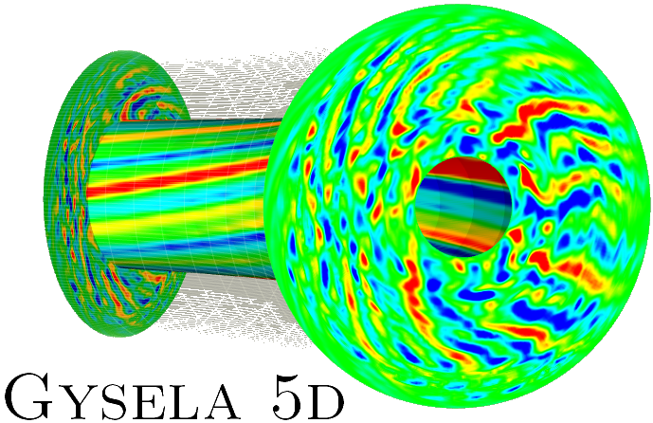
Example: I/Os in Gysela
Gysela: 5D Semi-Lagrangian Gyrokinetic code
  Large scale plasma simulation (16k+ core, ~month wallclock time)
  Large memory footprint (e.g. on Curie, 100+ TB)
2 I/O kinds: Diagnostics & checkpoints
Checkpoint
  Intermediate checkpoints (Fault tolerance)
    Performance, fast temporary storage, overlap w. computation
  Final checkpoints (Segmentation)
    File portability, domain decomposition change, permanent
… Except for small debug cases (ease of use 1st)

Slide 4
Example: I/Os in Gysela
Gysela: 5D Semi-Lagrangian Gyrokinetic code
  Large scale plasma simulation (16k+ core, ~month wallclock time)
  Large memory footprint (e.g. on Curie, 100+ TB)
2 I/O kinds: Diagnostics & checkpoints
Checkpoint
  Intermediate checkpoints (Fault tolerance)
    Performance, fast temporary storage, overlap w. computation
  Final checkpoints (Segmentation)
    File portability, domain decomposition change, permanent
… Except for small debug cases (ease of use 1st)

Slide 5
Context : I/O libraries
Many libraries for I/O's in HPC
POSIX I/O
ANSI C lib
MPI I/O
HDF5 (seq / par)
NetCDF (seq/par)
FTI
SCR
XIOS
SIONlib
DDN Infinite Memory Engine
Damaris
ADIOS
...

Slide 6
I/O libraries: make a choice
Stream vs. Object API
Imperative vs. declarative API
General purpose vs. Domain specific
Dedicated HW use (none, NVRAM, SSDs, I/O nodes, …)
File format: ASCII vs. HDF5 vs. …
Single file vs. one file / process
...

Slide 7
PDI: The requirements
Start a new code
  Use a simple API for I/O's
  Don't depend on anything fancy
When the code grows
  Have efficient parallel I/O's
  Different requirement in different places
    Checkpoint/Restart vs. code outputs
When the hardware changes
  Optimal I/O strategy changes
  Is our chosen library available there?
Minimize changes
in the code

Slide 8
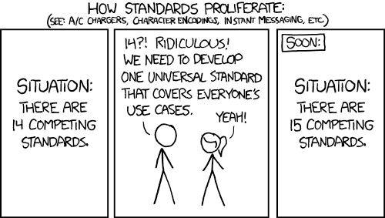
Introducing PDI
© XKCD https://xkcd.com/927/

Slide 9
Introducing PDI
No!
PDI is an Interface...
just an interface!
© XKCD https://xkcd.com/927/

Slide 10
The I/O stack
User code
User code
User code
MPI
...
API-adapt
API-adapt
API-adapt
I/O Library
API
I/O Library
API
API
Frontend
Frontend
Frontend
Parallel strategy
Backend
Backend
...
Backend
...
Backend
Parallel File-System

Slide 11
The I/O stack
User code
User code
User code
MPI
...
API-adapt
API-adapt
API-adapt
I/O Library
API
API
API
Frontend
Frontend
Frontend
Parallel strategy
Backend
Backend
...
Backend
...
Backend
Parallel File-System

Slide 12
The I/O stack
User code
User code
User code
Complex-type
App life-cycle
Serialization
…
MPI
...
File open & close
Data read & write
  Stream/Object
Distribution spec.
…
API-adapt
API-adapt
API-adapt
I/O Library
API
API
API
Frontend
Frontend
Frontend
Burst buffering
Compression
Data processing
  workflow
...
Parallel strategy
...
...
Redistribution
Dedicated nodes
Staged I/O's
...
Backend
Backend
Backend
Backend
Parallel File-System
File format
Buffering
...

Slide 13
The I/O stack: PDI
File open & close
Data read & write
  Stream/Object
Distribution spec.
…
PDI
API
API
API

Slide 14
The I/O stack: PDI
Standardize a declarative API
Describe actions in a config file
Rely on existing libraries through plugins
PDI
API
API
API

Slide 15
The I/O stack: PDI
Standardize a declarative API
Describe actions in a config file
Rely on existing libraries through plugins
PDI
API
API
API
metadata:
width: int
height: int
pwidth: int
pheight: int
nb_iter: int
iter: int
coord: { size: 2, type: int }
data:
main_field:
type: double
sizes: [$width, $height]
subsizes: [$width-2, $height-2]
starts: [1, 1]
plugins:
hdf5_per_process:
outputs:
main_field: # ref to a variable
select: $iter%16=0
file: output_${coord[0]}x${coord[1]}.h5
var: iter_${iter}/main_field

Slide 16
The I/O stack: PDI
Standardize a declarative API
Describe actions in a config file
Rely on existing libraries through plugins
PDI
API
API
API
metadata:
width: int
height: int
pwidth: int
pheight: int
nb_iter: int
iter: int
coord: { size: 2, type: int }
data:
main_field:
type: double
sizes: [$width, $height]
subsizes: [$width-2, $height-2]
starts: [1, 1]
plugins:
hdf5_per_process:
outputs:
main_field: # ref to a variable
select: $iter%16=0
file: output_${coord[0]}x${coord[1]}.h5
var: iter_${iter}/main_field
plugin
plugin
plugin
plugin
plugin
plugin
plugin
plugin
plugin
I/O Library
API
API
API
I/O Library
API
API
API
I/O Library
API
API
API

Slide 17
PDI: our choices
Stream vs. Object API
Imperative vs. declarative API
General purpose vs. Domain specific
Dedicated HW use (none, NVRAM, SSDs, I/O nodes, …)
File format: ASCII vs. HDF5 vs. …
Single file vs. one file / process
...

Slide 18
PDI: our choices
Stream vs. Object API
Imperative vs. declarative API
General purpose vs. Domain specific
Dedicated HW use (none, NVRAM, SSDs, I/O nodes, …)
File format: ASCII vs. HDF5 vs. …
Single file vs. one file / process
...
Plugins

Slide 19
PDI: The API
/** Initializes PDI
* \param[in] conf the configuration
* \param[in,out] world the main MPI communicator
* \return an error status
*/
PDI_status_t PDI_init(PC_tree_t conf, MPI_Comm* world);
/** Finalizes PDI
* \return an error status
*/
PDI_status_t PDI_finalize();
Initialization
  Takes a yaml config
  Might steal ranks from the provided MPI comm.
Finalization releases all resources

Slide 20
PDI: an example
int main( int argc, char *argv[] )
{
MPI_Init(&argc, &argv); PC_tree_t conf = PC_parse_path(argv[1]);
int width, height, max_iterations;
read_conf(conf, &width, &height, &max_iterations);
MPI_Comm main_comm=MPI_COMM_WORLD;
int rank; MPI_Comm_rank(main_comm, &rank);
double *cur = malloc(sizeof(double)*width*height);
double *next = malloc(sizeof(double)*width*height);
init(cur, width, height, car_coord[0], car_coord[1]);
int ii; for(ii=0; ii<max_iterations ; ++ii) {
iter(cur, next, width, height);
exchange(cart_com, next, width, height);
double *tmp = cur; cur = next; next = tmp;
}
PC_tree_destroy(&conf);
free(cur); free(next);
MPI_Finalize();
}

Slide 21
PDI: an example
int main( int argc, char *argv[] )
{
MPI_Init(&argc, &argv); PC_tree_t conf = PC_parse_path(argv[1]);
int width, height, max_iterations;
read_conf(conf, &width, &height, &max_iterations);
MPI_Comm main_comm=MPI_COMM_WORLD; PDI_init(PC_get(conf, ".pdi"), &main_comm);
int rank; MPI_Comm_rank(main_comm, &rank);
double *cur = malloc(sizeof(double)*width*height);
double *next = malloc(sizeof(double)*width*height);
init(cur, width, height, car_coord[0], car_coord[1]);
int ii; for(ii=0; ii<max_iterations ; ++ii) {
iter(cur, next, width, height);
exchange(cart_com, next, width, height);
double *tmp = cur; cur = next; next = tmp;
}
PDI_finalize(); PC_tree_destroy(&conf);
free(cur); free(next);
MPI_Finalize();
}

Slide 22
PDI: The API
typedef { PDI_IN, PDI_OUT, PDI_INOUT } PDI_inout_t;
/** Shortly exposes some data to PDI.
* \param[in] name the data name
* \param[in,out] data the exposed data
* \param[in] access whether the data can be accessed for read or write by PDI
*/
PDI_status_t PDI_expose(const char *name, void *data, PDI_inout access);
Expose data to PDI
  PDI_OUT ≈ write
    Might or might not use it (write it, use it for computation, send it over MPI, etc.)
  PDI_IN ≈ read
    Might or might not fill the content

Slide 23
PDI: an example
int main( int argc, char *argv[] )
{
MPI_Init(&argc, &argv); PC_tree_t conf = PC_parse_path(argv[1]);
int width, height, max_iterations;
read_conf(conf, &width, &height, &max_iterations);
MPI_Comm main_comm=MPI_COMM_WORLD; PDI_init(PC_get(conf, ".pdi"), &main_comm);
int rank; MPI_Comm_rank(main_comm, &rank);
double *cur = malloc(sizeof(double)*width*height);
double *next = malloc(sizeof(double)*width*height);
init(cur, width, height, car_coord[0], car_coord[1]);
int ii; for(ii=0; ii<max_iterations ; ++ii) {
iter(cur, next, width, height);
exchange(cart_com, next, width, height);
double *tmp = cur; cur = next; next = tmp;
}
PDI_finalize(); PC_tree_destroy(&conf);
free(cur); free(next);
MPI_Finalize();
}

Slide 24
PDI: an example
int main( int argc, char *argv[] )
{
MPI_Init(&argc, &argv); PC_tree_t conf = PC_parse_path(argv[1]);
int width, height, max_iterations;
read_conf(conf, &width, &height, &max_iterations);
MPI_Comm main_comm=MPI_COMM_WORLD; PDI_init(PC_get(conf, ".pdi"), &main_comm);
int rank; MPI_Comm_rank(main_comm, &rank);
PDI_expose("rank", &rank); PDI_expose("width", &width); PDI_expose("height", &height);
double *cur = malloc(sizeof(double)*width*height);
double *next = malloc(sizeof(double)*width*height);
if ( PDI_import("main_field", cur) ) {
init(cur, width, height, car_coord[0], car_coord[1]);
}
int ii; for(ii=0; ii<max_iterations ; ++ii) {
PDI_expose("iter", &ii); PDI_expose("main_field", cur);
iter(cur, next, width, height);
exchange(cart_com, next, width, height);
double *tmp = cur; cur = next; next = tmp;
}
PDI_expose("iter", &ii); PDI_expose("main_field", cur);
PDI_finalize(); PC_tree_destroy(&conf);
free(cur); free(next);
MPI_Finalize();
}

Slide 25
PDI: The API
/** Triggers a PDI "event"
* \param[in] event the event name
*/
PDI_status_t PDI_event(const char *event);
/** Begin a transaction. All the ::PDI_expose will be exposed together.
* \param[in] name the name of the transaction
*/
PDI_status_t PDI_transaction_begin( const char *name );
/** Ends the previously opened transaction.
*/
PDI_status_t PDI_transaction_end();
Events notifies PDI of interesting code location
Transactions
  Group multiple PDI_expose
  Triggers an event when all values are exposed

Slide 26
PDI: an example
int main( int argc, char *argv[] )
{
MPI_Init(&argc, &argv); PC_tree_t conf = PC_parse_path(argv[1]);
int width, height, max_iterations;
read_conf(conf, &width, &height, &max_iterations);
MPI_Comm main_comm=MPI_COMM_WORLD; PDI_init(PC_get(conf, ".pdi"), &main_comm);
int rank; MPI_Comm_rank(main_comm, &rank);
PDI_expose("rank", &rank); PDI_expose("width", &width); PDI_expose("height", &height);
double *cur = malloc(sizeof(double)*width*height);
double *next = malloc(sizeof(double)*width*height);
if ( PDI_import("main_field", cur) ) {
init(cur, width, height, car_coord[0], car_coord[1]);
}
int ii; for(ii=0; ii<max_iterations ; ++ii) {
PDI_expose("iter", &ii); PDI_expose("main_field", cur);
iter(cur, next, width, height);
exchange(cart_com, next, width, height);
double *tmp = cur; cur = next; next = tmp;
}
PDI_expose("iter", &ii); PDI_expose("main_field", cur);
PDI_finalize(); PC_tree_destroy(&conf);
free(cur); free(next);
MPI_Finalize();
}

Slide 27
PDI: an example
int main( int argc, char *argv[] )
{
MPI_Init(&argc, &argv); PC_tree_t conf = PC_parse_path(argv[1]);
int width, height, max_iterations;
read_conf(conf, &width, &height, &max_iterations);
MPI_Comm main_comm=MPI_COMM_WORLD; PDI_init(PC_get(conf, ".pdi"), &main_comm);
int rank; MPI_Comm_rank(main_comm, &rank);
PDI_expose("rank", &rank); PDI_expose("width", &width); PDI_expose("height", &height);
double *cur = malloc(sizeof(double)*width*height);
double *next = malloc(sizeof(double)*width*height);
if ( PDI_import("main_field", cur) ) {
init(cur, width, height, car_coord[0], car_coord[1]);
}
PDI_event("loop_start");
int ii; for(ii=0; ii<max_iterations ; ++ii) {
PDI_transaction_begin("loop_iter");
PDI_expose("iter", &ii); PDI_expose("main_field", cur);
PDI_transaction_end();
iter(cur, next, width, height);
exchange(cart_com, next, width, height);
double *tmp = cur; cur = next; next = tmp;
}
PDI_transaction_begin("loop_end");
PDI_expose("iter", &ii); PDI_expose("main_field", cur);
PDI_transaction_end();
PDI_finalize(); PC_tree_destroy(&conf);
free(cur); free(next);
MPI_Finalize();
}

Slide 28
PDI: an example
pdi:
metadata: # small values reference-able w. $syntax
rank: int # rank of the process
width: int # per proc. width including ghost
height: int # per proc. height including ghost
iter: int # curent iteration id

Slide 29
PDI: an example
int main( int argc, char *argv[] )
{
MPI_Init(&argc, &argv); PC_tree_t conf = PC_parse_path(argv[1]);
int width, height, max_iterations;
read_conf(conf, &width, &height, &max_iterations);
MPI_Comm main_comm=MPI_COMM_WORLD; PDI_init(PC_get(conf, ".pdi"), &main_comm);
int rank; MPI_Comm_rank(main_comm, &rank);
PDI_expose("rank", &rank); PDI_expose("width", &width); PDI_expose("height", &height);
double *cur = malloc(sizeof(double)*width*height);
double *next = malloc(sizeof(double)*width*height);
if ( PDI_import("main_field", cur) ) {
init(cur, width, height, car_coord[0], car_coord[1]);
}
PDI_event("loop_start");
int ii; for(ii=0; ii<max_iterations ; ++ii) {
PDI_transaction_begin("loop_iter");
PDI_expose("iter", &ii); PDI_expose("main_field", cur);
PDI_transaction_end();
iter(cur, next, width, height);
exchange(cart_com, next, width, height);
double *tmp = cur; cur = next; next = tmp;
}
PDI_transaction_begin("loop_end");
PDI_expose("iter", &ii); PDI_expose("main_field", cur);
PDI_transaction_end();
PDI_finalize(); PC_tree_destroy(&conf);
free(cur); free(next);
MPI_Finalize();
}

Slide 30
PDI: an example
pdi:
metadata: # small values reference-able w. $syntax
rank: int # rank of the process
width: int # per proc. width including ghost
height: int # per proc. height including ghost
iter: int # curent iteration id
data: # large values that should not be copied
main_field: # type similar to MPI_Type
type: double
sizes: [$width, $height]
subsizes: [$width-2, $height-2]
starts: [1, 1]

Slide 31
PDI: an example
int main( int argc, char *argv[] )
{
MPI_Init(&argc, &argv); PC_tree_t conf = PC_parse_path(argv[1]);
int width, height, max_iterations;
read_conf(conf, &width, &height, &max_iterations);
MPI_Comm main_comm=MPI_COMM_WORLD; PDI_init(PC_get(conf, ".pdi"), &main_comm);
int rank; MPI_Comm_rank(main_comm, &rank);
PDI_expose("rank", &rank); PDI_expose("width", &width); PDI_expose("height", &height);
double *cur = malloc(sizeof(double)*width*height);
double *next = malloc(sizeof(double)*width*height);
if ( PDI_import("main_field", cur) ) {
init(cur, width, height, car_coord[0], car_coord[1]);
}
PDI_event("loop_start");
int ii; for(ii=0; ii<max_iterations ; ++ii) {
PDI_transaction_begin("loop_iter");
PDI_expose("iter", &ii); PDI_expose("main_field", cur);
PDI_transaction_end();
iter(cur, next, width, height);
exchange(cart_com, next, width, height);
double *tmp = cur; cur = next; next = tmp;
}
PDI_transaction_begin("loop_end");
PDI_expose("iter", &ii); PDI_expose("main_field", cur);
PDI_transaction_end();
PDI_finalize(); PC_tree_destroy(&conf);
free(cur); free(next);
MPI_Finalize();
}

Slide 32
PDI: an example
pdi:
metadata: # small values reference-able w. $syntax
rank: int # rank of the process
width: int # per proc. width including ghost
height: int # per proc. height including ghost
iter: int # curent iteration id
data: # large values that should not be copied
main_field: # type similar to MPI_Type
type: double
sizes: [$width, $height]
subsizes: [$width-2, $height-2]
starts: [1, 1]
plugins:
hdf5: # load the HDF5 plugin
outputs: # write the following
main_field:
select: $iter % 16 = 0
file: output_${rank}.h5
var: iter_${iter}/main_field

Slide 33
PDI: under the hood
Replacing I/O libs function calls
Only 2 concepts
  “events” : (think Qt signal/slots)
  Zero copy buffer sharing
    name, pointer + access rights (R / W / RW)
2 APIs
  “low” level for plugins (events notification, access buffers)
  Higher-level API for the application

Slide 34
PDI: the plugin API
/** initialization notification */
PDI_status_t PDI_<plugin>_init(PC_tree_t conf,
MPI_Comm *world);
/** Finalization notification*/
PDI_status_t PDI_<plugin>_finalize();
/** Notification of a named event */
PDI_status_t PDI_<plugin>_event(const char *event);
/** Notification of a data availability event */
PDI_status_t PDI_<plugin>_data_start(PDI_variable_t *data);
/** Notification of a data unavailability event */
PDI_status_t PDI_<plugin>_data_end(PDI_variable_t *data);
/** Declare the plugin to PDI */
PDI_PLUGIN(<plugin>)

Slide 35
Gysela checkpointng w. PDI
4 versions of the production code Gysela
  No checkpoint
  HDF5 checkpoints
  FTI fault-tolerance
  PDI (none / HDF5 / FTI / HDF5+FTI)
Implementation cost
 | Native API | PDI
HDF5 | 24 func. 535 LOC. | 3 func. 207 LOC. 172 l. config.
FTI | 7 func. 216 LOC. 29 config | +2 func.+37 LOC. + 7 l. config.
HDF5 + FTI |  | +0 func. +3 LOC. + 3 l. config.

Slide 36
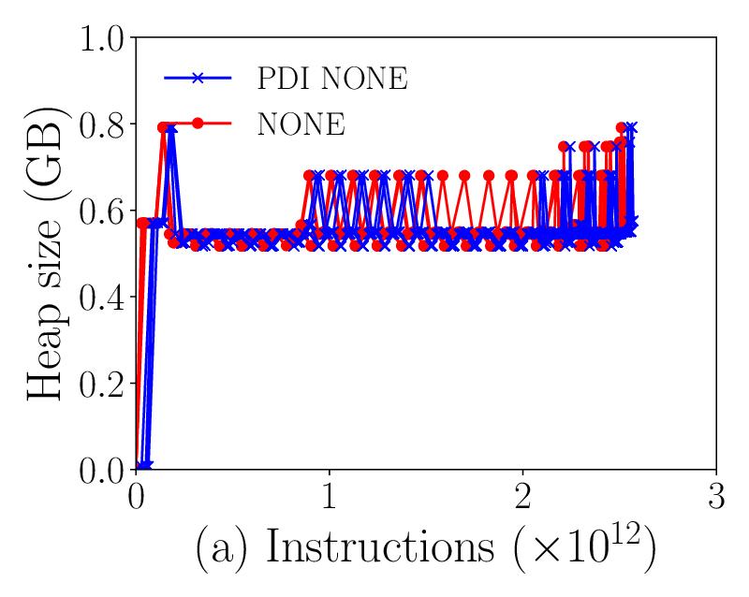
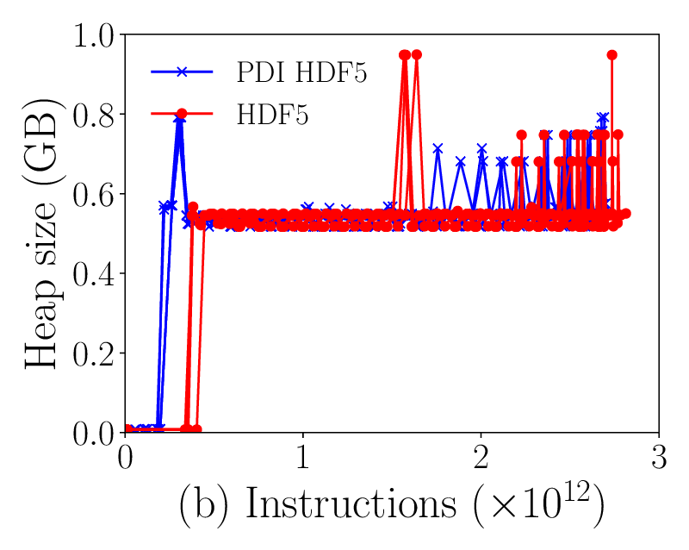
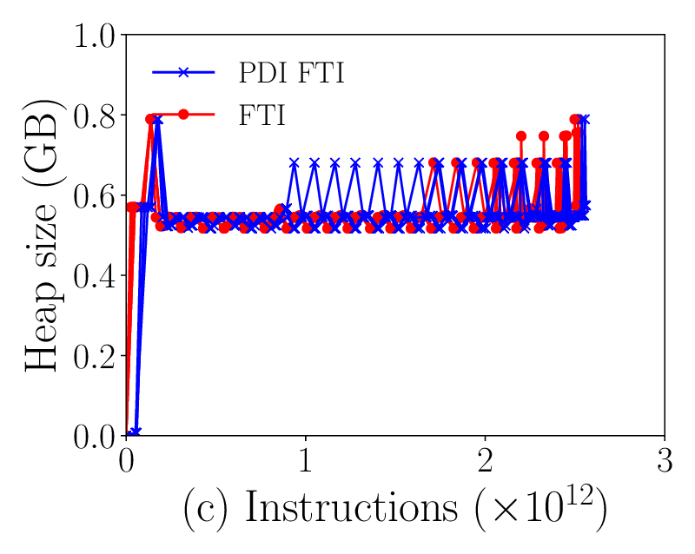
PDI: Memory overhead
Memory usage during a Gysela execution with and without PDI on 4 MareNostrum (BSC – Spain) nodes

Slide 37
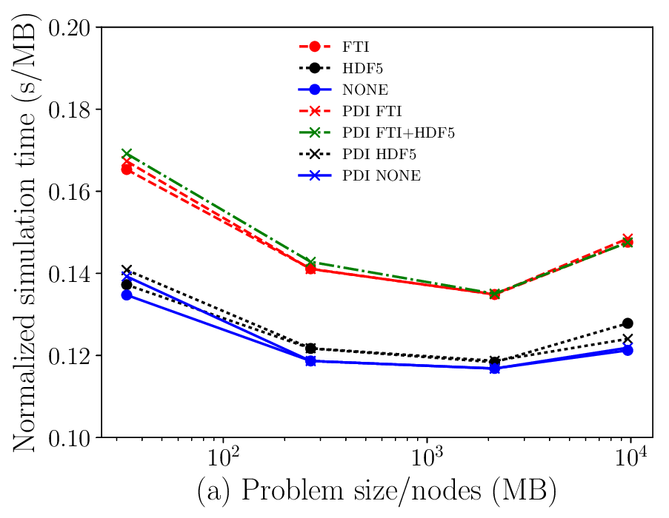
PDI: Perf. Evaluation 1/2
Execution time by MB of checkpointed data on 4 MareNostrum
Nodes with and without PDI

Slide 38
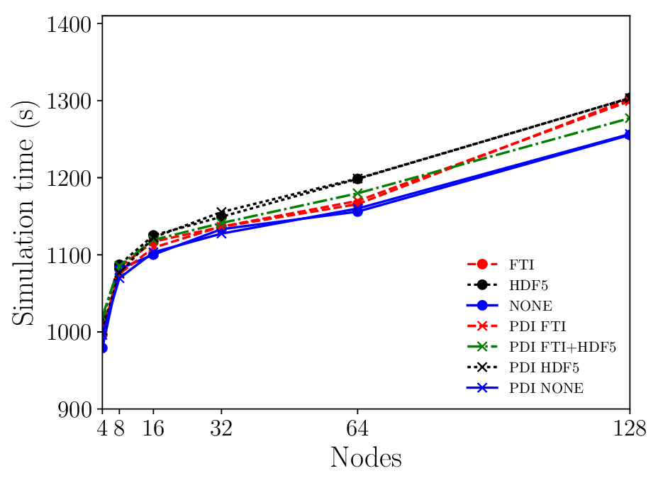
PDI: Perf. Evaluation 2/2
Gysela Wallclock time in weak scaling on Curie (TGCC – France) with and without PDI
Checkpointed data ~2.1GB/node

Slide 39
Conclusion
PDI enables to decouple I/O's & code
A declarative API
  In the code: data pointers
  In yaml: type descriptors (quite general, builds on MPI types)
  Only “optional” calls (without PDI calls, code remains valid)
  Minimal (read no) overhead
Actual I/O's
  Plugin specific, described In yaml
  (p)HDF5, SIONlib, FTI, user-code, ...
  But not only I/O's
    Think fault tolerance, debug, visualization, post-processing, coupling, …
https://gitlab.maisondelasimulation.fr/jbigot/pdi

Slide 40
Let’s work
$ git clone https://gitlab.maisondelasimulation.fr/jbigot/PDI_hands-on.git
Take a look at PDI-doc.html
Open README.md
Load the environment as specified
Start working on the exercises
If you need it, a complete Decl’HDF5 configuration is available in: full_decl_hdf5_config.yml

