Slide 1

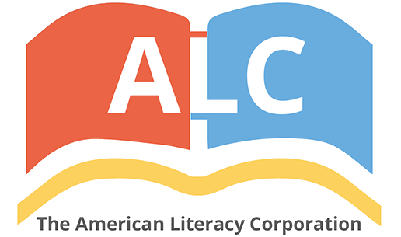


An Assessment of Understanding the Proper Usage of Semicolons in the United States and Implications for K-12 American Literacy.
AFS 2024 - September
Pavel Dimens

Slide 2
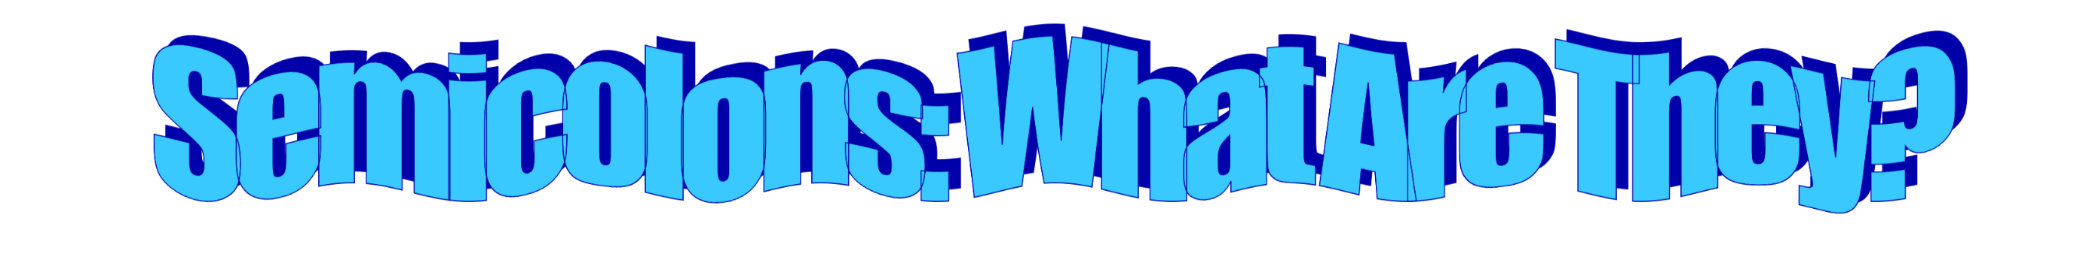
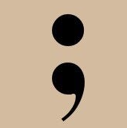
a punctuation mark indicating a pause, typically between two main clauses, that is more pronounced than that indicated by a comma.
When to use a semicolon
Between independent clauses that are not joined by conjunctions and, but, or, nor, for, and yet
Use a semicolon between independent clauses joined by words such as for example, for instance, that is, besides, accordingly, moreover, nevertheless, furthermore, otherwise, therefore, however, consequently, instead, and hence.
To separate phrases or clauses that already have commas
Building a career takes time; moreover, it requires dedication
Annika was partying all night; she felt sluggish the next day
We came up with a movie watchlist, which includes Love, Rosie; Good Morning, Vietnam; and Eat, Prey, Love.

Slide 3

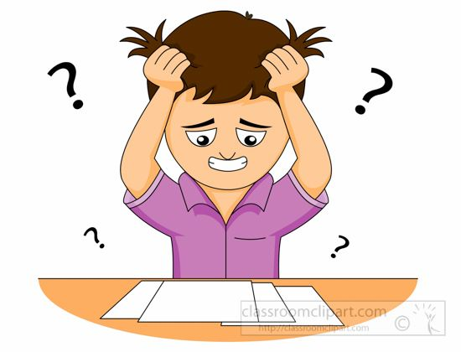
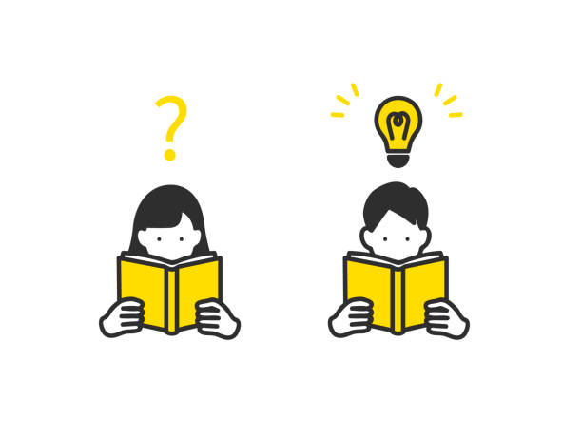

Are people more or less semicolon literate?
Why have semicolon searches plateaued?
Does the early absence of semicolon searches suggest people knew how to use semicolons more prior to 2007?

