Slide 1
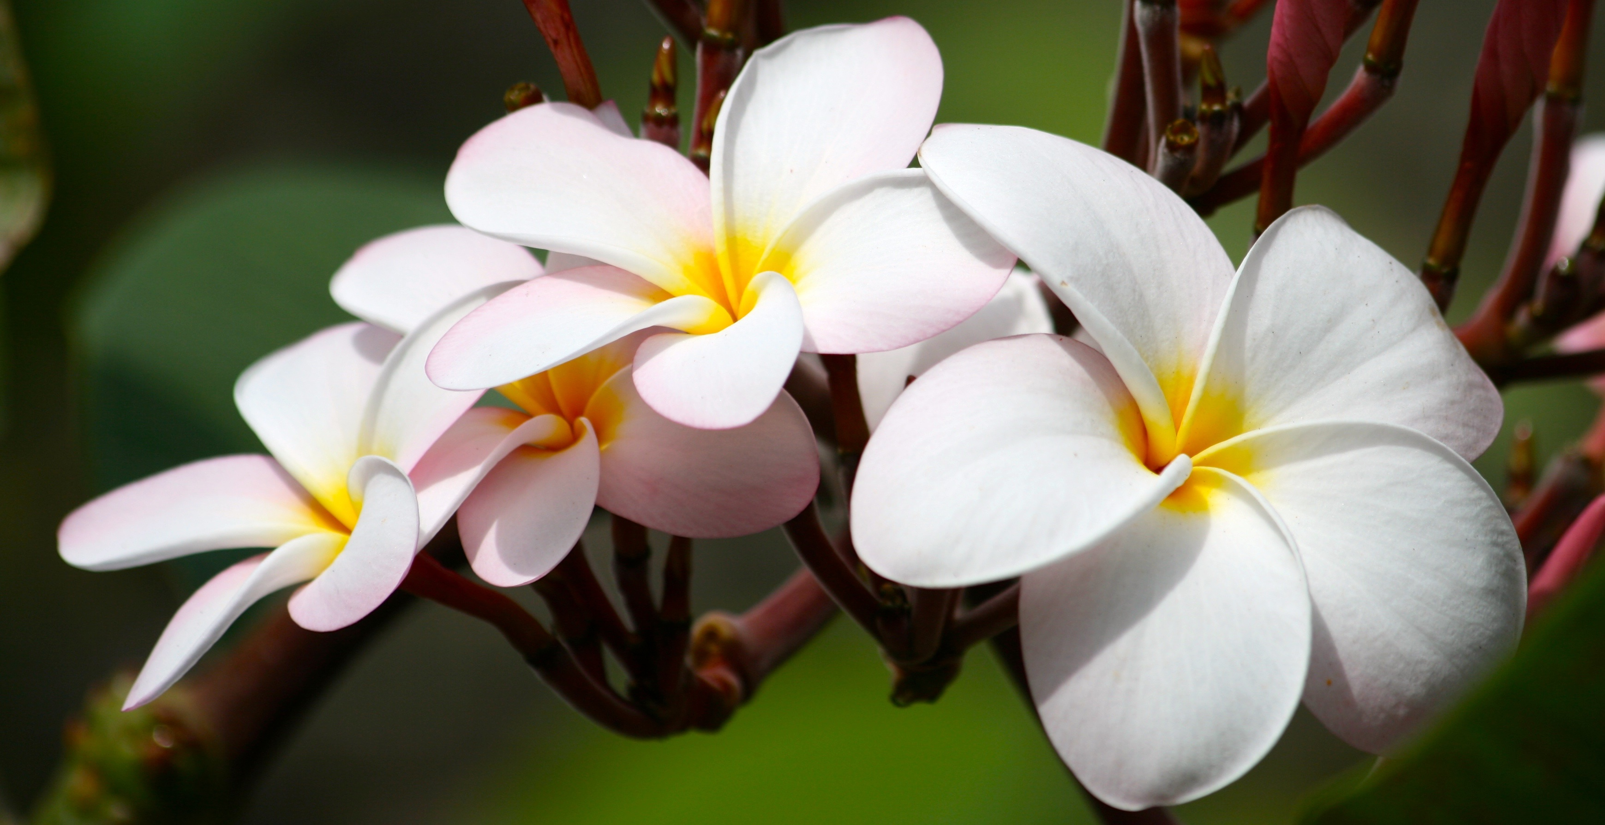
PLUMERIA IN HAWAII
AFS Workshop September 2024

Slide 2
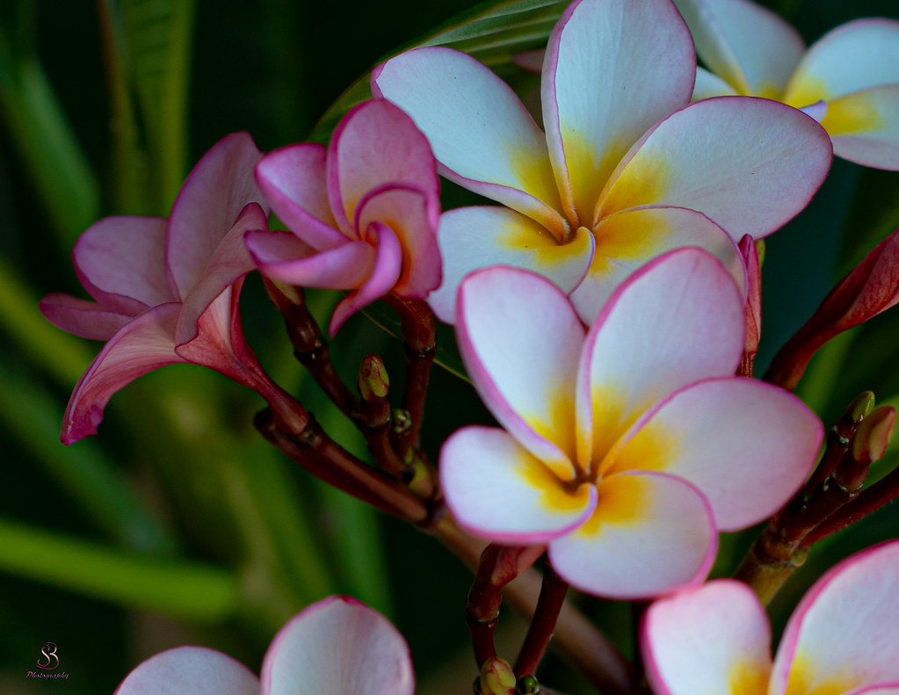
Where are plumeria from?
Plumeria are not native to Hawai’i. They were brought to Hawai’i in 1860.
Plumeria are endemic to Mexico, Central America, and the Caribbean

Slide 3
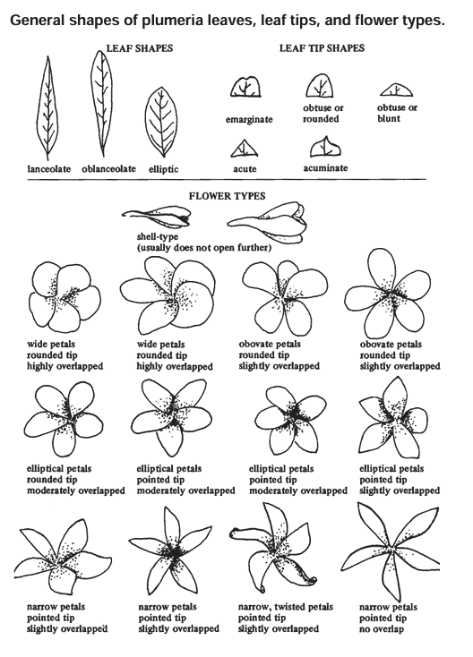
Characteristics of plumeria
SMALL TREES, GROW UP TO 30 FT
flower in early summer to fall
Deciduous Types Loose All Leaves In The Winter But Plumeria Obtusa And Its Hybrids Keep Their Leaves Year-round
flowers have 5 2-3 in petals that spread out in a pinwheel shape
Figure 1. Plumeria leaf and flower characteristics (Criley, 2005)

Slide 4
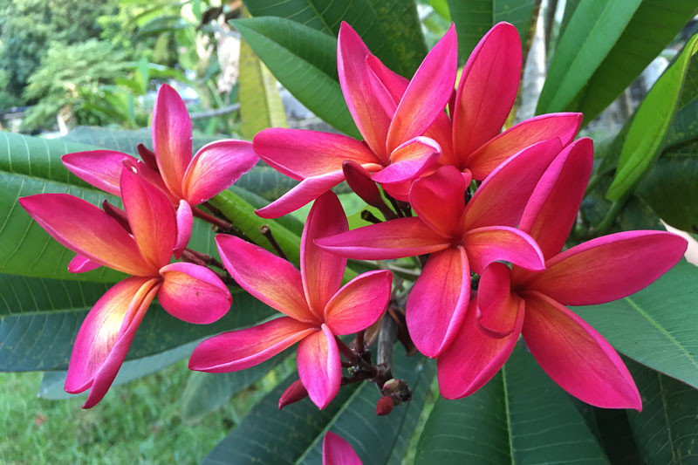
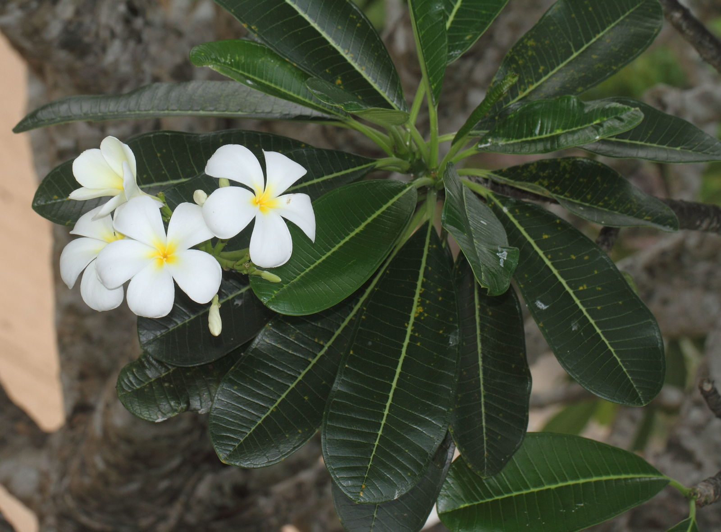
Species of Plumeria
Plumeria obtusa
Plumeria rubra

Slide 5
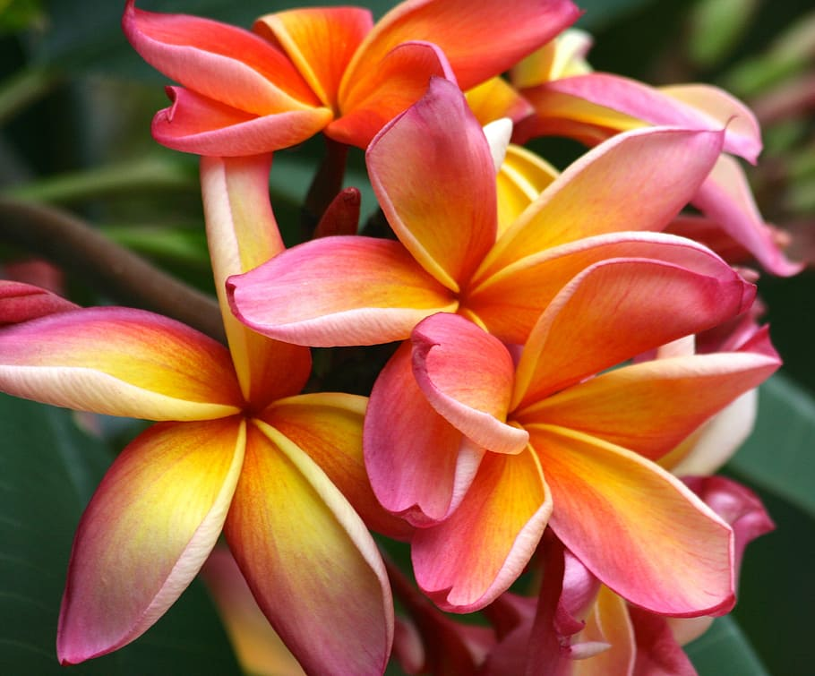
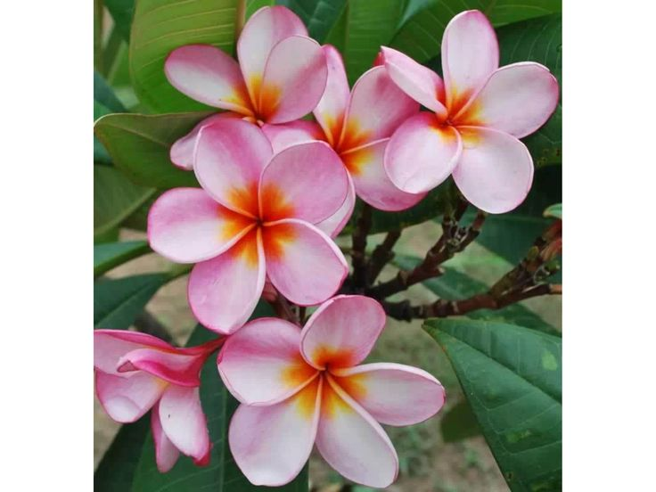
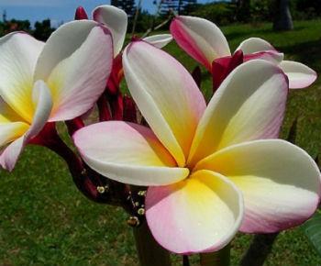
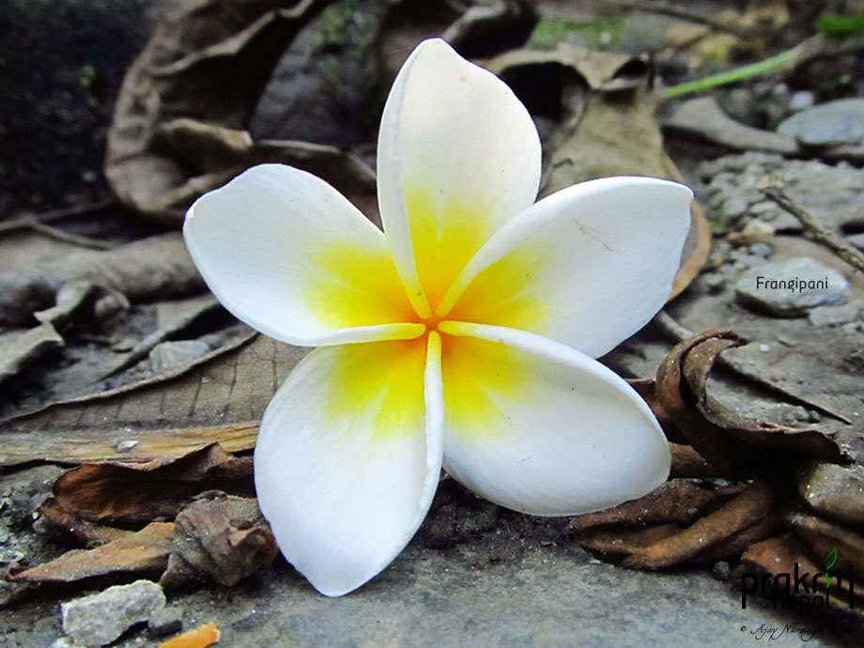
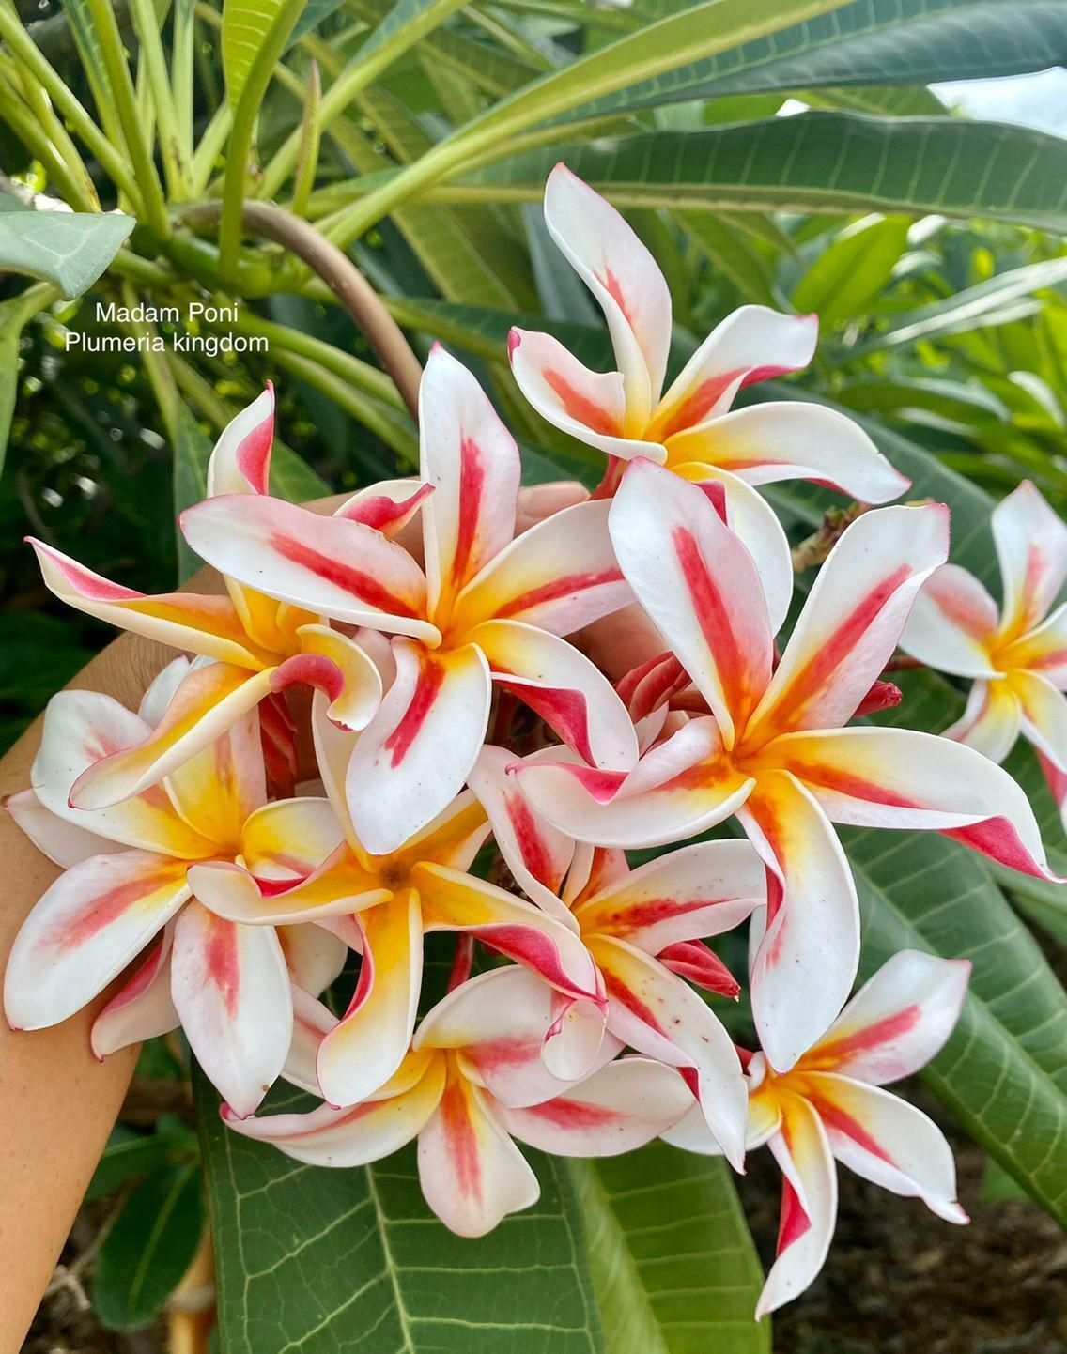
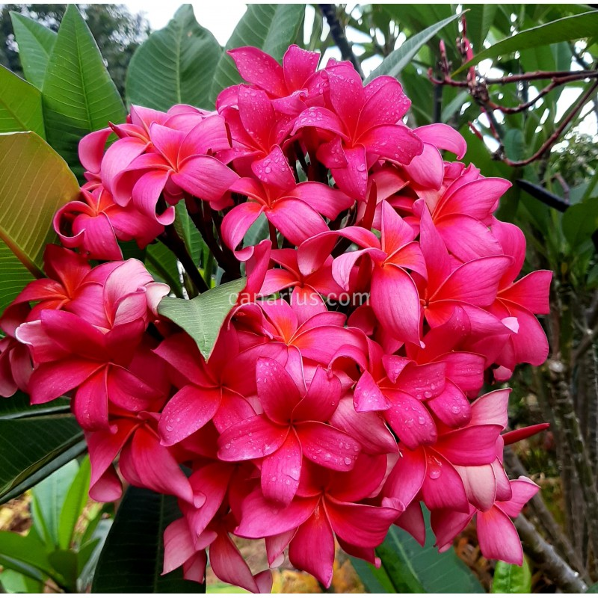
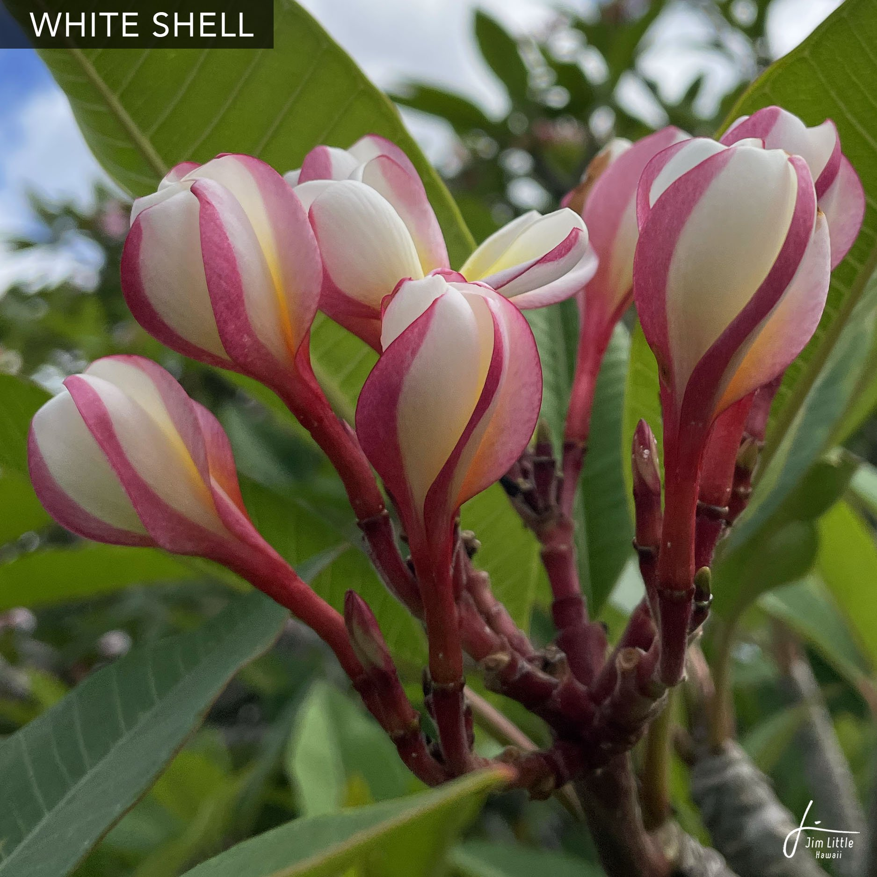
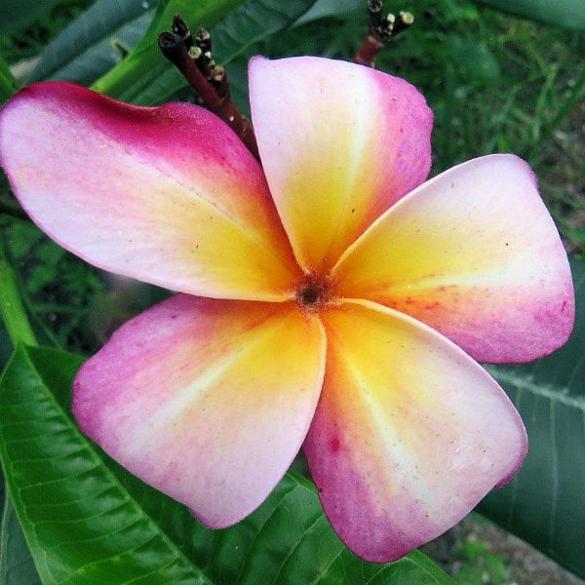
Varieties of plumeria
Pauahi Ali’i
Carmen
Common yellow
Mela matson
Madame Poni
Japanese Lantern
Peach glow shell
Duke

Slide 6
 | Mean Petal length | Number of petals | Color | Sample date
1 | 5.32000 | 5.0 | Pink | 10/1/23
2 | 4.32000 | 5.0 | Pink and white | 10/1/23
3 | 4.56000 | 5.0 | Yellow and white | 10-1-23
4 | 7.40000 | 5.0 | Pink | 1/10/23
5 | 6.33000 | 5.0 | White and pink | 10/1/23

Slide 7
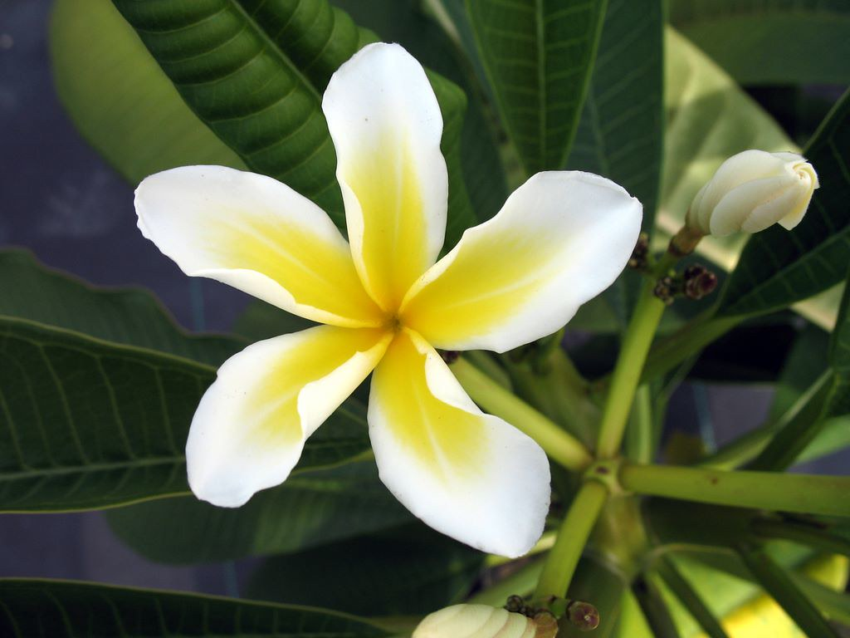
References
https://growplumeria.com/plumeria-in-hawaii/#types-of-plumeria-from-hawaii
Criley, R.A. 2005. Plumeria in Hawai’i. Ornamentals and Flowers, OF-31. https://www.ctahr.hawaii.edu/oc/freepubs/pdf/of-31.pdf

