Slide 1

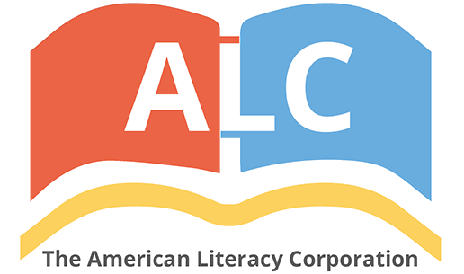


An Assessment of Understanding the Proper Usage of Semicolons in the United States and Implications for K-12 American Literacy.
AFS 2024 - September
Pavel Dimens

Slide 2
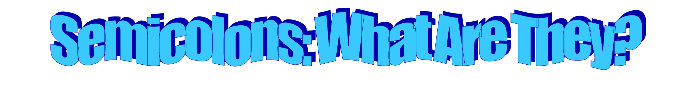
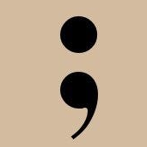
a punctuation mark indicating a pause, typically between two main clauses, that is more pronounced than that indicated by a comma.
When to use a semicolon
Between independent clauses that are not joined by conjunctions and, but, or, nor, for, and yet
Use a semicolon between independent clauses joined by words such as for example, for instance, that is, besides, accordingly, moreover, nevertheless, furthermore, otherwise, therefore, however, consequently, instead, and hence.
To separate phrases or clauses that already have commas
Building a career takes time; moreover, it requires dedication
Annika was partying all night; she felt sluggish the next day
We came up with a movie watchlist, which includes Love, Rosie; Good Morning, Vietnam; and Eat, Prey, Love.

Slide 3

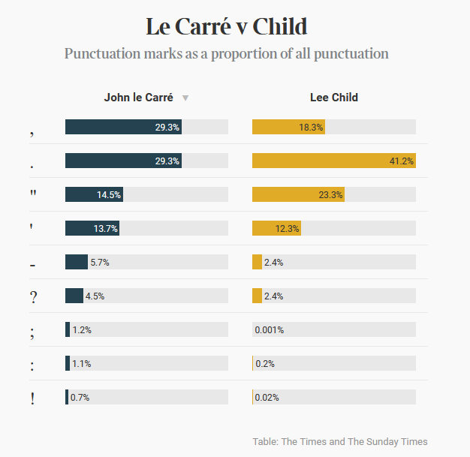
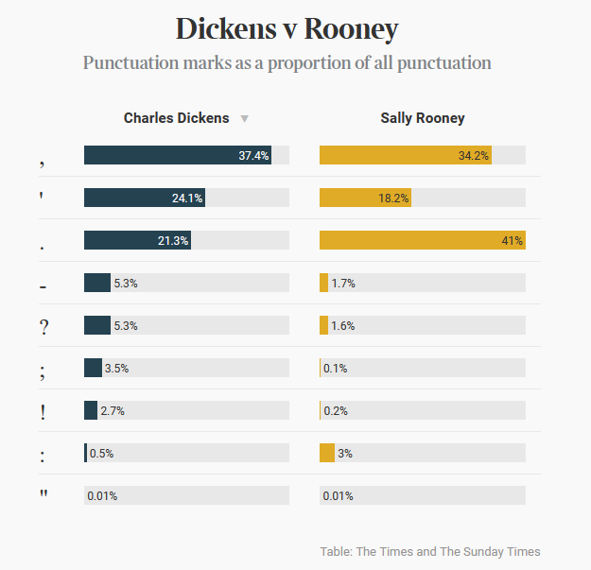
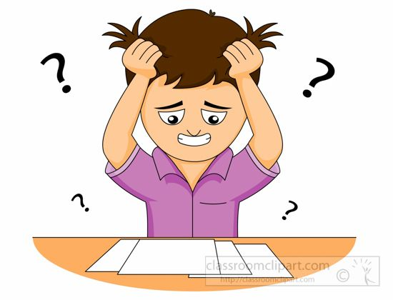
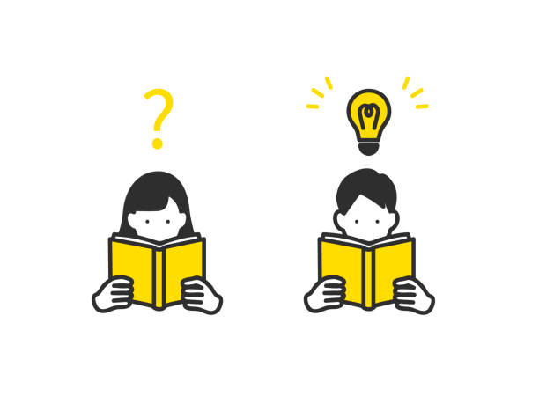

Are people more or less semicolon literate?
Why have semicolon searches plateaued?
Does the early absence of semicolon searches suggest people knew how to use semicolons more prior to 2007?

Slide 4
Conclusions
It’s not clear from the data, but the increase in searches for semicolons would suggest fewer people know what they are. However, it’s possible that this uptick in searches is correlated with the adoption of the internet and search engines at large. BUT, semicolon use has dropped in English-language literature since 1800, upwards of 70%.
Acknowledgements
First and foremost, I want to thank the funding agencies that make this work possible, including but not limited to: Google, Microsoft, National Institutes of Health, and the Cornell University STAR program.
I also want to thank my advisor, Nina Therkildsen, lab manager Harmony Borchardt-Weir, and my technician Azwad Iqbal.

