Slide 1
User research summary – Authenticate and Admin portal
March 2020 (Sprints 15 and 16)
Most recent research conducted on version 7 of the prototype
Link to prototype - https://authenticate-admin.herokuapp.com/
Passwords: nimda-etacitnehtua

Slide 2
Contents
Demographics
Methodology and recruitment strategy
Evidence based design iterations
Next steps

Slide 3
Demographics
User Role | Number of users spoken to
System admin
Service admin
Organisation admin (L3) | 7
Service users (L4)
Total | 7
Services represented: 1 Health, 1 ESF, 5 PRAP
We’ve interviewed 7 individual users in addition to the 22 interviewed in Feb on the same terms.

Slide 4



Recruitment and Methodology
Remote research with system and service admins
Skype and telephone
Recruitment Methods
DWP service teams introduced us to their contacts within organisations, we then recruited people via email
Icons made by <a href="https://www.flaticon.com/authors/freepik" title="Freepik">Freepik</a> from <a href="https://www.flaticon.com/" title="Flaticon"> www.flaticon.com</a>

Slide 5
Findings
Headline insights:
Naviagtation and scenario tasks were unproblematic
Email understood and easily acted upon
Some explanation of QR download process called for
Searching options of the user list did not meet user expectations
More explanation/development of status categories called for by 2/7 users
Other findings corroborated previous research findings in terms of general usability, ease of understanding and navigation

Slide 6
Evidence based design iterations
Email

Slide 7
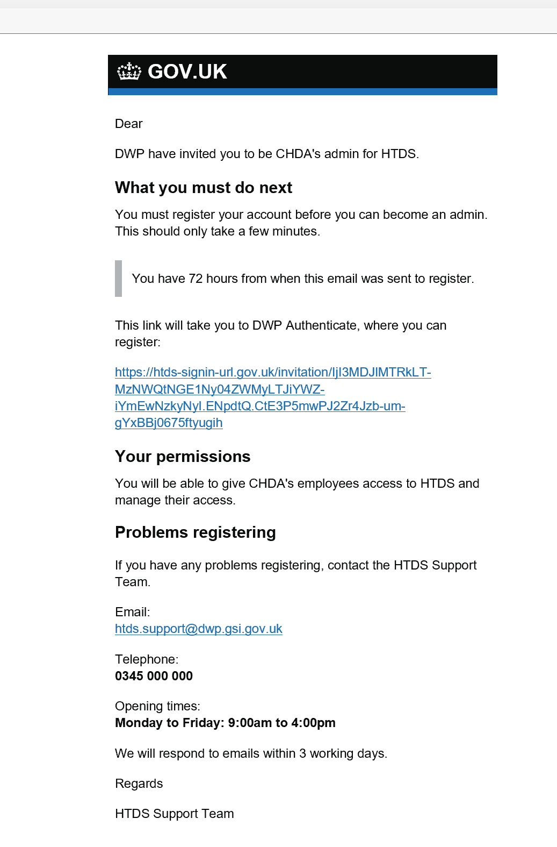
Email
“Very straightforward”
U24

Slide 8
Evidence based design iterations
Two factor authentication

Slide 9
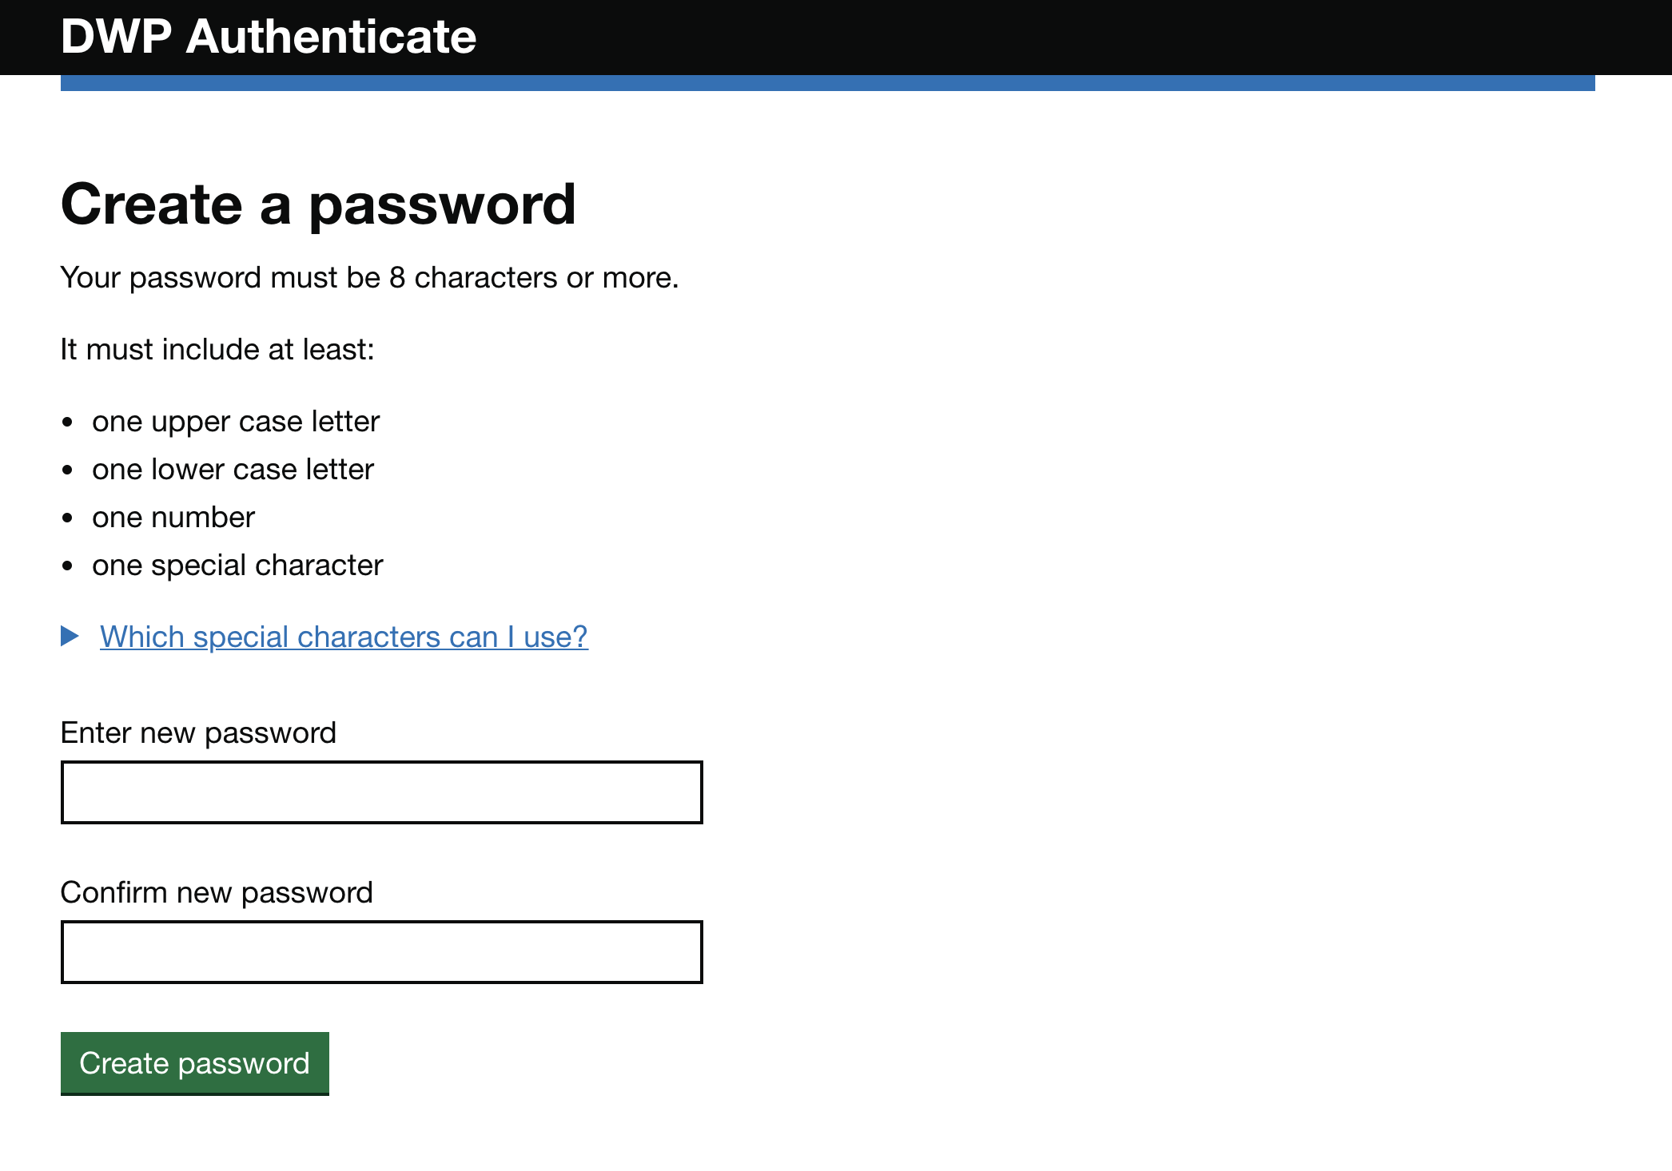
Create a password – Version 7
All users set a password first or second time with ease.
Users flew through this….
Slight hesitation with U24 & U27 over configuration of password

Slide 10
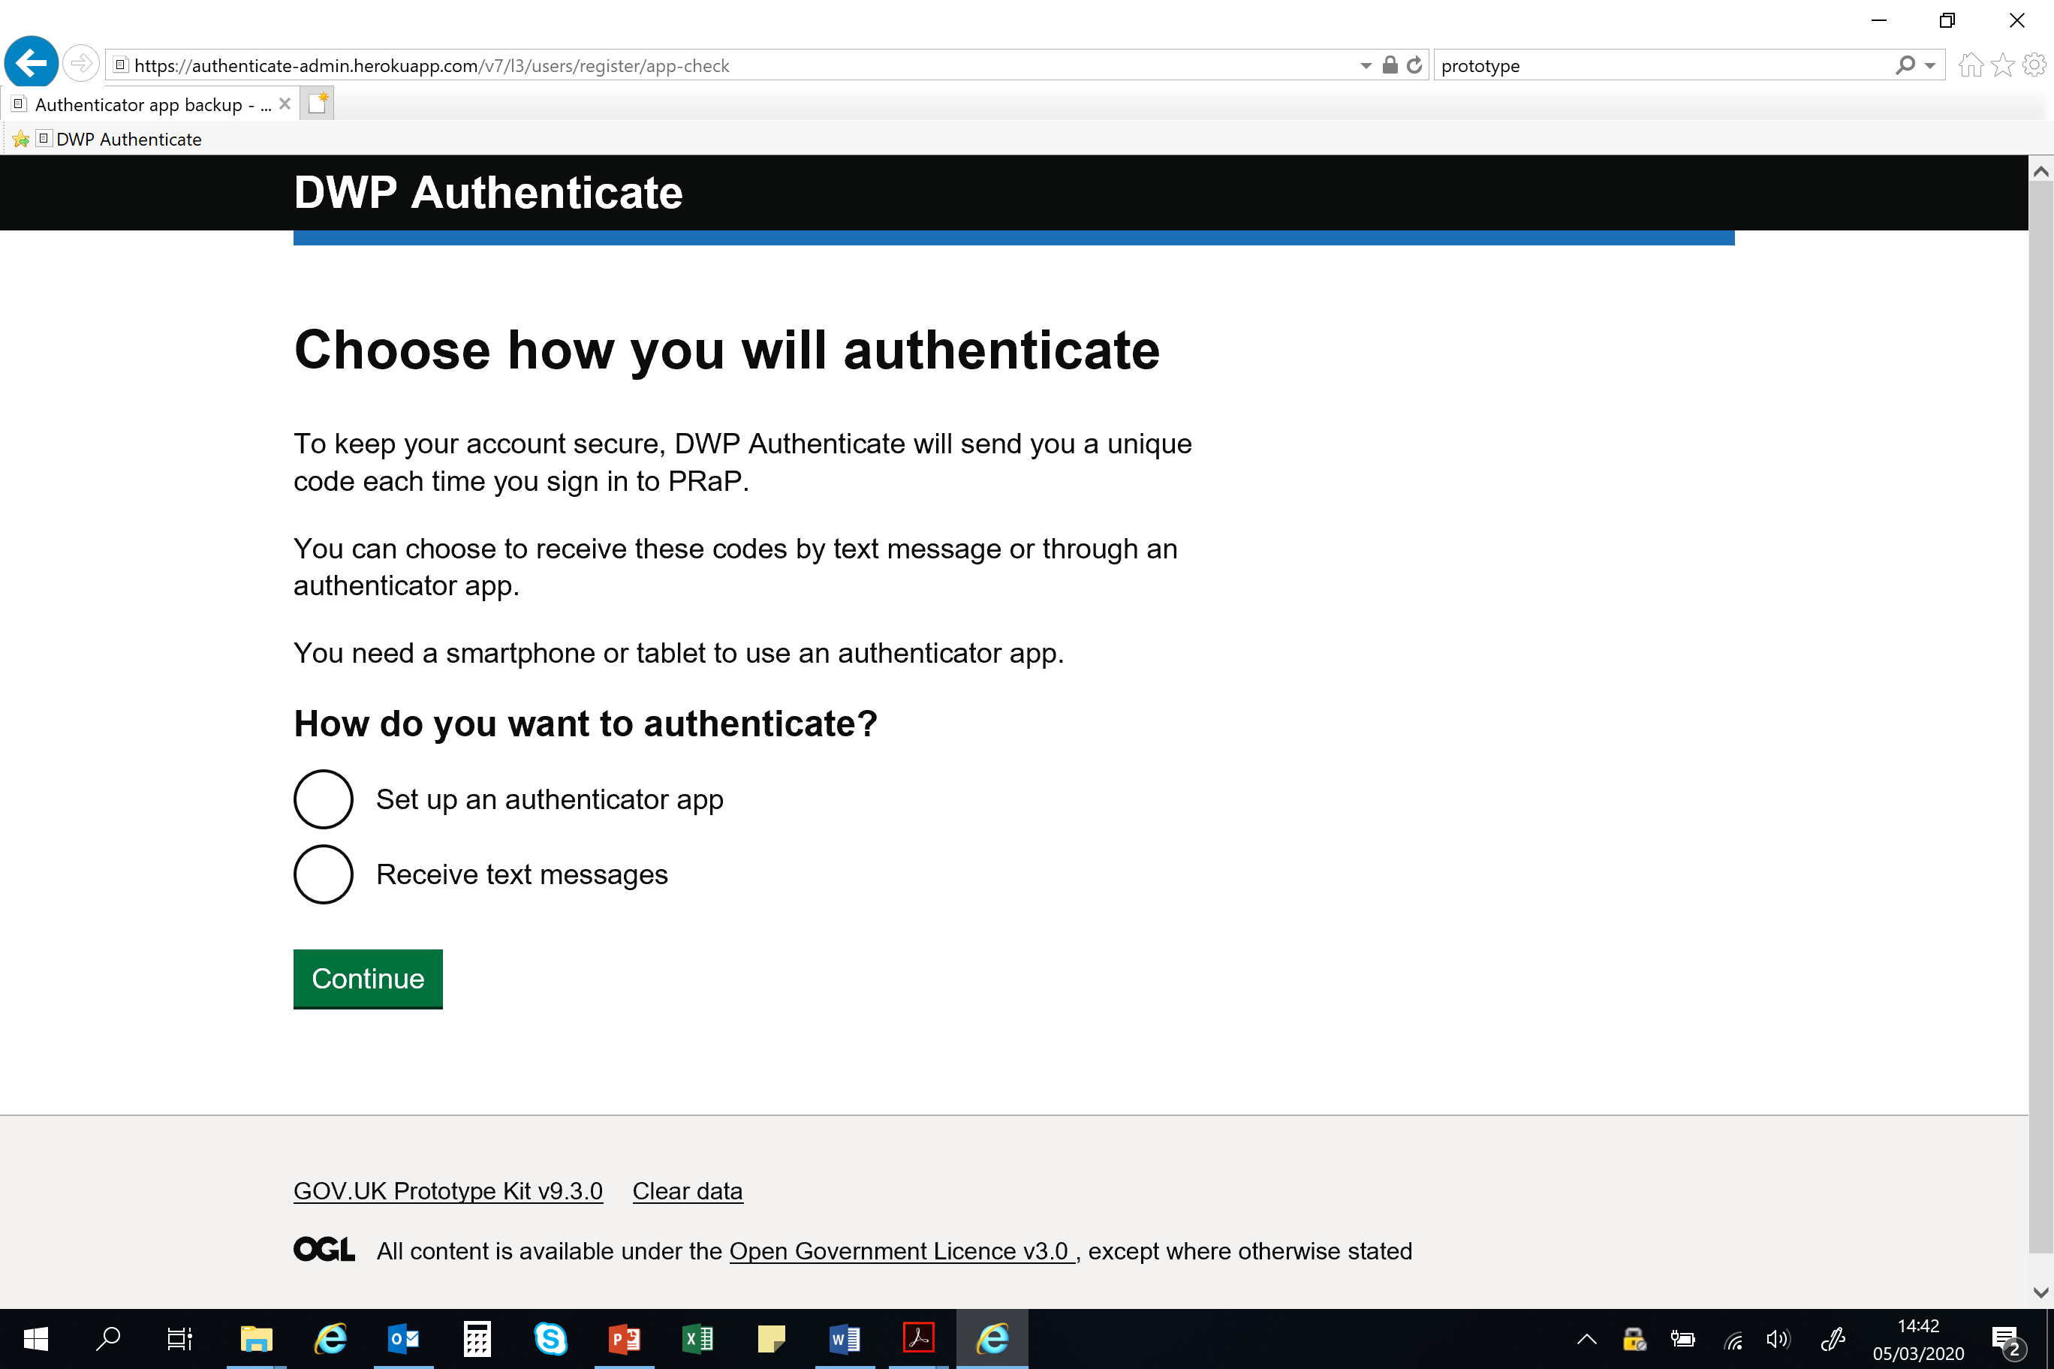
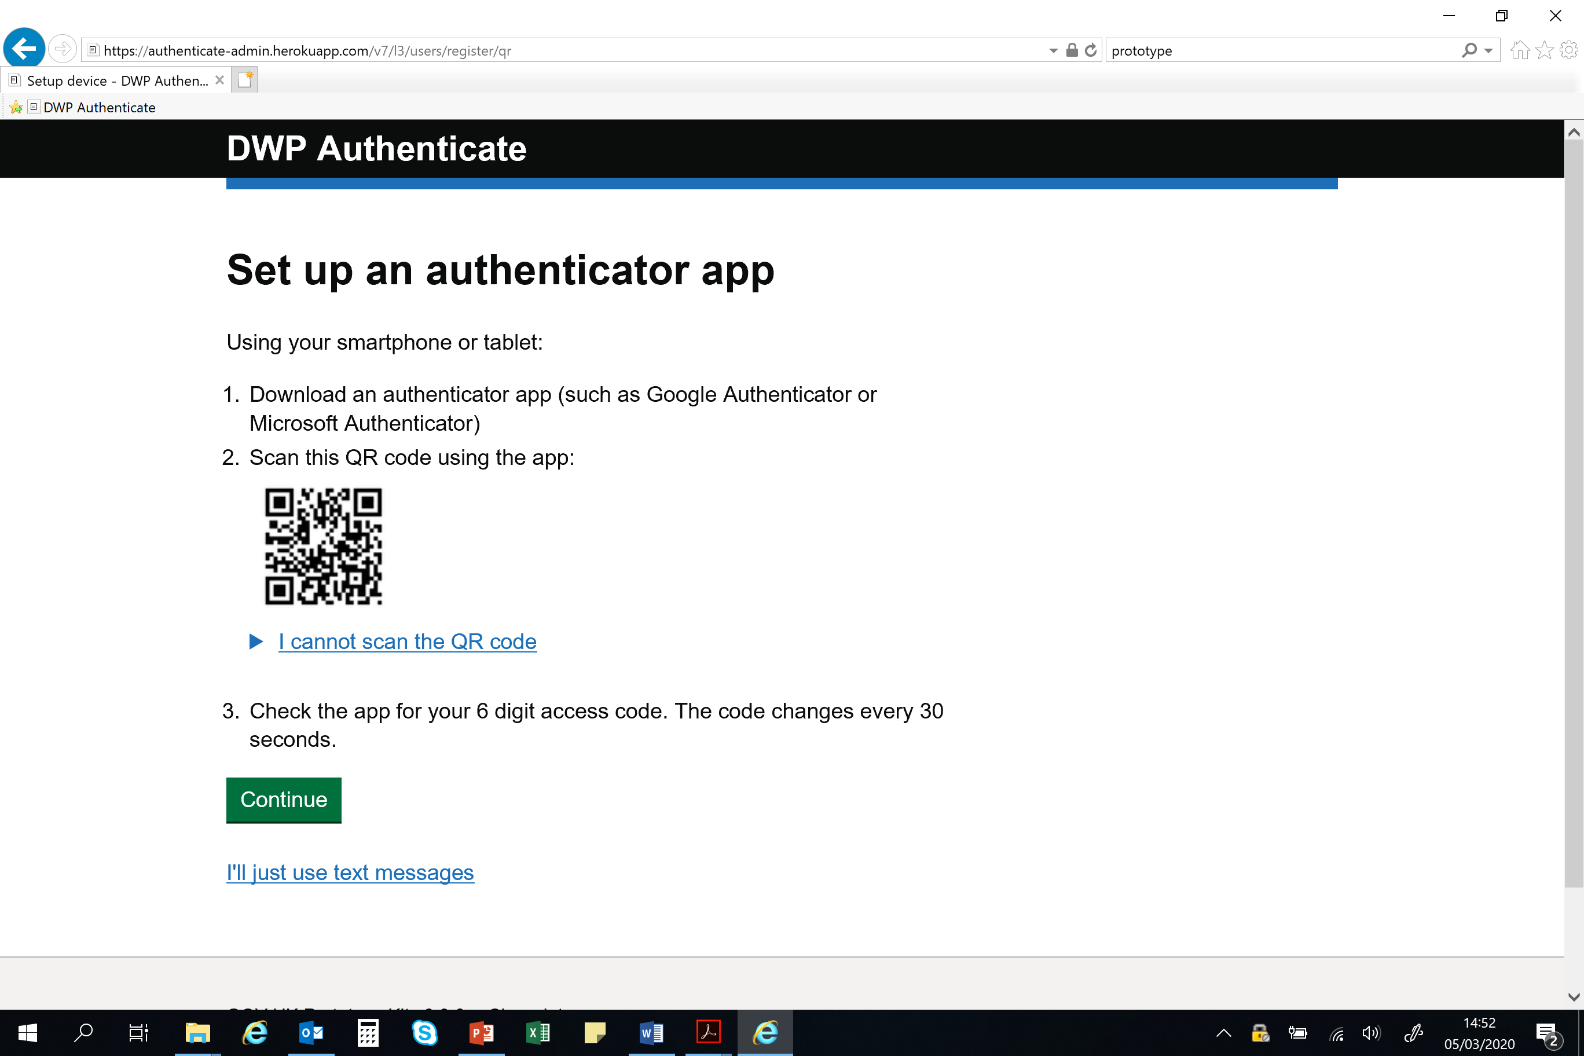
Users showed familiarity with each option. Would select according to current behaviour:
1/7 chose Authenticator App
Analytics show that when given the option within the live service, the majority of users use text message
“Ooh! I’ve never set up an app on my work phone”
U24
1/7 selected “App” option: “It’s good for mobile”
U23
“I’d want to see how to do it…. Oh there it is on the next page”
U24
User notes lots of “Authenticate” apps on his App store list.
U24
Iteration, consider adding signpost/hint text/link to app set up instructions

Slide 11
Evidence based design iterations
Landing page

Slide 12
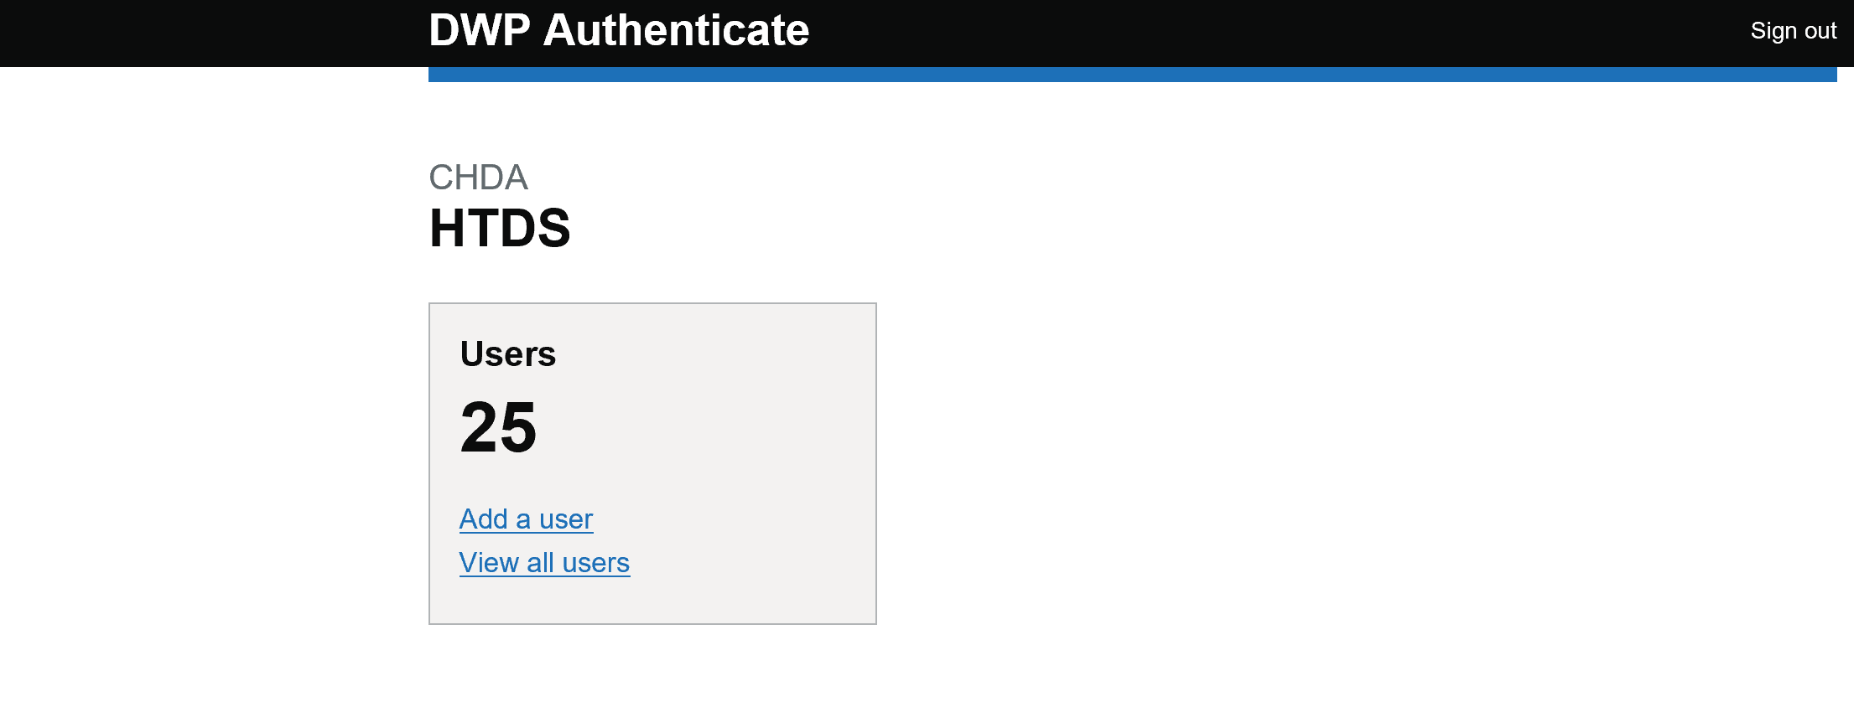
Landing page was unproblematic
Some sense that users found this a useful orientation
Notes:
When setting tasks for users - e.g. find a restore access for Steve Hodge - Users had no hesitation navigating through ‘view all users’

Slide 13
Evidence based design iterations
Filter, Sort and Search

Slide 14
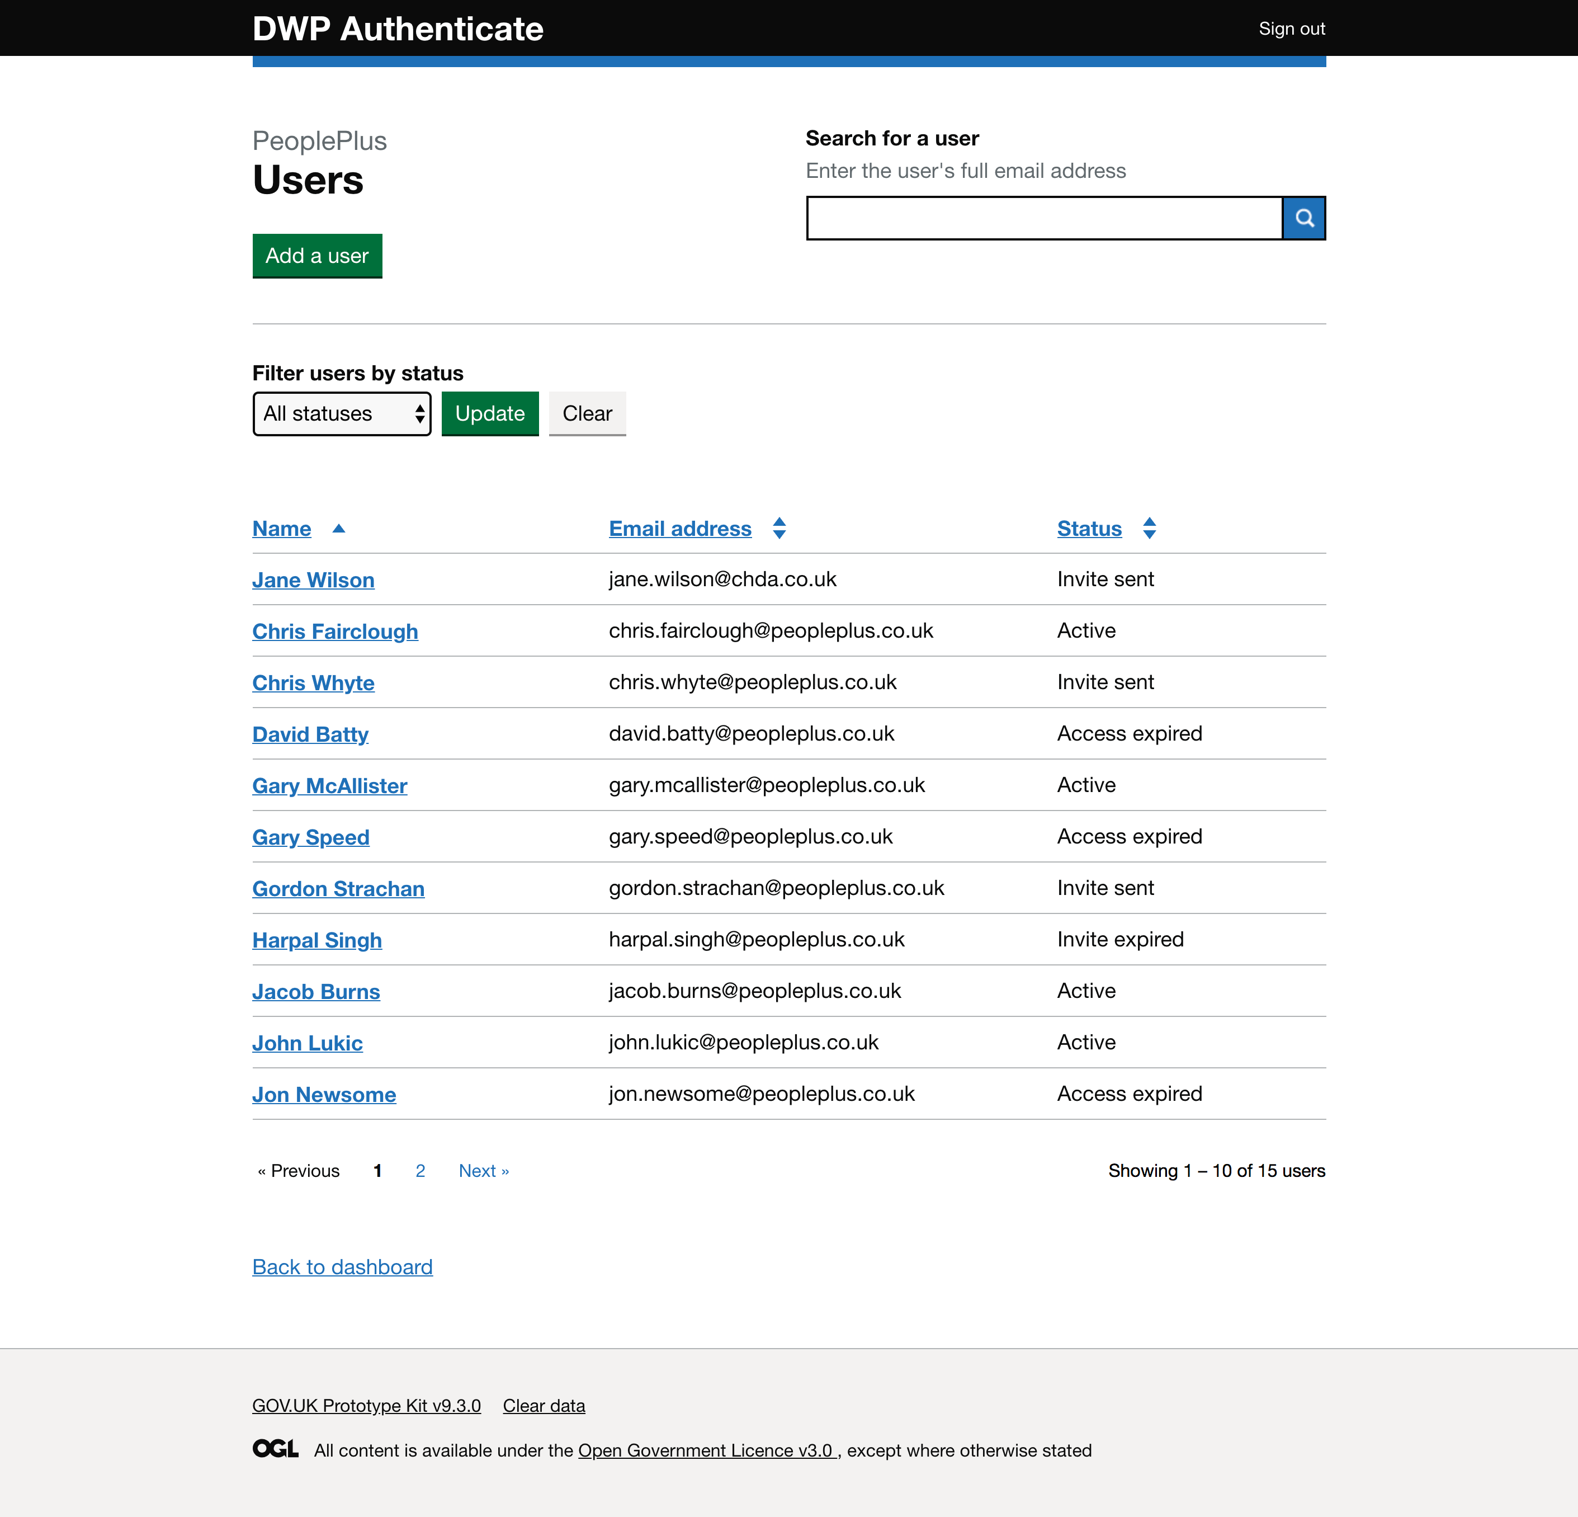
Filter– Version 7
Users understood the filter and sort functionalities on the version 7 prototype
2/7 Users pointed out naming conventions vary between organisations
U23, U27
Having searched manually, user did not initially notice filter tool
U24, U25
2/7 users declared preference to search by surname
U24, U27
User suggested being able to filter out (e.g. expired users) would be useful
U24
Iteration: Test naming preference with larger organisations
Notes:
PRAP users have short lists, rendering search functions largely redundant.

Slide 15
Sort– Version 7
Users understood the column sorting functionalities on the version 7 prototype
User attempted to use sort toggles unprompted
U24
User understood column sorting
U24, U25
Users tended not to filter by toggles unless prompted to do so.
User suggested up to 30 lines would be preferable for greater data visibility
U24
Iteration: Add more pages to test
Notes:
PRAP users tend to be lists of less than 20.
U25 told us, “There are 12 people in my team. I know them. I’m on first name terms with them. I know I’ve got a Chris, a Tiffany and a James..”

Slide 16
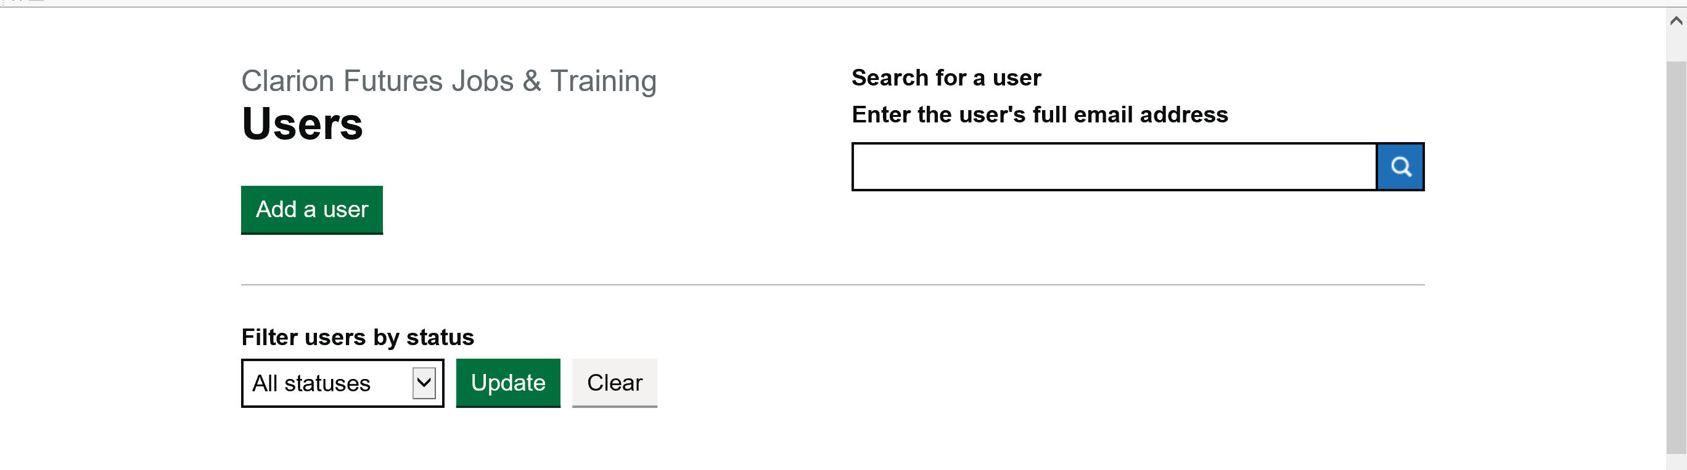
Search– Version 7
The requirement to submit a full email address was not noticed
We saw alternative search strategies used ahead of the Search option
1 – Manual paginated scrolling (small list on this prototype version)
2 – Attempt to use ‘sort’ toggles (not enabled on this prototype version)
3 – Use of Control F (P24’s current method)
User did not independently notice Search box
U24
Users attempted to search for “first name only”
Rejected full email requirement
U23, U24, 26, 27
“I wouldn’t use that [full email search]”
U24
“It’s pointless. Irrelevant… You’ve only done half the job”
U25
Iteration 1: For UR: Populate list beyond two pages as this skews user behavior towards manual pagainated searching
Iteration 2: Review Mongo options, otherwise, suggestion is to not proceed with search box as-is

Slide 17
Evidence based design iterations
Status

Slide 18
Statuses – Version 7
Some users were not entirely confident in their understanding of different status categories
Users wanted more explicit status beyond “User Expired” (see speaker notes)
U23, U24
2/7 users discussed utility of seeing pending approvals
U28, U29
User in a small organization saw no need for location type filtering
U24,U25
User complained “Access Expired” and “Invite Expired” were confusingly similar
U23
Iteration: Monitor status terms
Notes:
There was some confusion around the meaning of different status categories in earlier rounds of MVP1 testing. That was U08 who was confused by “Pending Activation”.
This time, “Access Expired” was understood literally (U23) – someone who had timed out – but discussion of other non-active status categories was provocative. What about cases where the user might be rendered inactive: suspended, removed, maternity leave etc etc?
U25 contradicted this. He said that minimal options suited him. For anything not already listed he felt it would be easy to remove and, when called for, reinstate a user. The same logic accounted for changes of name/email address.
Similar discussion around the visibility – or not – of the status of users who’ve been authorised but not yet approved. Where this was discussed U28, U29 it was seen favourably, albeit not necessarily as a status in this list (landing page suggested)

Slide 19
Overall reactions
“It’ll be a lot easier for us (as we’ll be able to do it for ourselves)” U24
“It’s good. Eight and a half out of ten!” U24
“Very straightforward” U23
Really simple. That’s what you need if you’re only coming back to it once in a blue moon” U25
Notes:
Quotes here reflect the prototype: There is a universal requirement to reduce admin burden via an automated portal.

Slide 20
To consider
More overt explanation of the standalone status of Authenticate (and logging into it)
Possible signposting to QR download instructions
Showing status of users who are authorised but not yet approved. If so where/how?
Implications of users being removed and re-added at a later date (as opposed to simply having access restored). Will this lead to multiple versions of identical users?

