Slide 1
Bayesian Optimization for Automatically Generating Neural Networks to Model Customer Churn
By Patrick Di Rita

Slide 2
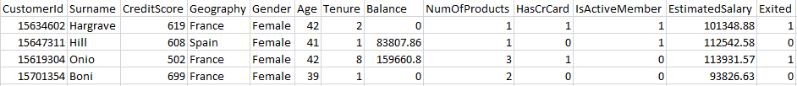
Data
Goal: predict customer churn (exited field) with high accuracy
80/20 train/test split, scaled to standard normal
Training further split into 80/10/10 train/val/hyp sets

Slide 3
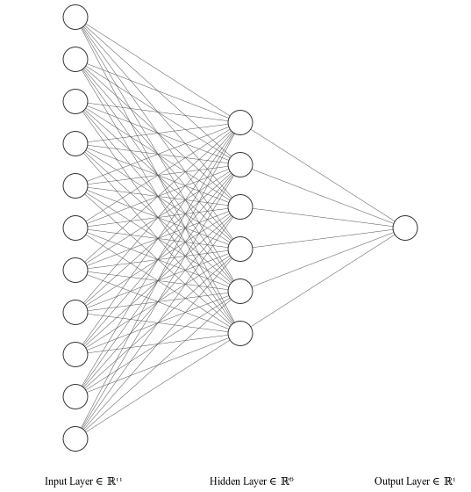
Model: Artificial Neural Network
Control parameters:
ANN:
Input layer: 11 nodes
1 hidden layer: 6 nodes
Dropout: 10%
Activation: Sigmoid
ADAM Optimizer:
Learning rate: 0.001
Batch size: 10
Workers: 4
Weight Decay: 0

Slide 4

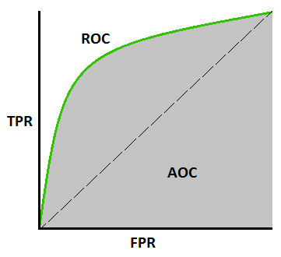
Optimization objectives and evaluation metrics
Model fitting:
Neural network trained to minimize Binary Cross Entropy loss function
Model evaluation:
Trained network evaluated by measuring area under the ROC curve (AUC)
https://towardsdatascience.com/understanding-auc-roc-curve-68b2303cc9c5

Slide 5
Bayesian optimization setup
Goal: use Bayesian optimization to optimize ADAM hyperparameters as well as ANN architecture hyperparameters
Implementation framework: PyTorch, GPyTorch, BoTorch, Ax stack
Surrogate model: Gaussian process with Matern 5/2 kernel
Optimization objective: Maximize AUC on hyp set
Acquisition function:
Control: Expected Improvement
Experimental: Bandit acquisition function

Slide 6
Bayesian optimization setup (cont.)
ADAM hyperparameter search space:
lr: [1e-6, .4] – log scale
batch size: [1, 100]
workers: [0, 16]
weight decay: [0, .5]
epochs: 100 – fixed
ANN hyperparameter search space:
hidden layers: [1, 10]
first hidden dim: [3, 100]
hidden growth: [.1, 2]
dropout: [0, .9]
activation: [ReLU, LReLU, tanh]
SOBOL random initialization
T rounds of Bayesian optimization:
1. Train network on nominated parameterization
2. Evaluate network on hyp set
3. Update model with observation
Train final model using best parameterization on full training data
Evaluate on test set to compare models

Slide 7
Bandit acquisition function
Intuition:
At each nomination step within the Bayesian optimization loop, optimize a set of acquisition functions rather than just one, and choose a nomination from the set with probability proportional to the cumulative rewards of its corresponding acquisition function. In other words, turn the acquisition function choice into its own multi-armed bandit problem
Reasoning:
There is no guarantee that an acquisition function chosen at the beginning of an experiment will remain optimal over the duration of the experiment
Observing points from a set of acquisition functions will lead to greater observation diversity and exploration of the search space

Slide 8
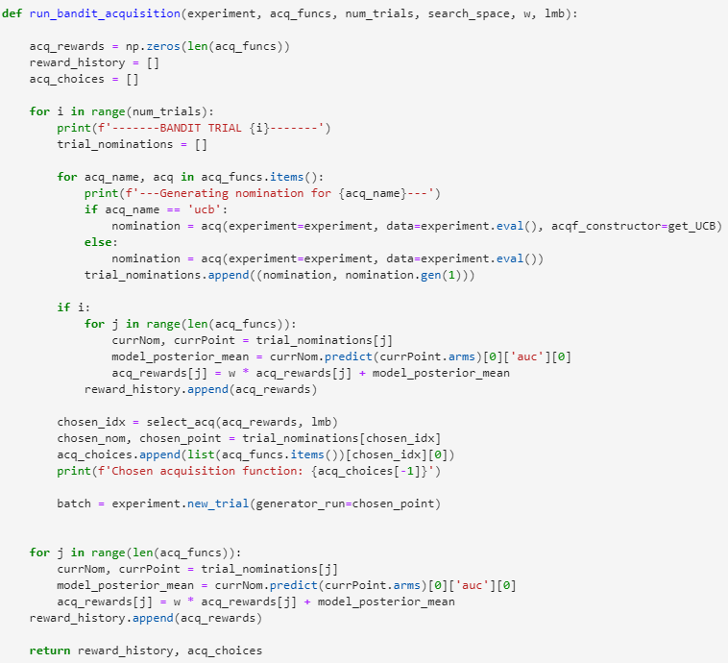
Bandit acquisition function implementation
Optimize all acquisition functions and get their nominations
Update reward history based on cumulative rewards of each acquisition function
Choose a nomination with probability proportional to cumulative rewards
Add chosen nomination to experiment and evaluate at that point

Slide 9
Results and analysis
Control Architecture + Control ADAM: 0.8569
Control Architecture + Optimized ADAM (EI): 0.8650
Optimized Architecture + Optimized ADAM (EI): 0.8709
Optimized Architecture + Optimized ADAM (Bandit): 0.8734
Optimal parameters:
ANN: ADAM Optimizer:
Hidden layers: 5 Learning rate: 0.00169
First hidden dim: 15 Batch size: 65
Dropout: .082 Workers: 5
Hidden growth: 1.779 Weight Decay: 0
Activation: TanH

Slide 10
Conclusion
Bayesian optimization is a viable and efficient option for neural architecture search and hyperparameter optimization
The proposed bandit acquisition function was able to outperform vanilla Expected Improvement, confirming the original hypothesis
The improvement was not by a huge margin, but the bandit-optimized model performed better than any other models found on Kaggle
Further work is to apply this same framework to a harder dataset, as ANNs reach the limit of this dataset very easily

Slide 13
f

