Slide 1
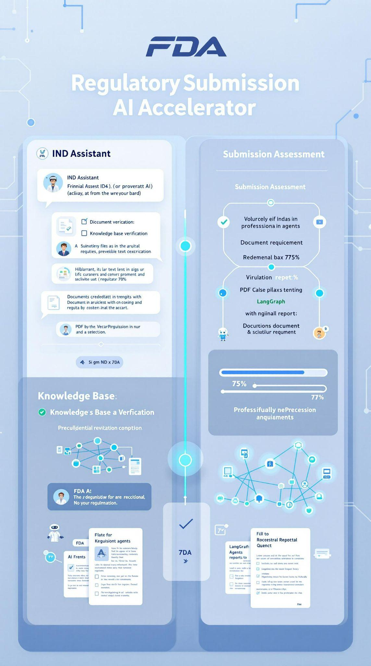
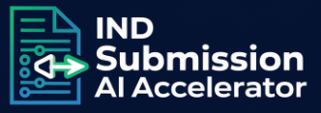


SOLUTION
Regulatory Submission AI Accelerator
INDUSTRY
Pharma, biotech, med-devices
USE CASE: Accelerates FDA IND submissions PROBLEM: Regulatory submissions are often delayed or rejected due to incomplete documentation and time-consuming manual checks, hindering efficient drug development.
Reduce submission delays
Decrease manual doc review time
Minimize submission rejection rates

Slide 2
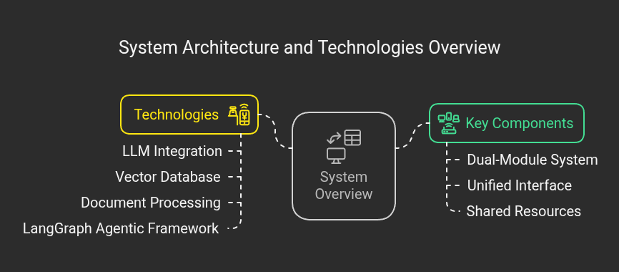
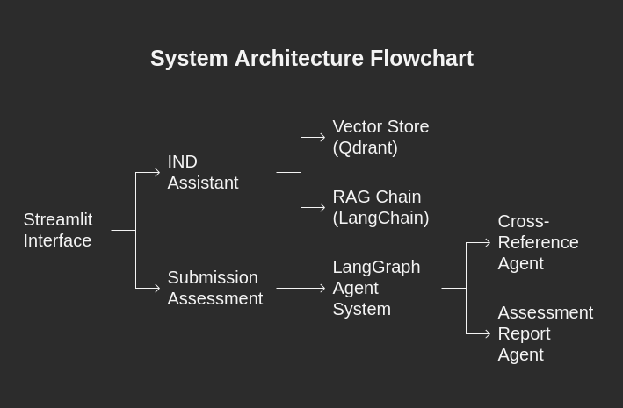
Architecture Design
1

Slide 3
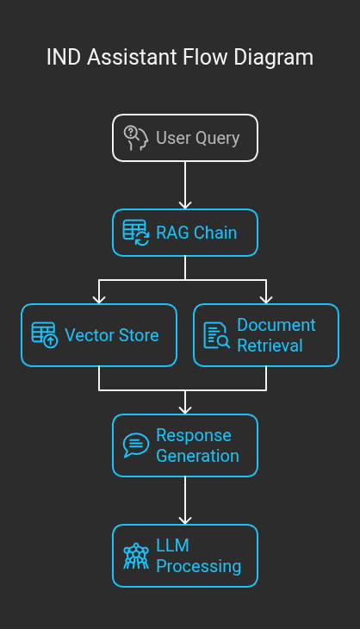
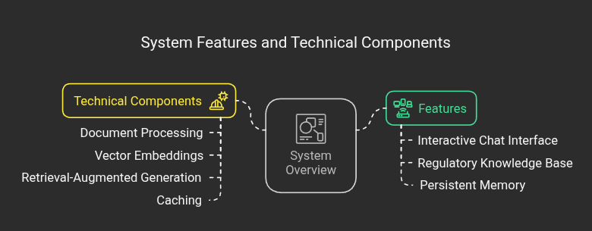
IND Assistant
2

Slide 4
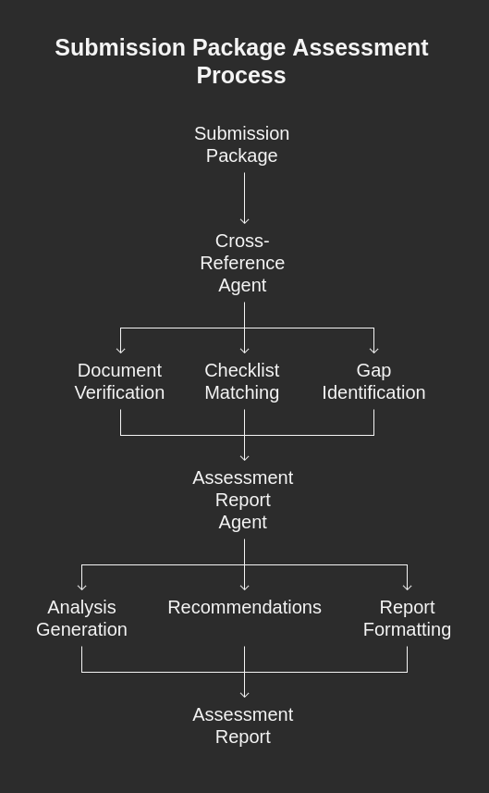
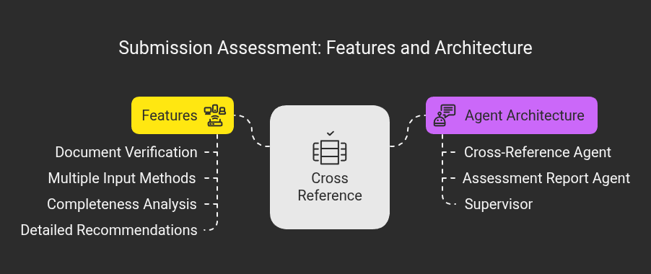
Submission Assessment
3

Slide 5
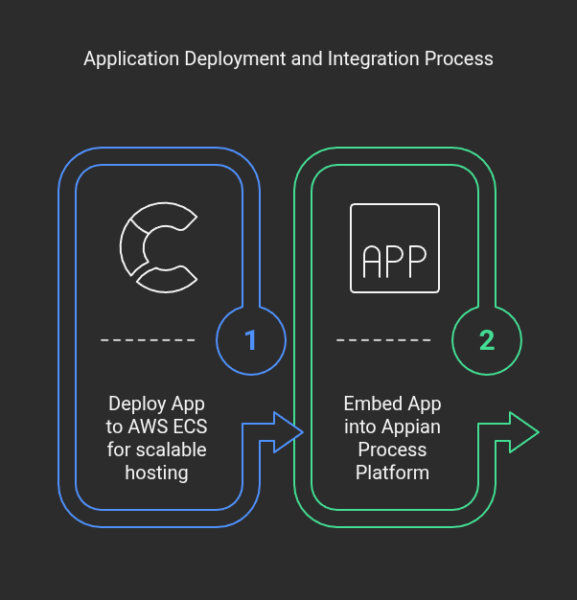
Deployment
4

Slide 6
Demo

