Slide 1
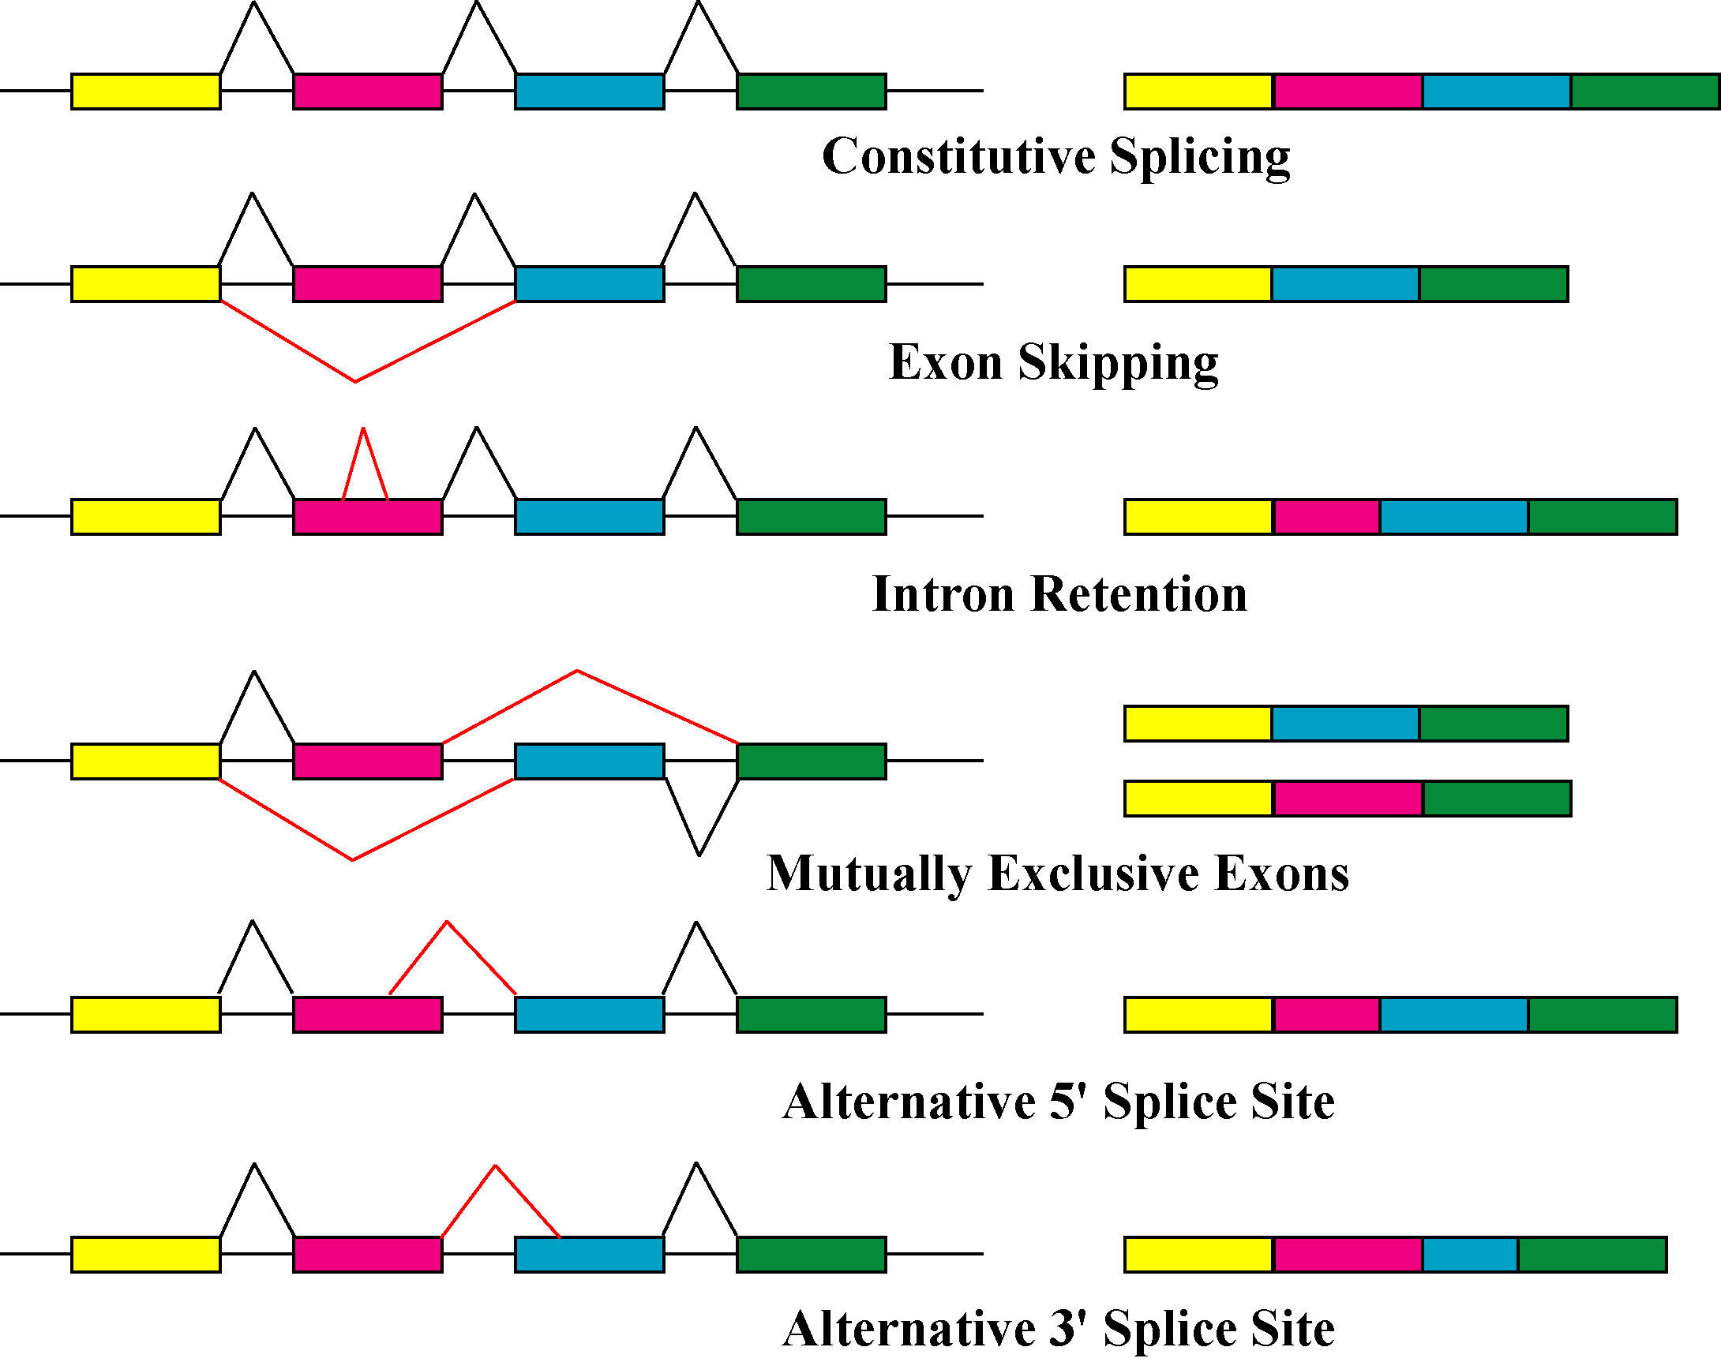
Alternative Splicing
  Alternative splicing (AS) is a post-transcriptional regulation mechanism that allows a single gene to produce multiple mRNA transcripts.
  AS can regulate gene expression in response to environmental stimuli and developmental changes.
  Variants of AS may be nonfunctional and quickly degraded, providing gives cells a mechanism to regulate gene expression after transcription.

Slide 2
NGS Design
Splicing analysis requires more input data than gene expression analysis because a given gene often has several splice isoforms.
A sequencing read can map anywhere along a gene and count towards expression, but a read must include the AS region to count towards splicing analysis.

Slide 3
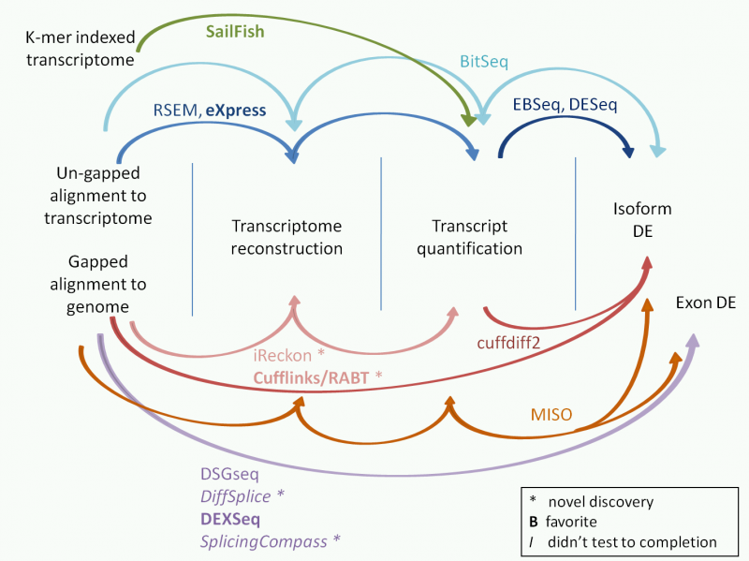
Splicing Detection
    2 Classes of Programs used here:
  Exon-centric programs
    Count-based models usually configure each gene into a single representation consisting of counting units.
    Counting units can be full or truncated exonic regions (DEXSeq), or junction regions (MATS).
  Isoform modelling programs
    Take all the reads that have been mapped onto a gene and distribute them between the isoforms.
    Produce a probabilistic model of the frequency of each isoform in the original sample.

Slide 4
Cufflinks (Pachter, UC Berkeley)
Assembles and quantifies the aligned reads and performs differential testing between samples/conditions.
Uses a linear model which includes a specific parameter for fragment length allowing it to take advantage of insert size information in paired-end data.
Performs tests for relative isoform abundance changes using a one-sided t-test of the Jensen-Shannon Divergence metric.
Pros:
  Can incorporate novel splicing events that it discovers in the mapped sequencing files
  Incorporates the statistical power of multiple samples and/or biological replicates.
Cons:
  Splicing results gives no indication of the exons/junctions involved
  Biased against genes with many isoforms.
  History of version differences.

Slide 5
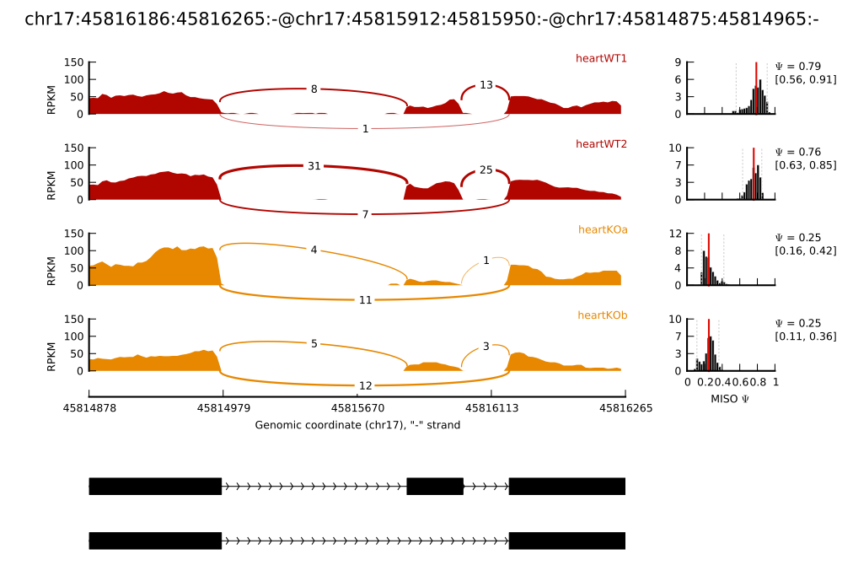
MISO (Burge, MIT)
This uses a probabilistic framework that quantitates the expression level of alternatively spliced genes.
Identifies differentially regulated isoforms or exons across samples.
Uses Bayesian inference to compute the probability that a read originated from a particular isoform.
Quantifies the abundances of the underlying set of alternative mRNA isoforms.
Pros:
  Provides detailed information on the detected splicing differences such as which exon/junctions are involved
  It can recognize the type of alternative splicing
Cons:
  Lacks statistical methods for handling groups of samples

Slide 6
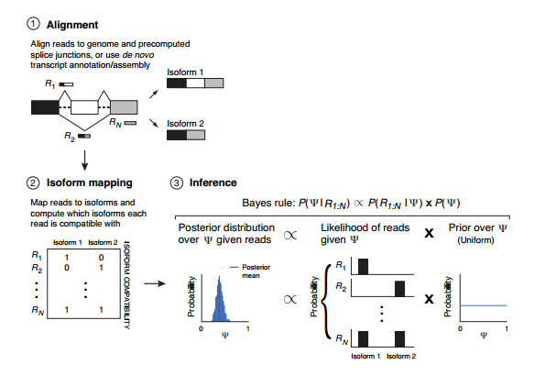
MISO (Burge, MIT)
Reads are aligned to the genome and a set of junctions are either precomputed or discovered de novo using transcript annotation/discovery tools. Aligned reads are then mapped to isoforms, shown here for the case of a skipped exon, and represented as binary matrices that correspond to their compatibility with isoforms. Each each row i in the isoform compatibility matrix corresponds to a read, and each column j to an isoform, where the ijth entry is 1 if read i is consistent with isoform j and 0 otherwise. In this example, read R1 is consistent only with the inclusive isoform (containing the white exon), R2 consistent only with the exclusive isoform (excluding the white exon), while RN consistent with both. Inference is performed by computing a probability distribution (the posterior) over Ψ (Percentage Spliced In) given the reads. Bayes’ rule states that this distribution is proportional to the product of our expectation about the value of Ψ (the prior, here taken to be uniformly distributed over [0, 1]) and the likelihood of observing the reads given Ψ (the likelihood). By summing over all possible assignments of reads to isoforms, weighting each assignment by its probability, the posterior distribution over Ψ is obtained. Inferences are then summarized by the mean of the posterior distribution, used as an estimate of Ψ, and confidence intervals that quantitate the confidence in the estimate.

Slide 7
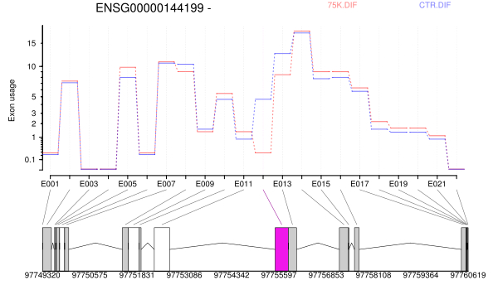
DEXSEQ (Huber, EMBL)
Equates differential usage of non-terminal exons with differential splicing.
Read densities are calculated for every annotated exon in the genome, data dispersion is modeled, and junction information is ignored.
Reports p-values for differential usage of each exon, with corrections for false discovery and with associated fold change.
Pros:
  Immune to isoform complexity
  Creates useful HTML report
Cons:
  It is expected to be biased against small exons; this includes alternate 5′ or 3′ splice sites, which are defined as separate exons

Slide 8
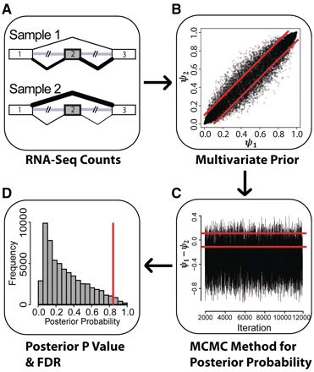
MATS (Xing, University of California)
Calculates a statistical metric called exon inclusion level, which is the proportion of the reads that exclusively support one outcome of the events to reads that exclusively support another outcome.
Returns the probability of differential splicing, expressed as PSI and returns both p value and magnitude (ΔPSI) for each alternative splice in the dataset.
This approach has high precision (low false-positive rate), at the expense of some sensitivity.
Pros:
  It recognizes the type of alternative splicing (e.g. skipped exon and retained intron)
  Unaffected by isoform complexity,
Cons:
  MATS is blind to events involving the first or last exon, which contains the UTR's where most post-transcriptional regulatory sequences are found.
  Struggles to identify complex AS events

Slide 9
MATS (Xing, University of California)
Basic steps of MATS. (A) For each exon MATS uses the counts of RNA-Seq reads mapped to the exon–exon junctions of its inclusion or skipping isoform to estimate the exon inclusion levels in two samples. (B) The exon inclusion levels of all alternatively spliced cassette exons are used to construct a multivariate uniform prior that models the overall similarity in alternative splicing profiles between the two samples. (C) Based on the multivariate uniform prior and a binomial likelihood model for the RNA-Seq read counts of the exon inclusion/skipping isoforms, MATS uses a Markov chain Monte Carlo (MCMC) method to calculate the Bayesian posterior probability for splicing difference. (D) MATS calculates a P-value for each exon by comparing the observed posterior probability with a set of simulated posterior probabilities from the null hypothesis, followed by adjustment for multiple testing to obtain the FDR value.

Slide 10
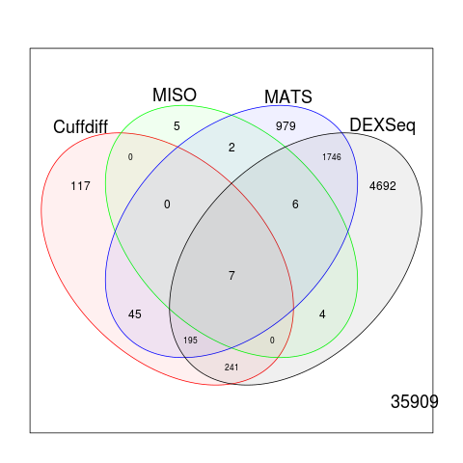
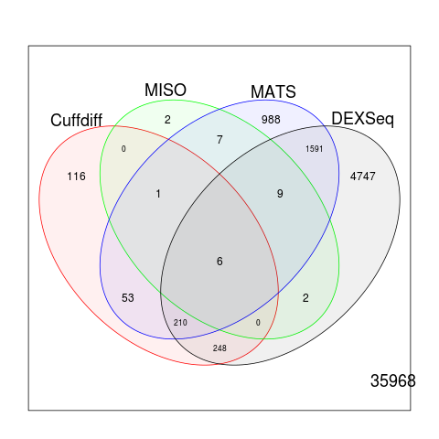
Results Summary
7SK DIF vs CTR DIF
Cuffdiff: 605 genes
MISO: 24 genes
MATS: 2980 genes
DEXSeq: 6891 genes with differentially spliced transcripts
7SK UND vs CTR UND
Cuffdiff: 634 genes
MISO: 27 genes
MATS: 2865 genes
DEXSeq: 6813 genes with differentially spliced transcripts

Slide 11
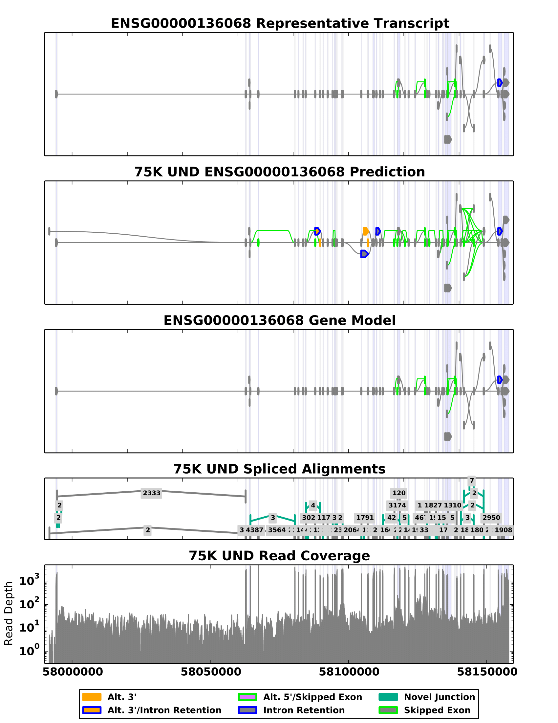
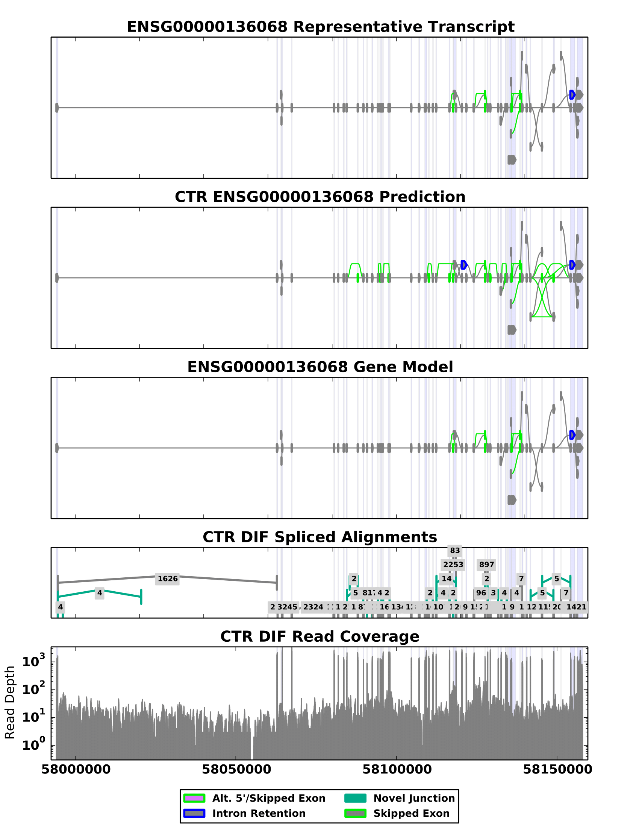
SpliceGrapher

Slide 12
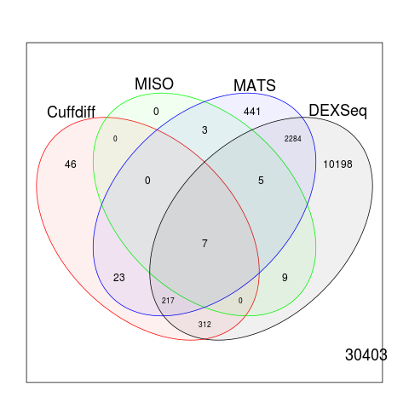
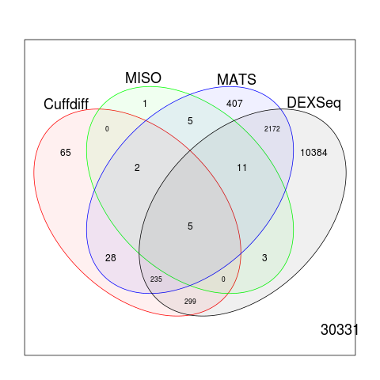
Results Summary
7SK DIF vs CTR DIF
Cuffdiff: 605 genes
MISO: 24 genes
MATS: 2980 genes
DEXSeq: 13032 genes with differentially spliced transcripts
7SK UND vs CTR UND
Cuffdiff: 634 genes
MISO: 27 genes
MATS: 2865 genes
DEXSeq: 13109 genes with differentially spliced transcripts

Slide 13
References
Hooper, Joan E. "A survey of software for genome-wide discovery of differential splicing in RNA-Seq data." Human genomics 8.1 (2014): 3.
Shen, Shihao, et al. "MATS: a Bayesian framework for flexible detection of differential alternative splicing from RNA-Seq data." Nucleic acids research (2012): gkr1291.
Katz, Yarden, et al. "Analysis and design of RNA sequencing experiments for identifying isoform regulation." Nature methods 7.12 (2010): 1009-1015.
https://www.biostars.org/p/13525/ - Cuffdiff splicing explanation
Liu, Ruolin, Ann E. Loraine, and Julie A. Dickerson. "Comparisons of computational methods for differential alternative splicing detection using RNA-seq in plant systems." BMC bioinformatics 15.1 (2014): 364.
Anders, Simon, Alejandro Reyes, and Wolfgang Huber. "Detecting differential usage of exons from RNA-seq data." Genome research 22.10 (2012): 2008-2017.

