Slide 1
Gender & Crime
Padma Danturty
STATS 551

Slide 2

Understanding crime demographics
Crime prevention
The Department of Justice provides grants to “to conduct research; and to implement programs that improve the criminal, civil, and juvenile justice systems”

Slide 3
Project objective:
Estimate+narrow+improve the underlying population parameter–proportion of crimes committed by women

Slide 4
San Jose Arrests Dataset
Details ARRESTS and INCIDENTS (joined by INCIDENT #)
Keep SEX, RACE, AGE, INCIDENT TIME, DATE
Total rows = 134573

Slide 5
Methods
One Parameter
Hierarchical
Sequential
Conjugate Prior (closed form)
MCMC in Stan with Hyperparameter Search
Hierarchy on Race
Hierarchy on Age
Hierarchy on Time (hourly)
Sequential Bayes by year (2015 -> 2016 … )

Slide 6
One Parameter
Conjugacy
Prior: Beta(2,7) **
Data: Binomial(134573, 0.2354)
Posterior: Beta(2 + 31683, 7 + 134573 - 31683)
** using National Bureau of Justice Statistics (1999)
MCMC Hyperparameter Search
Use Stan to test different prior values with similar expected values
α | β
2 | 7
10 | 45
22 | 78
154 | 700

Slide 7
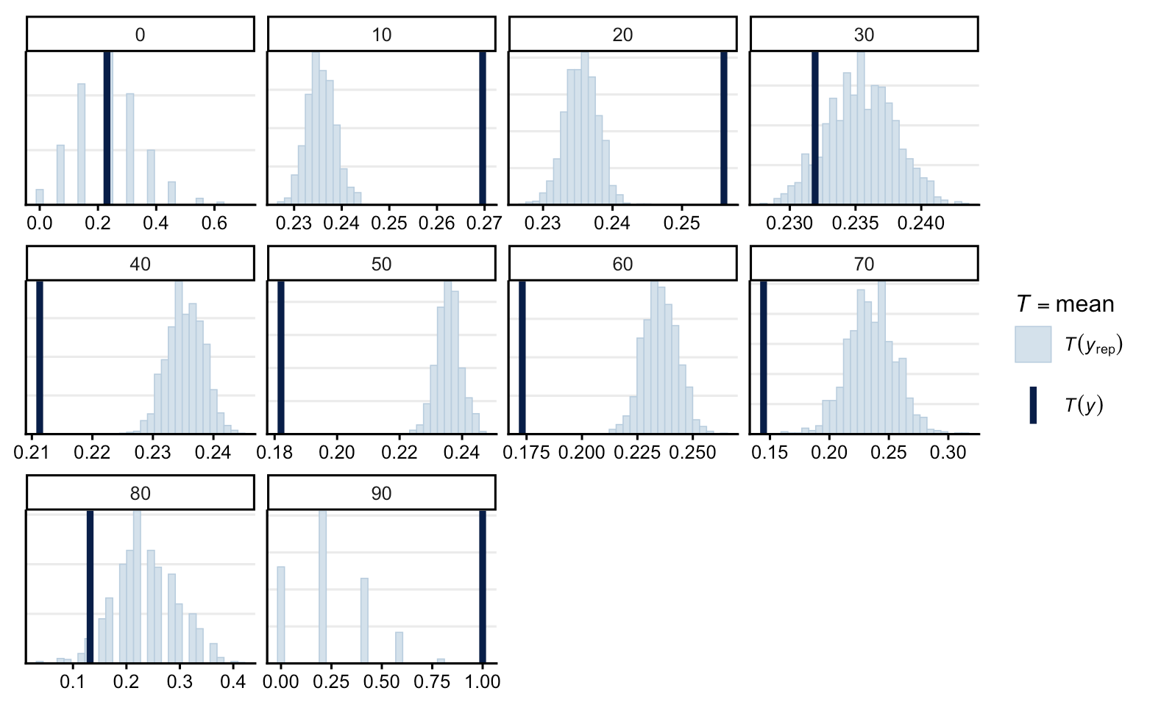
One Parameter Checks

Slide 8
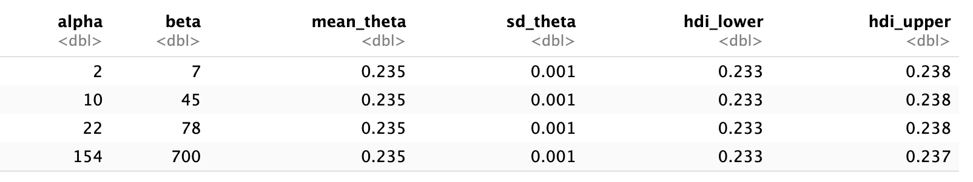
One Parameter Checks

Slide 9
Hierarchical
Decade
AGE -> “DECADE” with floor(AGE / 10)
Hierarchy on DECADE
Race Group
RACE CODE -> RACE -> RACE GROUP
Hierarchy on RACE GROUP
Time
TIME -> TIME24HR
Hierarchy on TIME24HR
Deliverable 4

Slide 10
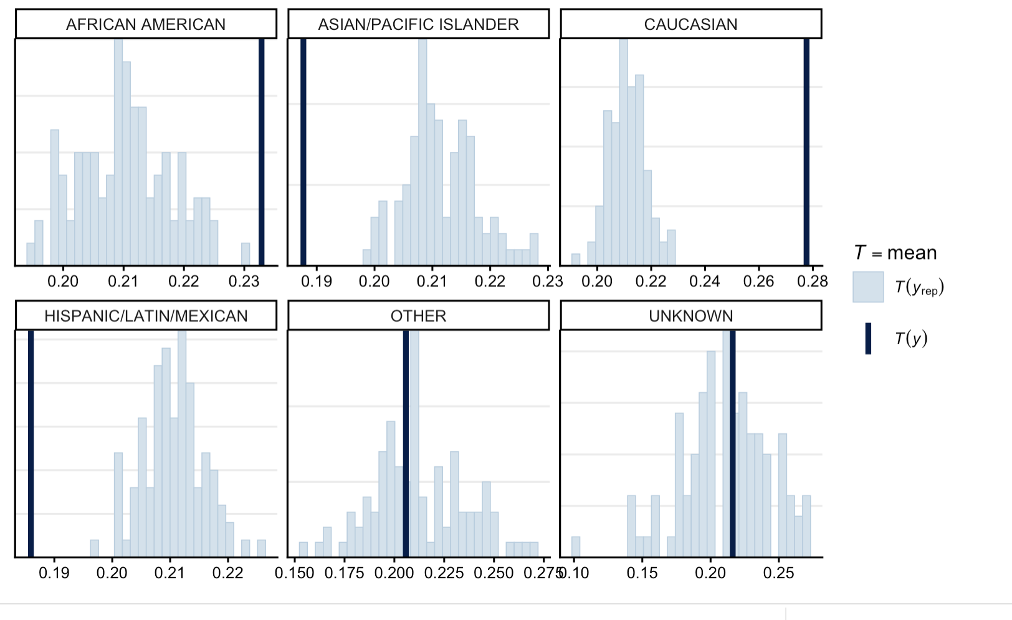
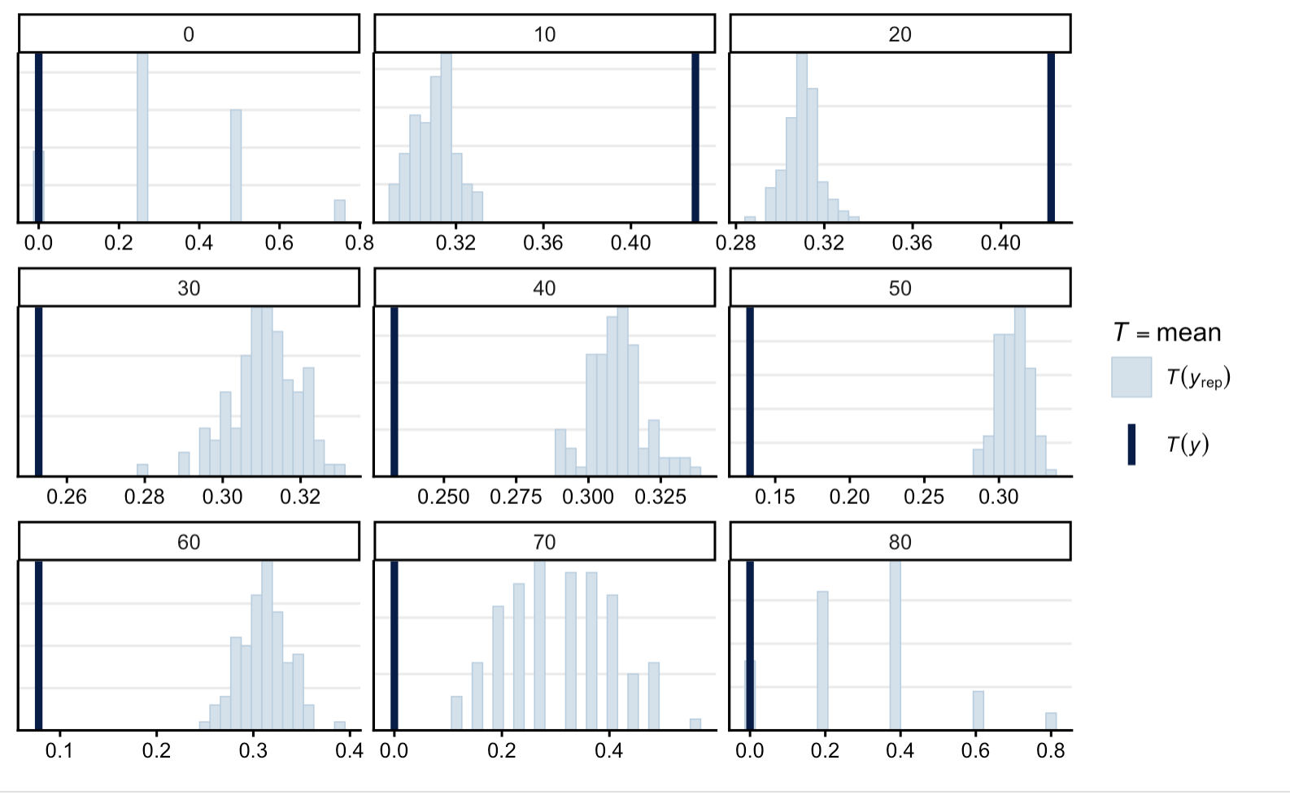
Hierarchical Checks
Using RACE_GROUP = “African American”
Using DECADE = 5 (50-60)

Slide 11
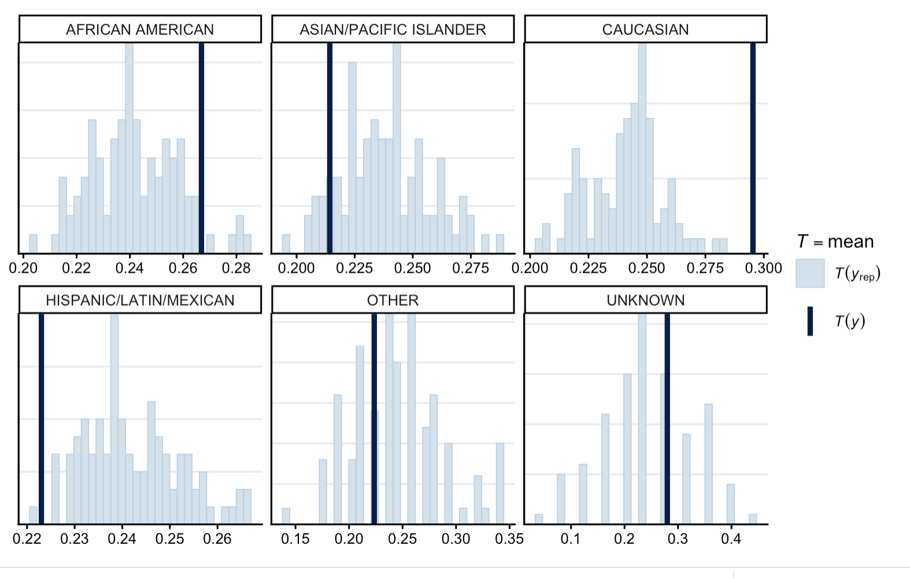
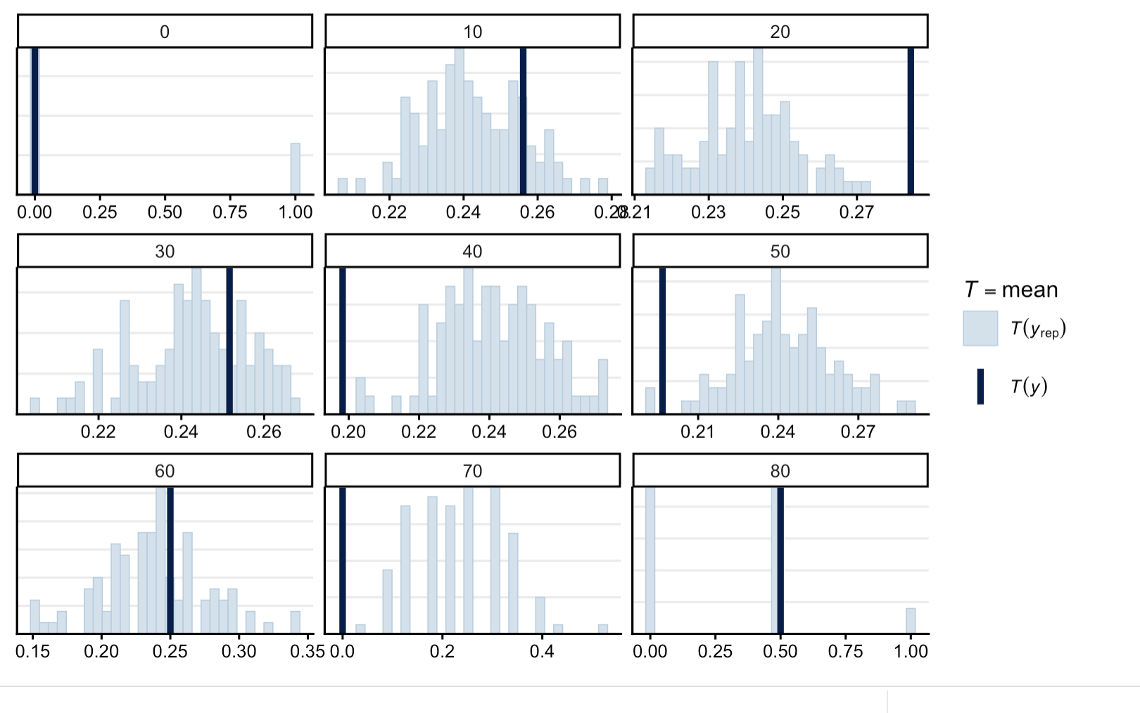
Hierarchical Checks
Using TIME24HR = 14 (2-3pm)

Slide 12
Sequential Hierarchical on Time
2015 | 2016 | 2017 | 2019 | 2020
 | Input: Beta(2, 7) prior
Input: shared Beta(2,7) mean prior
Output/input: 24 θ block posteriors
Output/input: 24 θ block posteriors
Output/input: 24 θ block posteriors
Output/input: 24 θ block posteriors
Final θ block posteriors

Slide 13
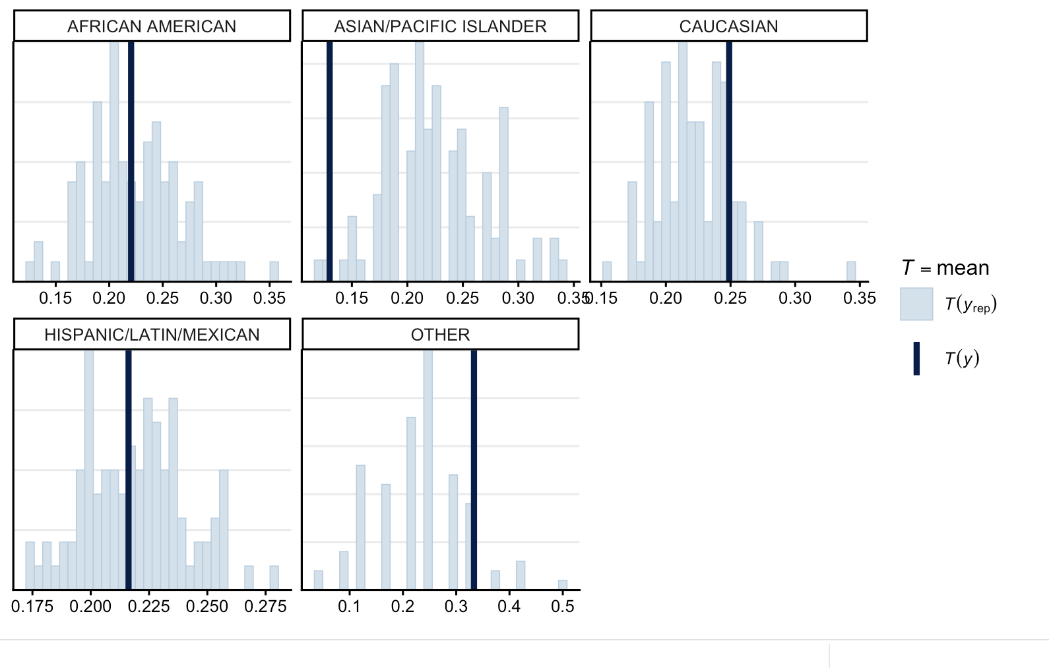
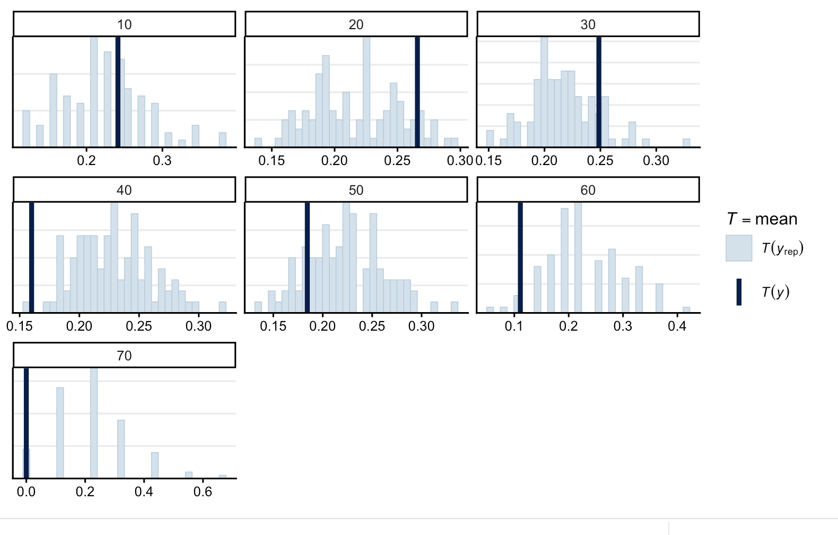
Sequential Hierarchical Checks
Using TIME24HR = 14 (2-3pm)

Slide 14
Results
Model | Elapsed Runtime | ELPD_LOO | P_LOO | LOOIC
Closed Form | 0.042 | - | - | -
MCMC (2,7) | 92.559 | -7.592 | 1.287 | 15.185
MCMC(10, 45) | 92.559 | -7.031 | 0.711 | 14.063
MCMC(22, 78) | 92.559 | -7.462, | 1.131 | 14.924
MCMC(154, 700) | 92.559 | -7.691 | 1.349 | 15.382
Hierarchical DECADE | 0.516 | -51.334 | 8.257 | 102.668
Hierarchical RACE | 0.330 | -33.914 | 3.877 | 67.828
Hierarchical TIME | 0.591 | -129.599 | 17.679 | 259.197
Sequential + Hierarchical TIME | 2.829 | -110.699 | 18.902 | 221.398

Slide 15
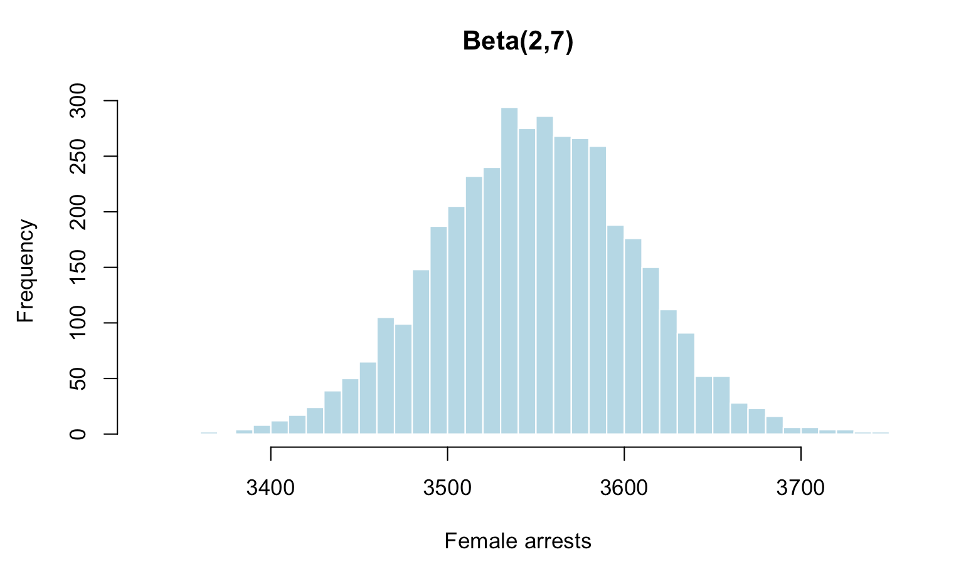
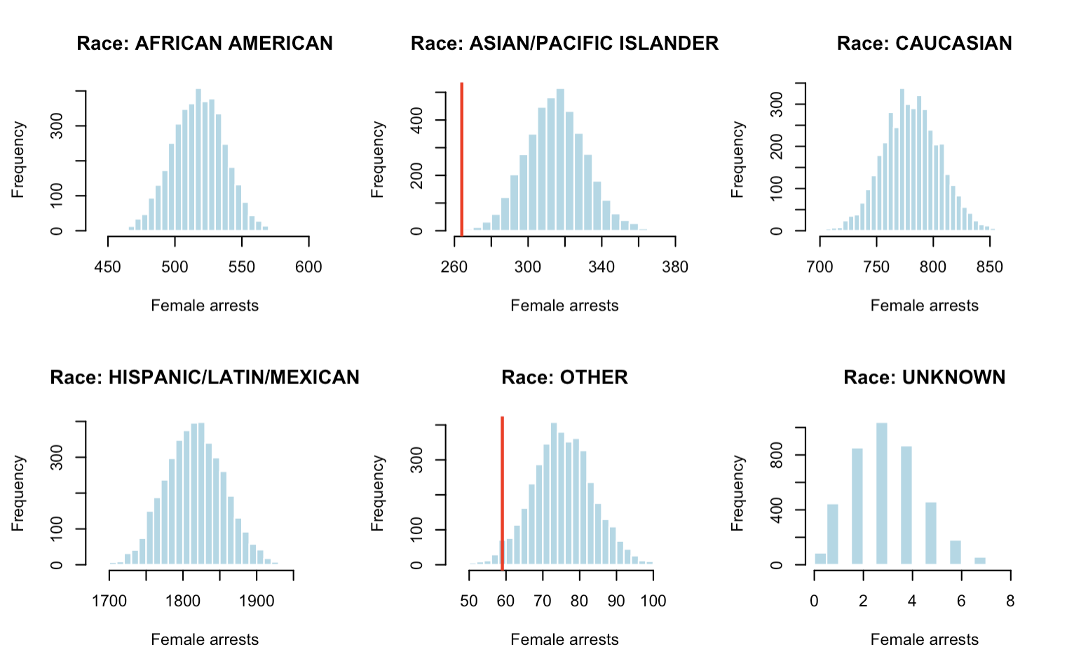
Predictive Results–2021
Hierarchical (RACE)
One Parameter

Slide 16
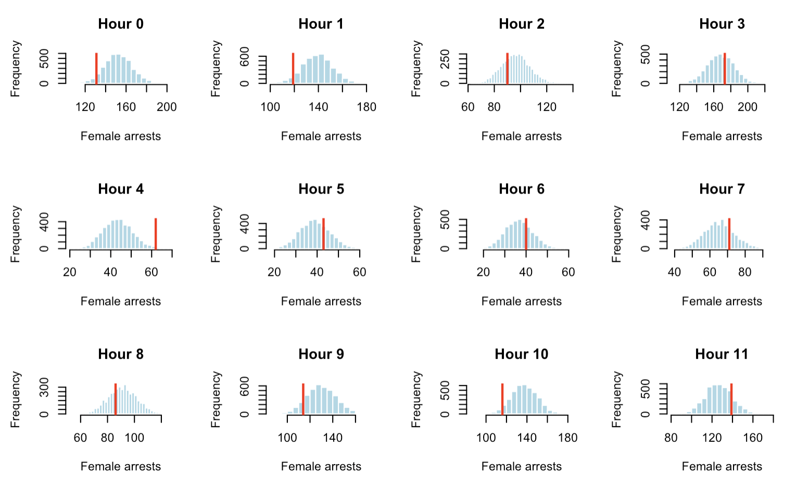
Predictive Results–2021

Slide 17
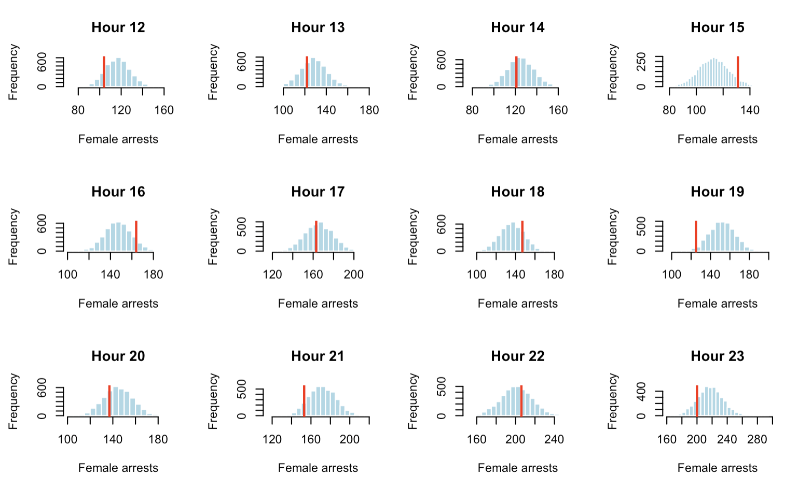
Predictive Results–2021

Slide 18
Conclusion
Hierarchical + Sequential model had best predictive performance
  Best model despite LOO estimates
Can predict with a good degree of certainty the population of female offenders -> invest resources into women-specific shelters, programs, rehabilitation centers etc.
Many drug related offenses (incident type)

Slide 19
Future Work
Issues: very few observations in some category
  (UNKNOWN - RACE, 0-10 or 80-90 AGES)
Include different priors
Incorporate more interactions between predictors
Incorporate spatial data

