Slide 1


MyBuild Website Project
Developing a System to Encourage Custom PC Building
Presented by Peter Monks

Slide 2
Aims & Objectives
Customer centric website:
Knowledge base of components
Suggested compatible selections
Informed customer choices
Staff administration GUI:
Product catalogue management
Dispatch build orders
Generate performance reports

Slide 3
Methodology
Hybrid Waterfall with Agile elements
Prototype customer website
Extensive user evaluation
Improved prototype iteration

Slide 4
Requirements
Identify essential components
Key Design Principles
Utility
Usability
Relevant content
Data integrity and security

Slide 5
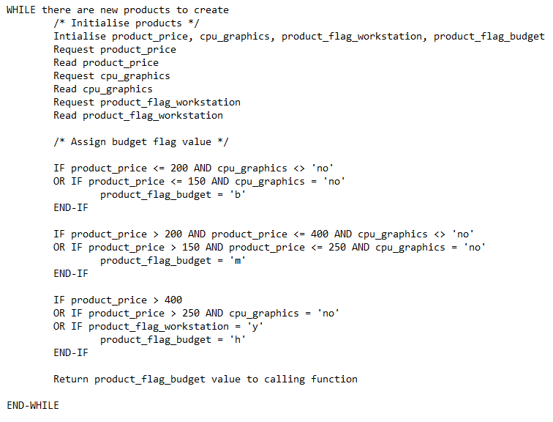
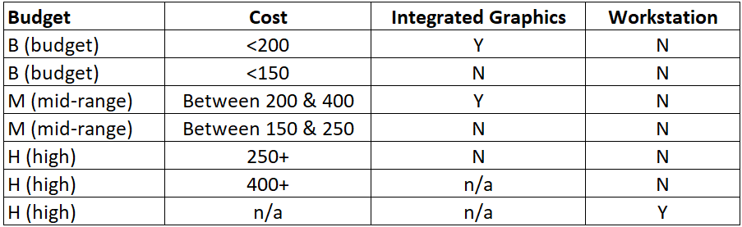
Design - Logic
Usage category
Budget category, eg CPU

Slide 6
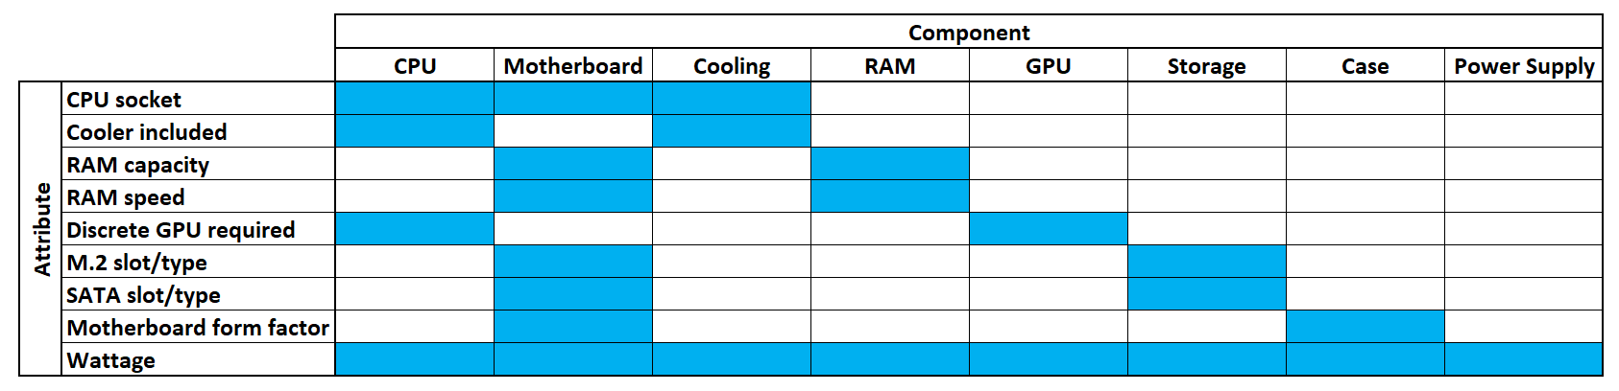
Design - Logic
Essential components identified
Common attributes allow cross-referencing
Component selection sequence

Slide 7
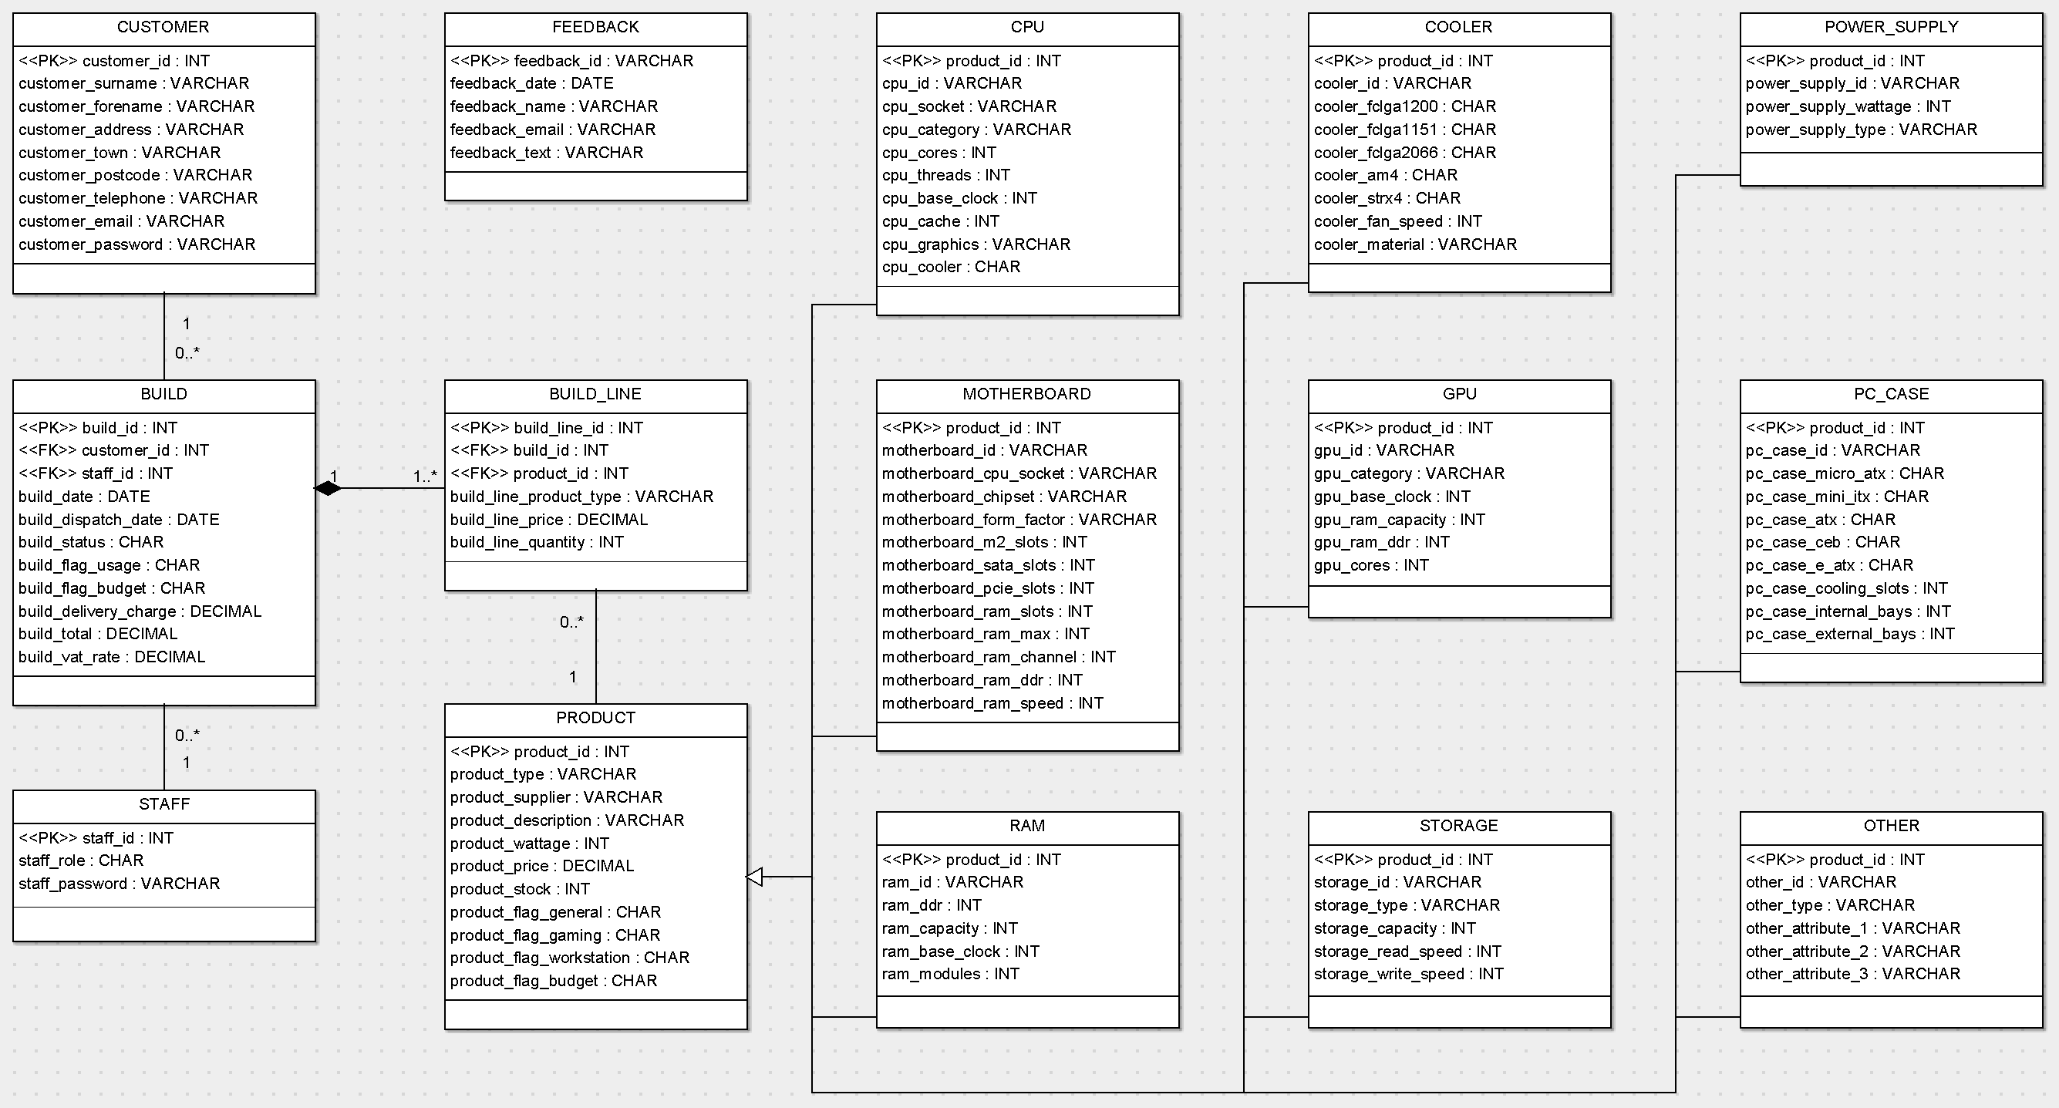
Design - Structure
Database structure
One-to-many for builds
Inheritance for components
Distinct user profiles

Slide 8
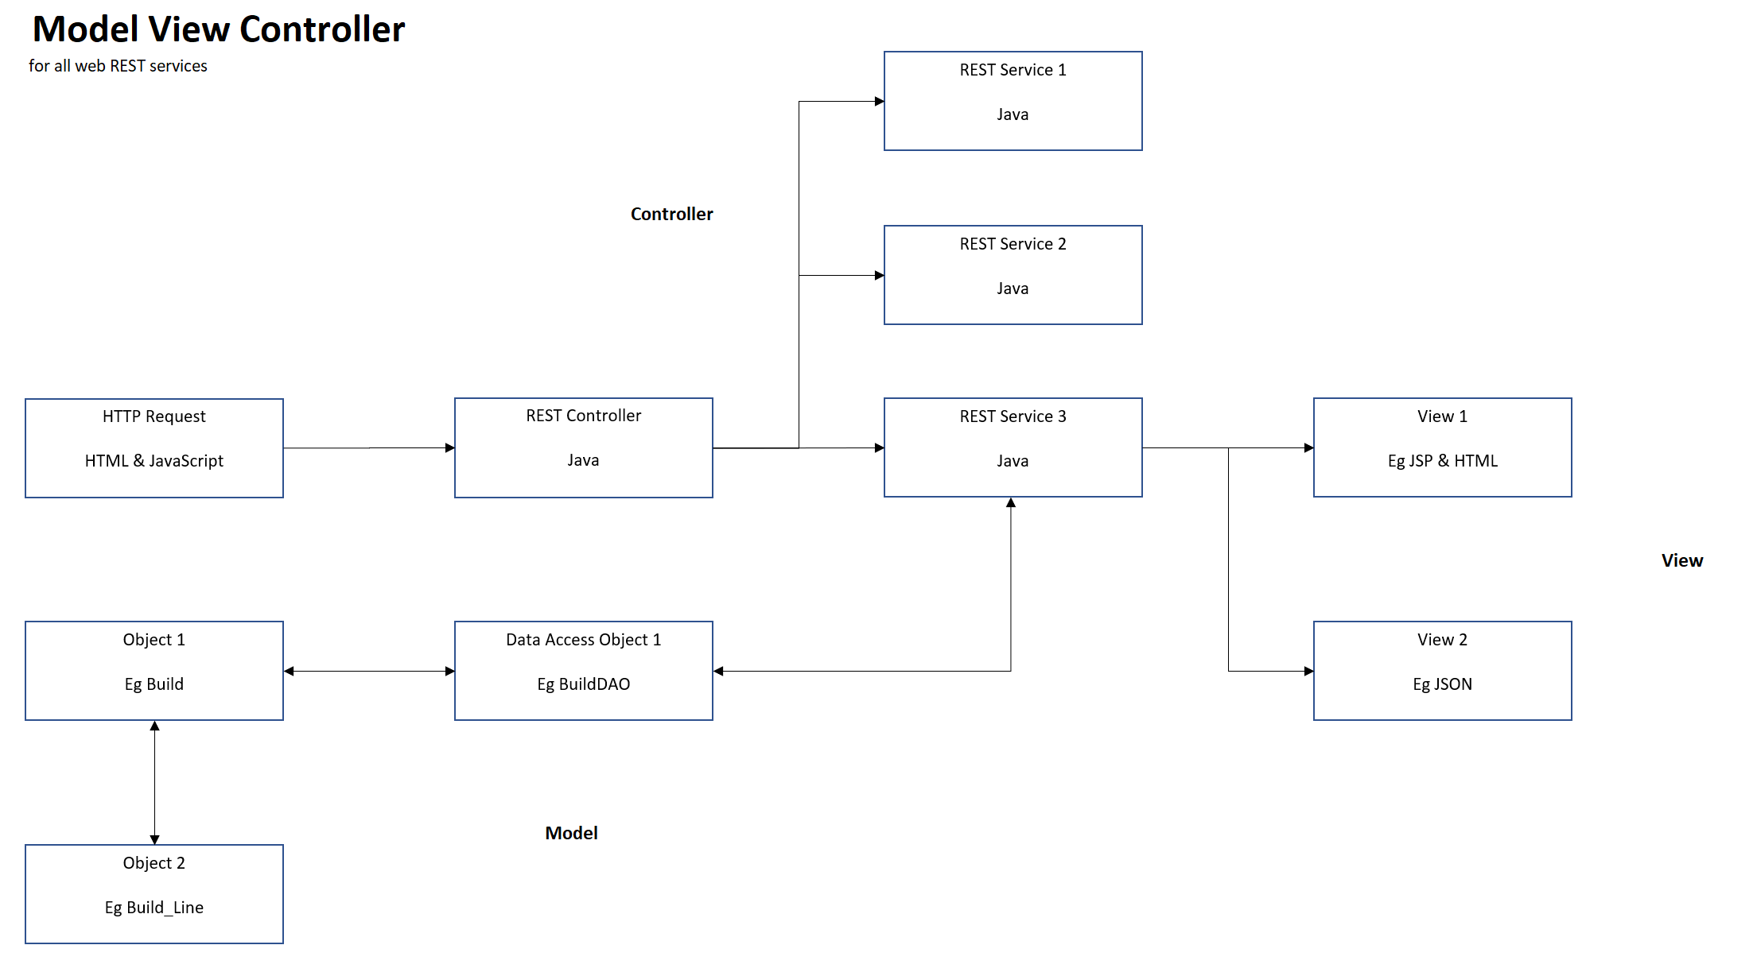
Design - Structure
MVC application structure
Model mirrors database
REST controller
Multiple view options

Slide 9
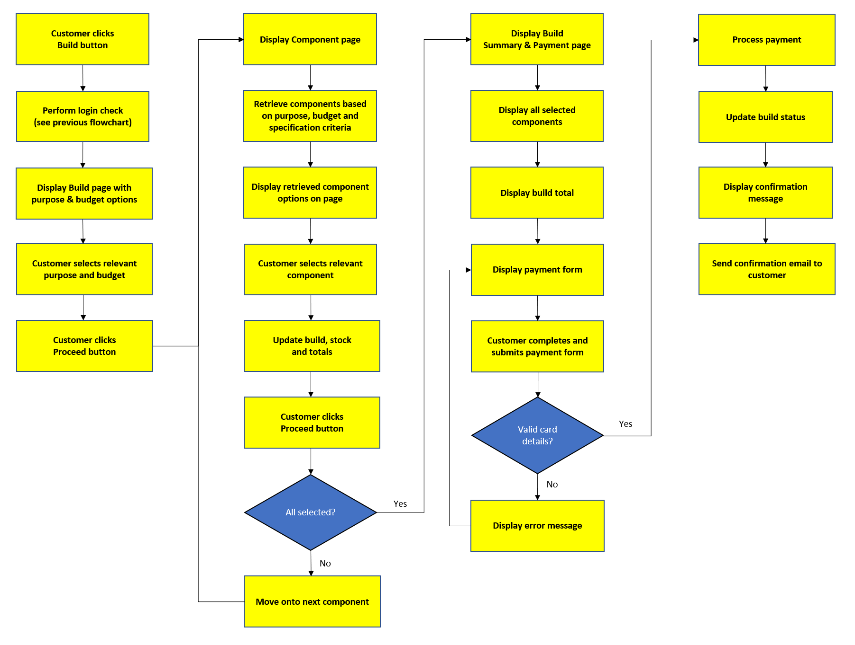
Design – Build Process
Journey flow charts
Customer
Staff

Slide 10
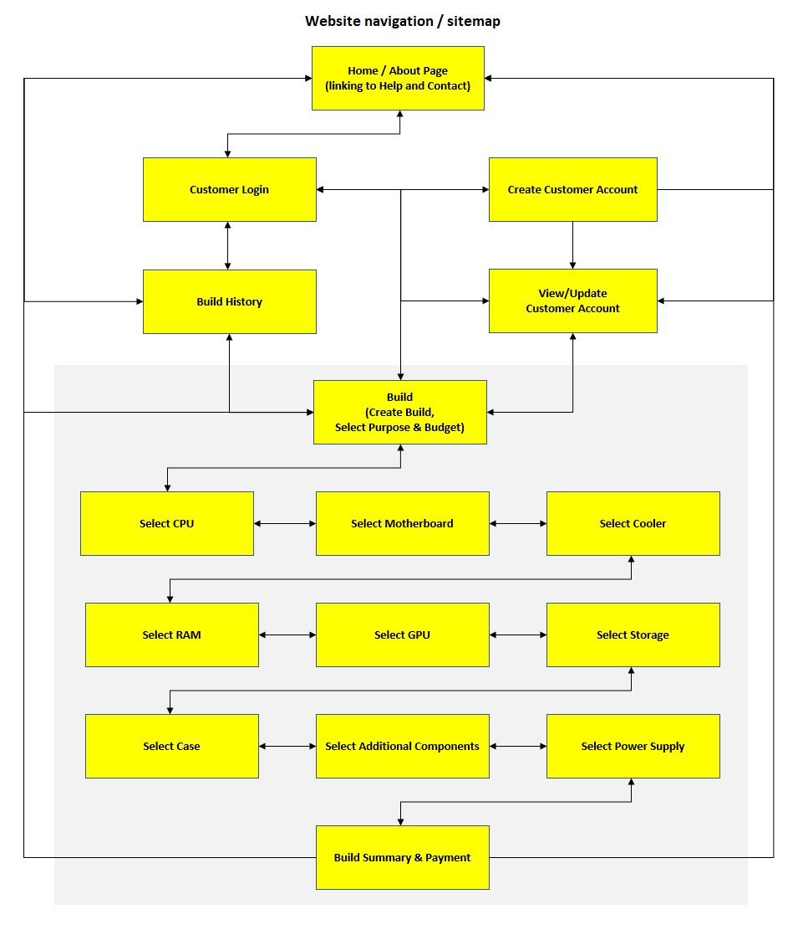
Design – Build Process
Website map
Customer functions
Order of component selection

Slide 11
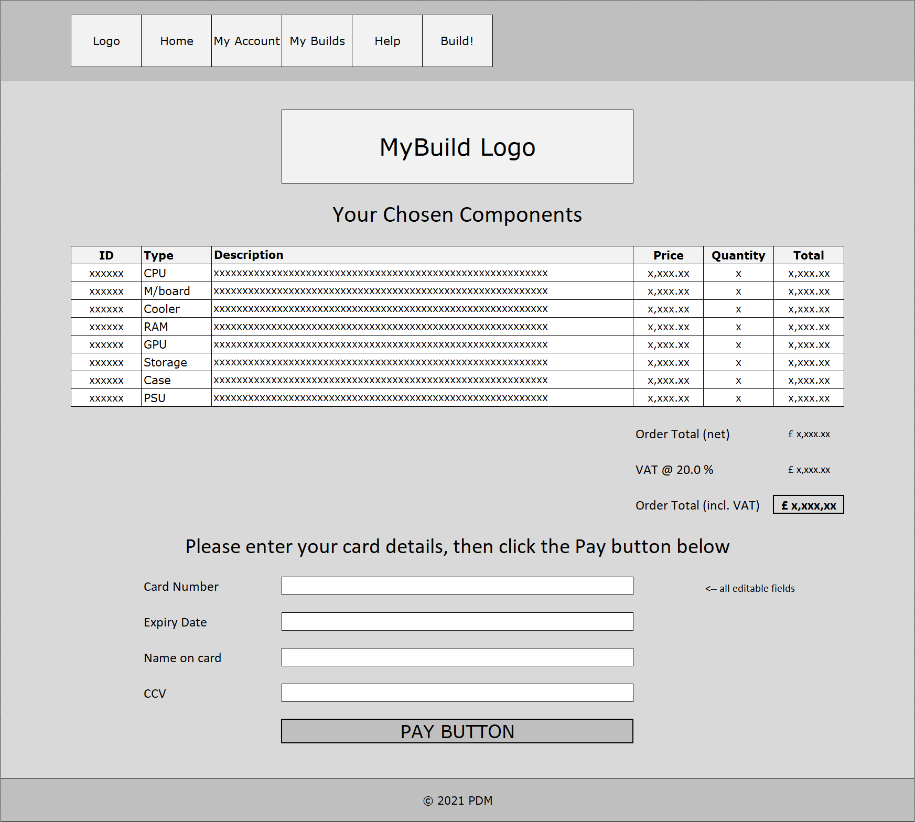
Design – Build Process
Interface mock-ups
Customer website
Staff application
Layouts
Functions
Focused implementation

Slide 12
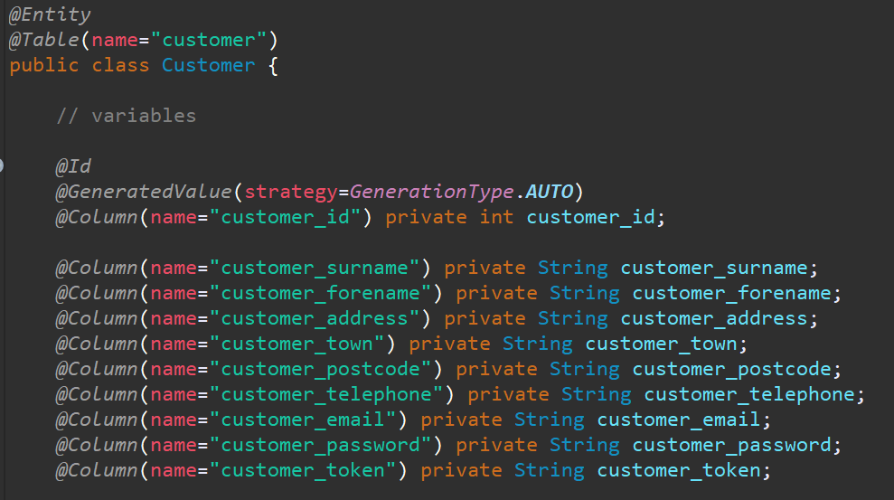
Implementation
Customer prototype implemented
MySQL database
Java back-end
Model classes with DAO
Hibernate utilities
REST controller and utilities

Slide 13
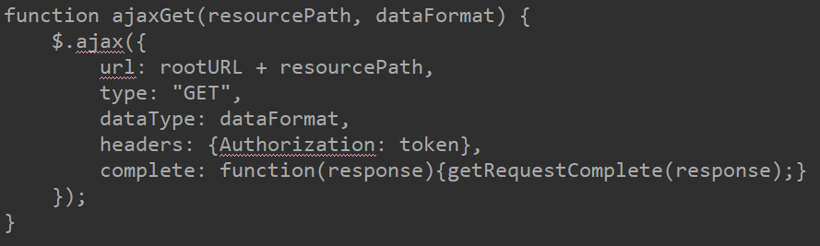
Implementation
JavaScript front-end
REST resource path
jQuery/AJAX for HTTP requests

Slide 14
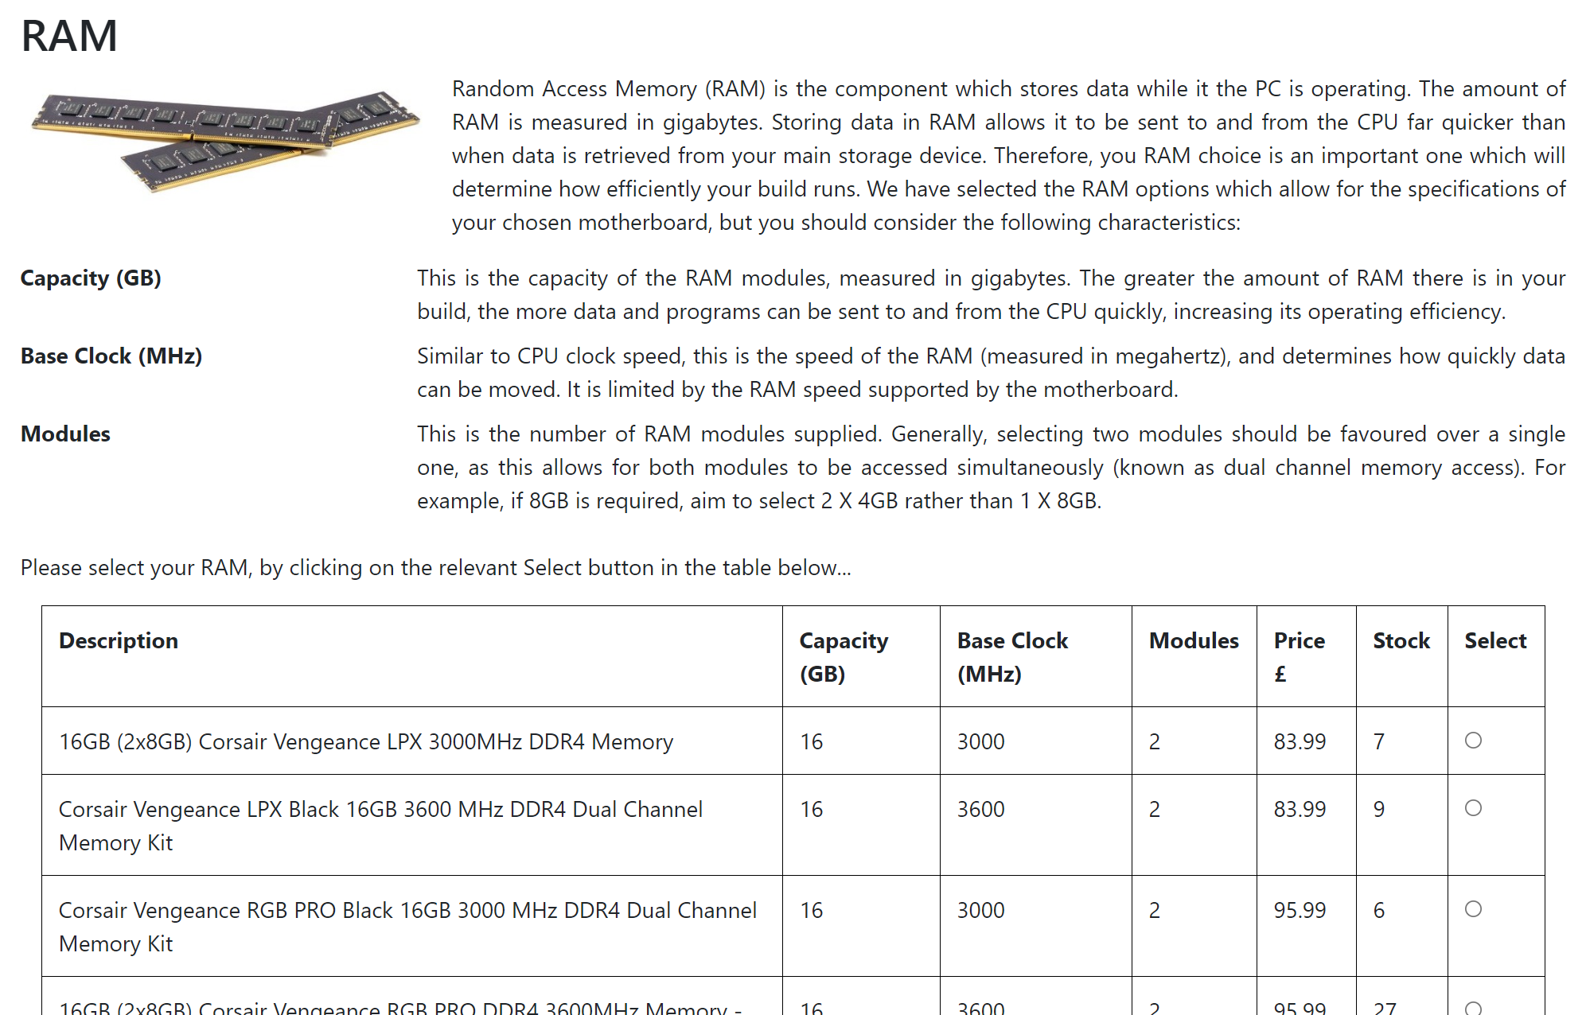
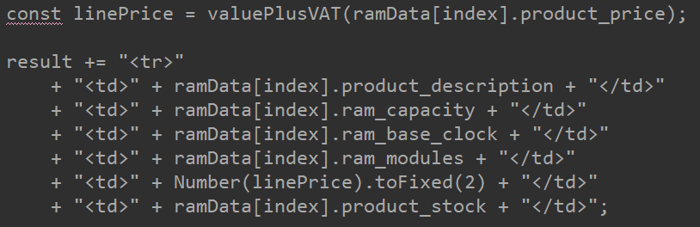
Implementation
JavaScript front-end
Response in generated HTML
Integrated with knowledge base

Slide 15
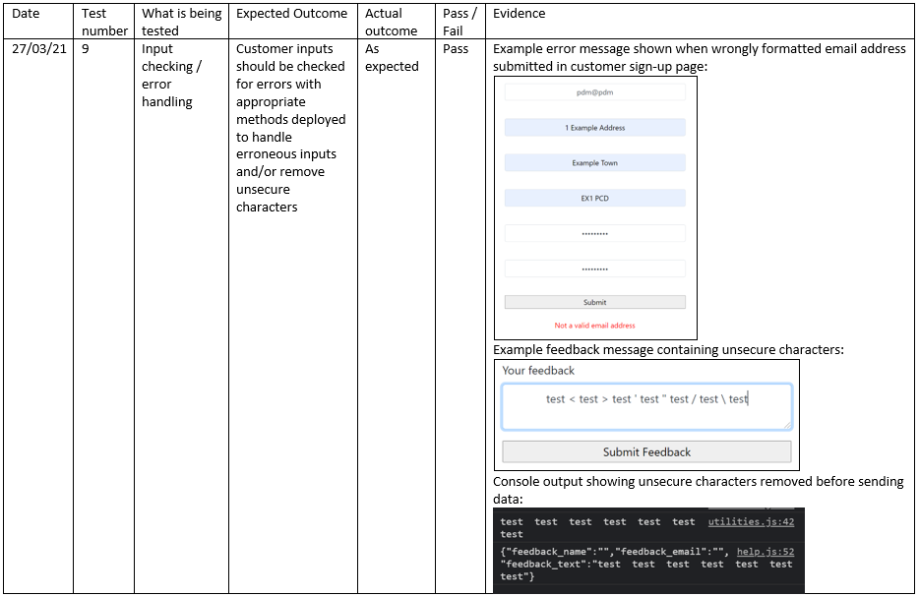
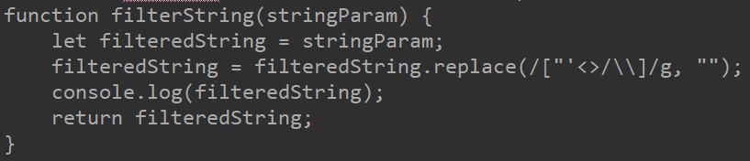
Implementation
Developed on local host
Testing Programme
Usability
Functionality
Security
Deployed to GCP

Slide 16
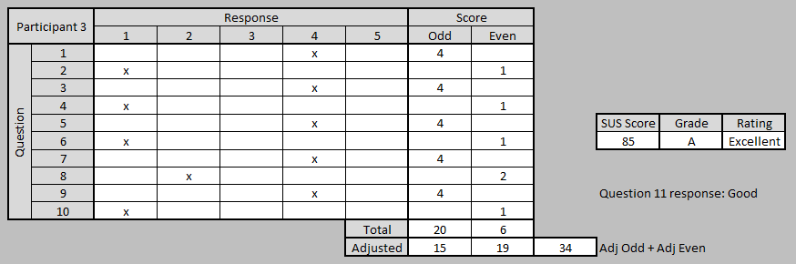
Evaluation
Usability Testing
Voluntary Participants
System Usability Scale

Slide 17
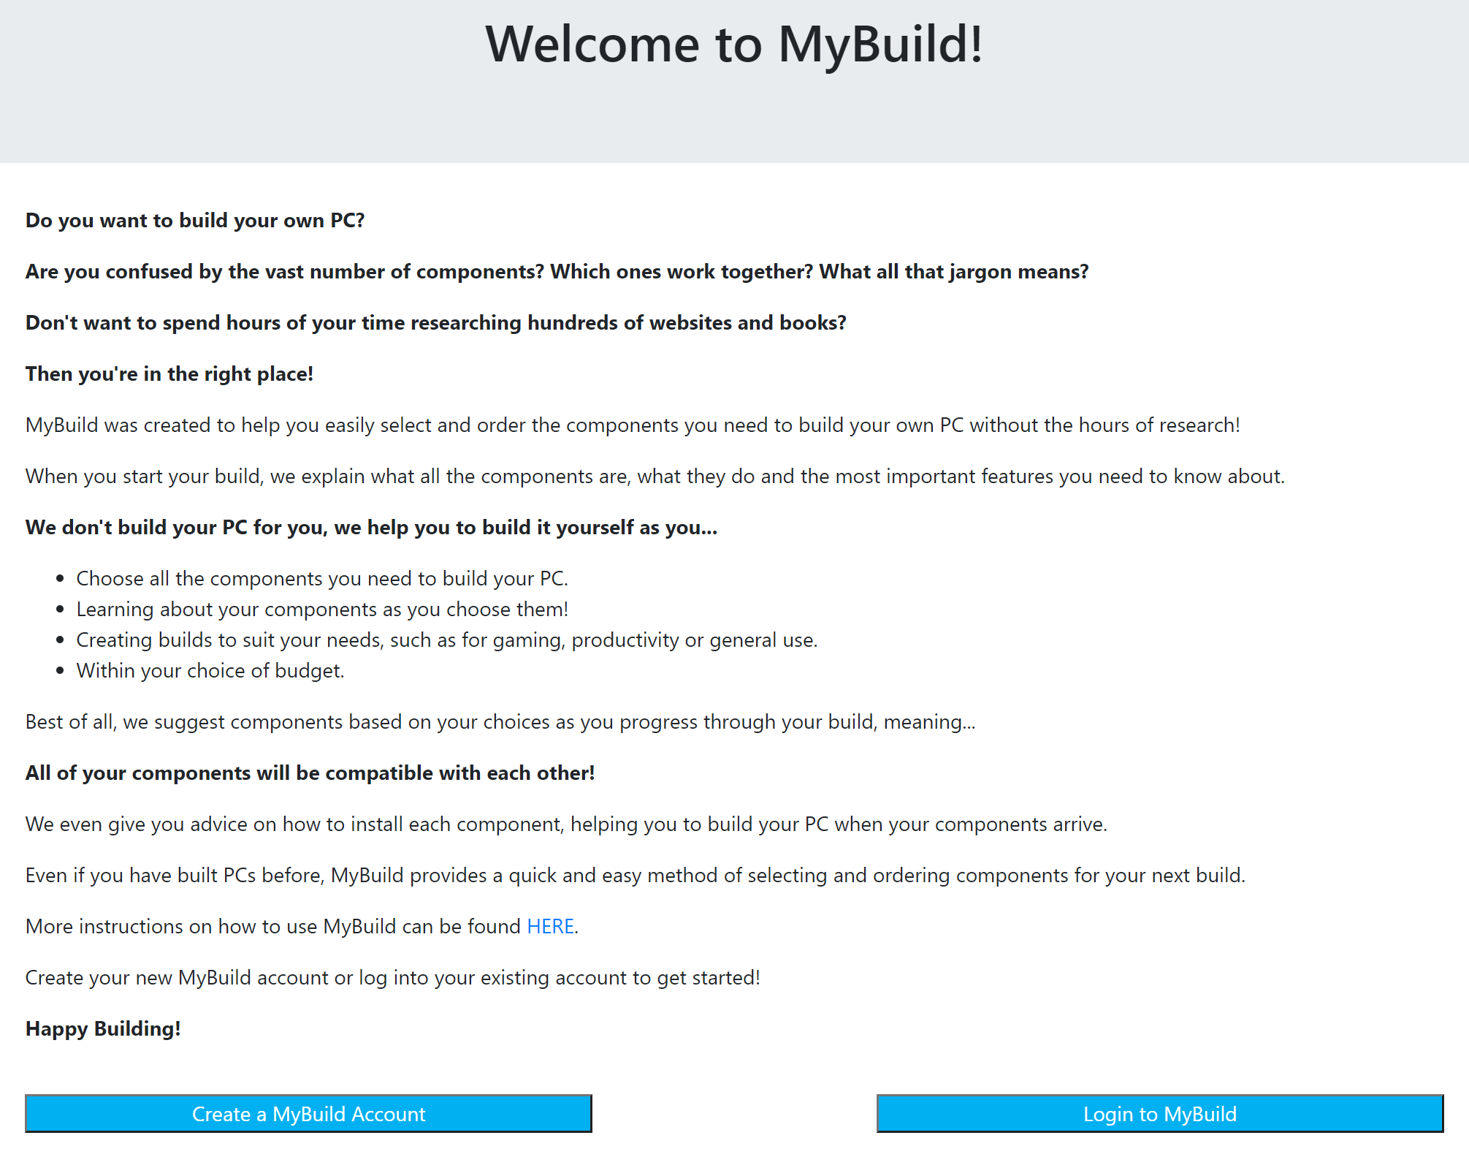
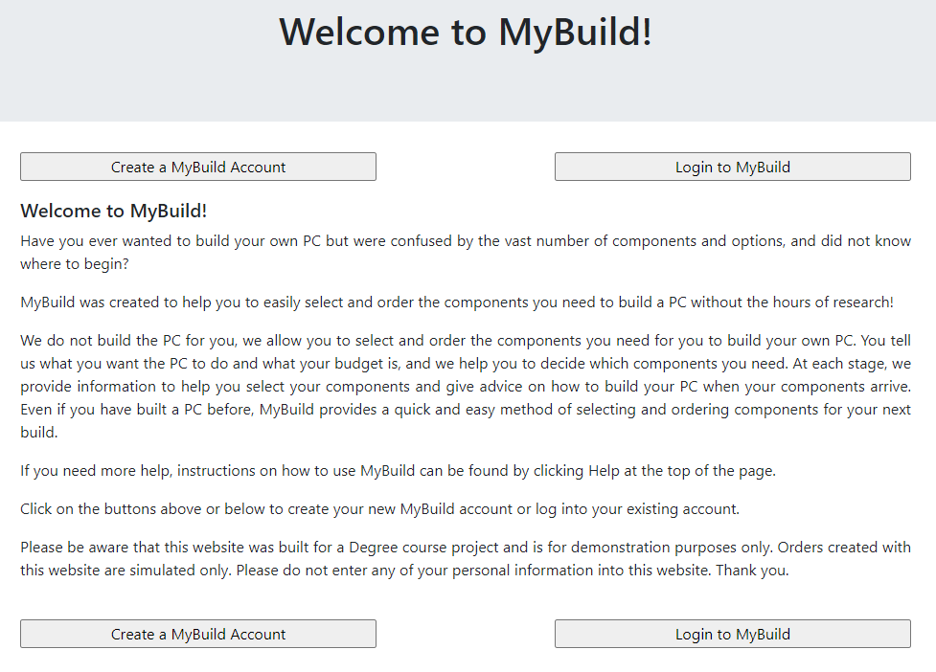
Evaluation
Very positive feedback – concept and build process well received
Second prototype iteration – based on constructive criticisms
Improved usability
Emphasised benefits

Slide 18
Further Work
Implement further applications
Staff application
Mobile application for customers
Images and infographics
Drag and drop building
Build browsing
Expanded options
Usage/budget
Product catalogue

Slide 19
Thank you for listening
Are there any questions?

